Slide 1
San Francisco Heat and Air Quality Resilience Project
All Hands Meeting 11 | 12/05/2024
Matt Wolff, SFDPH, Matt.Wolff@sfdph.org Alex Morrison, ORCP, Alex.Morrison@sfgov.org.org

Slide 2
Agenda
HAQR All-Hands Meeting #11 Date: 12/05/2024 Time: 2pm - 3pm
Introductions | 5 Minutes
Updates and Announcements: | 10 Minutes
HAQR All-Hands Presentations: Jane Gilbert, Chief Heat Officer and Director of Urban and Community Forestry, Miami-Dade County Office of Resilience Chris Losavio, Disaster Planning Manager, San Francisco Department of Homelessness and Supportive Housing | 35 Minutes
Heat and Air Quality Resources Overview | 5 Minutes
Next Steps | 5 Minutes

Slide 3
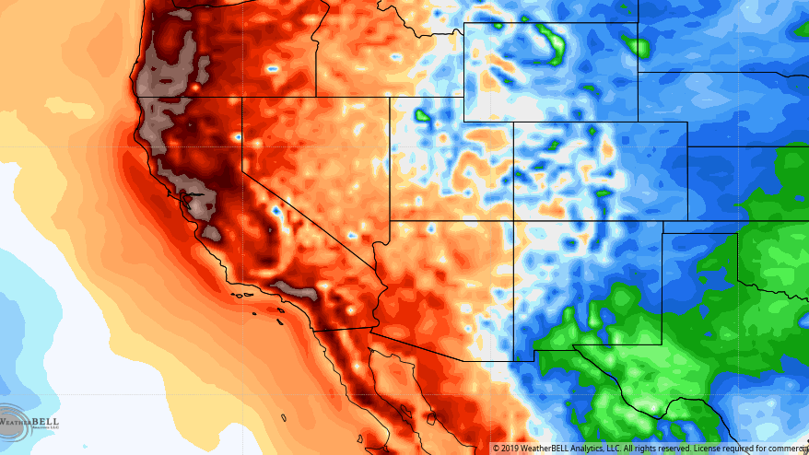
Updates and Announcements
Notes:
Updates: Becca Sugrue

Slide 4
Updates and Announcements
Update Bullet Points
Grant Applications
OPR (did not receive)
C40 (submitted)
Project Updates
Heat/Air Monitors (purchase approval)
Resilience Hubs (literature review completed, results being synthesized)
Heat Epidemiology (preliminary findings from October heat event)

Slide 5
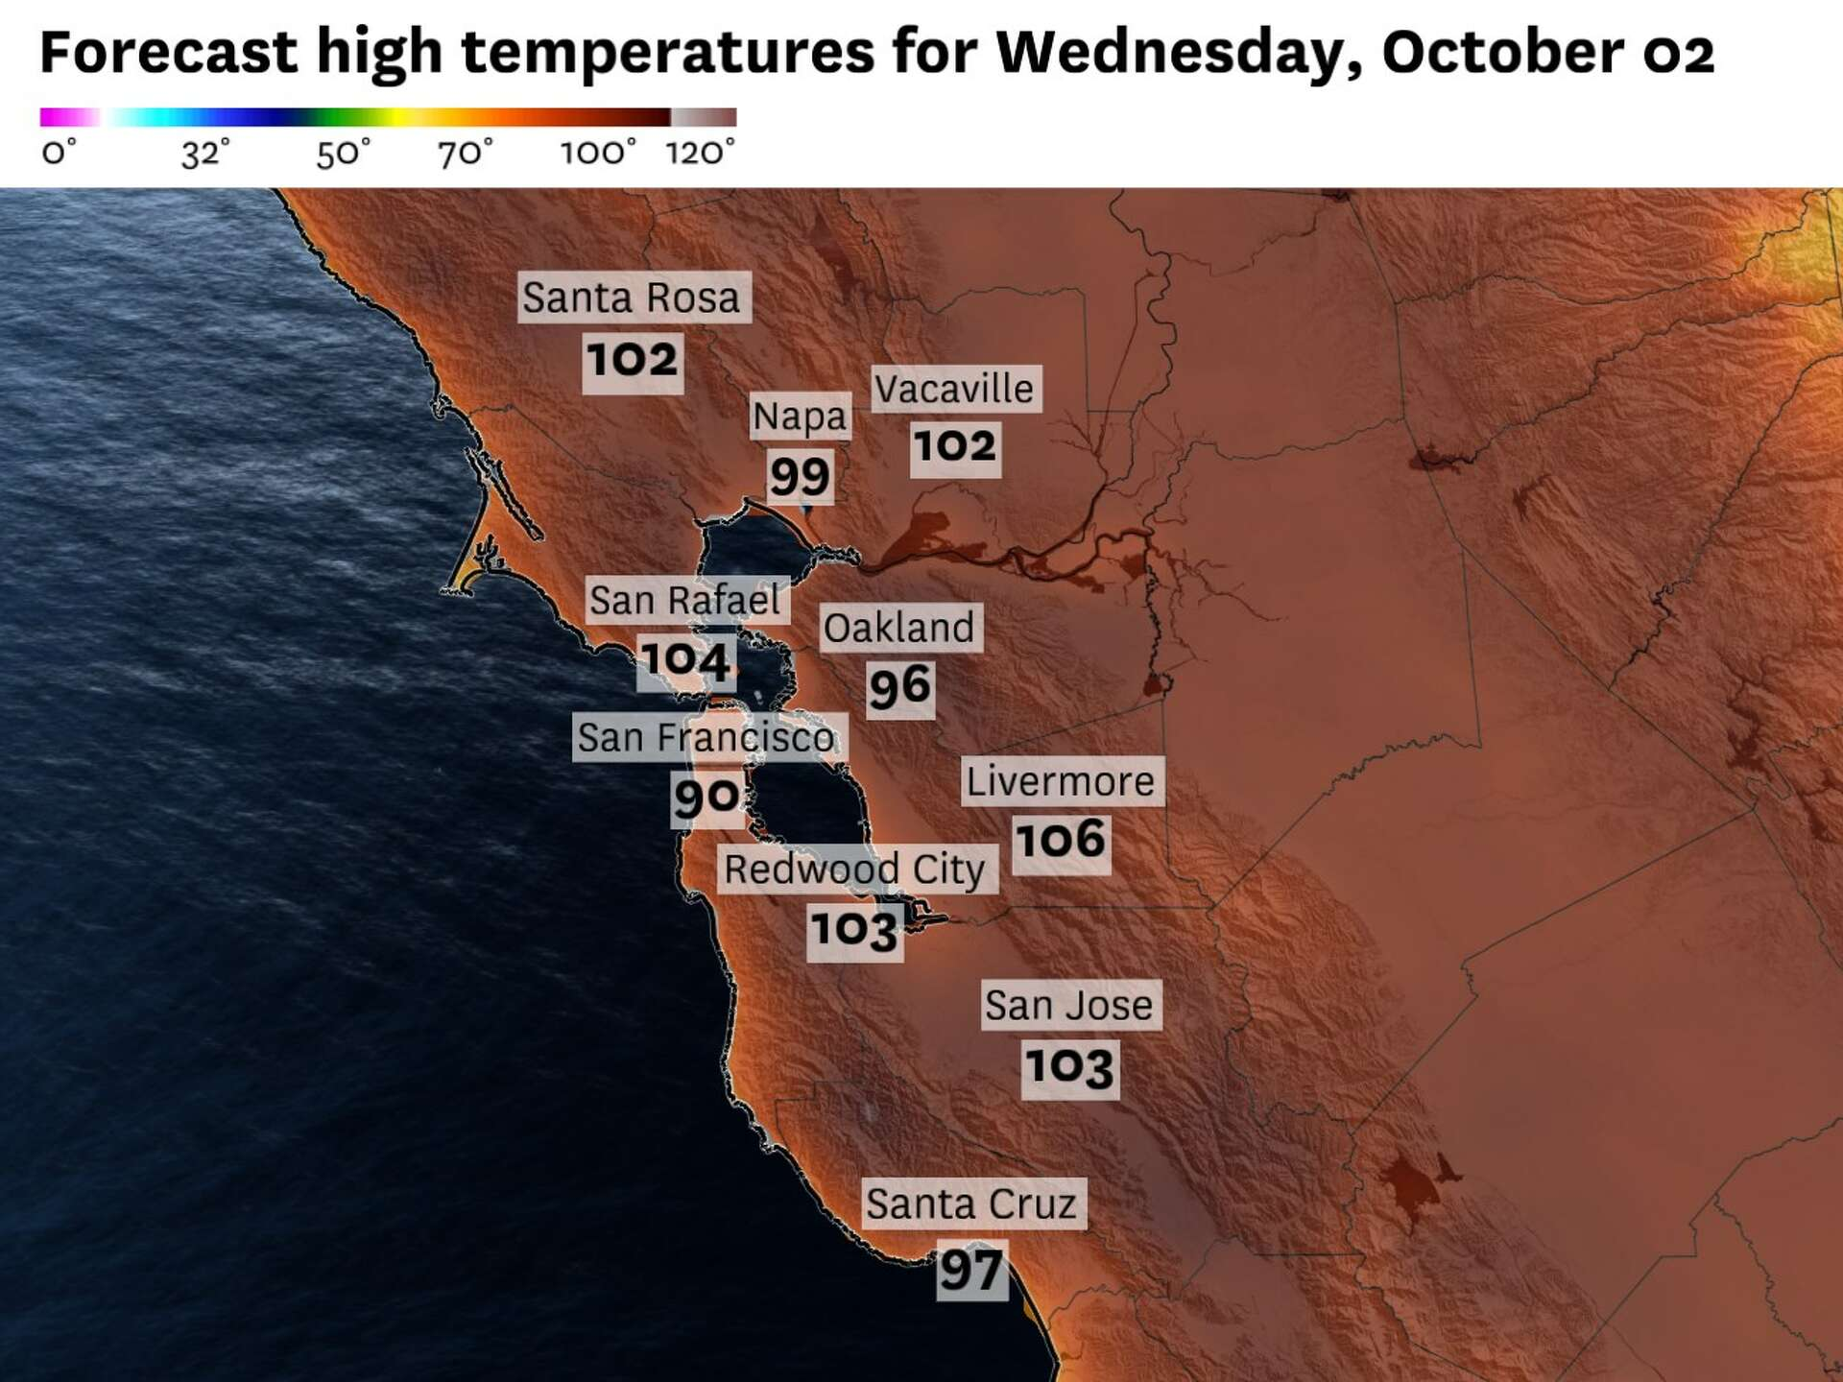
Updates and Announcements
October 2024 Heat Wave
Prolonged heat wave 9/30th – 10/8th (9 days)
4 days of Major Heat Risk, 2 days of Moderate Heat Risk
8 days of Excessive Heat Warnings and Advisories
Record high temps for October and little overnight relief (daytime highs 90s – nighttime lows in 60s)

Slide 6
Updates and Announcements
October 2024 Heat Wave
Time Period | Dates | Daily Max Temperature Range | Daily Average
Heat Wave | Sep 30 – Oct 7, 2024 | 82° - 98° | 580
Week Before | Sep 16 – Sep 23, 2024 | 65° - 86° | 489
Year Before | Oct 2 – Oct 9, 2023 | 69° - 92° *includes a 4-day heat wave | 540
Compared to the previous week, there was an 18% increase in EMS calls during the heat wave.
Key Observations:
October 6th – Daily Max of 98°– Highest temperature reached during the heat wave.
EMS calls = 608
October 7th – Daily Max of 87°– Last day of heat wave.
EMS calls = 621
Highest number of daily calls during heat wave.

Slide 7
HAQR All-Hands Presentations
Jane Gilbert, Chief Heat Officer and Director of Urban and Community Forestry, Miami-Dade County Office of Resilience
Chris Losavio, Disaster Planning Manager, San Francisco Department of Homelessness and Supportive Housing
Notes:
So onto updates

Slide 8
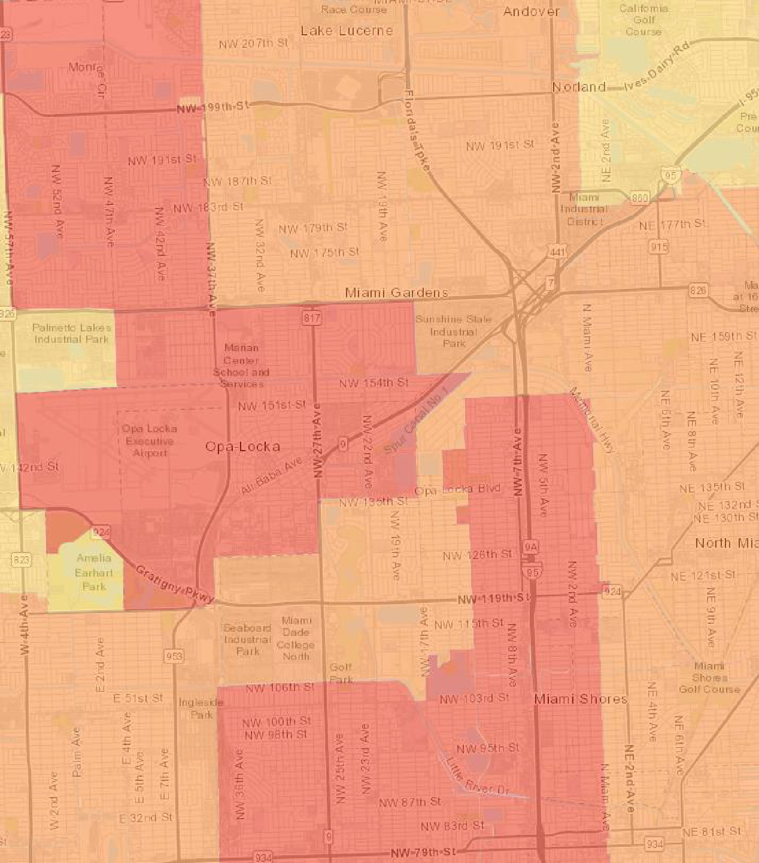
Addressing the Health and Economic Impacts of Extreme Heat
Jane Gilbert
Chief Heat Officer
December 5, 2024

Slide 9
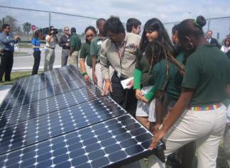
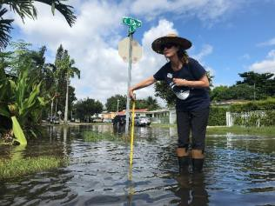
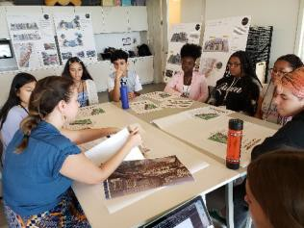
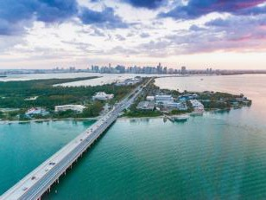
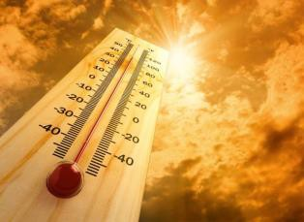
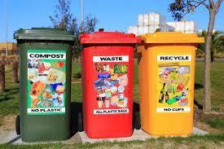
Miami-Dade County's Office of Resilience
MITIGATION
ADAPTATION
COMMUNICATION
BISCAYNE BAY
EXTREME HEAT
FUTURE READY
ZERO WASTE
Reduce sources of climate change
Address climate change impacts
Engage & connect stakeholders
Protect &
restore
Implement heat risk reduction efforts
Plan & Implement
Minimize waste & consumption
Stormwater Management Through Bioretention | Silva Cell by DeepRoot
Our primary resilience initiatives + office divisions

Slide 10
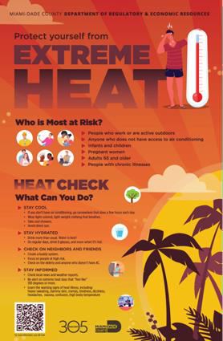
Extreme Heat
Heat is the leading weather-related killer in the United States.
700 average annual heat caused deaths nationwide
(CDC)
But real impacts are much higher:
Annual excess heat related death estimates in U.S. at 12,000
(Shindell)
34 or 600 average annual heat-related deaths in Miami-Dade
(Uejio, MDC)
3

Slide 11
Extreme Heat is an Inequitable Hazard

Slide 12
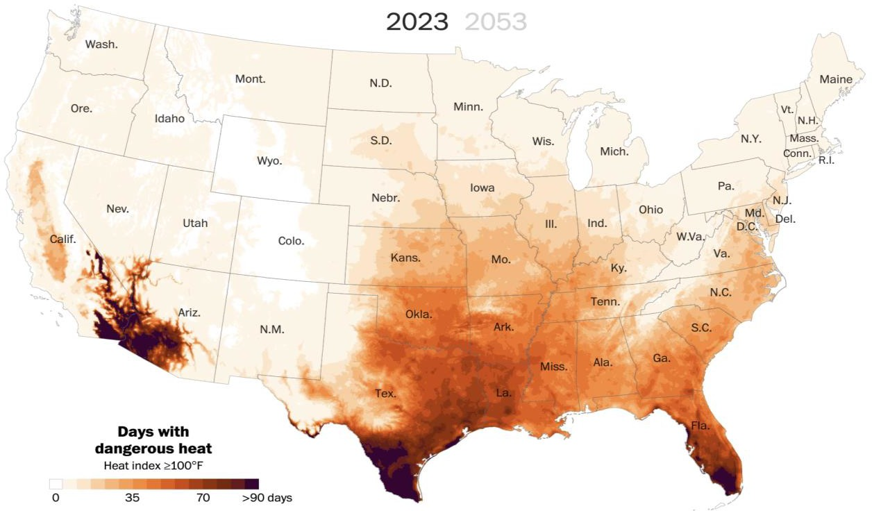
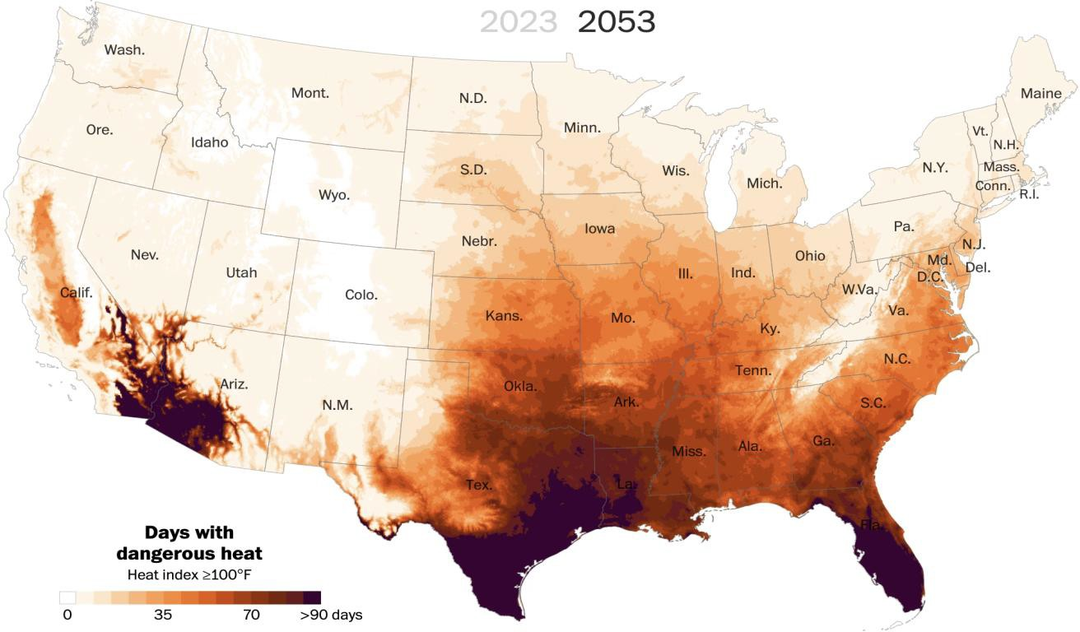
Heat Risk is Increasing
By mid-century, nearly two-thirds of Americans will experience perilous heat waves, with some regions in the South expected to endure more than 70 consecutive days over 100 degrees.¹
¹Washington Post, 2023

Slide 13
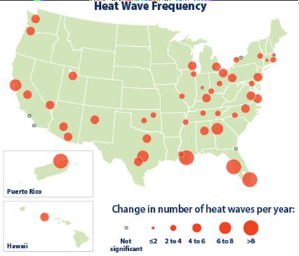
U.S. heat wave frequency rose substantially 1961-2021
Heat threats are escalating in the USA and can hit especially hard in disadvantaged communities with vulnerable populations
https://www.epa.gov/climate-indicators/climate-change-indicators-heat-waves

Slide 14
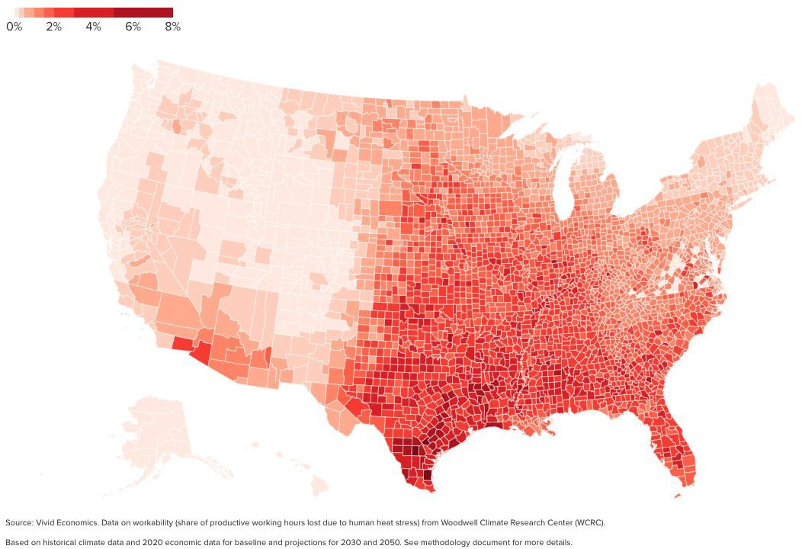
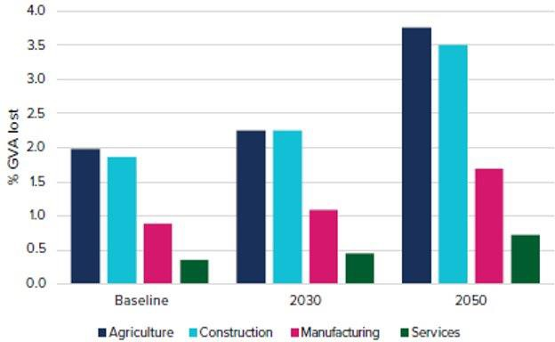
US Economic Analysis: Heat and Productivity Loss
Modeled projected percent loss by 2050 in gross value added from reduced worker productivity due to human heat stress
~$500bn
~$200bn
~$100bn
Assuming working conditions and sectors of economic activity remain unchanged, percentage losses nearly double from heat stress

Slide 15
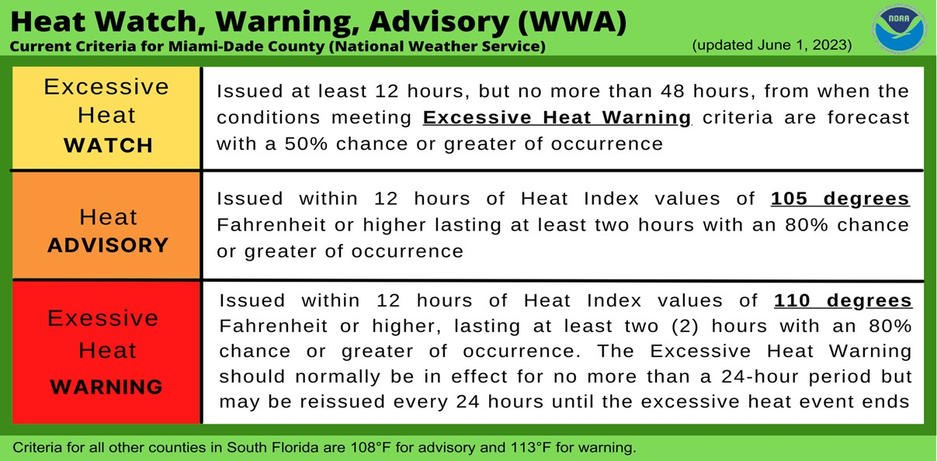
2023
First ever heat warning in recorded history.
42 days reaching a heat index of 105F or more, compared to an average of
6 days/year (over the past 14 years).

Slide 16
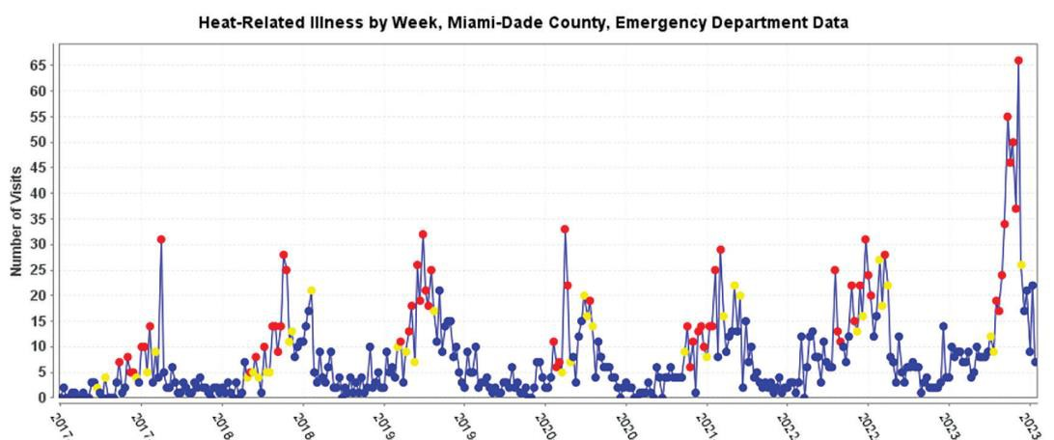
In 2023:
Peaks in weekly heat-related emergency department visits were 100% higher than past 5 years.

Slide 17
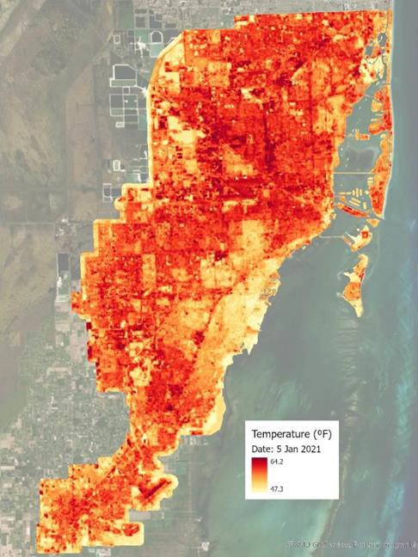
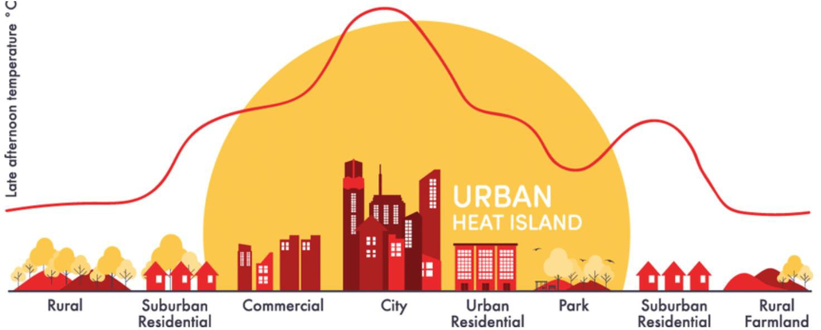
Urban Heat Island Effect
Urban areas can be 5 to 9 degrees Fahrenheit hotter than rural areas during the day.
Some neighborhoods in cities, often in low-income areas, can be as much as 15-20 degrees F hotter during the day.
American Forests 2021

Slide 18
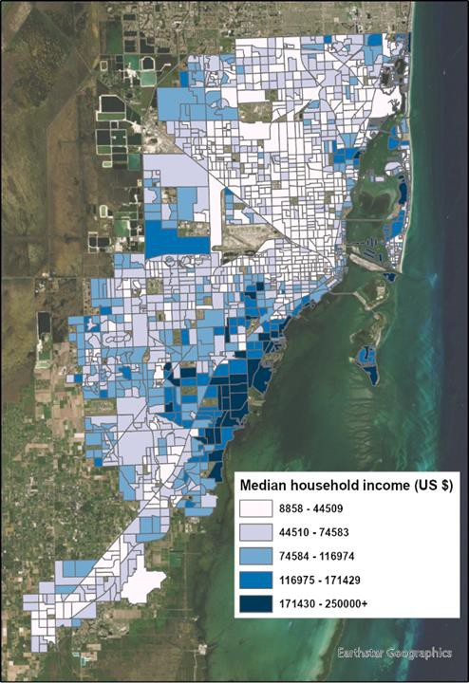
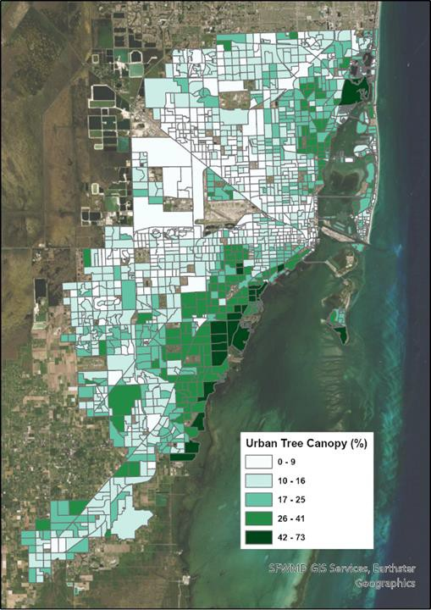

Slide 19
Heat Vulnerability Study:
Populations at Risk in Miami-Dade
Category | Description of Data | Provider
Health Outcome | Heat Related Illness Emergency Department | FDOH
 | Heat Related Illness Hospitalizations | FDOH
Exposure | Land Surface Temperature | NASA
 | % Impervious Surface | NLCD (2019)
Sensitivity | % Older Adults (age > 65) | US Census
 | % Living Alone | US Census
 | Children 0-5 | US Census
 | % Living in Poverty | US Census
 | Household Income | US Census
 | % Limited Language Proficiency | US Census
 | % African American | US Census
 | % Hispanic | US Census
 | % Indigenous | US Census
 | % Mobile Homes | US Census
 | % High School Education | US Census
 | % Outdoor Workers (Agr, Forestry, Fish, Mining, Construction) | US Census
 | % Female Head of Housing | US Census
Hospitalizations
% Living in Poverty
% Mobile Homes
Emergency Department Visits
Daytime surface temperature
% Outdoor Workers
% Age less than 18
Miami-Dade Extreme Heat Vulnerability Mapping Report (Uejio and Ahn, 2022)

Slide 20
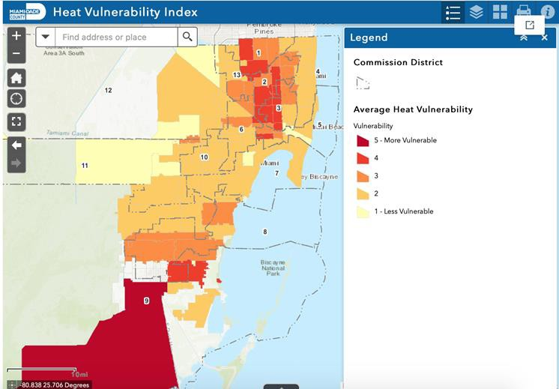
ArcGIS StoryMap: Vulnerability
Interact with the Heat Vulnerability Index web mapping application to identify vulnerable zip codes in Miami-Dade
Homestead, Florida City, Hialeah, Miami, Opa-Locka, and Miami Gardens
** Average of Heat Hospitalization and ER Visit Vulnerability as seen on previous slide

Slide 21
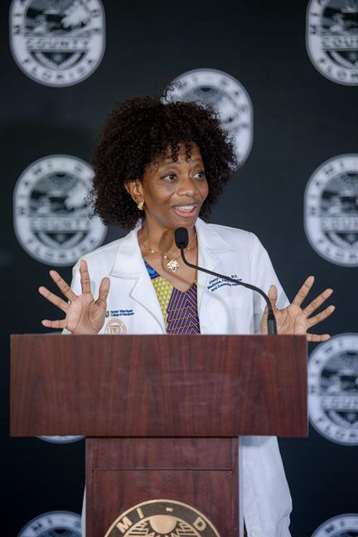
Climate & Heat Health Task Force
Goals:
Prioritize short term actions
Create framework for monitoring progress
Equitable representation
Best available science
The Task Force included 15 appointed members representing local, state and fed govt, scientific experts, community orgs and health care professionals as well as two citizen members who will ensure community voices are heard and lifted up in the formation of the heat plan.
https://miamifoundation.org/extremeheat/

Slide 22
Collaboration is a critical asset

Slide 23
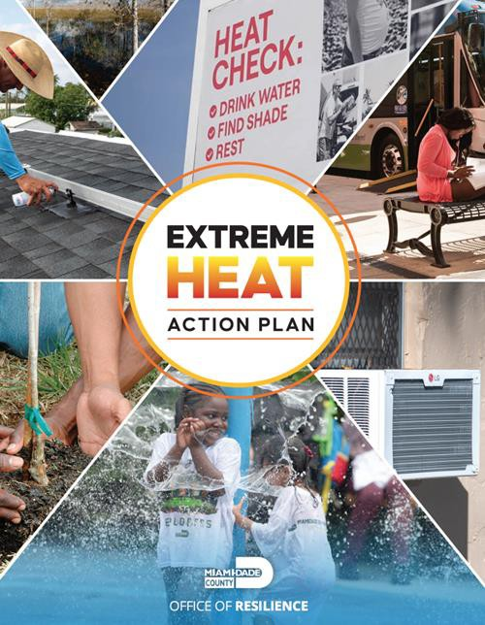
Miami-Dade County Extreme Heat Action Plan
Goal 1: Inform and Prepare People
Goal 2: Cool our Homes & Emergency Facilities
Goal 3: Cool our Neighborhoods

Slide 24
Goal 1: Inform & Prepare People
Heat Season Campaign
Heat Safety Trainings
Updated NWS thresholds and response protocols
Outdoor Worker Protection
Urban Heat Research Group

Slide 25
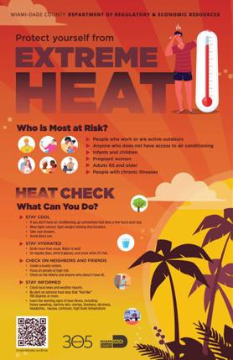
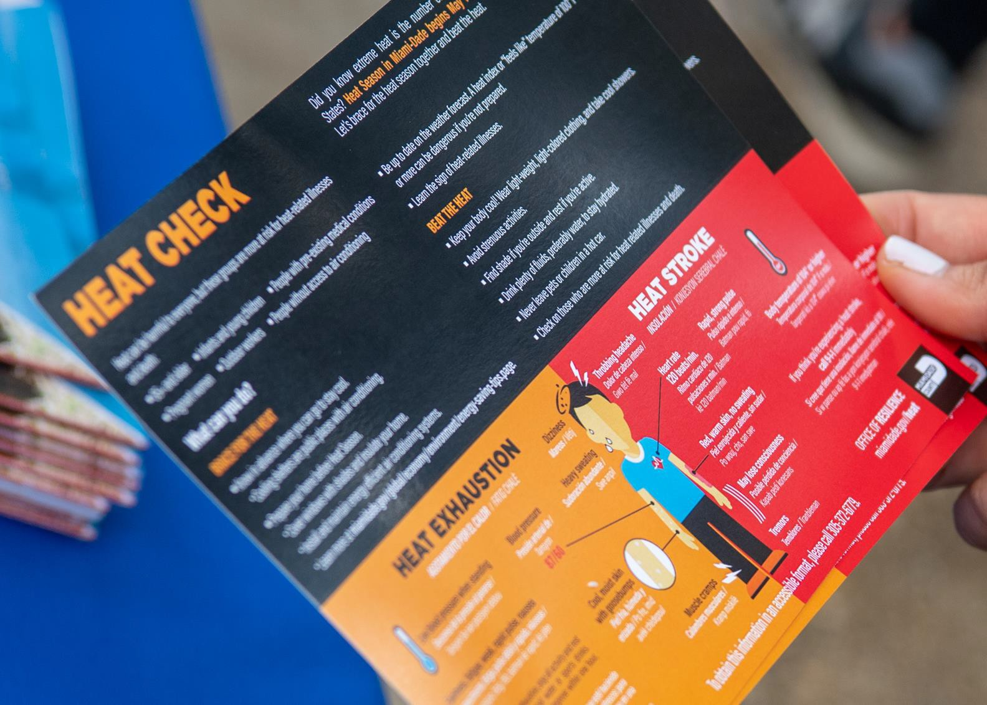
18

Slide 26
Goal 2: Cool our Homes & Emergency Facilities
1700 efficient AC units installed in public housing
Increased funding for weatherization and NOAH rehabs
Education outreach – Brace for the Heat
Sustainable Buildings Program
Cool roof ordinance and Indoor cooling standards
Resilience hub plan

Slide 27
Goal 3: Cool our Neighborhoods
Dramatically increased funding for tree equity
Draft Urban Forestry plan released
Bus stop shelter investments and cooling commutes
Partnerships with schools and faith-based orgs
Citizen science on UHI monitoring

Slide 28
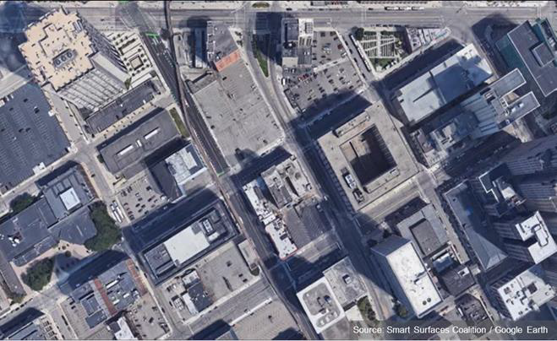
The Cities We Live In Now...
Dark, impervious hot surfaces with very few trees and little green space, contributing to urban heat islands. Current solution: More air conditioners = Hotter Cities
Dark and impervious roads ...
Absorbs and re-radiates heat
Low reflection causes global warming
Increased rain runoff and flooding
No shade
Dark and impervious parking lots ...
Increases the heat of a city
Increases smog
Dark and impervious roofs ...
Heats up buildings, increasing electricity usage for air conditioning
Heats up the city

Slide 29
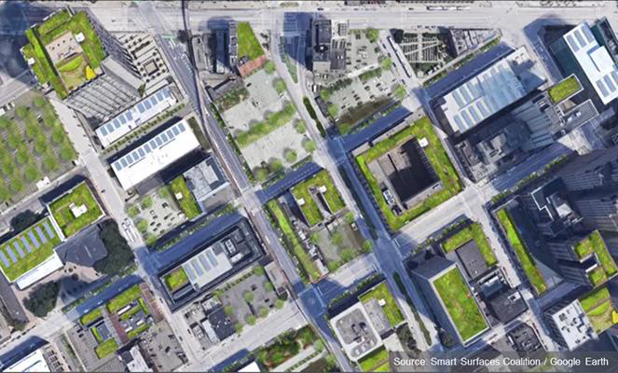
The Smart Surface Cities We Could Live In...
Reflective, porous, and green surfaces with trees and solar PV:
a cost-effective Smart Surface solution for cooler, healthier more resilient cities
Light-colored and reflective roads ...
Reduced heat absorption, reduces ambient temperatures
Porous parking lanes manage stormwater
and reduce runoff
Porous, reflective parking lots with trees ...
Increased thermal comfort
Shading and stormwater management
Reflective, green, and PV roofs ...
Reduced building and city temperatures
Reduced runoff
Generating clean renewable energy

Slide 30
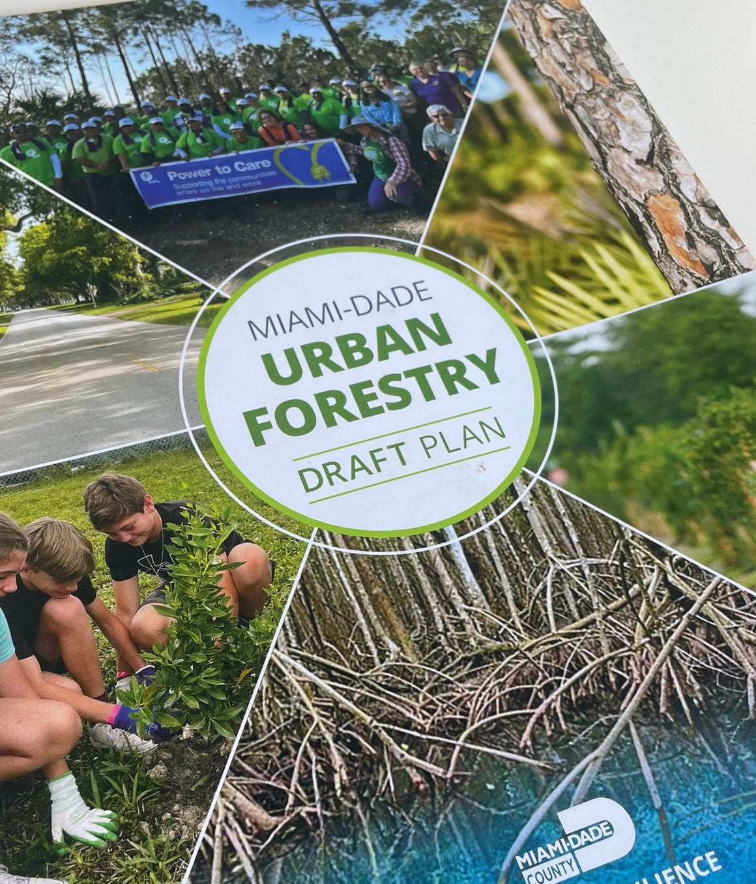
Highlights from the Urban Forestry Plan
Establish a tree ambassador program
Strengthen school and faith-based partnerships
Build on Adopt a Tree and Million Trees Miami
Advance policies to strengthen tree protection and establish dedicated funding

Slide 31
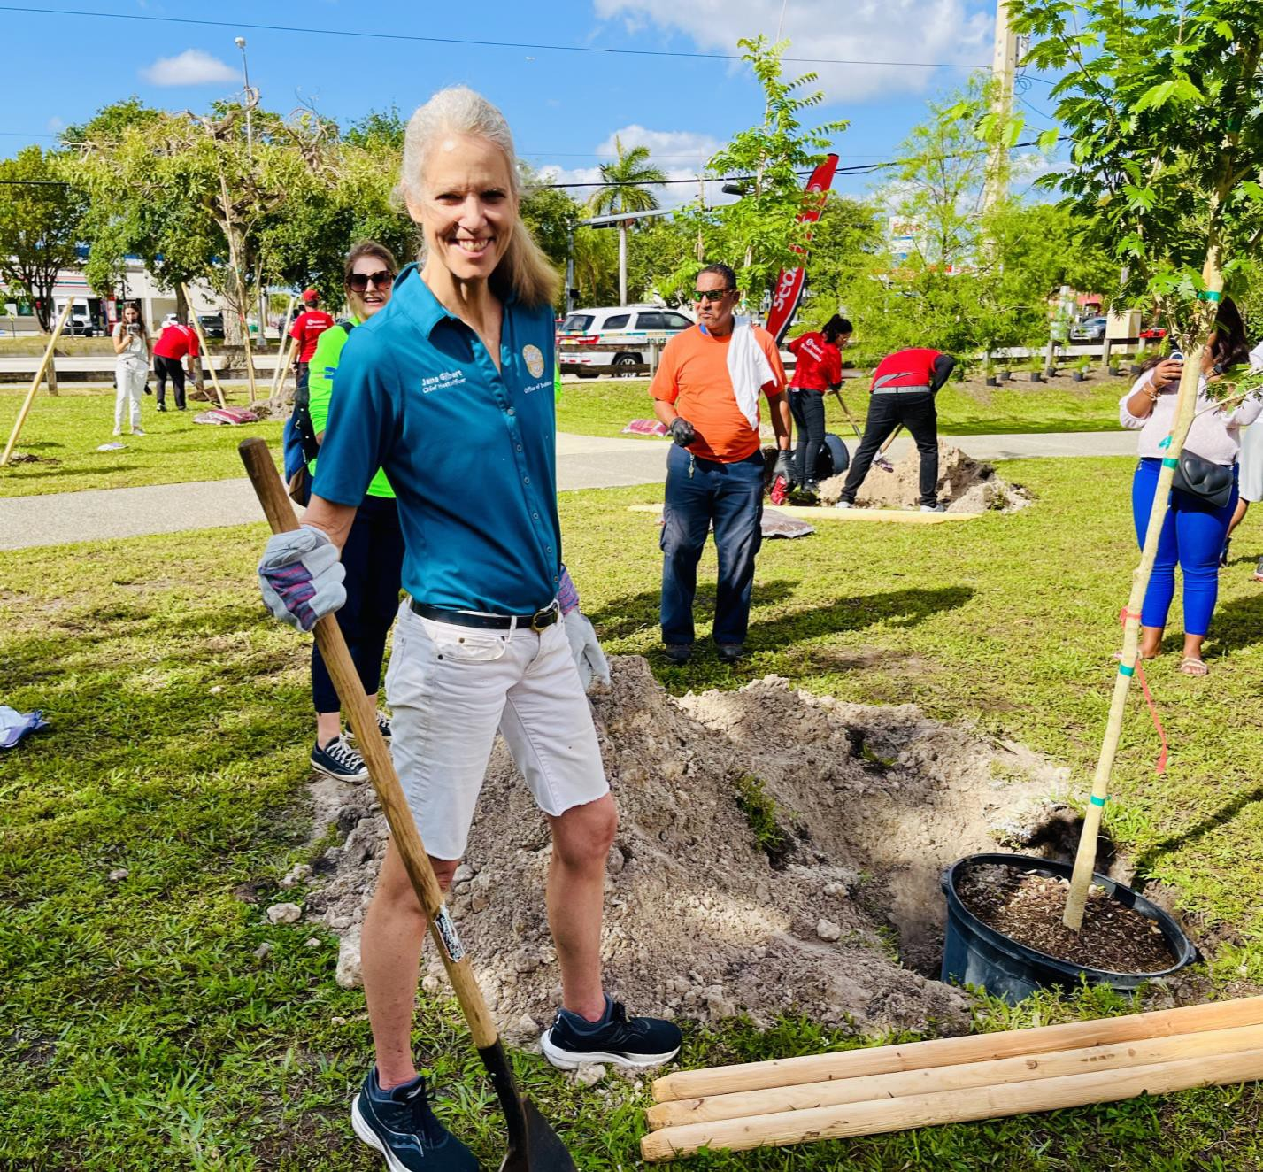
Sign up for the resilience newsletter:
miamidade.gov/resilience
Jane Gilbert
Chief Heat Officer Miami-Dade County
Jane.Gilbert@miamidade.gov www.miamidade.gov/heat

Slide 32
Intro to the Homelessness Response System and Emergency Preparedness and Response
Chris Losavio, HSH Disaster Manager
2024

Slide 33
HSH Overview – Background and Mission
The Department of Homelessness and Supportive Housing (HSH) launched in August 2016.
Consolidates and coordinates City programs to address homelessness.
Mission: make homelessness in San Francisco rare, brief, and one-time.
Serves over 15,000 people daily through the homelessness response system (HRS):
youth ages 18-24 (sometimes called transitional age youth/TAY)
families with minor children
adults

Slide 34
Who We Serve
Learn more on the HSH website.
Federal definition of homelessness (used in the PIT Count) includes individuals and families:
With a primary nighttime residence not meant for human habitation (incl. cars).
Living in a shelter or transitional housing.
People fleeing domestic violence, dating violence, sexual assault, stalking, and other violent situations that make them afraid to return to their primary residence, when they have no other housing resources.
People at imminent risk of homelessness who will lose their residence within 14 days and have no other housing resources
San Francisco uses a broader definition that includes families who are "doubled up" or living in single room occupancy units.

Slide 35
Strategic Plan Goals: July 2023 - June 2028
GOAL #1: Decrease Homelessness | Reduce the number of people who are unsheltered by 50% and reduce the total number of people experiencing homelessness by 15%.
GOAL #2 Reduce Inequities | Demonstrate measurable reductions in racial inequities and other disparities in both: the experience of homelessness and the outcomes of City programs intended to prevent and end homelessness.
GOAL #3 Increase Exits from Homelessness | Actively support at least 30,000 people to move from homelessness into permanent housing.
GOAL #4 Support Housing Success | Ensure that at least 85% of people who exit homelessness do not experience it again.
GOAL #5 Prevent homelessness | Provide prevention services to at least 18,000 people at-risk of losing their housing and becoming homeless.

Slide 36
Homelessness Response System Overview
HSH's work is organized into several core components:
Outreach
Homelessness Prevention
Coordinated Entry
Shelter & Crisis Intervention
Housing Problem Solving
Housing

Slide 37
HSH Disaster Preparedness and Response Mission
Ensure our department, our providers, and the people we serve are better prepared and more resilient in the face of all types of emergencies.
Training and Exercises
Preparedness Planning
Operations and Response
Recovery and Mitigation

Slide 38
Importance of Disaster Preparedness at HSH
The Homelessness Response System needs a strong preparedness, response, and recovery plan to adapt to a dynamic event.
People experiencing homelessness are often the most vulnerable and at-risk in a disaster or other emergency situation and often forgotten
Structured departmental planning helps identify gaps; advocate for resources and coordinate with emergency management

Slide 39
HSH Inclement Weather Protocol
Activated during times of inclement weather including:
Heat
Cold/Wet Weather
Air Quality

Slide 40
HSH Activation Protocol:
Determine Activation Level
Assess Shelter Capacity
Activate Outreach
Activate Shelters/Drop In Centers
Communicate

Slide 41
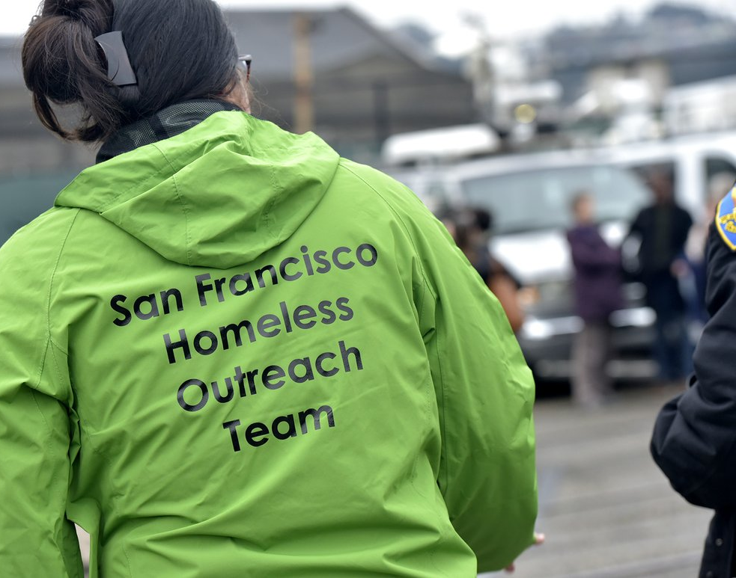
Outreach
Wellness checks
Provide information
Distribute Emergency Supplies

Slide 42
Shelter, Drop In Chairs, Drop In Centers
Wellness Checks
Activate Resources and Extend Hours for Walk Up Respite
Activate Emergency Pop Up Shelter, when needed

Slide 43
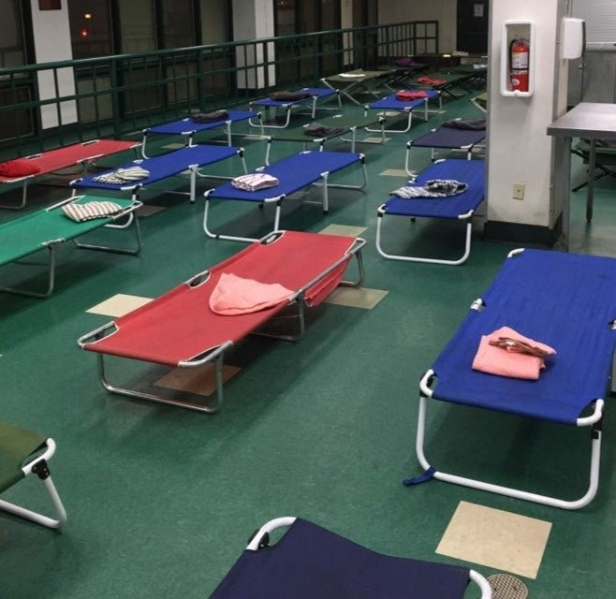
Emergency Pop Up Shelter
24/7 Emergency Walk Up Shelter
Activates when additional capacity is needed. (Phase 2 and 3)
Provide meals twice a day
Provide basic supplies to guests (Clothing, socks, underwear, etc.)

Slide 44
Interfaith Winter Shelter
Partnership between HSH, San Francisco Interfaith Council, and Episcopal Community Services
Increases shelter capacity for people experiencing homelessness during the winter months
Runs from Monday before Thanksgiving (11/25) to the End of March.

Slide 45
Thank you

Slide 46
Resource Overview
Notes:
So onto updates

Slide 47
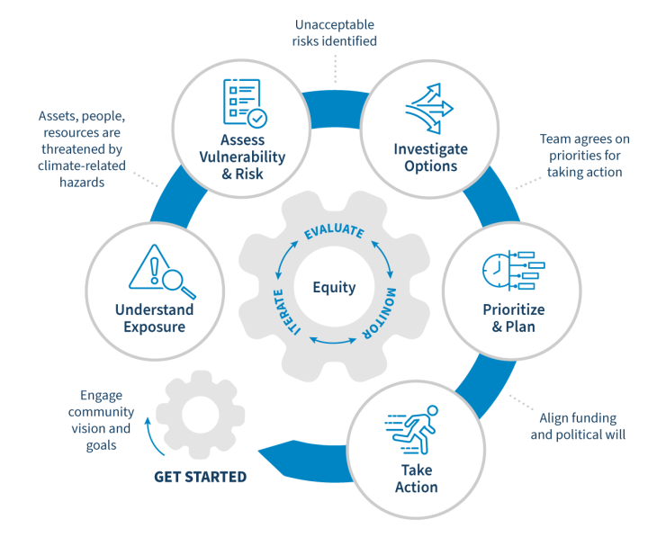
Climate Smart Communities (Competitive Grant)
Grants provided to advance climate resilience plan or project in collaboration with frontline communities. Funds can be used for a variety of activities ranging from risk assessment to project delivery. Grantees will be project teams composed of CBOs working with government partners and supported by adaptation professionals.
Key Deadlines: January 10th (community sign up form), March 3rd (final application deadline)
Available Funding: $100,000 (12-Month Period)​
Eligibility: CBO's (non-profit, universities, non-governmental or community serving institution) & Governmental Partner (City, town, special planning commission, etc.)
Grant Website
Notes:
Sharing this grant offering from the center for regenerative solutions and the urban sustainability director's network. IT can be used for community based tree care and protection programs as well as workforce development through urban foresty provision
Really tight turn around given the date but thought it would be good to include. Funds anywehre from 300,000 to 600,000 in work over 3 years and can be applied for by CBO's as well as municipalities,
Links on the right go to the main site, an overview for every program, sample budgets and the link to the application

Slide 48
Center for Heat Resilient Communities
This opportunity brings together cross-sector partners to create a roadmap for community heat resilience. This cohort will receive support and capacity building to create a Roadmap Workbook and Blueprint to position communities to maximize existing resources and be competitive for state, federal, and philanthropic funding opportunities. Participating communities will receive micro-grants to implement aspects of identified roadmap.
Key Deadlines:
Application opens (November 20th, 2024)
Application deadline (January 24th, 2025)
Available Funding: $10,000 Micro-fund for staff or
Financing strategies identified in roadmap. (12-month cohort period)
Eligibility: Non-federal state, local, tribal, and territorial governments.
Grant Website
Notes:
Sharing this grant offering from the center for regenerative solutions and the urban sustainability director's network. IT can be used for community based tree care and protection programs as well as workforce development through urban foresty provision
Really tight turn around given the date but thought it would be good to include. Funds anywehre from 300,000 to 600,000 in work over 3 years and can be applied for by CBO's as well as municipalities,
Links on the right go to the main site, an overview for every program, sample budgets and the link to the application

Slide 49
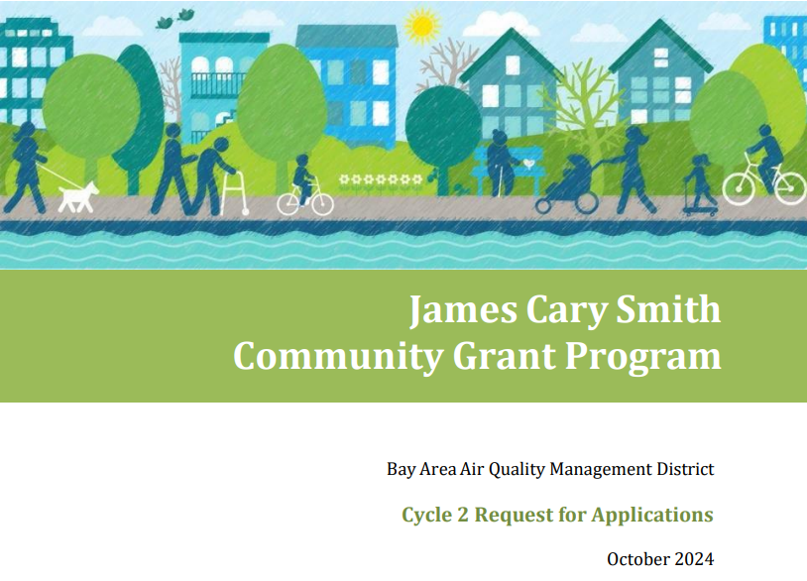
James Cary Smith Grant Program (BAAQMD)
The James Cary Smith Grant Program was created to support work done by CBO's to improve air quality and public health through meaningful engagement and increased community capacity. This program supports community organizations in designing and implementing strategies that increase engagement in planning activities. Eligible activities include community organizing and implementing strategies that facilitate authentic participation in planning activities such as trainings or providing resources and information to community.
Key Deadlines: January 7th (Applications Due), Winter 2025 (Grantee award announcements)
Available Funding: $100,000 (12-Month Period)​
Eligibility: California CBO's within Air District Jurisdiction (the counties of Alameda, Contra Costa, Marin, Napa, San Francisco, San Mateo, Santa Clara, southwestern Solano, and southern Sonoma). Preference for projects in areas that are above 70 out of 100 on CalEnviroScreen 4.0
Grant Website
Grant Guidelines
Notes:
Sharing this grant offering from the center for regenerative solutions and the urban sustainability director's network. IT can be used for community based tree care and protection programs as well as workforce development through urban foresty provision
Really tight turn around given the date but thought it would be good to include. Funds anywehre from 300,000 to 600,000 in work over 3 years and can be applied for by CBO's as well as municipalities,
Links on the right go to the main site, an overview for every program, sample budgets and the link to the application

Slide 50
Thanks!
Notes:
So onto updates

