Slide 1
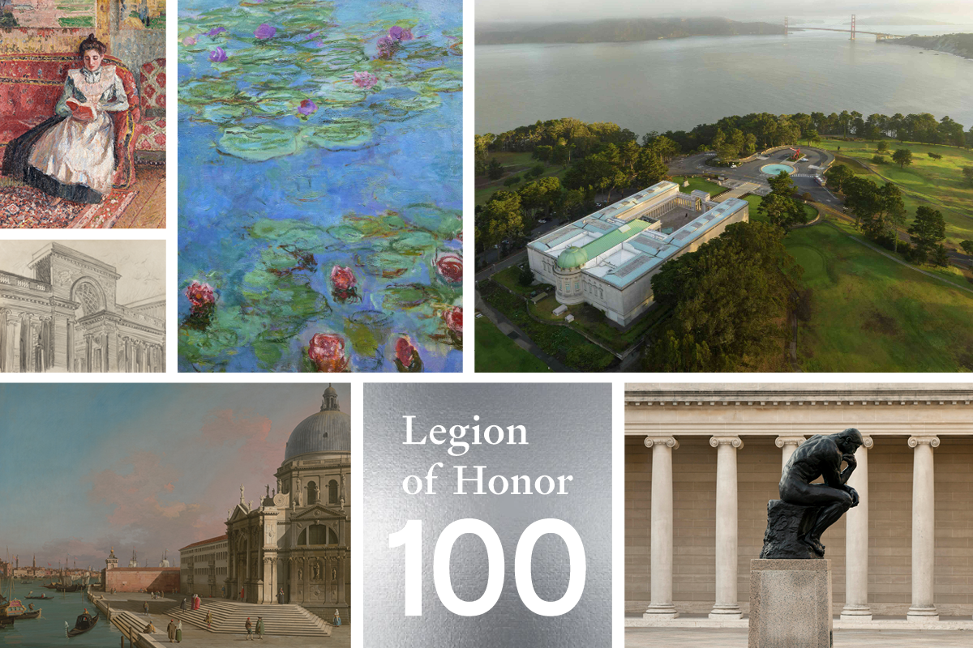
Legion of Honor 100
Centennial Weekend
November 9th–November 11th

Slide 2
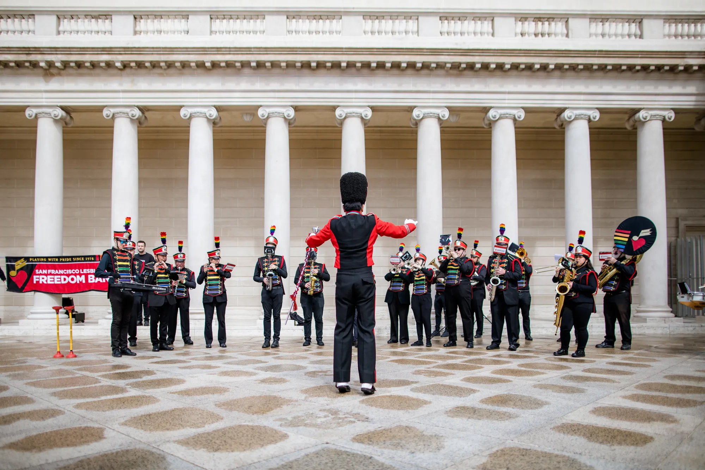
Celebrate the first Free Saturdays event of the Centennial Year!
Free Admission to Mary Cassatt at Work provided by Bank of America.
9:30 am \ Court of Honor
100 Years, 100 Portraits with The Thinker
10:50 am \ Court of Honor
Music Performance by George Washington High
11:00 am \ Court of Honor
Centennial Program with Remarks and Birthday Cake

Slide 3
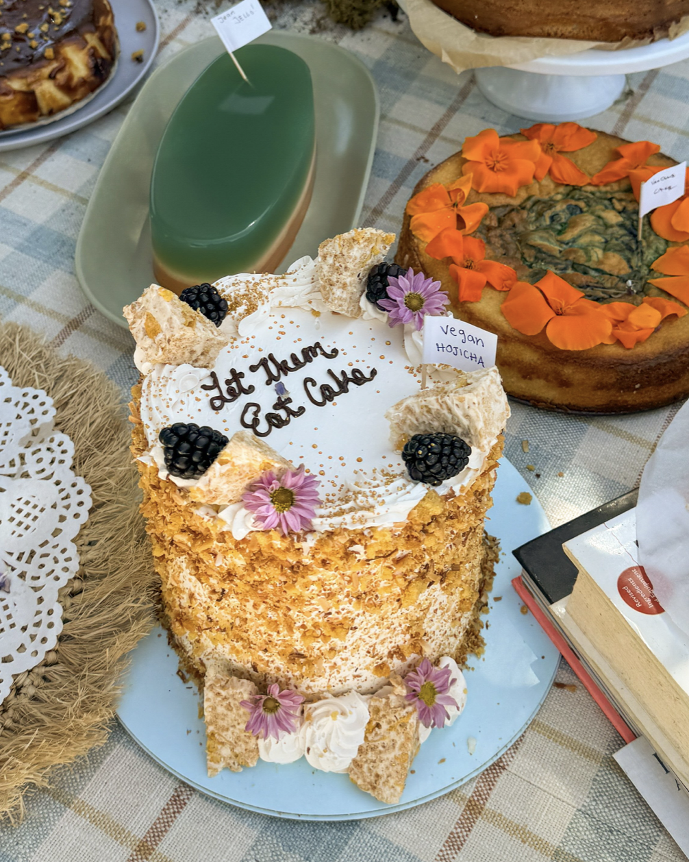
Public Celebration: Activations
9:30 am -3:00 pm \ Court of Honor, Galleries 6 & 14
SMARTBOMB Oakland Performances
11:30 AM \ Front Lawn
Cake Picnic
11:30 am \ Front Lawn
Screen Printing with ARTivate
1:30 pm \ Court of Honor
Croquembouche Pop Up by
Tarts de Feybesse
4:00-5:00 pm \ Rodin Galleries & Court of Honor
Organ Concert with SF Ballet Trainees Program
Cake Picnic, Elisa Sunga

Slide 4
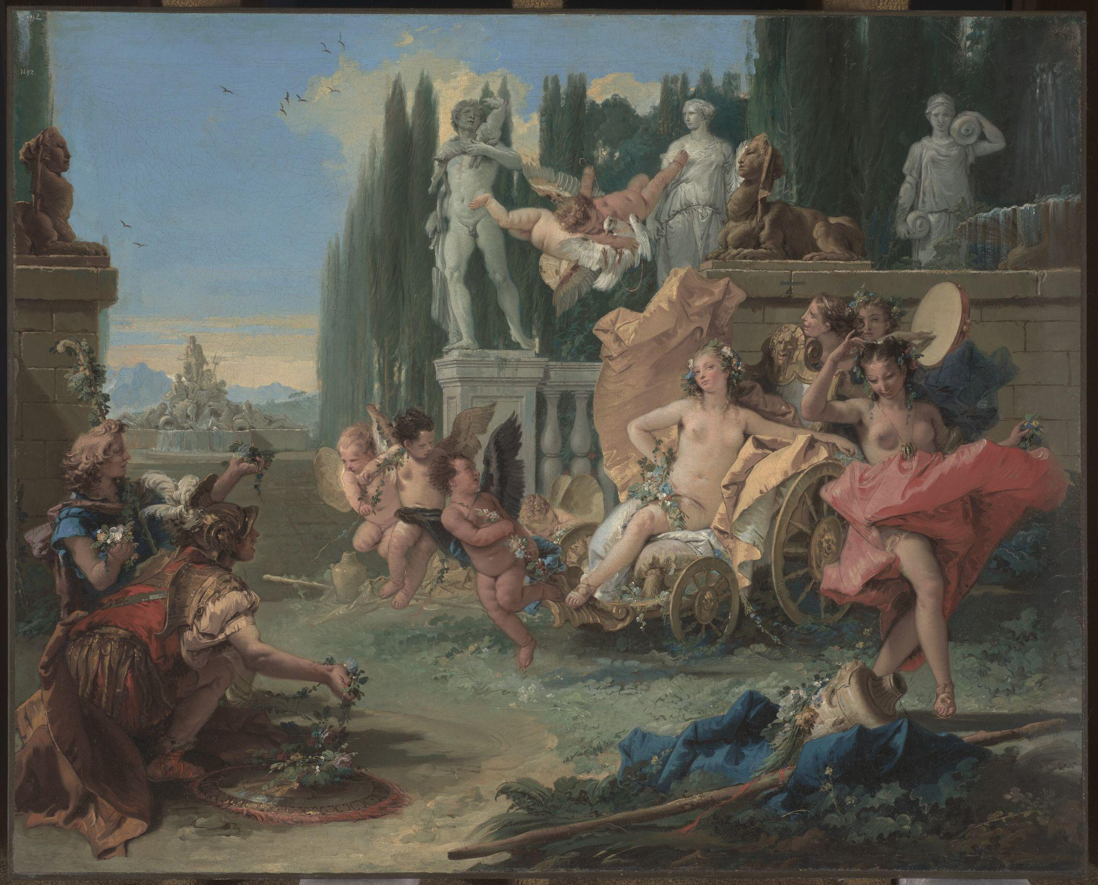
Public Celebration: Double Feature Lecture
1pm \ Gunn Theater
Debut of A Closer Look curatorial lecture series
“Collecting European Paintings for San Francisco,” Emily A. Beeny, Chief Curator of the Legion of Honor and Barbara A. Wolfe Curator in Charge of European Paintings
2:30 pm \ Gunn Theater
Conversation on Rodin & San Francisco with Thomas P. Campbell and Amélie Simier, Director, Musée Rodin`
Giovanni Battista Tiepolo, The Empire of Flora (detail), ca. 1743. Oil on canvas, 28 1/4 x 35 in. (71.8 x 88.9 cm). Fine Arts Museums of San Francisco, Gift of the Samuel H. Kress Foundation, 61.44.19

Slide 5
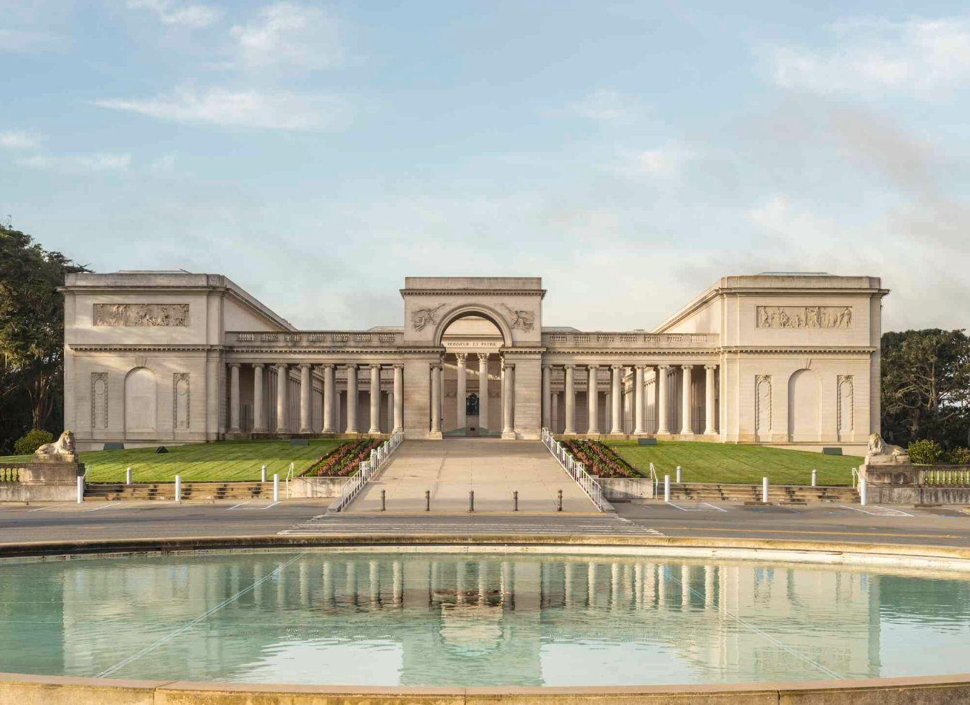
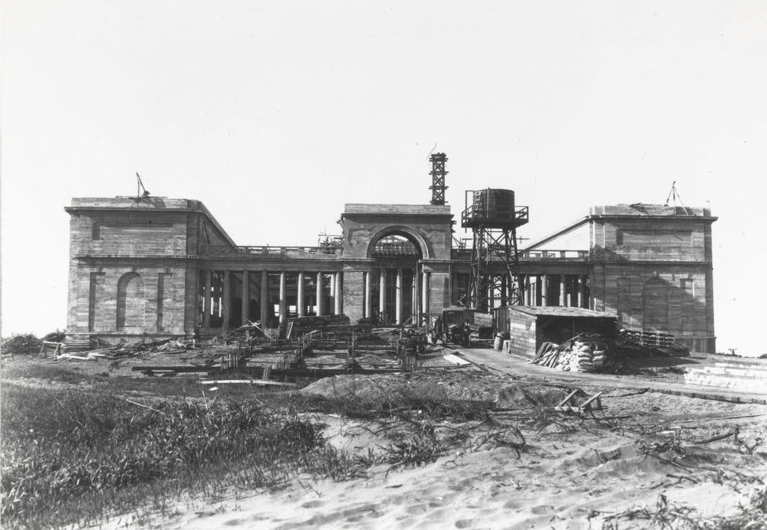
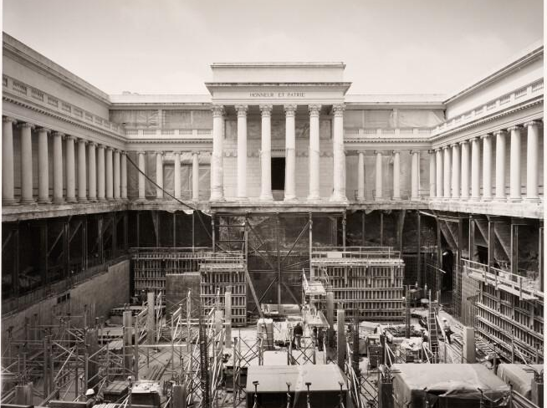
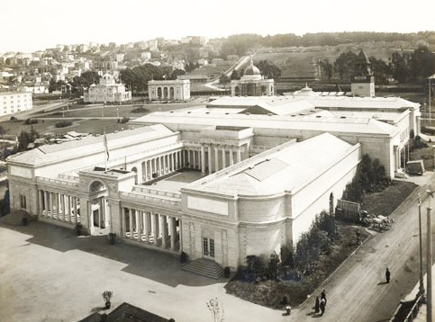
Celebrating 100 Years at the Legion of Honor
November 9, 2024-November 2, 2025
1920s
Legion of Honor
Construction
Legion of Honor today
1915
French Pavilion,
Panama-Pacific International Exposition
1994
Legion of Honor Renovation

Slide 6
4
Veterans Day
Monday, November 11th
9:30am–5:15pm

Slide 7
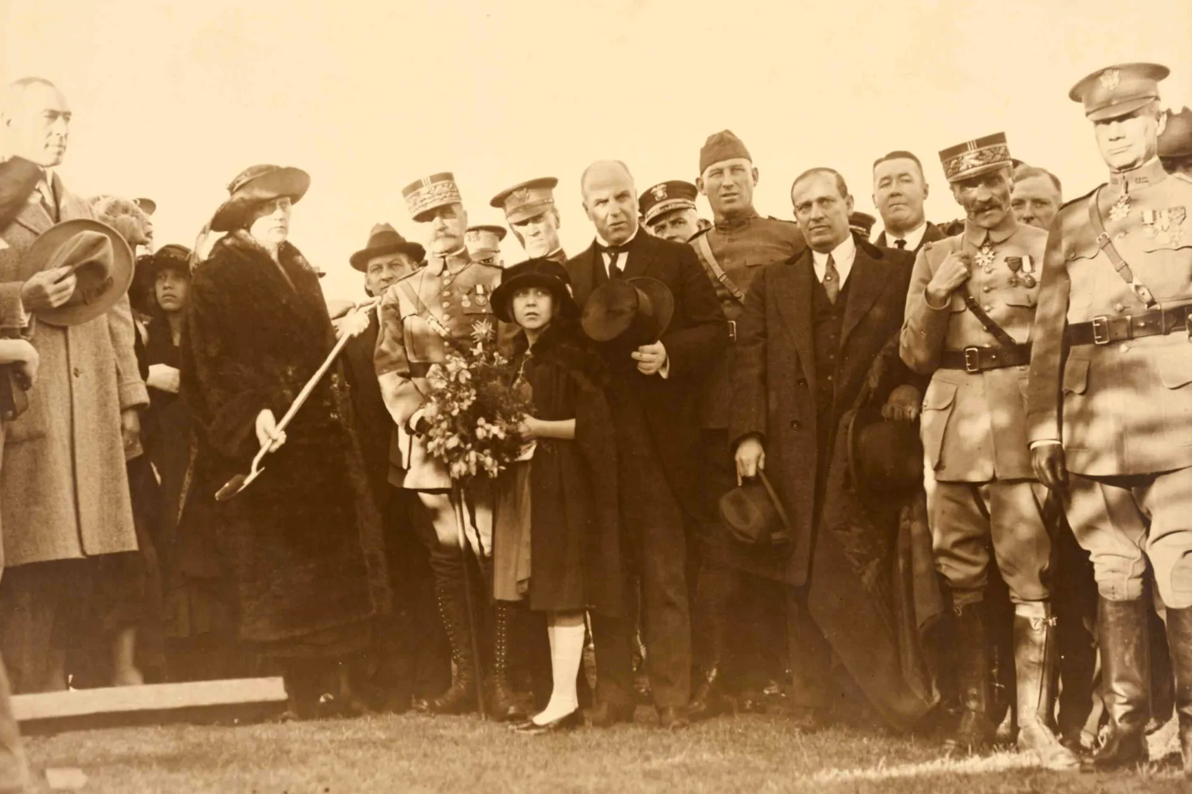
Legion of Honor 100: Veterans Day Ceremony
11:11 am \ Court of Honor
Veterans Day Ceremony with Color Guard and Patriotic Organ Music
1:00 pm \ Gunn Theater
“The Thinker’s Place: 100 Years at the Legion of Honor,” lecture by Isabella Lores-Chavez, Associate Curator of European Paintings & Curator, Celebrating 100 Years at the Legion of Honor with Jonathan Cordero and Gregg Castro
12pm & 2pm \ Collection Galleries
Docent-led tours with military themes
4pm \ Rodin Galleries and Court of Honor
Second organ concert of patriotic music

Slide 8
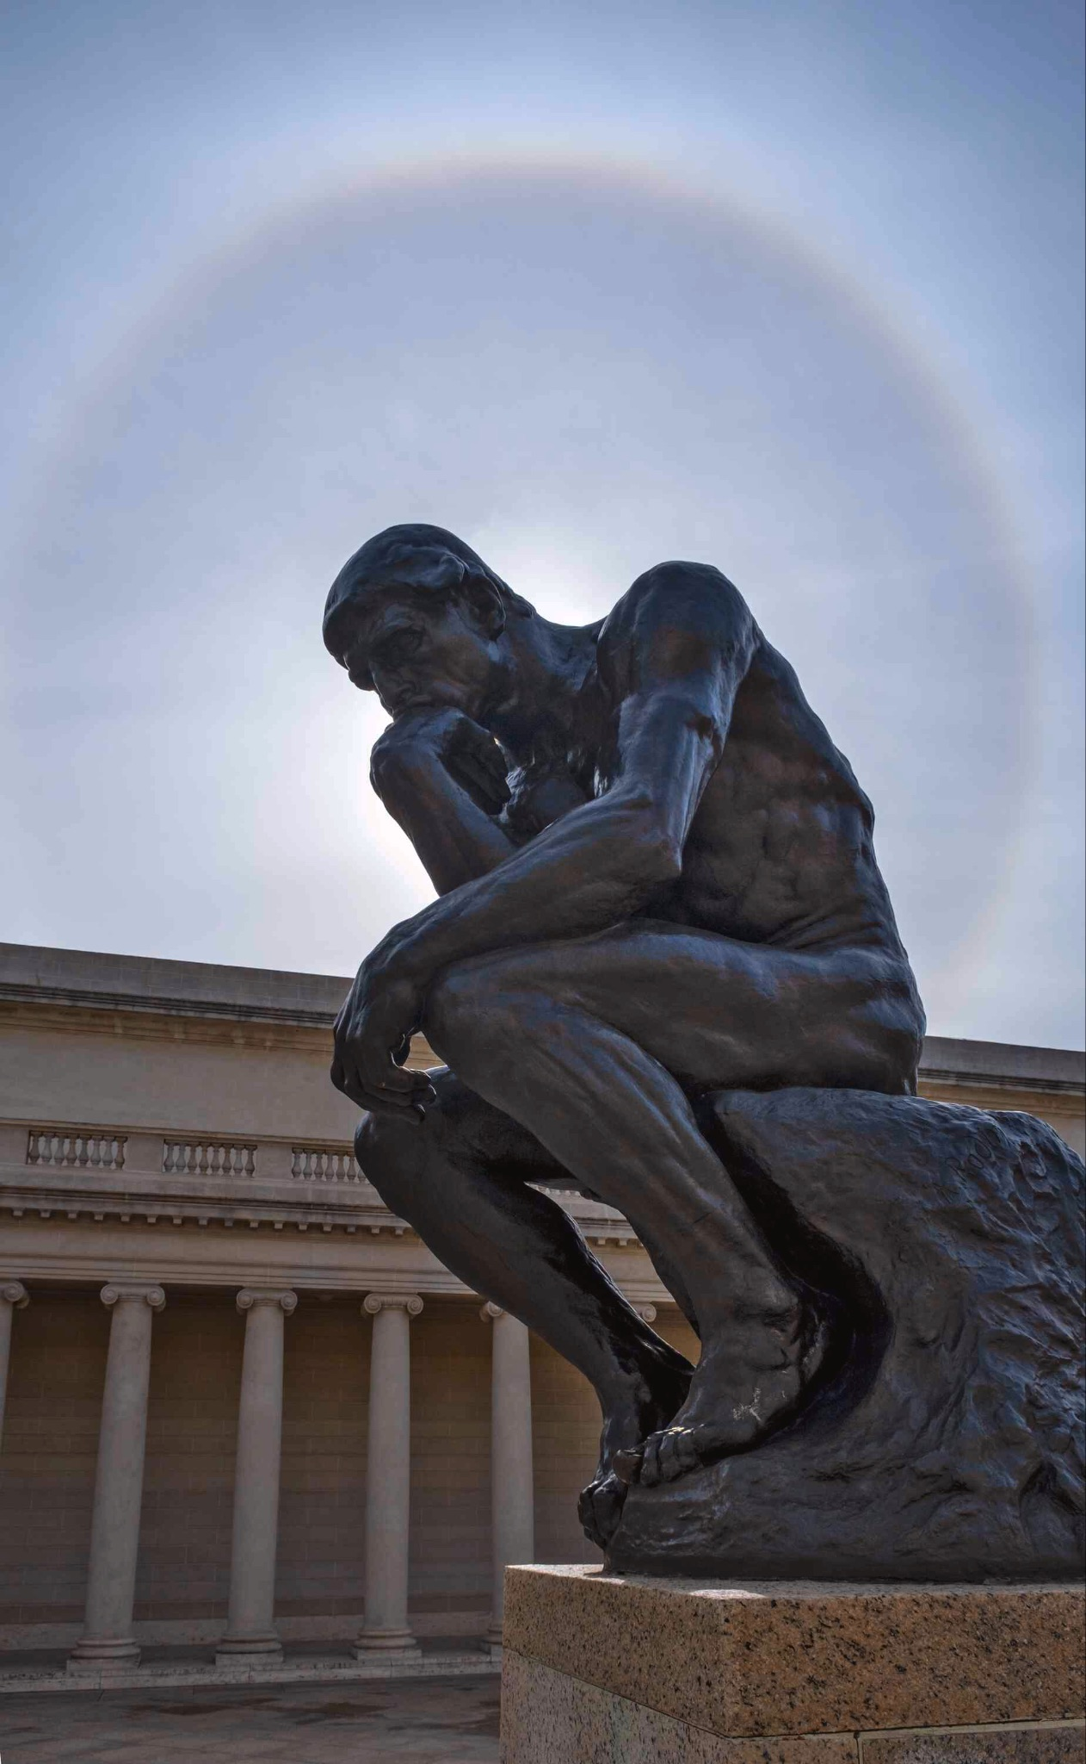
Thank you!

