Slide 1
San Francisco Heat and Air Quality Resilience Project
All Hands Meeting 10 | 09/05/2024
Matt Wolff, SFDPH, Matt.Wolff@sfdph.org Alex Morrison, ORCP, Alex.Morrison@sfgov.org.org
Notes:
Hello everyone, we're going to wait a little bit to get started as people trickle in.
My name is Alex Morrison and I'm a Resilience GIS Analyst with the Office of Resilience and Capital Planning and Co-project manager for HAQR along with Matt Wolff who also manages the SFDPH Climate and Health Program.
It's been a while since we met last but excited to see everyone
Please feel free to drop your name, department/organization, position

Slide 2
Agenda
HAQR All-Hands Meeting #9 Date: 06/26/2024 Time: 11am - 12pm
Introductions | 5 Minutes
Updates and Announcements: | 10 Minutes
HAQR All-Hands Presentations: Ria I. Mercado RN MSN PHN, Director of the Clinical and Quality Improvement Unit from the Human Services Agency’s Department of Disability and Aging Services. Neal Hatten, Deputy Director at Bayview Senior Services Allie Larman, Planner, California Office of Planning and Resources’ Extreme Heat and Community Resilience Program | 35 Minutes
Heat and Air Quality Resources Overview | 5 Minutes
Next Steps | 5 Minutes

Slide 3
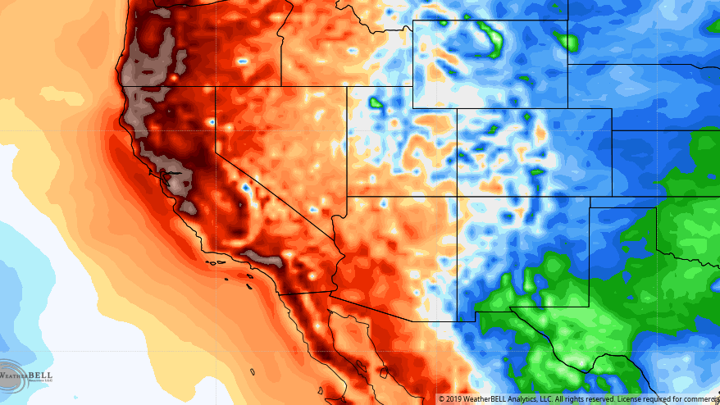
Updates and Announcements
Notes:
Updates: Becca Sugrue

Slide 4
Heat and Air Quality Resilience Project
HAQR Poll Results
What would you most like to see at future HAQR all-hands meetings? | 1st Choice | 2nd Choice | 3rd Choice | 4th Choice
Situational Awareness (program and policy updates from San Francisco public, academic, and community partners) | 22 | 5 | 1
Resource Library (introduce national heat and wildfire-smoke websites and toolkits) | 1 | 12 | 9 | 6
Best Practices (presentations from other Cities, Counties, and Organizations with heat and wildfire smoke programs) | 5 | 11 | 2 | 10
Journal Club (discuss extreme heat and wildfire smoke in the news, including current events and research) |  |  | 16 | 12
People are the most interested in Situational Awareness with Resources/Best Practices as about equal

Slide 5
Heat and Air Quality Resilience Project
CalTrans SOMA UnderFreeway Park

Slide 6
Heat and Air Quality Resilience Project
Resilience Hubs
Numerous State and Federal agencies are currently releasing funds for resilience hubs.
Field is relatively new in practice, no standardized terminology (state or federal), numerous overlapping terminology in use (Weather Relief Center, Cooling Center, Resilience Hub, etc.), differences in offered programmatic/infrastructure opportunities (emergency response vs. blue sky).
Community organizations have been interested in resilience hub model and reaching out for city support. City response has been largely ad-hoc and department specific.
To develop a more coordinated/comprehensive response, and ensure SF communities are best positioned to access current and future funding, improving our understanding of this field is essential.
What is already happening in San Francisco? (key informant interviews)
What is happening nationally? (landscape analysis, typology document)
How can we take lessons learned nationally and apply them to San Francisco?
What role should the City play?
Notes:
This is an update on a project HAQR is taking on this year to help move forward work in the implementation plan and also address something we are seeing in the heat and air quality space right now. Recently, there have been numerous State and Federal sources being offered for the creation of Resilience Hubs.
This field of climate resilience is relatively new, only developed in the last 6 years or so nationally and as such there isn't any standardized terminology in use. Locally, there is also different terminology being used interchangeably with differences in programmatic/infrastructure provision.
Recently, many CBO's have been increasingly interested in this model of work and reaching out to the city for support. The city response has been largely ad-hoc and department specific.
In order to develop a more coordinated response, and ensure SF communities are best positioned to navigate the funding and development landscape in this field, improving our collective understanding is essential.
We are hoping to answer the following questions through aspects of the project: [Read Slides]
If you know of organizations that are operating weather relief centers, cooling centers, resilience hubs, or any facilities that activate during heat and air quality events, please let us know as we'd love to talk to them to inform our efforts
With that I'm going to turn it back to Matt to introduce the presentors

Slide 7
HAQR All-Hands Presentations
Ria I. Mercado RN MSN PHN, Director of the Clinical and Quality Improvement Unit from the Human Services Agency’s Department of Disability and Aging Services.
Neal Hatten, Deputy Director at Bayview Senior Services
Allie Larman, Planner, California Office of Planning and Resources’ Extreme Heat and Community Resilience Program
Notes:
So onto updates

Slide 8
Department of Disability and Aging Services (DAS) Overview and Wellness Outreach Program by Ria I. Mercado, RN MSN PHN

Slide 9
About the Department of Disability and Aging Services (DAS)
The Department of Disability and Aging Services (DAS) coordinates services for older adults, veterans, people with disabilities, and their families to maximize safety, health, and independence.
Our vision is a San Francisco where people with disabilities and older adults are valued, engaged, and living with dignity.

Slide 10
About the Department of Disability and Aging Services (DAS) cont.
Program | What we do
Adult Protective Services (APS) | Accepts and responds to reports of abuse, exploitation, and self-neglect involving older adults and adults with disabilities.
Clinical & Quality Improvement (CQI) | Internal team of Public Health Nurses (PHNs) that provide short-term support to DAS clients with complex clinical needs
County Veterans Service Office (CVSO) | Helps veterans and their dependents understand and apply for benefits from the US Department of Veterans Affairs
DAS Eligibility Unit | Helps older adults and adults with disabilities access and stay connected to Medi-Cal and CalFresh benefits
DAS Intake Unit | Operates the Benefits & Resource Hub phone helpline and in-person service center to help people access the City’s resources for older and disabled adults
In-Home Supportive Services (IHSS) | IHSS provides paid assistance to income-eligible aged, blind, and/or disabled individuals
Legal and Guardianship Programs | Support the most vulnerable adults including those who are at imminent risk of abuse and exploitation
Office of Community Partnerships (OCP) | Manages services provided via contract to non-profit organizations that support seniors and adults with disabilities

Slide 11
Accessing DAS Services
DAS Benefits and Resources Hub (HUB) provides a wide variety of programs and services that help older adults and people with disabilities access food assistance, safety and protection, veterans benefits, health programs, case management, and adult learning.
DAS HUB helps clients find services and resources that are right for them.
Access to DAS services can be done with a single phone call, or an in-person visit.
Monday – Friday, 8AM – 5PM
By Phone
Call our help line at
(415) 355-6700
In Person
Drop in to see us at 2 Gough Street
Online
Visit our website at
www.SFHSA.org

Slide 12
Disaster Preparedness and Emergency Response (DPER)
DAS partners with the City’s Department of Emergency Management (DEM) and other agencies to safeguard the wellbeing of older adults and people disabilities during a citywide emergency or disaster.
During a citywide emergency or disaster, DAS programs carry out wellness outreach calls to conduct health screenings of their most vulnerable population, then response accordingly (e.g., calling 911).
Activation Procedure
Step 1
Step 2
Step 3
DEM or other agency notifies DAS of emergency or disaster
DAS assesses details of emergency or disaster and activates in accordance with criteria outlined in our policy and procedures
DAS Programs carries out wellness outreach calls and conducts health screenings

Slide 13
Heat Outreach
In an extreme heat event, DAS receives notifications from DEM and the National Weather Services (NWS). DAS programs initiate their extreme heat protocols and conducts outreach calls when the weather is forecasted to be 91º F (or more) for 2 – 3 consecutive days.
Each DAS program identifies vulnerable clients based the criteria set by the program’s policy and procedures.
Below are examples of the criteria set by IHSS:
Priority 1
Priority 2
Priority 3
Dependent on a ventilator
Indicated as Critical or Urgent
Dependent on Oxygen
Lives Alone
Contact Degree of Urgent or Critical
Aged 65+ OR Bedbound OR Non-Ambulatory / Transfer dependent
Contact Degree of Urgent or Critical
Requested for disaster notification.

Slide 14
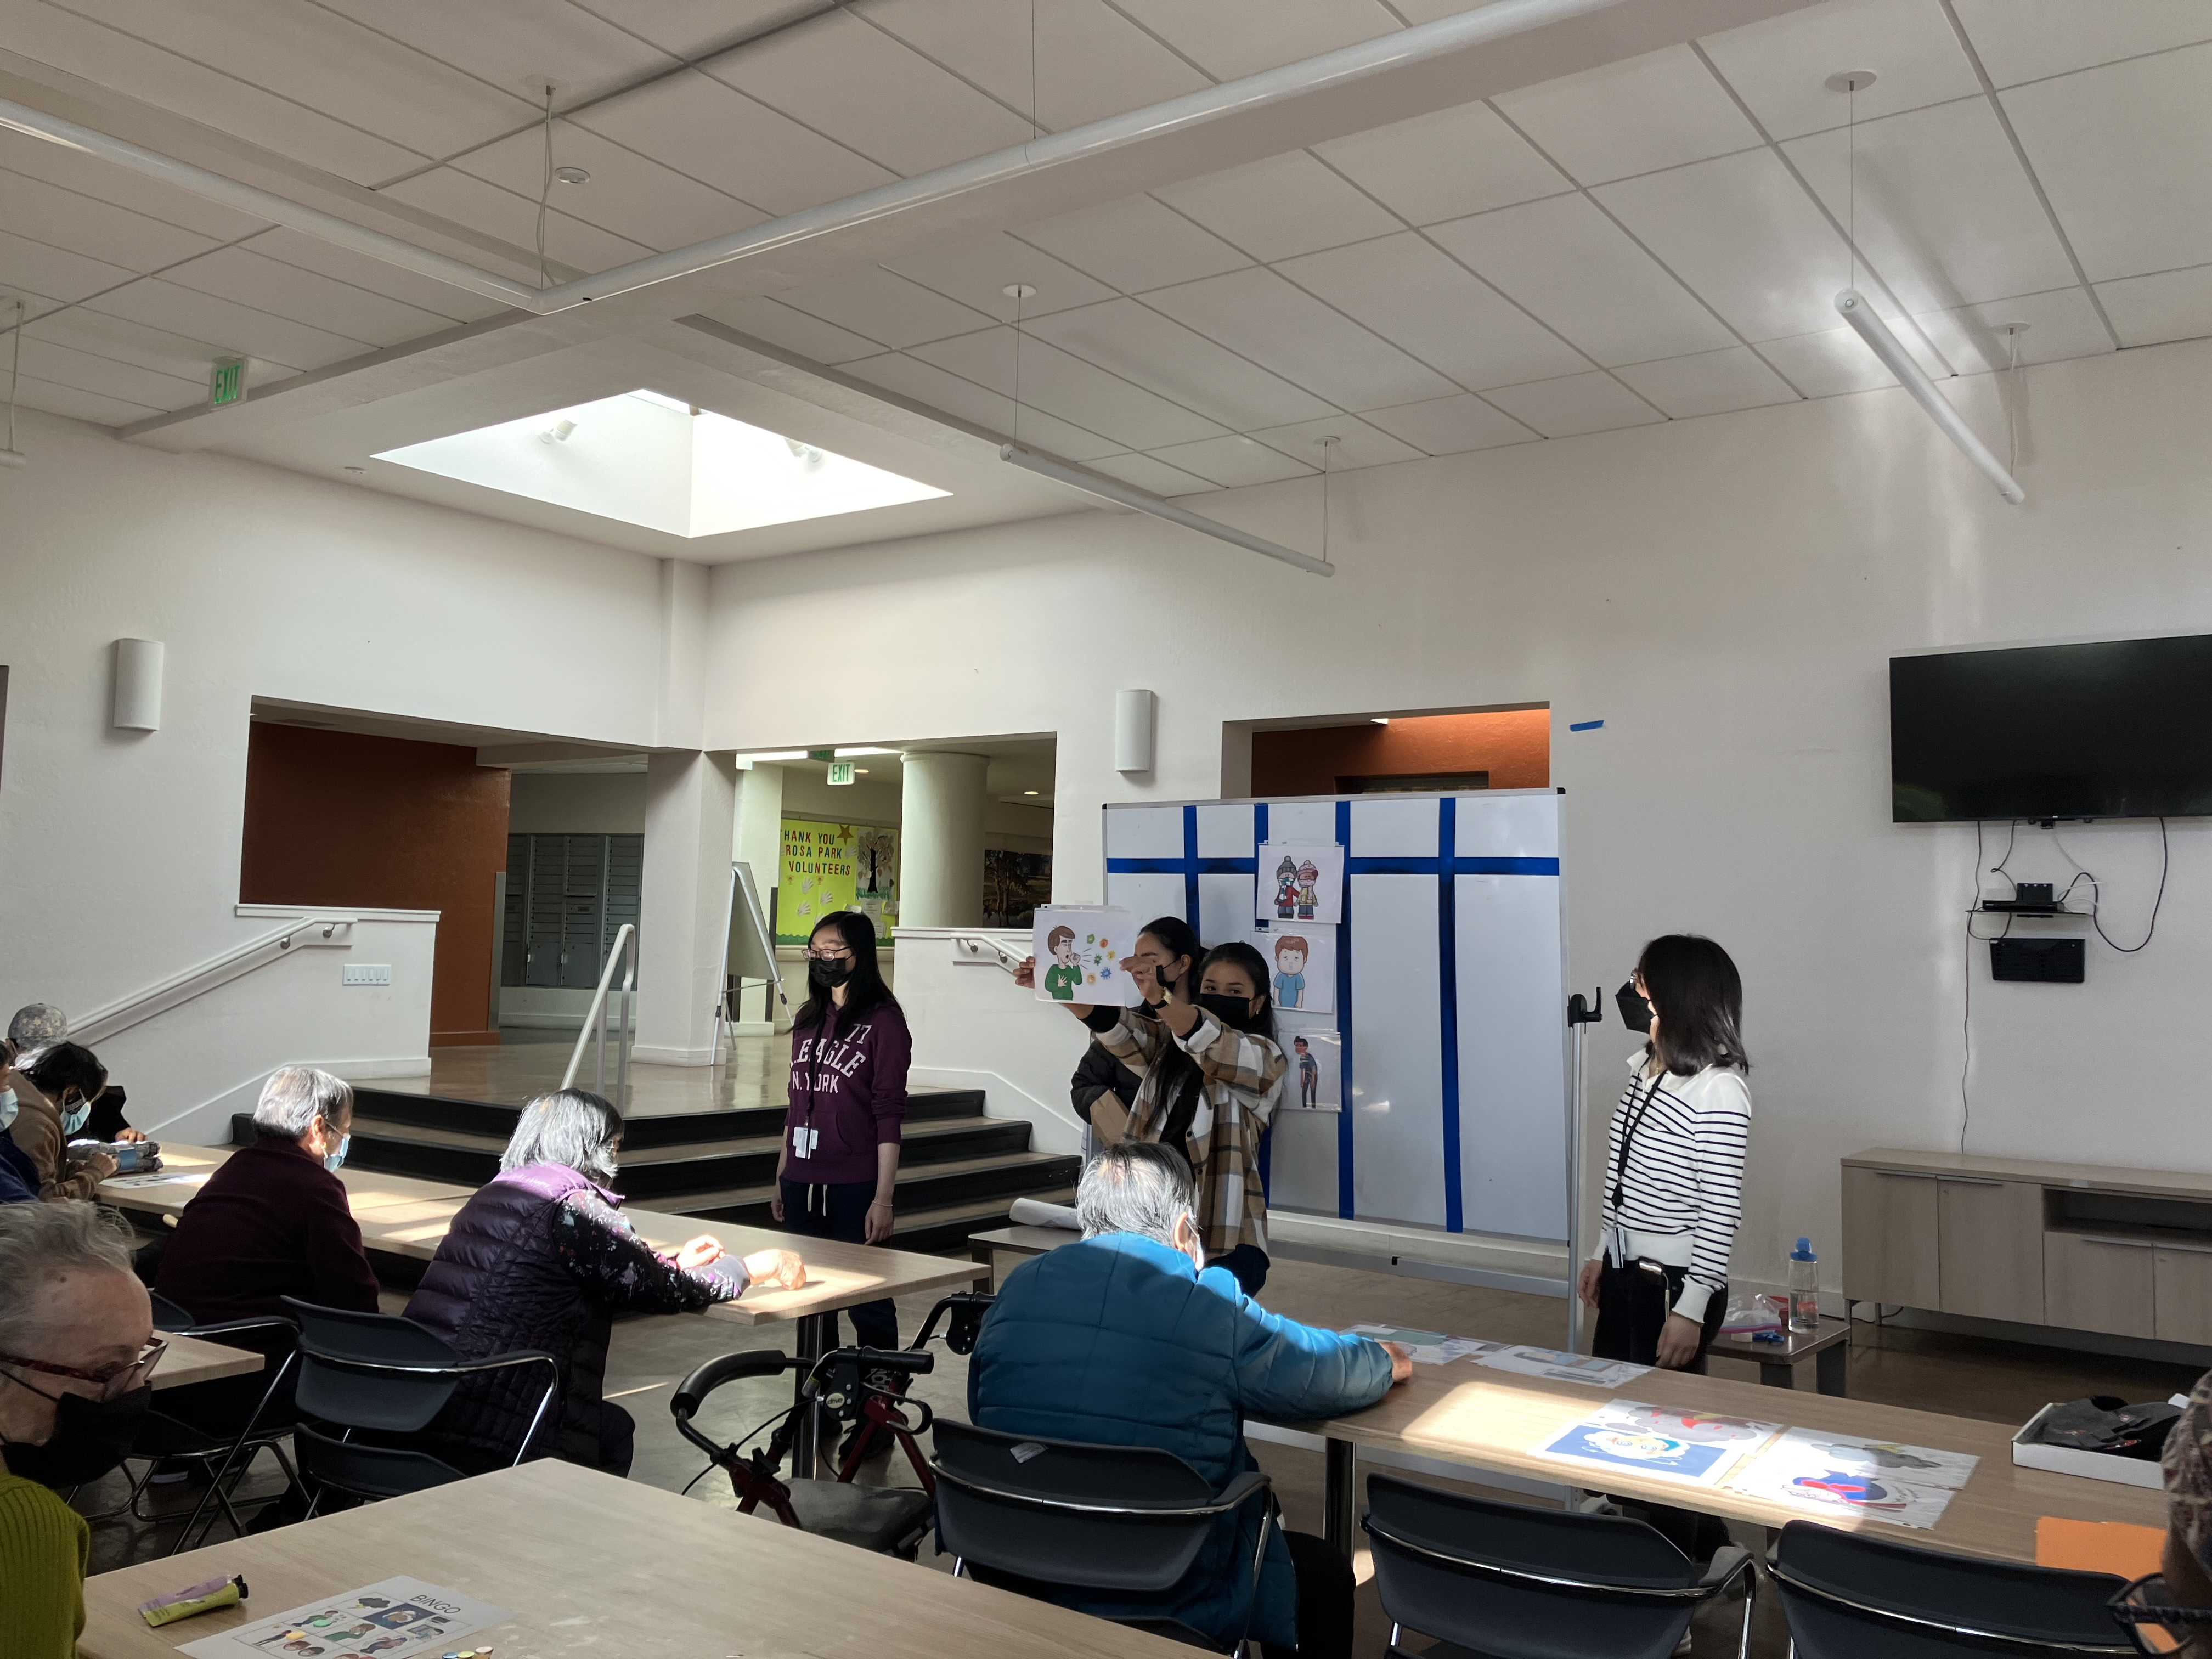
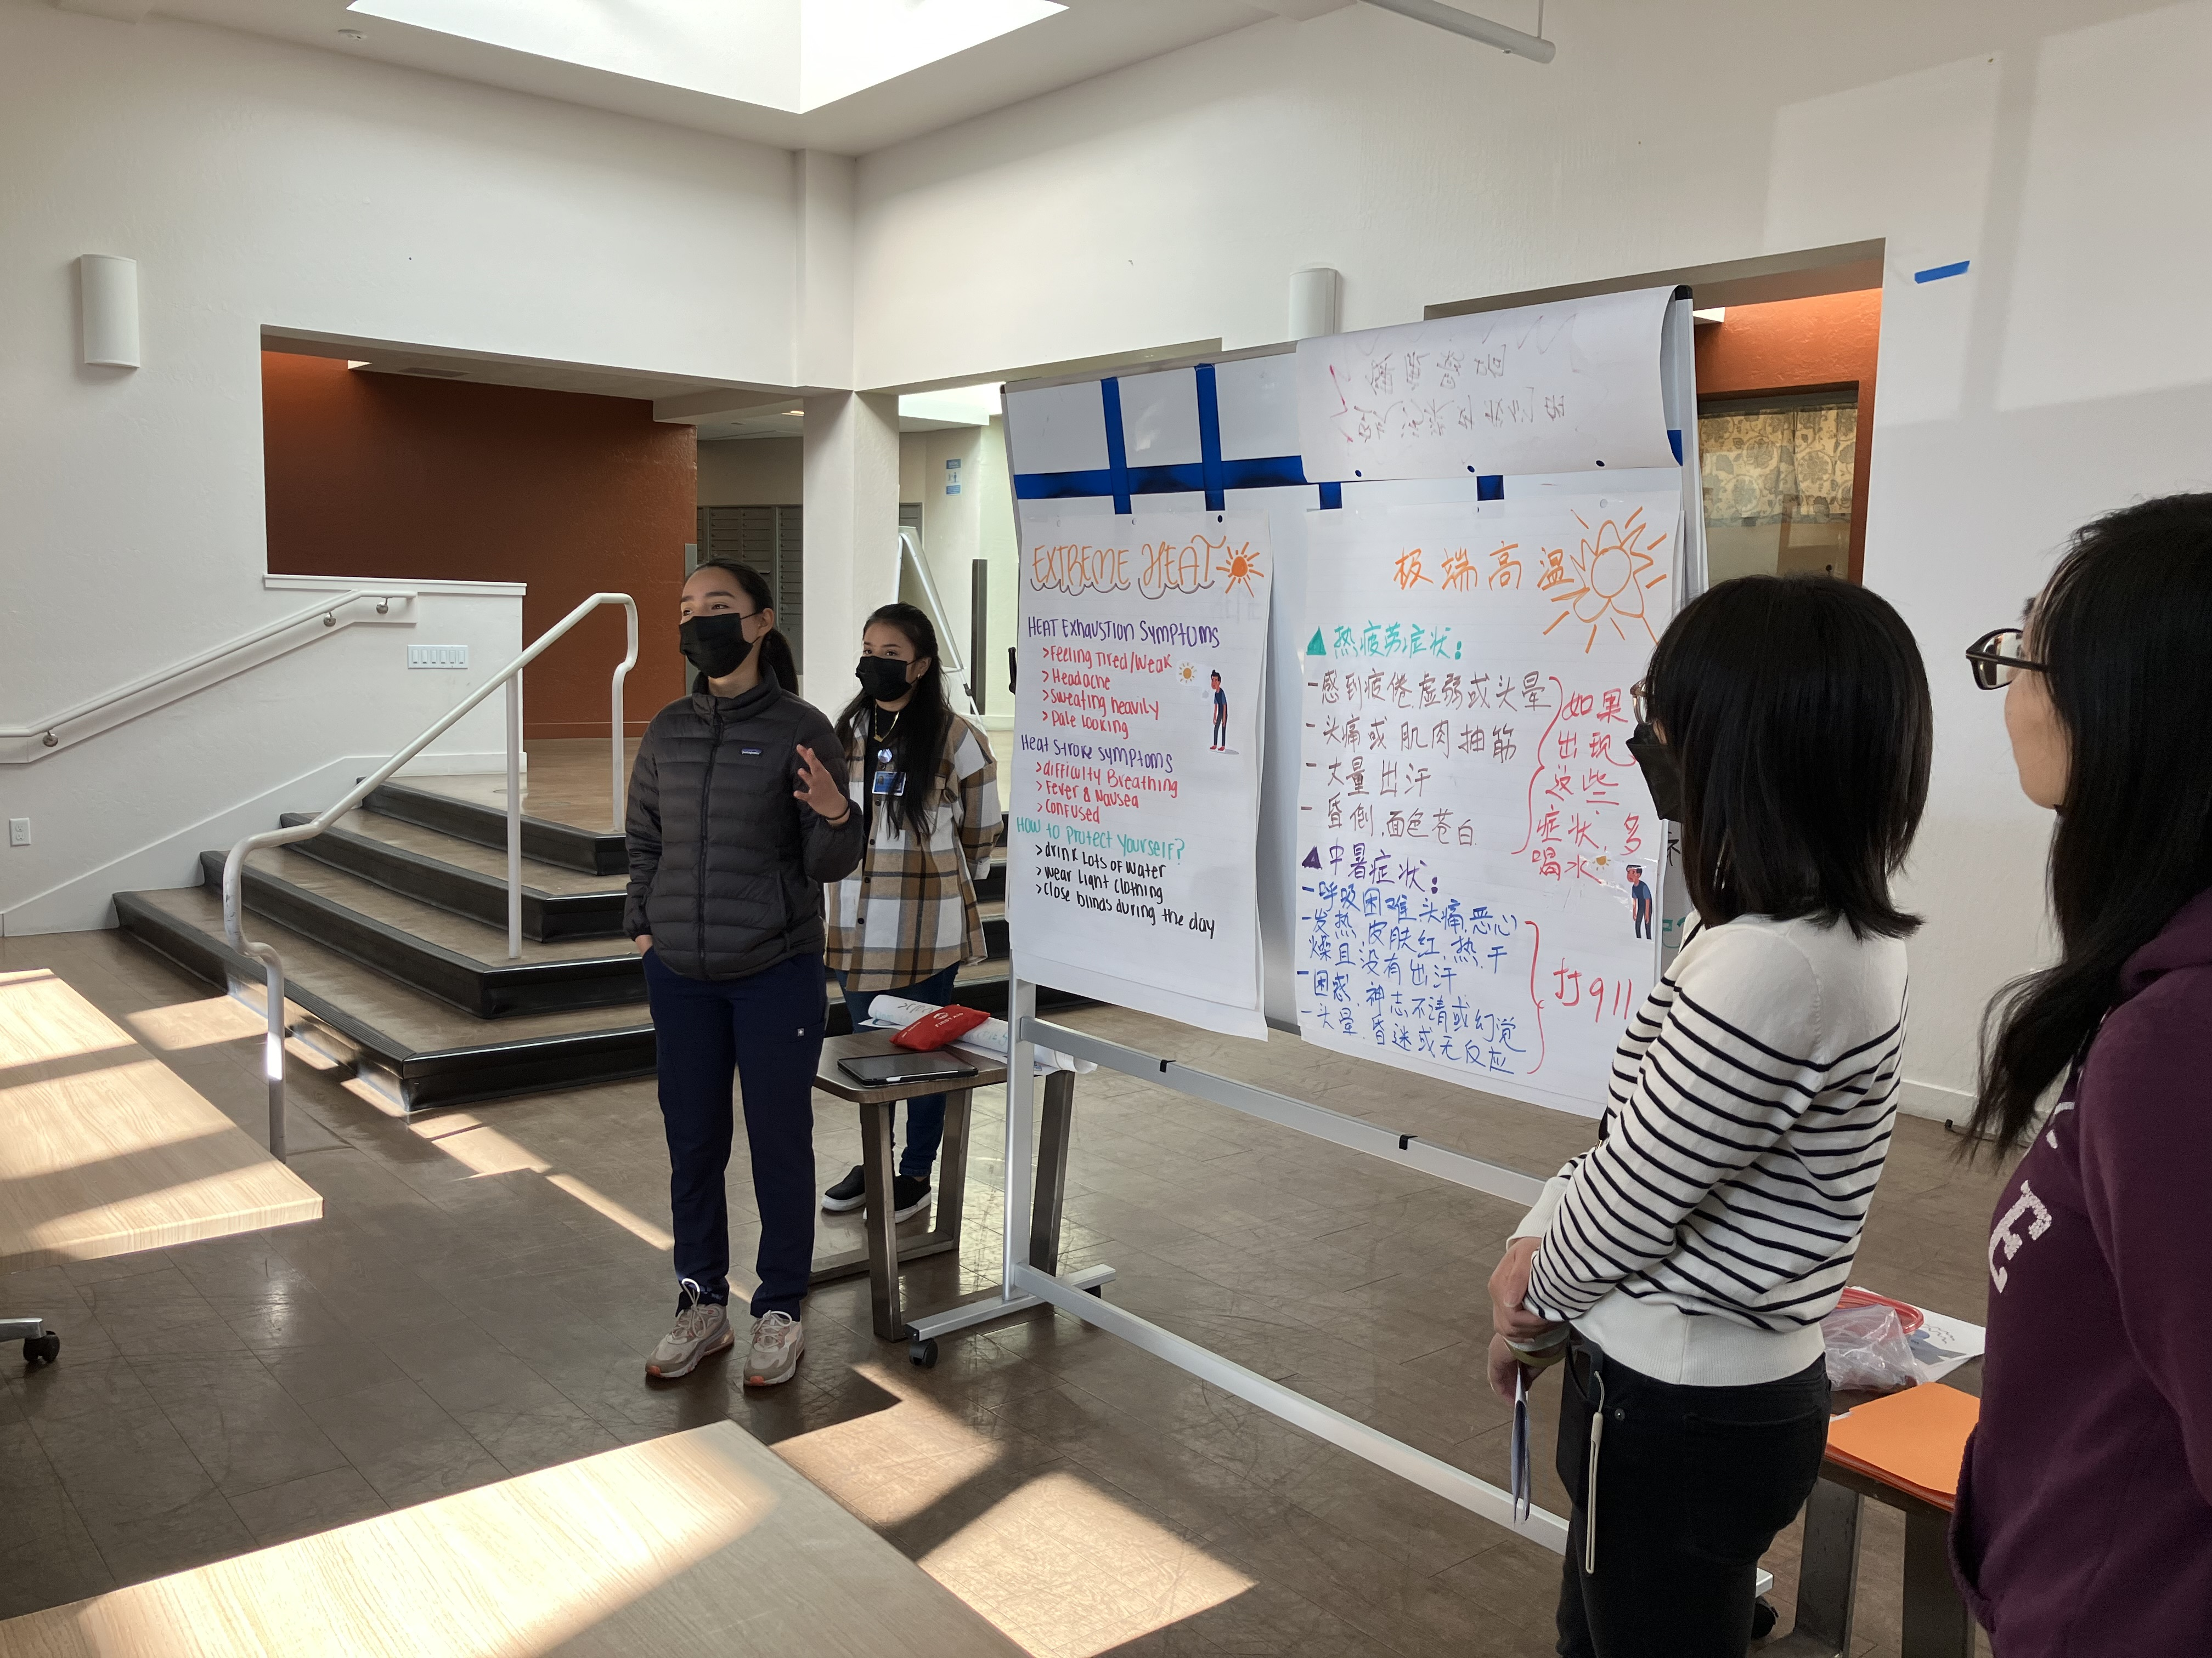
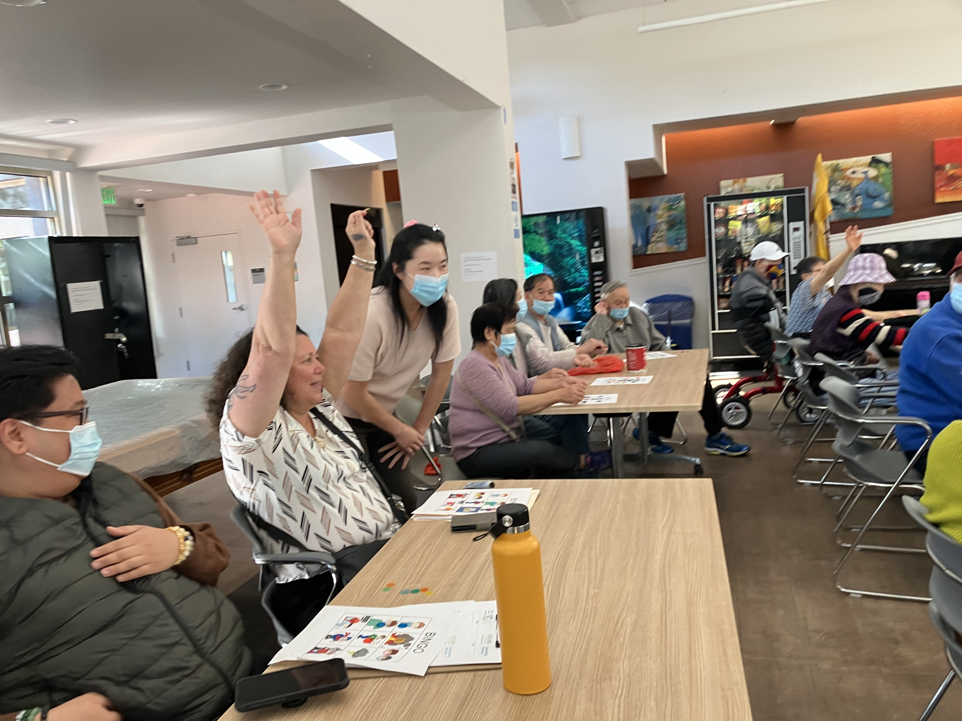
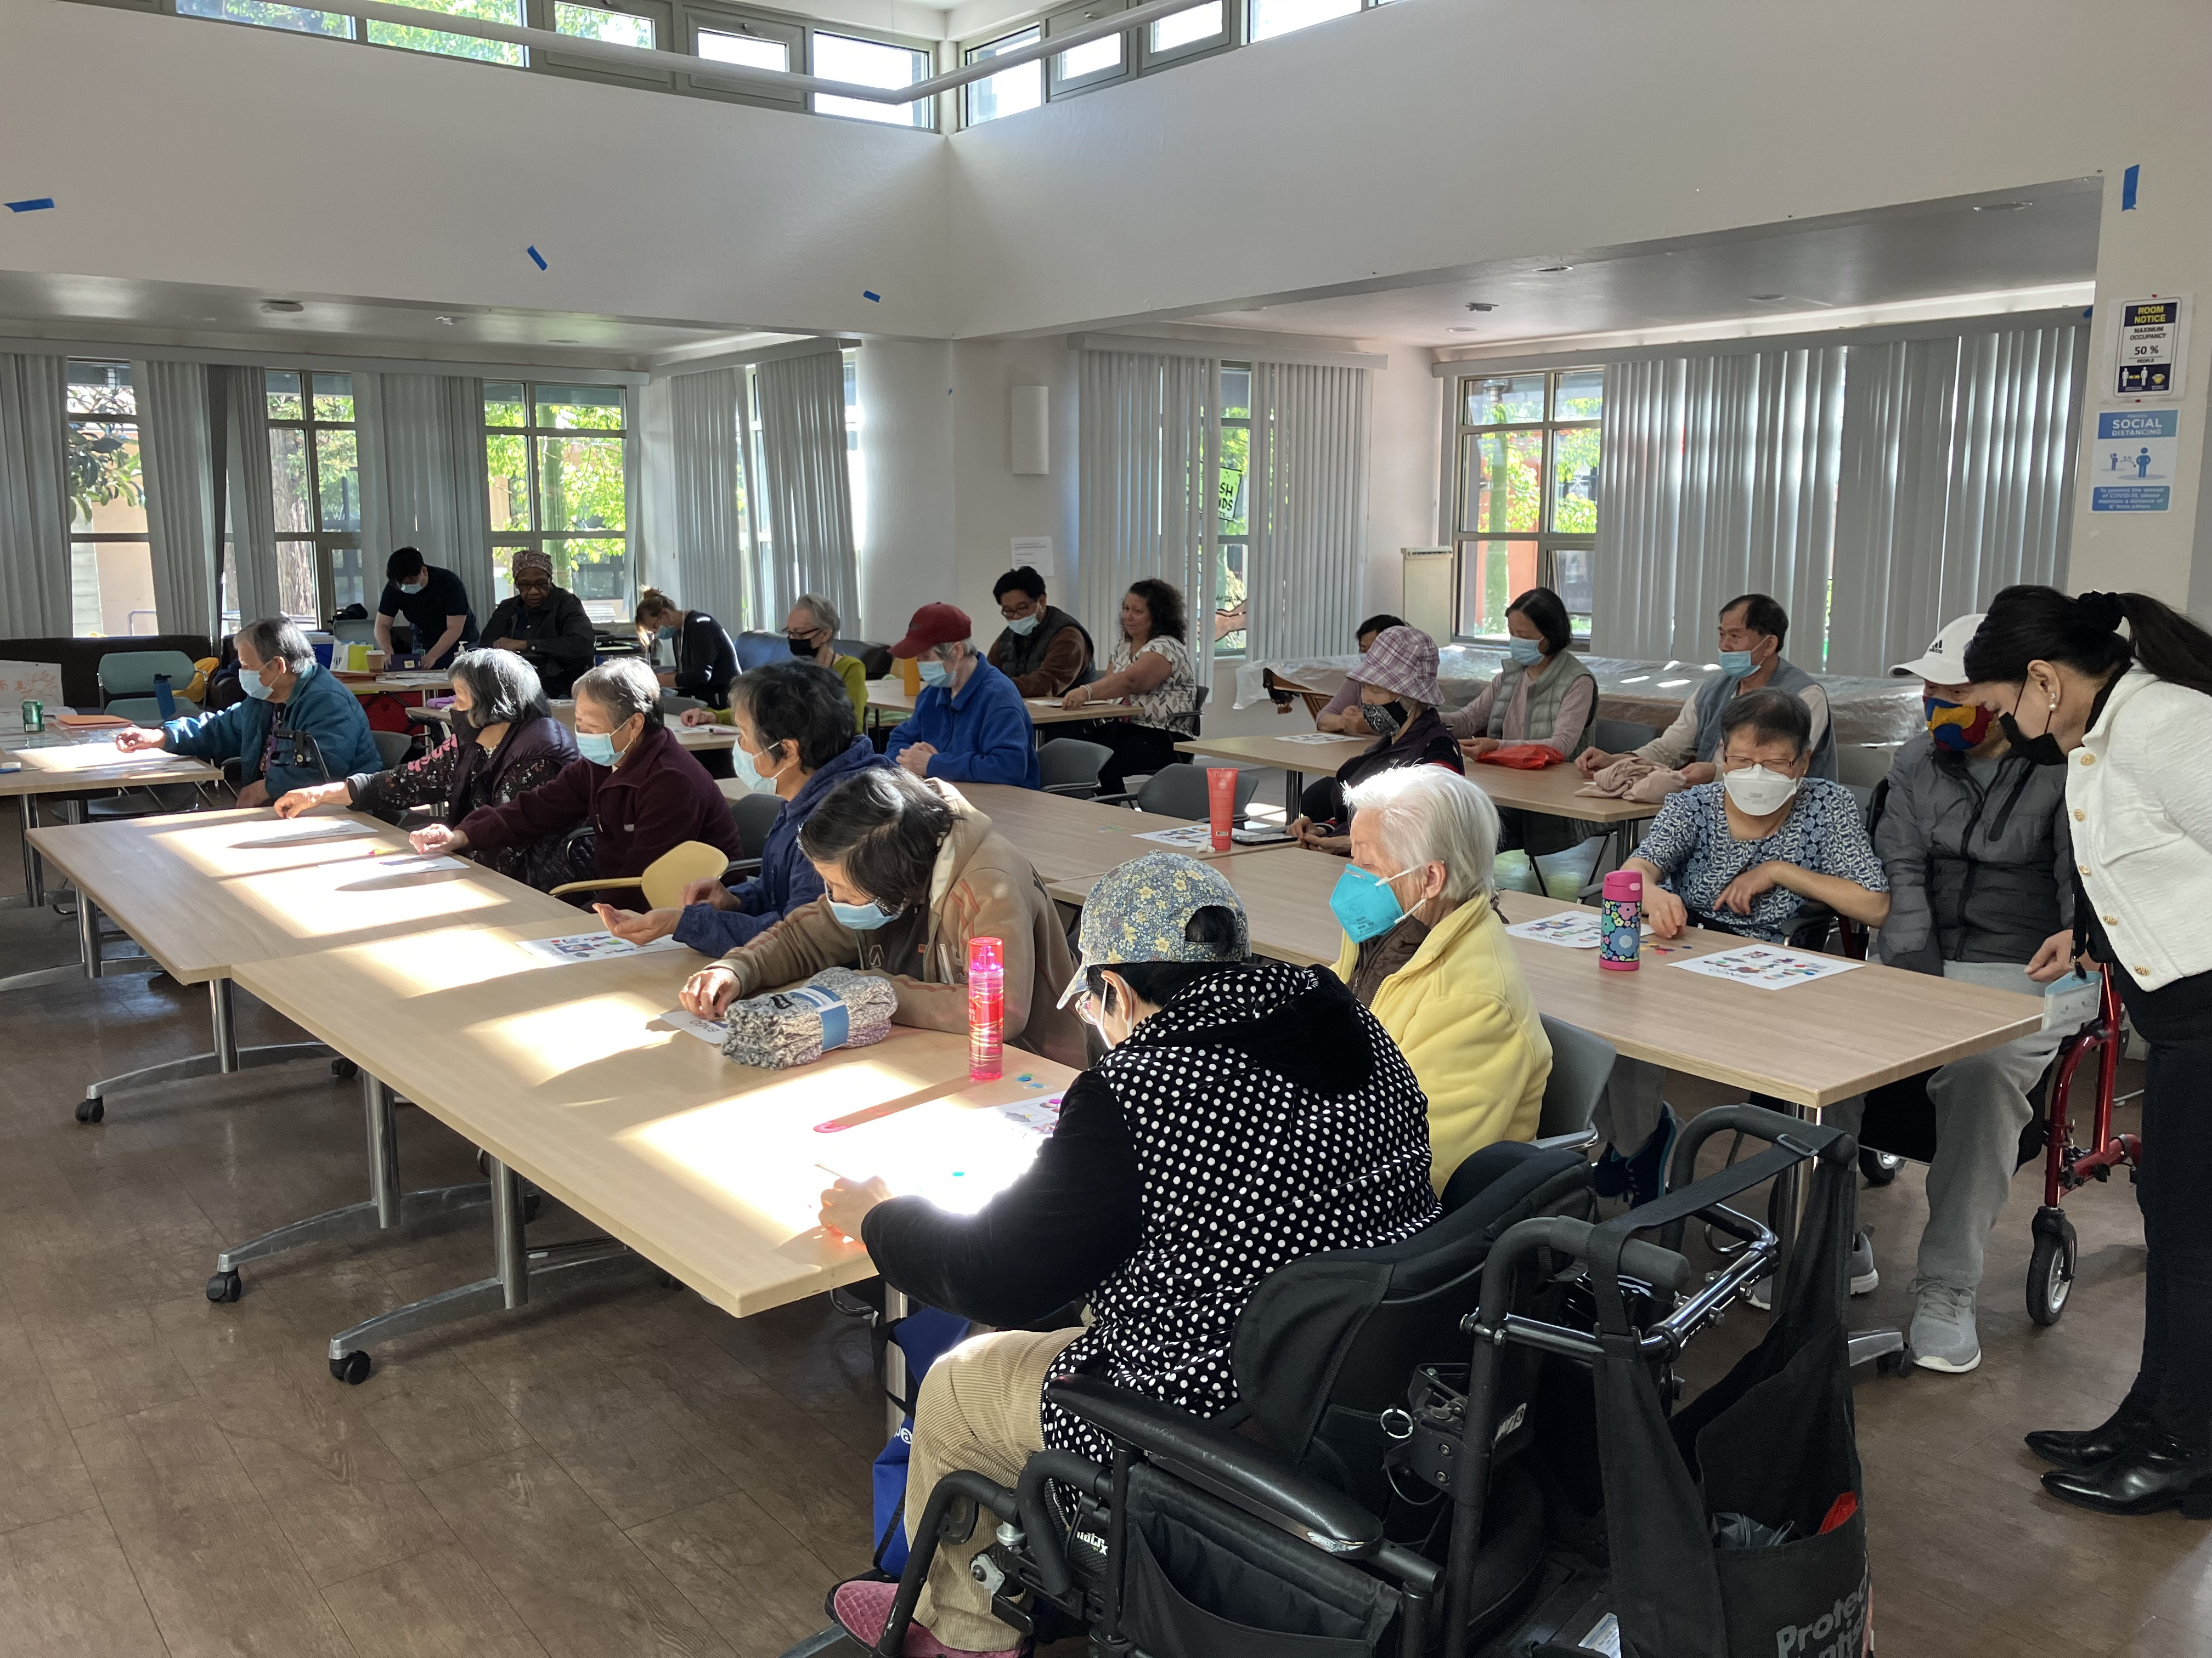
Additional DPER Activities
In addition to carrying out wellness outreach calls DAS done the following activities relating to DPER:
Shared the wellness outreach process with community-based organization (CBOs)
Participated in tabling events to educate and encourage community members to be prepared, stay informed, and stay connected.
Partnered with San Francisco State University (SFSU) School of Nursing to give health presentations to older adults and people with disabilities on the health impacts of extreme weather conditions.

Slide 15
Thank you!
Ria Mercado
Director of Clinical and Quality Improvement
Phone: 415-283-6183
Email: Ria.Mercado@sfgov.org
Minyi Xian
Senior Clerk
Phone: 415-407-5579
Email: Minyi.Xian@sfgov.org
Simon Tan
Senior Clerk
Phone: 415-407-5764
Email: Simon.Tan@sfgov.org

Slide 16
Neal Hatten Deputy Director Bayview Senior Services
Notes:
So onto updates

Slide 17
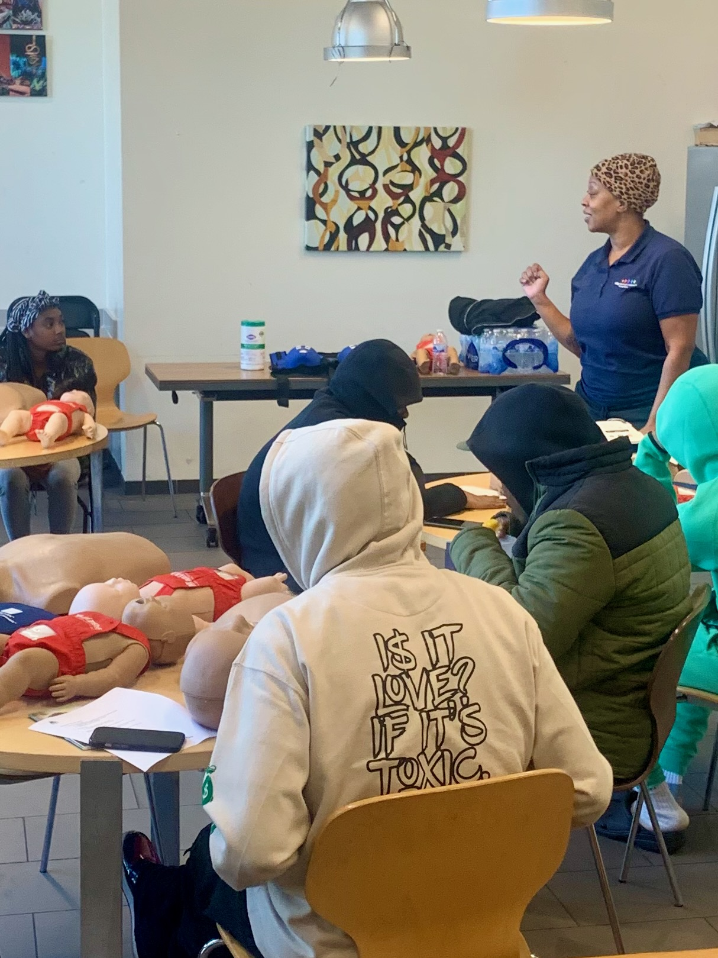
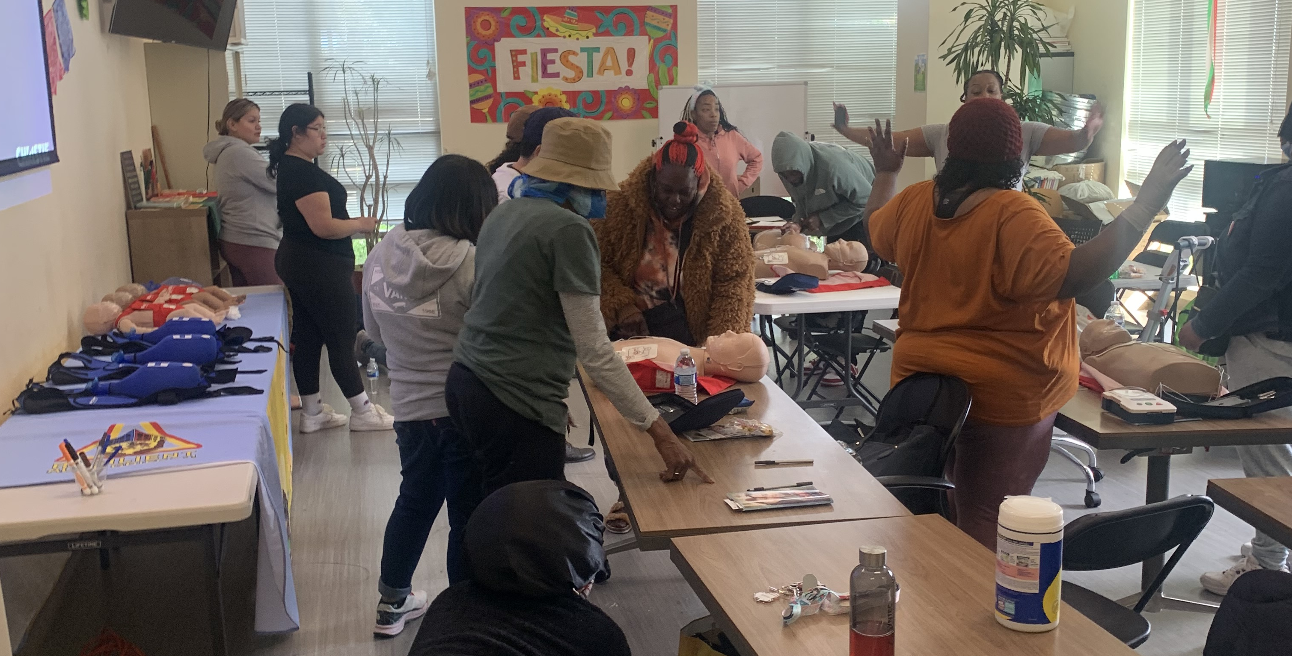
Bayview Senior Services | Resilient Alice Griffith
Resilient Alice Griffith
First Aid Training
Resilient Alice Griffith Youth First Aid Training

Slide 18
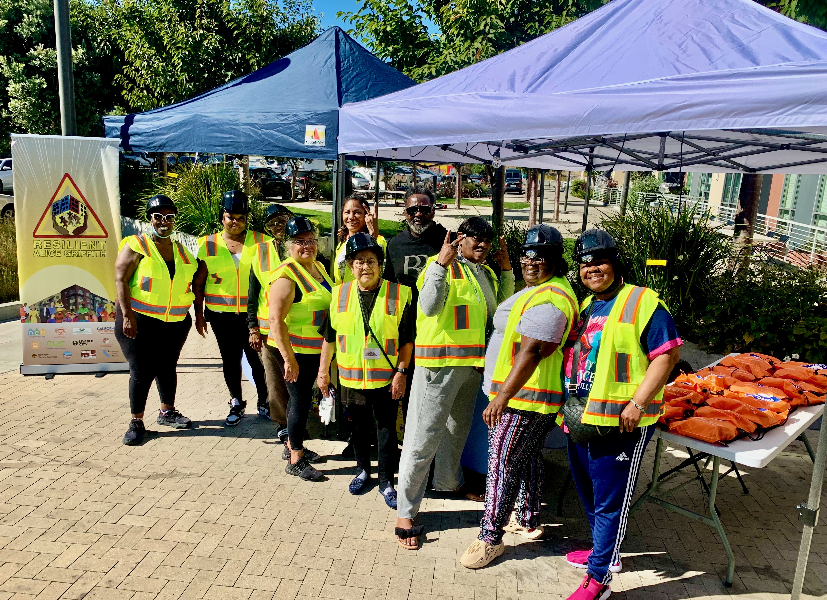
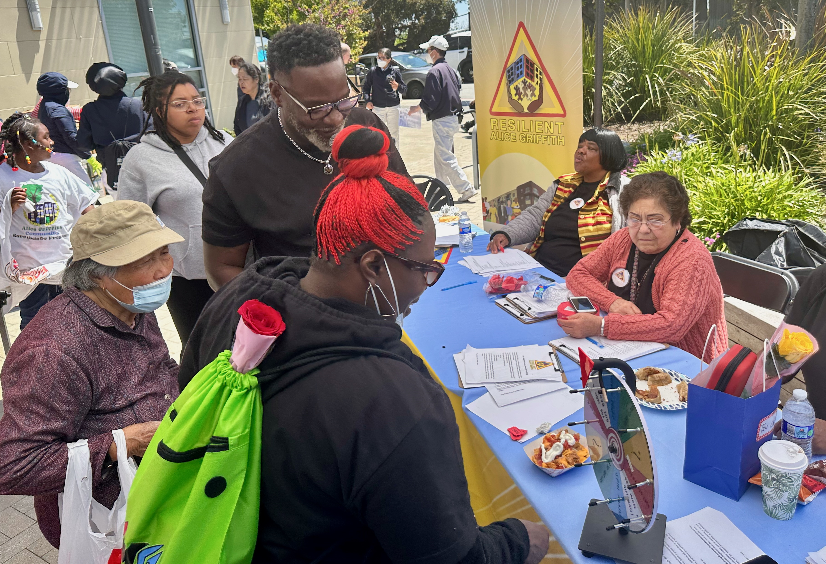
Bayview Senior Services | Resilient Alice Griffith
Neighborfest Kickoff Event
Resilient Alice Griffith

Slide 19
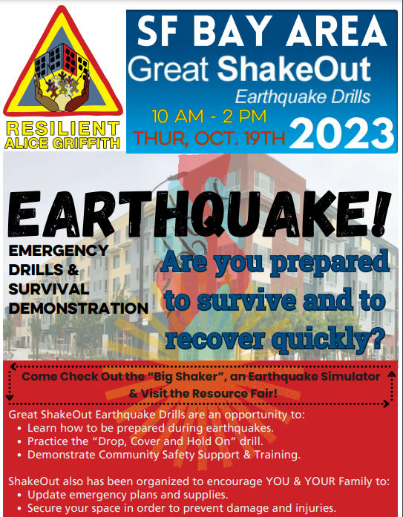
Bayview Senior Services | Resilient Alice Griffith

Slide 20
ICARP Extreme Heat and Community Resilience Program September HAQR Meeting

Slide 21
Background
Notes:
Allie

Slide 22
Integrated Climate Adaptation and Resiliency Program (ICARP)
Background
Technical Advisory Council
Grant Programs
ICARP
Climate Assessment, Science, and Research
Climate Services
Notes:
The Integrated Climate Adaptation and Resiliency Program
The Integrated Climate Adaptation and Resiliency Program (ICARP) coordinates climate change adaptation efforts among state agencies and with external partners. ICARP supports comprehensive adaptation planning implementation by providing decision-support tools, actionable climate science, guidance, technical assistance, and grant programs. Several teams within ICARP support this mission:
Policy and programmatic alignment (TAC Team): The TAC provides the state’s only public forum for consideration and discussion of California’s resilience policy with state agencies; local, regional, and tribal governments; nonprofits and boundary organizations; academia; and the private sector.
Actionable Climate Science (5th Assessment Team): ICARP leads the development of California’s Climate Assessment, which is similar to the national climate change assessment but focuses on the state scale
Climate Services (Climate Services Team): ICARP provides guidance, tools, and technical assistance, including the Adaptation Clearinghouse, a central resource for curated case studies, reports, tools and data, and best practices.
Direct Investments: Through the 2021 Climate Budget ICARP is developing three new grant programs to fund local, regional, and tribal adaptation efforts across the state

Slide 23
ICARP Grant Programs
Regional Resilience Grant Program (RRGP)
Adaptation Planning Grant Program (APGP)
Extreme Heat & Community Resilience Grant Program (EHCRP)
Background
Notes:
Allie
Adaptation Planning Grants Program provides support to local, regional, and tribal governments to support adaptation planning efforts.
Regional Resilience Planning and Implementation Grants Program supports regions in advancing resilience through capacity-building, planning, and project implementation.
Community Resilience and Heat Grant Program will help communities prepare for the impacts of extreme heat.

Slide 24
Extreme Heat and Community Resilience Program
Notes:
Allie

Slide 25
Extreme Heat and Community Resilience Program
EHCRP Background and Overview
Grant
Planning
Policy Based Projects
Notes:
The primary function of the extreme heat and community resilience program is to develop and administrate a grant program to help California communities prepare for the impacts of extreme heat.
We also work on long range planning as well as assist with policy based projects.

Slide 26
Action Plan
Planning
Extreme Heat and Community Resilience Program: Planning

Slide 27
Action Plan
Planning
Build Public Awareness and Notification
Ex. Heat awareness and education strategies, emergency alerts and early warning, and data accessibility and heat modeling
Strengthen Community Services and Response
Ex. Cooling centers and resilience hubs, community infrastructure, and support for local and regional extreme heat response plans
Increase Resilience of Our Built Environment
Ex. Infrastructure, building retrofit, cool roof and pavement technologies, and air conditioning
Utilize Nature-based Solutions
Ex. Community greening and gardens, urban forestry, and greenbelts
Notes:
Track A: Public Awareness and Notification
Public Awareness and Notification increase understanding of the heat threats and preparation for extreme heat events. Targeted communication campaigns, actionable research, and accurate and accessible heat data/models are essential tools in this preparation.
Track B: Community Services and Response
Community Services and Response increase community capacity, reduce economic risks, and increase protections for vulnerable populations related to extreme heat. This track highlights the need to invest in social resilience by protecting workers and the economy from the effects of extreme heat, as well as supporting local planning and response measures.
Track C: Increase Resilience of our Built Environment
Extreme heat can have cascading impacts on the built environment, negatively affecting people, the economy, and the environment. This track outlines a proactive approach highlighting investments in cool buildings and surfaces, using science-based frameworks and tools, and support for heat-resilient communities through relevant regulations and codes.
Track D: Utilize Nature – Based Solutions
Healthy natural systems provide essential services and benefits to the economy and community, yet they are compromised by extreme heat events. Nature-based solutions include green roofs, urban forests, and wetlands, which can provide natural shade, cool the air, and absorb and retain water, thus reducing heat stress.

Slide 28
Policy Based Projects
Extreme Heat and Community Resilience Program: Policy Based Projects
Notes:
The primary function of the extreme heat and community resilience program is to develop and administrate a grant program to help california communities prepare for the impacts of extreme heat.
We also work on long range planning as well as assist with policy based projects.

Slide 29
AB 2238- California’s Extreme Heat Ranking System
Policy Based Projects
Mapping system will rank the severity of California's heat events
Historical Data
Projections and Forcasts
Online and Mobile
Notes:
OEHHA on will develop and maintain the system in consultation with three agencies 1) ICARP, 2) the California Department of Public Health (CDPH), and 3) the Department of Insurance (CDI). Once it is created ICARP will be tasked with disseminating this information
System being developed by California Environmental Protection Agency’s Office of Environmental Health Hazard Assessment (OEHHA)
This statewide mapping system will rank the severity of California’s heat events.
Based on historical climate and morbidity and mortality data, develop thresholds of severity of heat impacts on a community level basis
Forecast for heat ranks/impacts with emerging extreme heat events
Be available online and as a mobile application
OEHHA will engage stakeholders on data inputs and usability of the system

Slide 30
Grant Program
Extreme Heat and Community Resilience Program: Grant Program
Notes:
The primary function of the extreme heat and community resilience program is to develop and administrate a grant program to help california communities prepare for the impacts of extreme heat.
We also work on long range planning as well as assist with policy based projects.

Slide 31
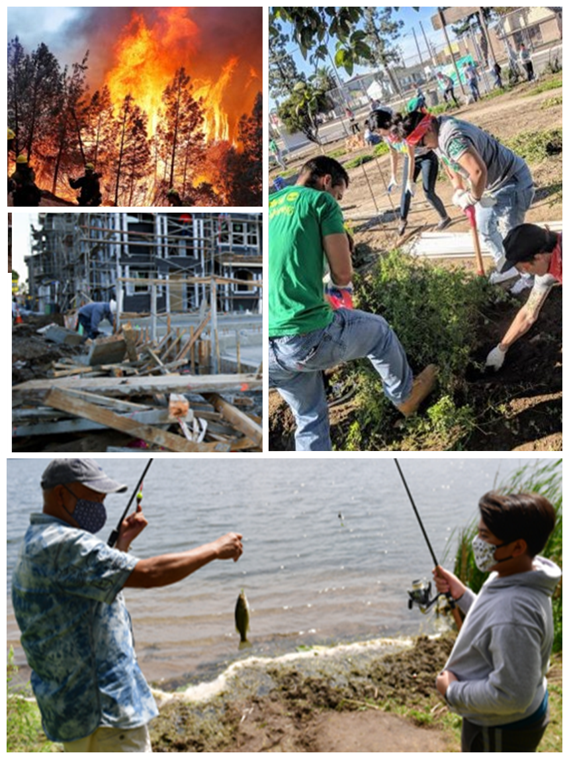
Program Vision
Grant Program
This program will offer planning and implementation grants for heat relief and long-term resilience to extreme heat.
Supporting a statewide movement to build resilience to extreme heat through:
placemaking & place-keeping
immediate response & long-term resilience
job creation
protecting the health of Californians who are most vulnerable to extreme heat
Notes:
Allie

Slide 32
Eligible Applicants
Grant Program
Local Public Entities
California Native American tribes
Community-Based Organizations (CBOs)
Public Academic Institutions
Coalitions of Non-profits
Notes:
The grant program is open to Local Public entities, California Native American Tribes, Community Based Organizations, and Public Academic Institutions. State agencies are not eligible applicants.

Slide 33
Overview
Grant Program
Small Planning Grants
$100,000-$250,000
$3 Million Total
Small Implementation Grants
$100,000-$450,000
$3 Million Total
Large Planning Grants
$300,000-$750,000
$5 Million Total
Large Implementation Grants
$500,000-$4 Million
$9 Million Total
Notes:
We plan to offer four distinct grant types
Small Planning Grants, which range from one hundred thousand dollars to two hundred and fifty thousand dollars
Large Planning Grants, which range from three hundred thousand dollars to seven hundred fifty thousand dollars
Small Implementation Grants, will range from one hundred thousand dollars to four hundred and fifty thousand
And finally, Large Implementation Grants will range from half a million to five million
Each grant type has unique partnership requirements, and can fund different activities. I am going to walk through each one quickly

Slide 34
Small Planning Grants
Planning Grants
Grant Program
Small Planning Grants
Large Planning Grants
Capacity Development
Comprehensive Local Heat Action Plans
Pre-Planning Activities
Amend/integrate, align/prepare existing planning documents
Small Scale Planning
& Project Development
Conducting Studies
Notes:
The small planning grants are available to communities that want to develop partnerships to advance response efforts to extreme heat and/or to build long-term resilience to extreme heat
Applicants of small planning grants do not need a co-applicant.
These grants can fund capacity development, preplanning activities, and small scale planning and project development.
Capacity Development could include workforce development and staff training.
Pre Planning Activities could include forming partnerships or vulnerability assessments.
Small scale planning could include making an extreme heat resiliency plan for a single location.
Large planning grants are meant to build community-wide programs and/or infrastructure that can transform how communities address extreme heat
Applicants of large planning grants should apply with a co-applicants, or –if this is not possible- submit a justification to explain how they will engage with communities.
Large planning grant activities could include-
Comprehensive heat action plans
Amending, updating, or integrating extreme heat considerations into existing documents
Conducting studies,

Slide 35
Implementation Grants
Small Planning Grants
Grant Program
Small Implementation Grants
Smaller scale projects
Large Implementation Grants
Larger scale projects
Notes:
Both types of infrastructure grants can fund the same kinds of projects, but they vary in scale.
Small implementation grants fund single site or technology projects, and applicants are not required to apply with a co-applicant.
Conversely, large implementation grants fund projects that combine multiple infrastructure solutions or locations. Applicants should apply with a co-applicants, or –if this is not possible- submit a justification to explain how they will engage with communities.

Slide 36
Implementation Grants
Small Planning Grants
Grant Program
Track A: Build Public Awareness and Notification
Neighborhood resilience events
Educational programming
Assistance applying for and receiving community services
“Cool Buddy” programs
Placemaking projects and informational signage
Art and culture projects for awareness
Youth empowerment and leadership
Public awareness campaigns
Track B: Strengthen Community Services and Response
Mutual Aid
Basic first aid training
Heat survival packs
Home energy saving toolkits
Community Resilience Center Activities
Transportation to/from community resources during heat events
Environmental monitoring systems
Apprenticeships
Notes:
Activities for infrastructure grants are split into four tracks, which were established by the Statewide Extreme Heat Action Plan.
Track A covers Public awareness this could include youth empowerment and leadership programs, or environmental programs
Track B focuses on community services and response this could include first aid training, environmental monitoring systems, or transportation during extreme heat events.

Slide 37
Implementation Grants
Small Planning Grants
Grant Program
Track C: Increase Resilience of our Built Environment
Cool and smart surfaces
Shade structures
Water fountains
Splash pads
Transit shelters (shade and cooling enhanced)
Active and passive cooling infrastructure in key community buildings and resilience hubs
Cool home pilot projects
Track D: Utilize Nature-based Solutions
Tree planting
Residential tree program
Tiny forests
Cool community gardens
Green stormwater infrastructure pilots
Nature-based playgrounds or shaded playgrounds
Cool ecosystems work
Maintenance for nature-based solutions
Notes:
Track C relates to built environment infrastructure projects. This includes cool surfaces, water fountains, splash pads, and shade structures.
Finally, Track D covers nature based solutions, this could cover tree planting and community gardens.
Now I will pass it back to braden to lead us through a discussion of the grant program and extreme heat.

Slide 38
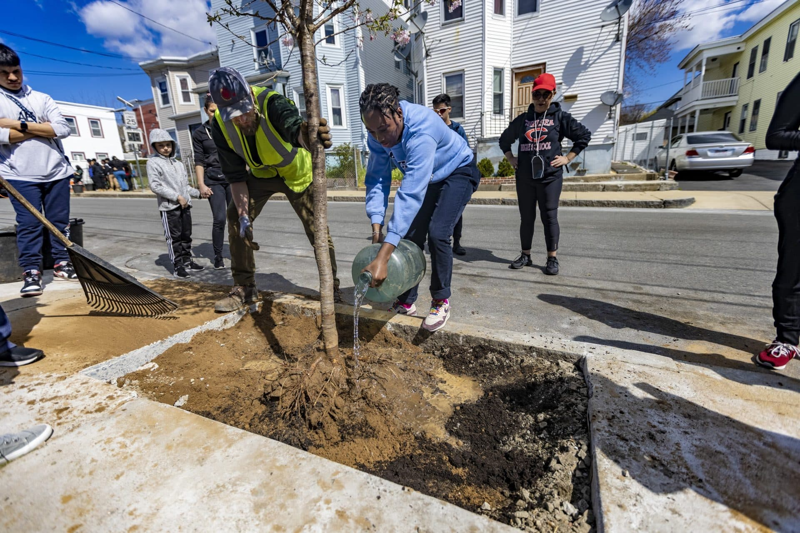
Example: Chelsea Cool Blocks
Small Planning Grants
Grant Program
Notes:
This project focuses on making the city of Chelsea, in the Boston area more resilience to extreme heat.
The project is a collaboration between a non profit called green roots, the City of Boston, and Boston University
It focuses on making one block at a time more cool through combined solutions across all the tracks
In this example, the block they chose contains multi family housing, and community assets including a Boys and Girls club.
Let’s walk through this example combines multiple of our tracks.
Track A: The project team hosted multiple community engagement and volunteer events to bring the community together and educate them on the impacts of extreme heat. The non-profit also facilitates a youth EJ group- Environmental Chelsea Organizers (ECO)- which comprises a team of 6 teens that work on and inform projects that are important to them in the community,
Track B: Sustainable Workforce Development, program is seeking funding so low income residents will be paid to water the trees. While it's not listed online, these residents could also be paid to provide community services during Extreme Heat Events or hosting heat-safe activities at the Boys and Girls Club on the block
Track C: The team is adding porus pavement throughout the block to reduce the reflectance of extreme heat. They also plan to add reflective roofing to the boys and girls club. Nearby, a white roof on a city elementary school lowered the surface temperature by 20 degrees and the surrounding air temperature dropped by seven to 10 degrees in the summertime.
Track C: The team is working hard to add shade trees in the block. As of May 2022, they had added 47 new elm, crabapple, cherry and hawthorn trees.

Slide 39
Other Statewide Efforts
Notes:
Allie

Slide 40
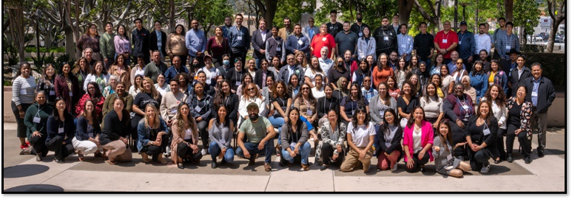
142 Community-Based Organizations
Strengthen partnerships between state governments and communities
Reflect the languages and ethnicities of their communities
Peer-to-peer outreach services to reach those who are most vulnerable
The OCPSC Trusted Messenger Network
Notes:
OCPSC focuses on building partnerships and capacity with community based organizations in the places that are the most socially and health vulnerable
Trusted Messenger network is a statewide network of community based organizations. OCPSC supports them in a variety of initiatives, including heat resilience, and strengthens relationships between state government and local communities
The CBOs represent their communities, and reach people that speak over 50 languages across the state!

Slide 41
Heat Ready CA
Heat Ready CA
Heat Ready CA is OCPSC's campaign that works to keep Californians safer during extreme heat by sharing important resources with communities
Heat Ready CA WEBSITE
TOOLKIT
VIDEOS
Notes:
Heat Ready CA is OCPSC's campaign that works to keep Californians safer during extreme heat by sharing important resources with communities
The online platform has information and resources that are tailored to vulnerable groups. You can use this resource today to share with your communities!

Slide 42
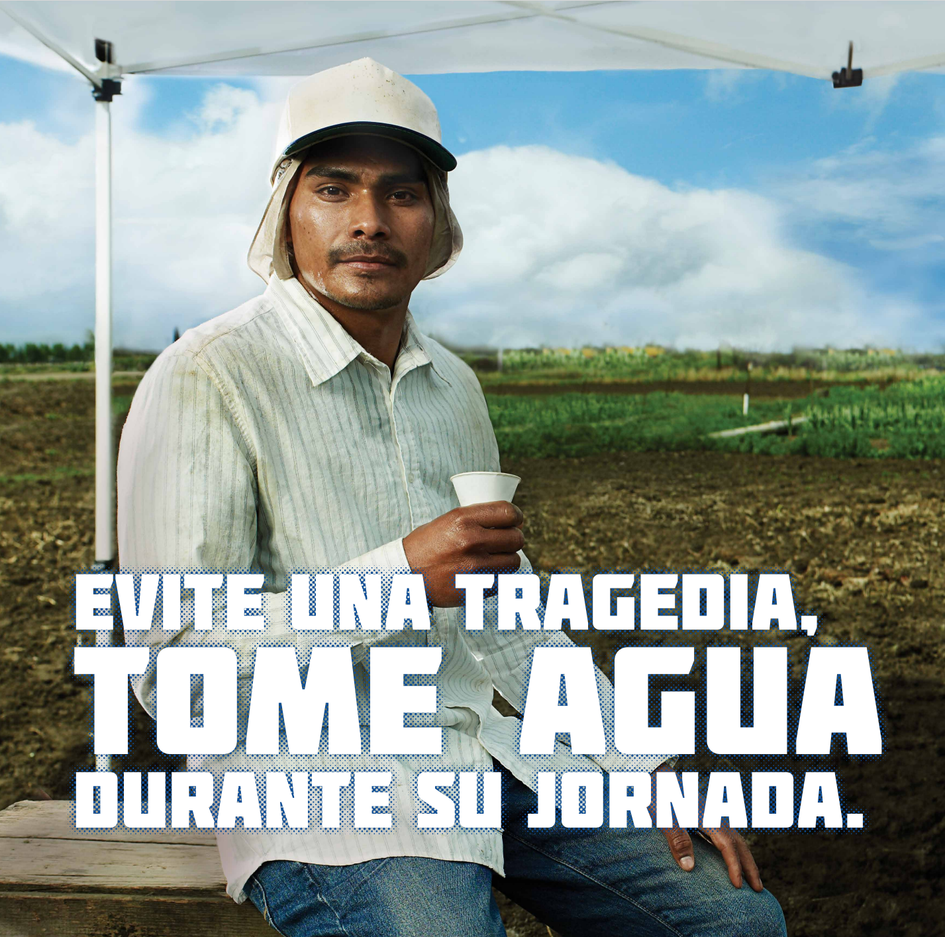
CalOSHA- 99 Calor & Heat Standards
Grant Program
Notes:
Another effort I want to make you aware of comes out of CALOSHA, who recently passed the indoor heat standard.
The indoor heat standard, along with the existing outdoor heat standard, provides protections to workers in a hot environment. It mandates employers provide things like shade, water, and rest.
Along with the indoor and outdoor heat standards, the CalOSHA 99Calor campaign provides communications resources like posters, videos, and educational materials to keep outdoor workers safe in the heat. These resources are available in multiple languages and are available online for you to distribute to your communities.

Slide 43
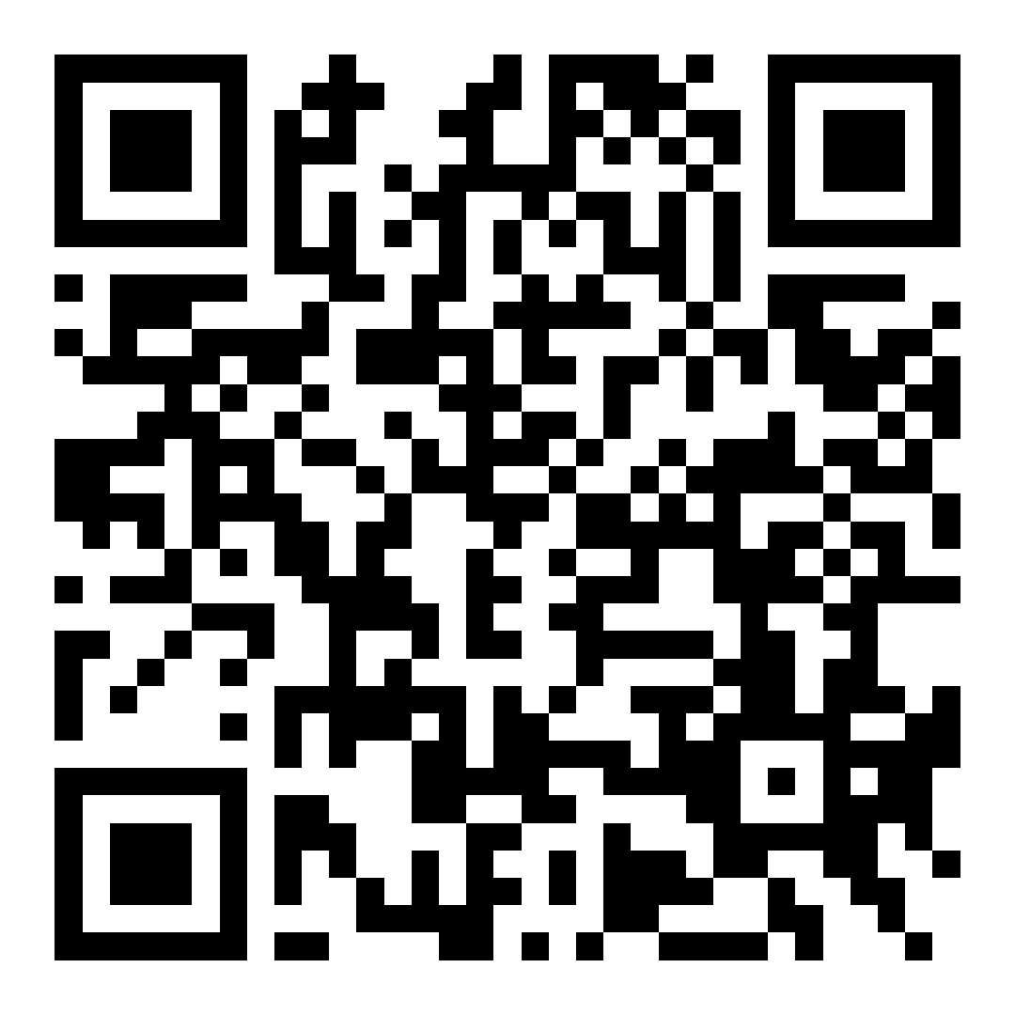
EHCRP Contact Information
Braden Kay
Manager- Extreme Heat and Community Resilience Program
Braden.Kay@opr.ca.gov
Allie Larman
Assistant Planner- Extreme Heat and Community Resilience Program
Allie.Larman@opr.ca.gov
Listserv Sign Up
Notes:
Braden

Slide 44
Resource Overview
Notes:
So onto updates

Slide 45
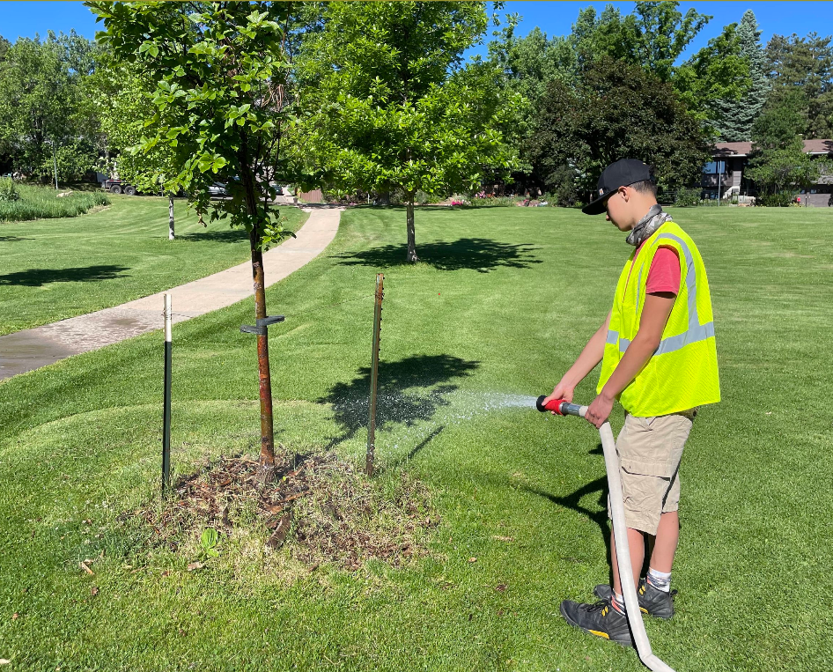
Accelerating Ruban Froestry Funding Opportunities
Center for Regenerative Solutions and Urban Sustainability Director's Network accepting applications for Community Forest Corps and Urban Forestry Equity Fellowship Program
Uses: Community-based tree care and protection and workforce development through urban forestry provision.
Deadline: September 13th​
Available Funding: $300,000-$600,000 (3-Year Period)​
Eligibility: CBO's/Municipalities eligible.
Main site
Community Forest Corps Overview
Urban Forestry Fellowship Program Overview
Sample Budgets
Application Link
Notes:
Sharing this grant offering from the center for regenerative solutions and the urban sustainability director's network. IT can be used for community based tree care and protection programs as well as workforce development through urban foresty provision
Really tight turn around given the date but thought it would be good to include. Funds anywehre from 300,000 to 600,000 in work over 3 years and can be applied for by CBO's as well as municipalities,
Links on the right go to the main site, an overview for every program, sample budgets and the link to the application

Slide 46
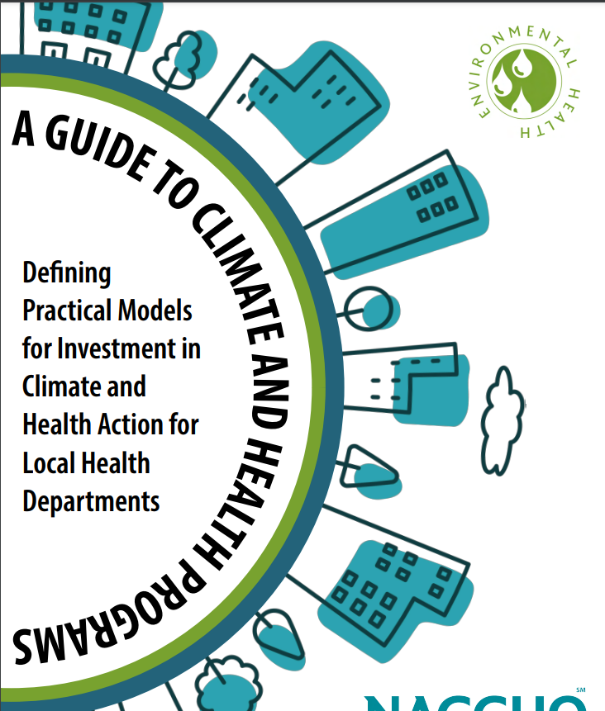
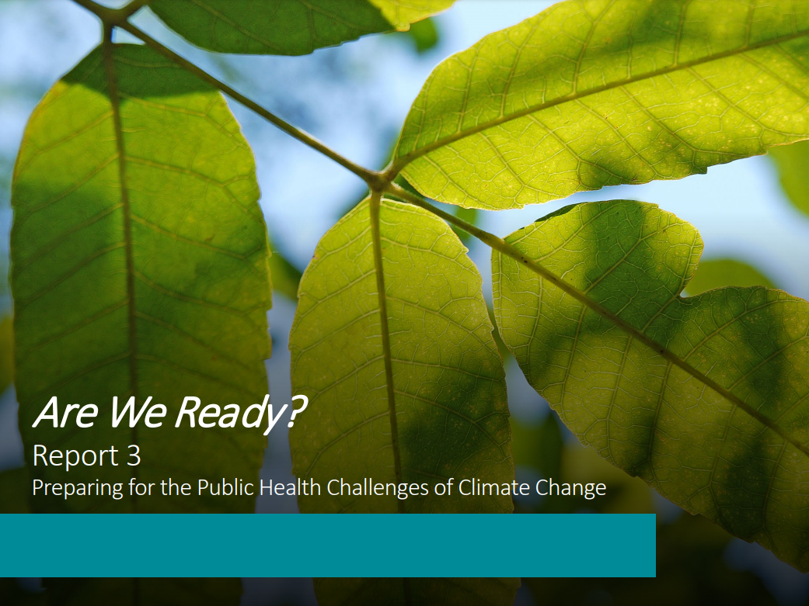
NACCHO Products
https://www.naccho.org/uploads/downloadable-resources/Are-We-Ready-2024-7-18-Final.pdf
https://www.naccho.org/uploads/downloadable-resources/Climate-and-Health-Program-Guide.pdf

Slide 47
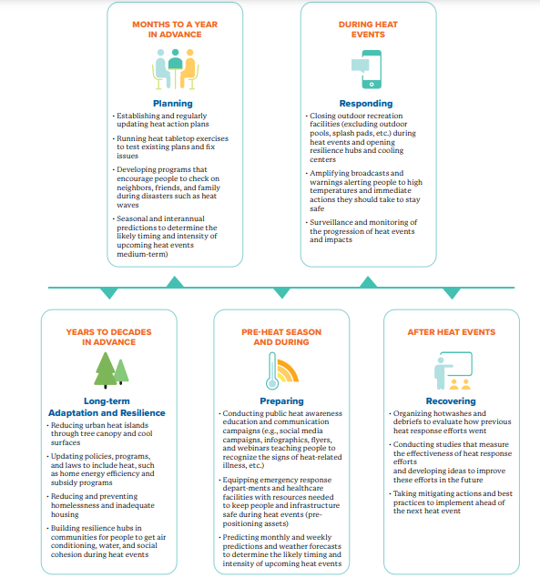
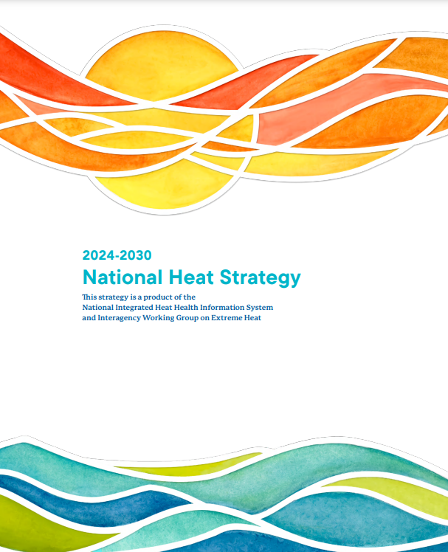
National Integrated Heat Health Information System (NIHHIS) National Heat Strategy
This first National Heat Strategy is framed within a broader national context to
Align and strengthen Federal capacity, capabilities, and resources to ensure the nation is resilient to heat, and
Foster engagement, collaboration, support, and joint activities among and with state, local, Tribal, and Territorial governments, and other non-Federal partners to build a heat-resilient nation and promote heat resilience globally
https://cpo.noaa.gov/wp-content/uploads/2024/07/National_Heat_Strategy-2024-2030.pdf
Notes:
Communications
Science
Solutions
Support

Slide 48
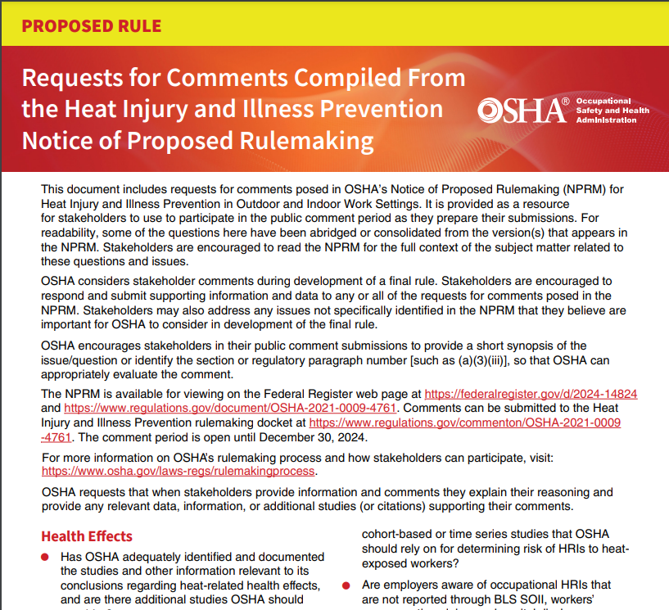
OSHA Heat Injury and Illness Prevention Rulemaking Public Comment
OSHA’s Heat Injury and Illness Prevention in Outdoor and Indoor Work Settings Rulemaking is now open for public comment. The public comment period is open for 120 days, until December 30th.
Here is the link to the federal register notice: https://www.federalregister.gov/documents/2024/08/30/2024-14824/heat-injury-and-illness-prevention-in-outdoor-and-indoor-work-settings .
Here is a link to a document that compiles all requests for comments: https://www.osha.gov/sites/default/files/Heat-NPRM-Compilation-of-Requests-for-Comment.pdf .
Here is the link to the docket where comments can be submitted: https://www.regulations.gov/commenton/OSHA-2021-0009-4761

Slide 49
Thanks!
Notes:
So onto updates

