Slide 1
San Francisco Heat and Air Quality Resilience Project (HAQR)
Coordination Committee #8 | 9/18/2023
Matt Wolff, SFDPH, Matt.Wolff@sfdph.org Alex Morrison, ORCP, Alex.Morrison@sfgov.org.org
Notes:
Hello everyone, we're going to wait a little bit to get started as people trickle in. If you want, please feel free to drop your name and title in the chat so people can get an idea of who's in the room.
My name is Alex Morrison and I'm a Resilience GIS Analyst with the Office of Resilience and Capital Planning and Co-project manager for HAQR along with Matt Wolff who also manages the SFDPH Climate and Health Program.
It's been quite a while since we all last met, two months shy of a year if you'll believe that but we'd like to welcome you to our 7th coordination committee meeting!

Slide 2
Agenda
HAQR Coordination Committee Meeting #8 Date: 09-18-23
The Heat and Air Quality Resilience Project (HAQR) is a cross-sectoral and interdepartmental initiative to support short-term extreme heat and wildfire smoke emergency preparedness and response actions with medium-to-long-term resilience actions. HAQR Plan
Introductions In the chat: Name, Organization/Department, What was a particularly memorable Halloween Costume of yours? | 5 Minutes
Updates and Announcements: National Weather Service HeatRisk Tool Extreme Weather Resilience Program Bayview Climate Summit Department of Public Works Heat Mapping | 15 Minutes
Presentation: HAQR Phase 2, Moving from Planning to Implementation HAQR Implementation Plan Release How would you like to be connected to funding/partnership opportunities? Departmental engagement to September | 20 Minutes
Presentation: PCORI Presentation Survey Results | 15 minutes
Next Steps | 5 Minutes

Slide 3
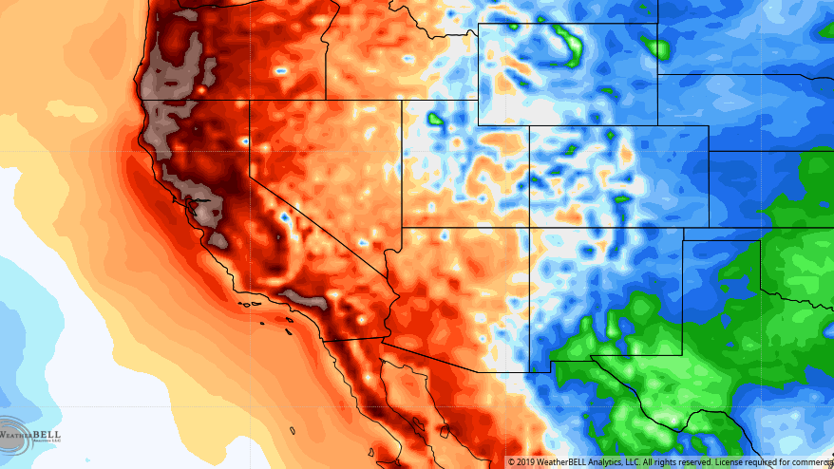
Updates and Announcements
Updates and Announcements: National Weather Service HeatRisk Tool Extreme Weather Resilience Program Bayview Climate Summit Department of Public Works Heat Mapping
Notes:
So onto updates

Slide 4
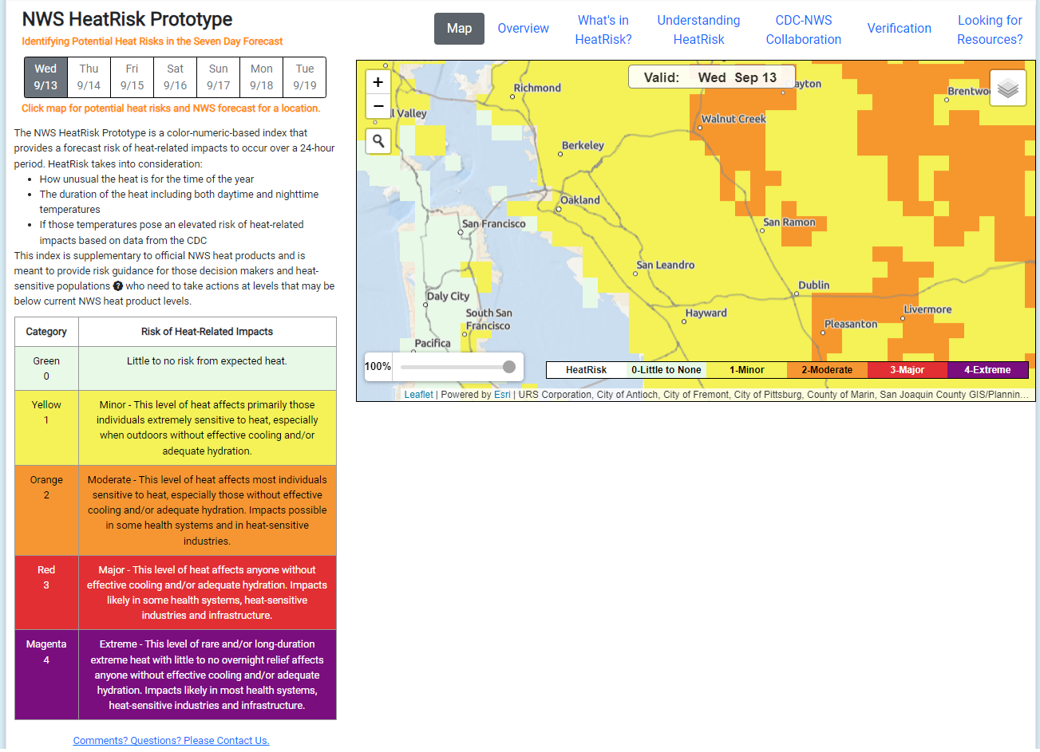
Heat and Air Quality Resilience Project
DPH PHEPR: National Weather Service HeatRisk

Slide 5
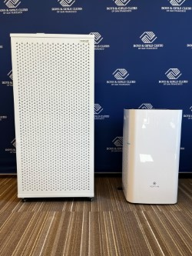
Heat and Air Quality Resilience Project
DEM: Extreme Weather Resilience Program
Over the past several years, wildfires and extreme heat events in California have increased significantly which have caused negative impacts to our most vulnerable communities and populations in San Francisco. SFDEM has gained access to regional and state funding to purchase and deploy air filtration systems and air conditioners to community-serving organizations.
The goal of the Extreme Weather Resilience Program is to provide community serving organizations with streamlined access this equipment that will help protect the health and well-being of their staff, clients, and community served during extreme weather events particularly extreme heat and bad air quality.
This is a 5-year program beginning in Oct that provides all selected organizations with one portable air conditioner unit that can cool up to 450 sqft, one air purifier that can purify up to 2090 sqft, one air purifier that can purify up to 4,500 sqft, and five years of filter replacements for both air purifiers.
We will be partnering with 39 community-based organizations in San Francisco, totaling 90 locations that will receive this equipment in efforts to strengthen their resilience towards mitigating extreme heat and poor air quality.

Slide 6
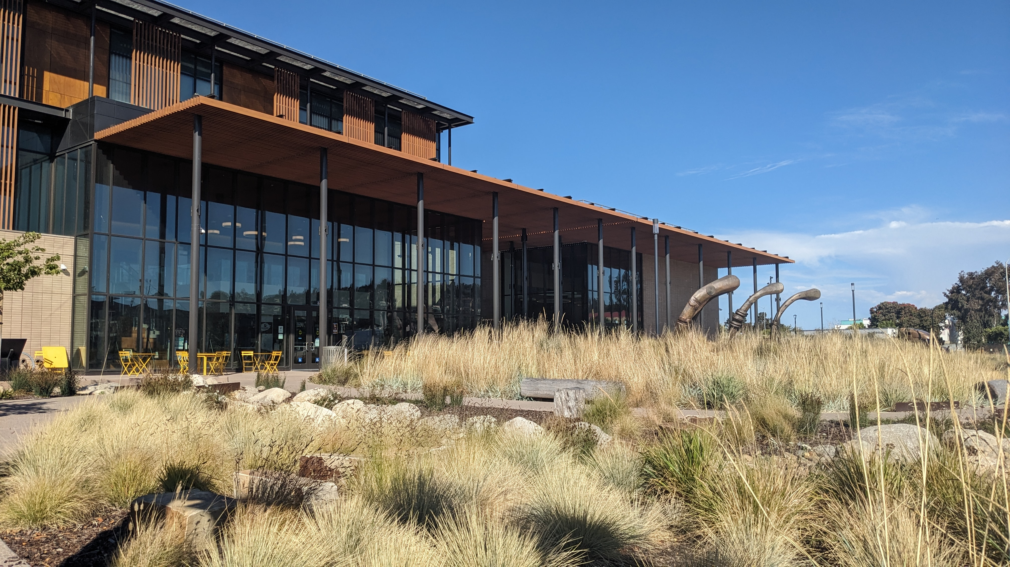
Heat and Air Quality Resilience Project
DEM: Bayview Climate Summit

Slide 7
Heat and Air Quality Resilience Project
Public Works Green Infrastructure Priority Mapping

Slide 8
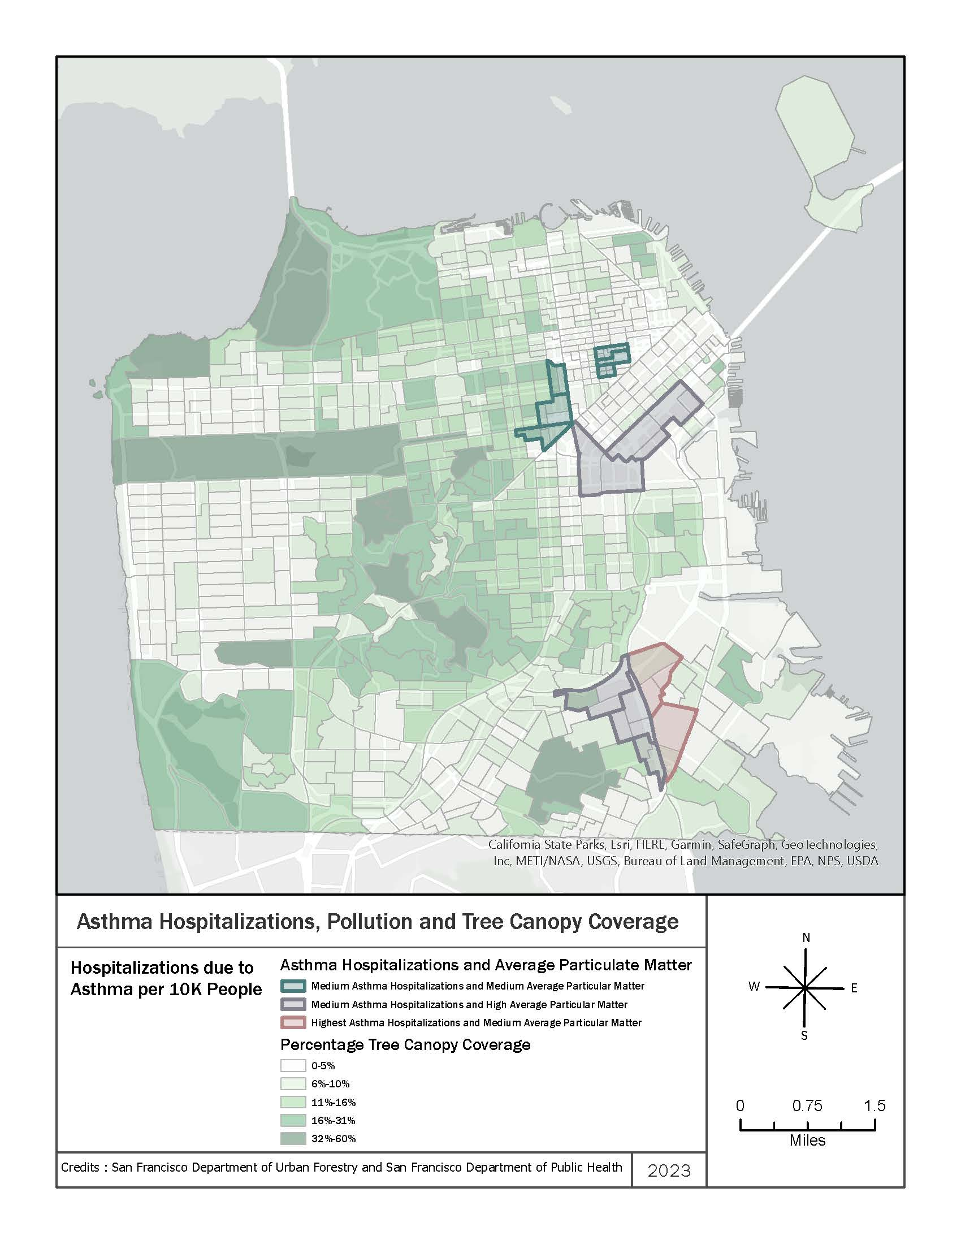
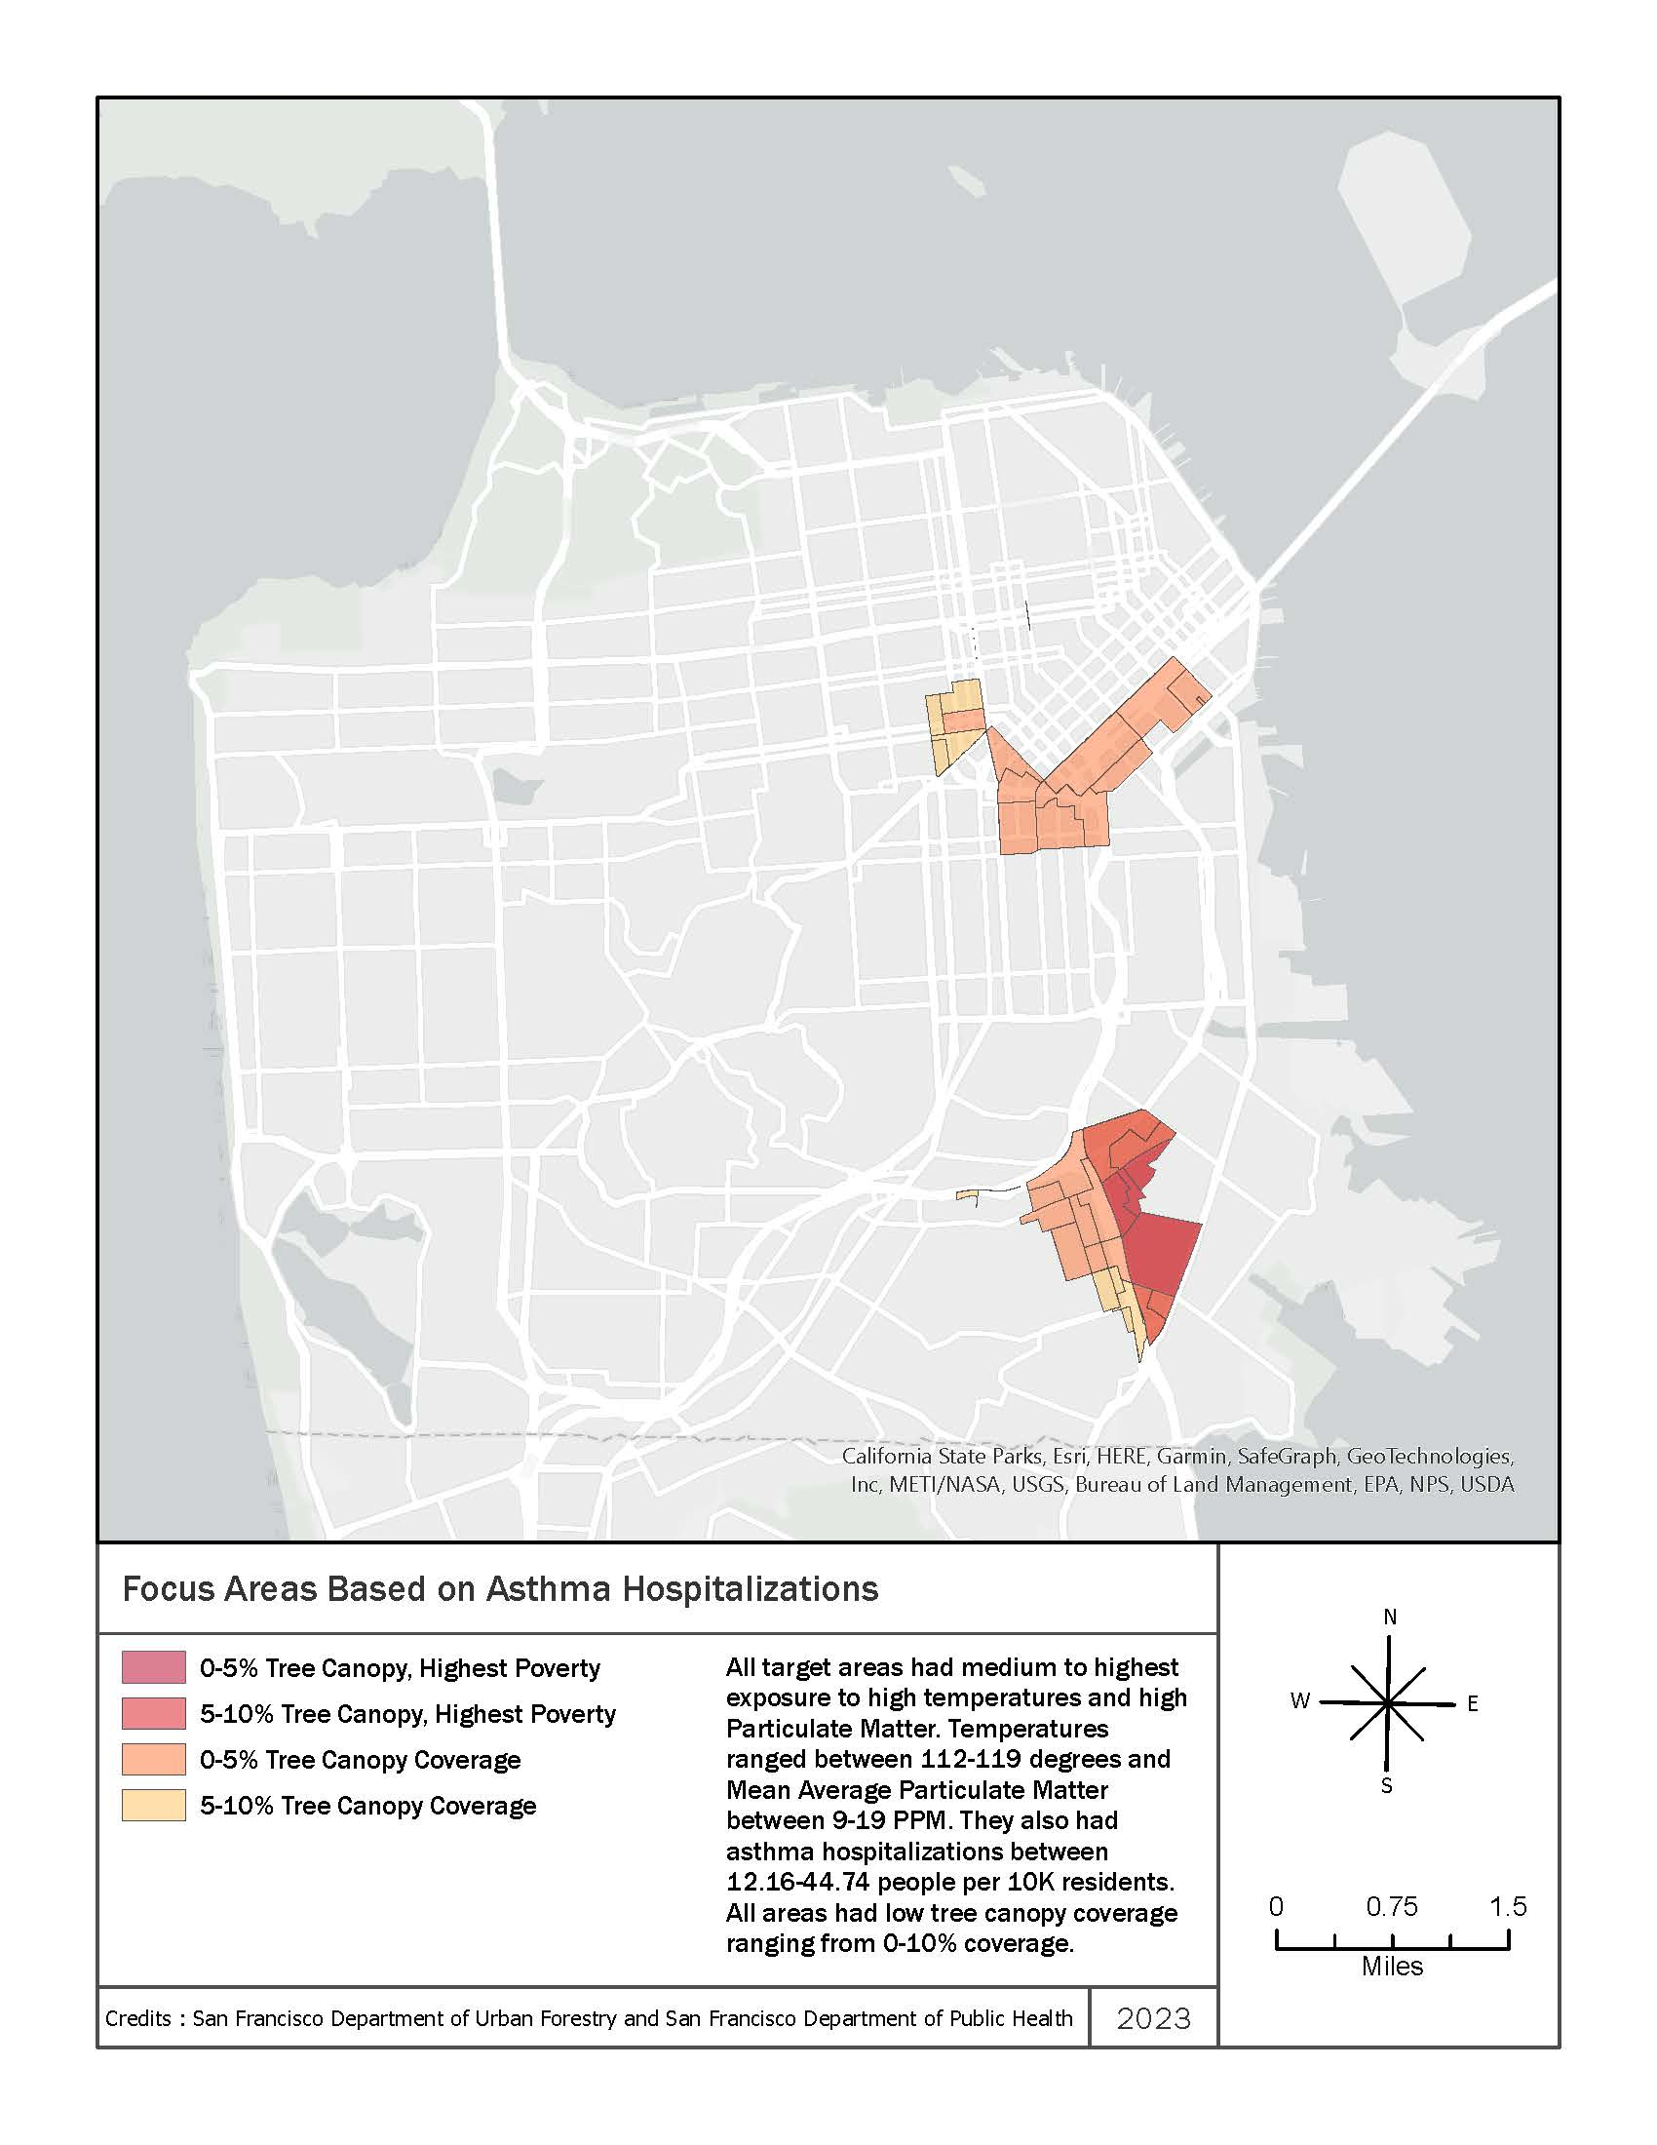
Heat and Air Quality Resilience Project
Public Works Green Infrastructure Priority Mapping

Slide 9
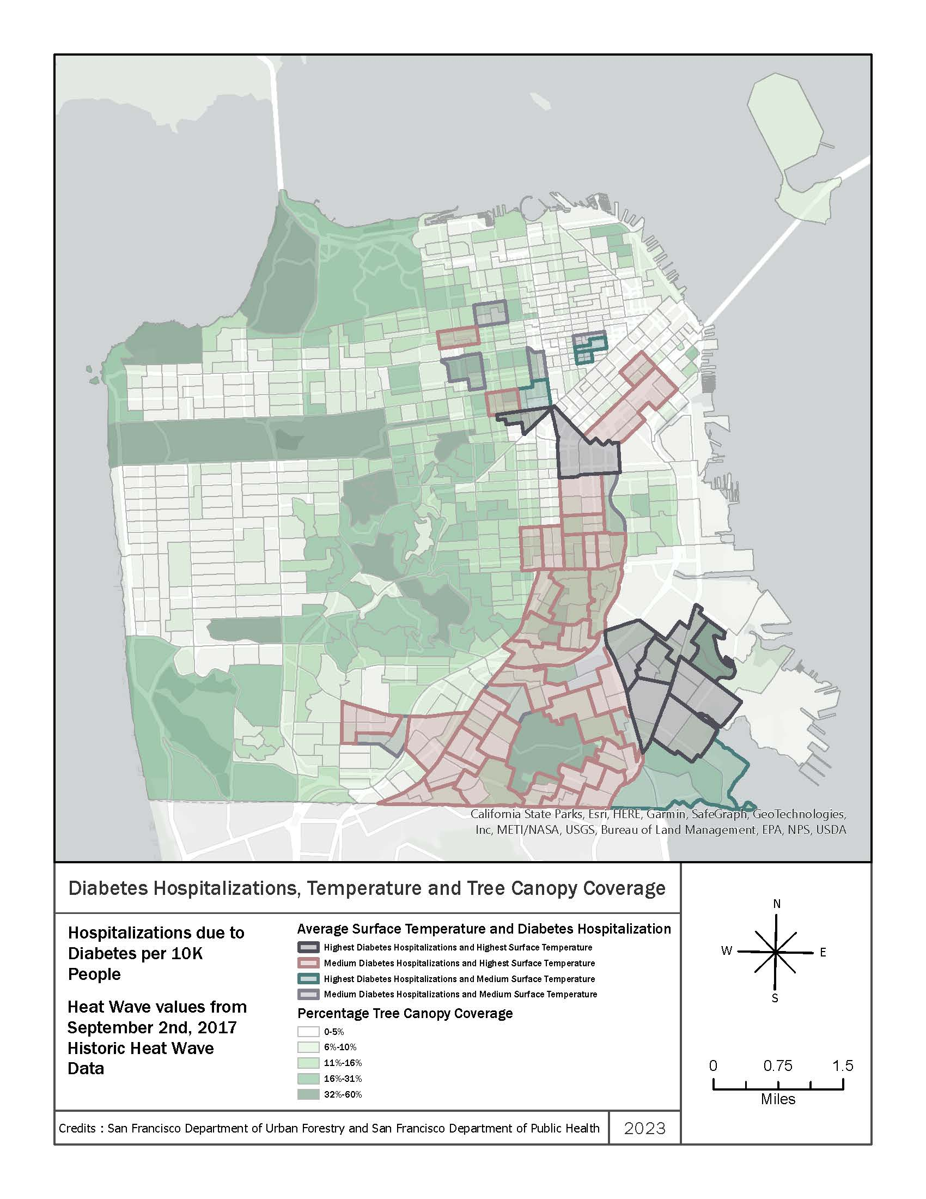
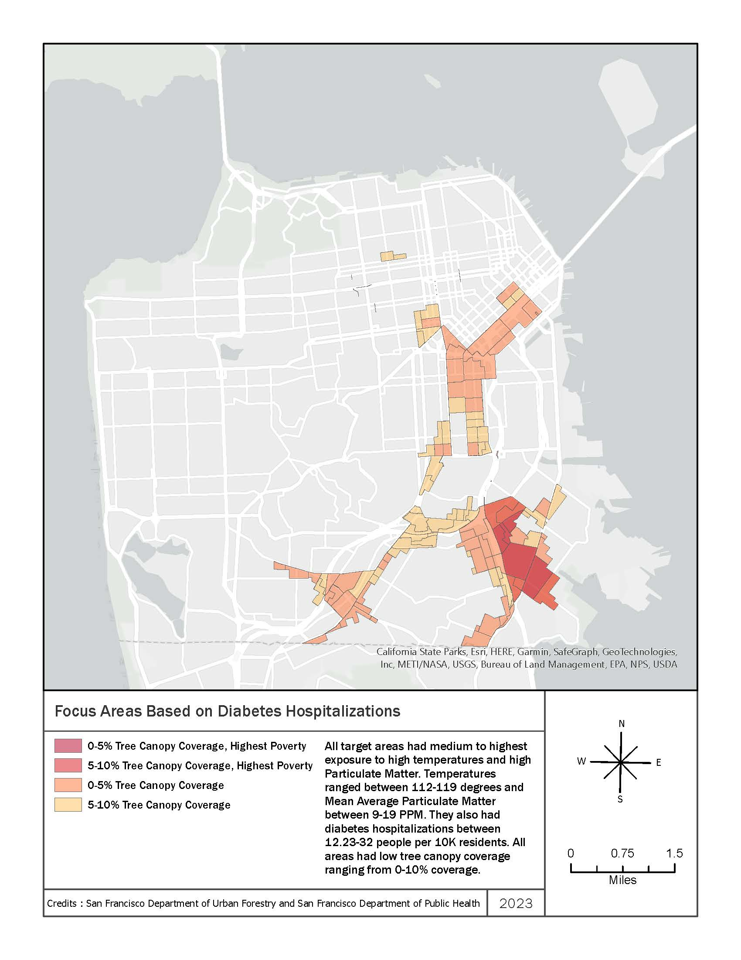
Heat and Air Quality Resilience Project
Public Works Green Infrastructure Priority Mapping

Slide 10
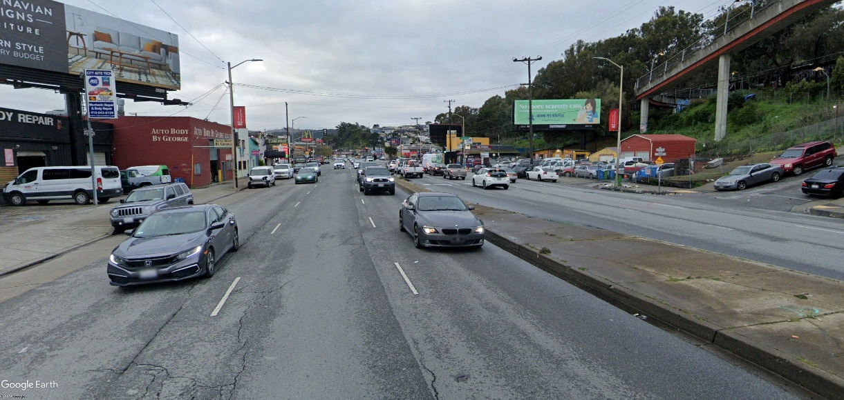
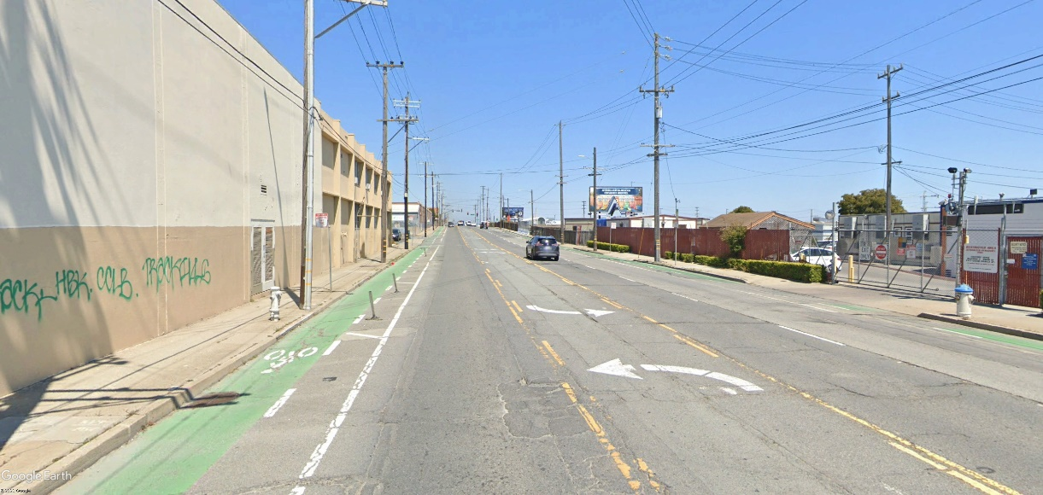
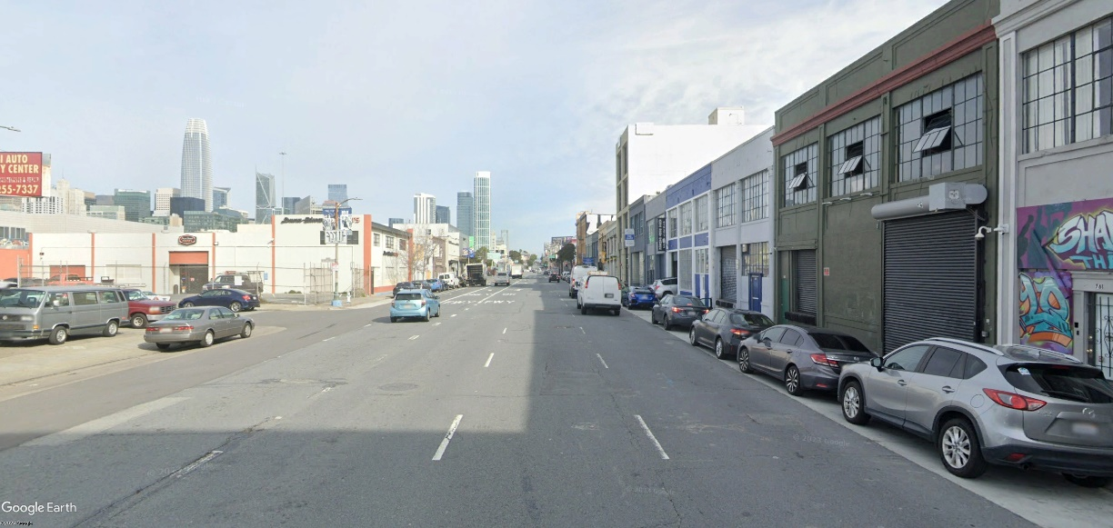
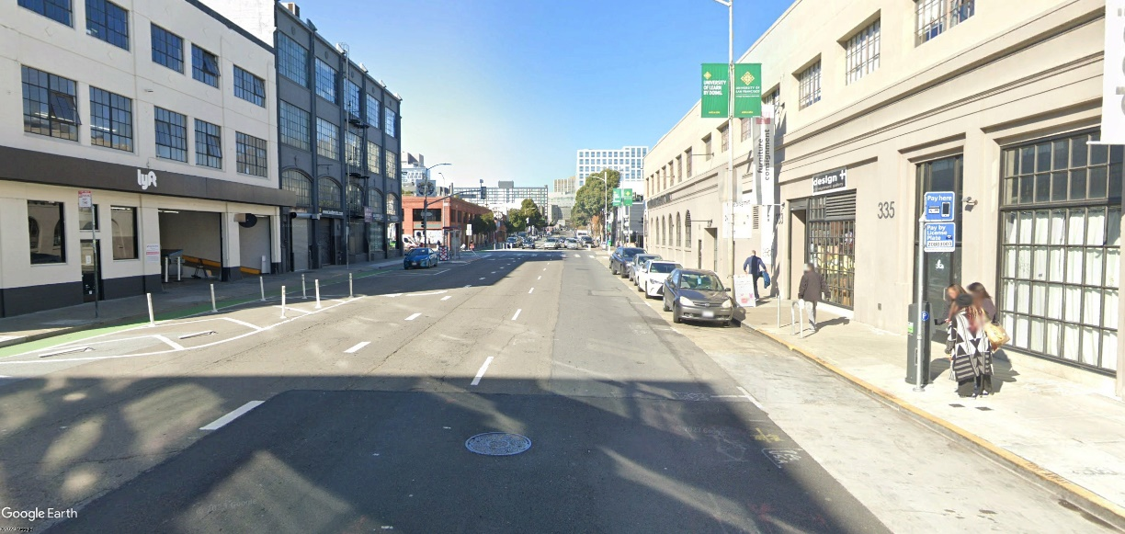
Heat and Air Quality Resilience Project
Public Works Green Infrastructure Toolkit – Industrial SOMA/Bayview

Slide 11
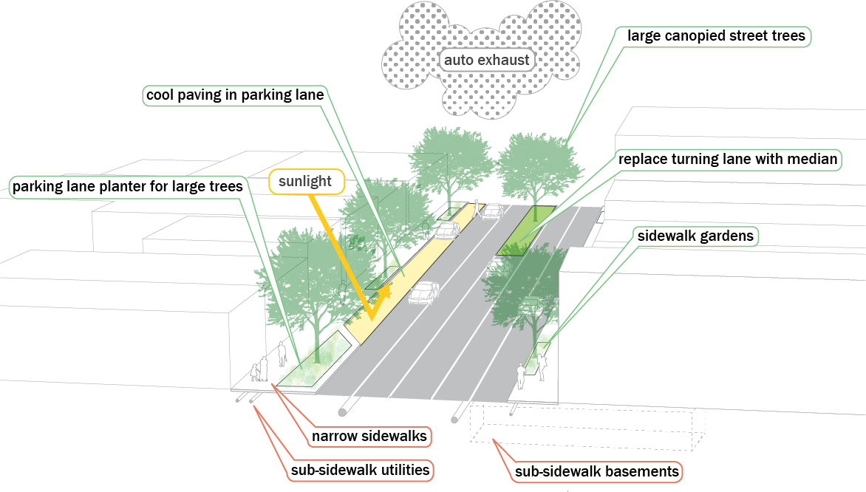
Heat and Air Quality Resilience Project
Public Works Green Infrastructure Toolkit - Industrial

Slide 12
Heat and Air Quality Resilience Project
Public Works Green Infrastructure Toolkit - Industrial

Slide 13
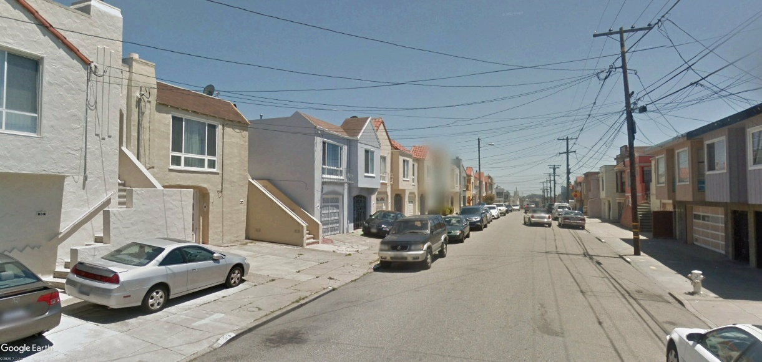
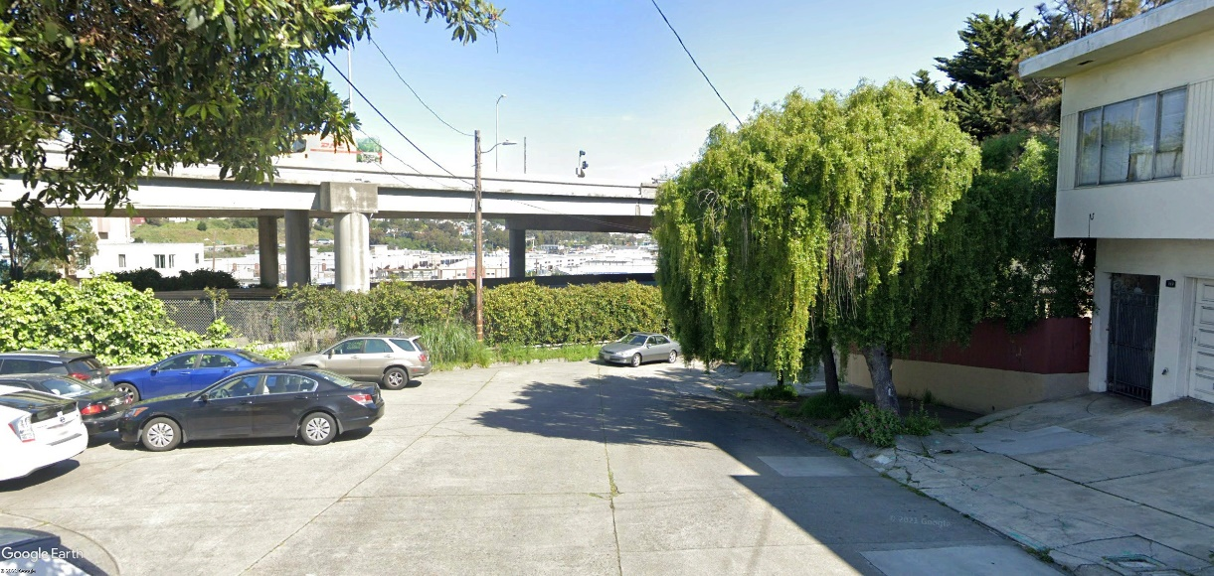
Heat and Air Quality Resilience Project
Public Works Green Infrastructure Toolkit – Residential

Slide 14
Heat and Air Quality Resilience Project
Public Works Green Infrastructure Toolkit – Residential

Slide 15
Where We’ve Been: HAQR 2021 – 2023 (Review)
Notes:
So onto updates

Slide 16
Heat and Air Quality Resilience Project
HAQR Mission Statement
Centralize extreme heat and air quality resilience planning to foster increased interdepartmental coordination and align objectives, share research, engage stakeholders, identify barriers, and discuss heat and air quality-related issues as they emerge.
Facilitate the technical implementation and evaluation of specific extreme heat and air quality-related strategies.

Slide 17
Heat and Air Quality Resilience Project
Phase 1: Planning
Objectives:
Increase knowledge of extreme heat and wildfire smoke as local health threats
Increase collaboration between departments and sectors
Build consensus on the actions necessary to build resilience
Deliverable:
Extreme Heat and Wildfire Smoke Implementation Plan
We are here!
Phase 2: Implementation
Objectives:
Increase resources dedicated to extreme heat and air quality adaptation
Increase implementation of cross-sectoral and cross-departmental actions
Increased efficacy of implementation actions
Deliverable(s)
Plan strategies implemented and improved

Slide 18
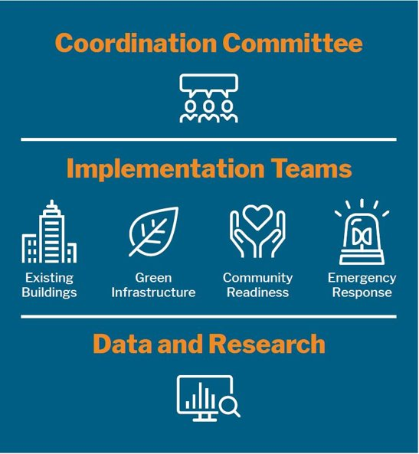
Heat and Air Quality Resilience Project
HAQR Structure
Oversight
Program Management
Matt Wolff, SFDPH
Alex Morrison, ORCP

Slide 19
Heat and Air Quality Resilience Project
HAQR Implementation Plan Released!
Press Coverage
SF Chronicle
SF Examiner
KTVU, KCBS, KQED, ABC
Have been fielding requests to meet and discuss plan from other government agencies and community-based organizations
Companion Data
SFDPH Climate and Health Program
Implementation Plan
Plan hosted on ORCP website

Slide 20
HAQR Implementation Plan
Notes:
So onto updates

Slide 21
Heat and Air Quality Resilience Project
HAQR Implementation Plan
Pathway 1: Reducing Exposure to Extreme Heat and Wildfire Smoke In Homes and Buildings
Cooling and Ventilation (Individual Rooms and Full Buildings)
Resilient Design
Connecting Vulnerable Populations to Weatherization Resources
Pathway 2: Addressing Urban Heat Islands
Tree Coverage
Cool Pavements
Shade Structures
Pathway 3: Preparedness, Response, and Resilience
Community Outreach, Engagement, and Involvement
Extreme Weather Respite Centers
Sheltering In Place
Emergency Communications
Pathway 4: Research and Organization
Research and Data Analysis
Interdepartmental Coordination and Governance

Slide 22
Heat and Air Quality Resilience Project

Slide 23
Heat and Air Quality Resilience Project

Slide 24
What's Next for HAQR: Moving from Planning to Implementation
Notes:
So onto updates

Slide 25
Heat and Air Quality Resilience Project
Strategy Status | Possible HAQR Role(s)
Ongoing | Evaluation Technical Assistance
Planned | Facilitation Technical Assistance
Needs Resourcing | Grant Tracking Advocacy
Needs Further Planning | Research and Data Analysis
All Strategies | Coordinating Community Involvement / Feedback Progress Tracking

Slide 26
Heat and Air Quality Resilience Project
New HAQR Structure
Oversight
All-Hands Meeting
Program Management
Agency Steering Committee
Matt Wolff, SFDPH
Alex Morrison, ORCP
Data and Research
Notes:
Oversight will come from this body as well as utilizing the ClimateSF structure for broader feedback including at the director level when necessary, the same as it has been for the first Phase of the project. The cadence will be changed to meeting every two months.
Steering Committee: Serves as a structure for departmental champions of HAQR strategies to move these strategies from planning to implementation, provide feedback on what is needed to move forward on projects to inform coordination committee agenda’s (such as SME presentations/discussions). Liaison between HAQR and departmental leadership on strategies. Assist in coordination between different departments on related strategies.
All Hands Meeting: Rename for the coordination committee meeting. Will meet quarterly to increase situational awareness, disseminate research findings, and connect with technical experts both within the city as well as from academic and community organizations. Invitations to this space will go out through the HAQR List serve as well as to through existing CBO networks like NEN, SFDPH list, Planning EJ Framework community group list. This will also be a space that is specifically open to community organizations, to learn about actions and potentially partners on efforts.
Planning and Facilitation actions: Take place within the steering committee with support from project management team of Matt and Alex. Involves coordinating with each agency identified in Implementation plan to understand priorities, support needed, and address barriers to implementation. This will include developing trackers for grant opportunities and understanding which opportunities align with different strategies. The function of the project management role is to align these opportunities with strategy liaisons and support with grant writing
Data and Research actions: Climate and Health program will work with agencies and organizations to support evaluating HAQR related actions to understand impacts and support future efforts. This will also include the pursuit of new research projects that support gaps in knowledge for implementation of strategies. Additionally, the research function will be responsible for reviewing best practices at the local, regional, and national level to inform implementation
Community coordination actions: We are hoping to use the information that we collect on grant opportunities and the connections that we have to existing CBO networks to match-make organizations withy agencies in the pursuit of projects and also be able to then provide analytical support in the pursuit of these grant opportunities
Steering committee meetings: Planning and facilitation of these meetings will be a responsibility of the project management team

Slide 27
Heat and Air Quality Resilience Project
New HAQR Structure
Coordinated outreach
Feedback through established channels.
Collaboration with CBO partners.
Grant tracking
Opportunities sent through HAQR email list (to both City agencies and community organizations).
Grant-writing support.
Supporting implementation actions
Facilitation
Research and evaluation
Situational awareness
Tracking progress
Connecting processes
Communications
Oversight
Program Management
Matt Wolff, SFDPH
Alex Morrison, ORCP

Slide 28
Heat and Air Quality Resilience Project
New HAQR Structure
All-Hands Meeting
Presentations on research, best practices
Citywide heat and air quality updates
Feedback
All-Hands Meeting
Agency Steering Committee
Liaison between HAQR and department leadership to advocate for resources and report on progress.
Increase cross-departmental situational awareness
Identify barriers to implementation, opportunities for collaboration.
Support with outreach, grant-tracking, and advocacy
Agency Steering Committee
Data and Research
Data and Research
Evaluate effectiveness of implementation
Identify and address data gaps

Slide 29
Heat and Air Quality Resilience Project
Next Steps
Stakeholder Interviews
City Agencies
Community-Based Organizations
Finalize HAQR 2024 Work Plan
Move Strategies Along the Implementation Pipeline
“Needs Further Planning” → “Needs Resources” → “Planned” → “Ongoing”
Identify resource needs for implementation
Establish Research and Analysis Agenda
Convene Agency Steering Committee
Plan Quarterly All-Hands Meetings

Slide 30
UCSF | PCORI Survey Results
Notes:
So onto updates

Slide 31
Climate Survey Final Results
HAQR Update
September 2023

Slide 32
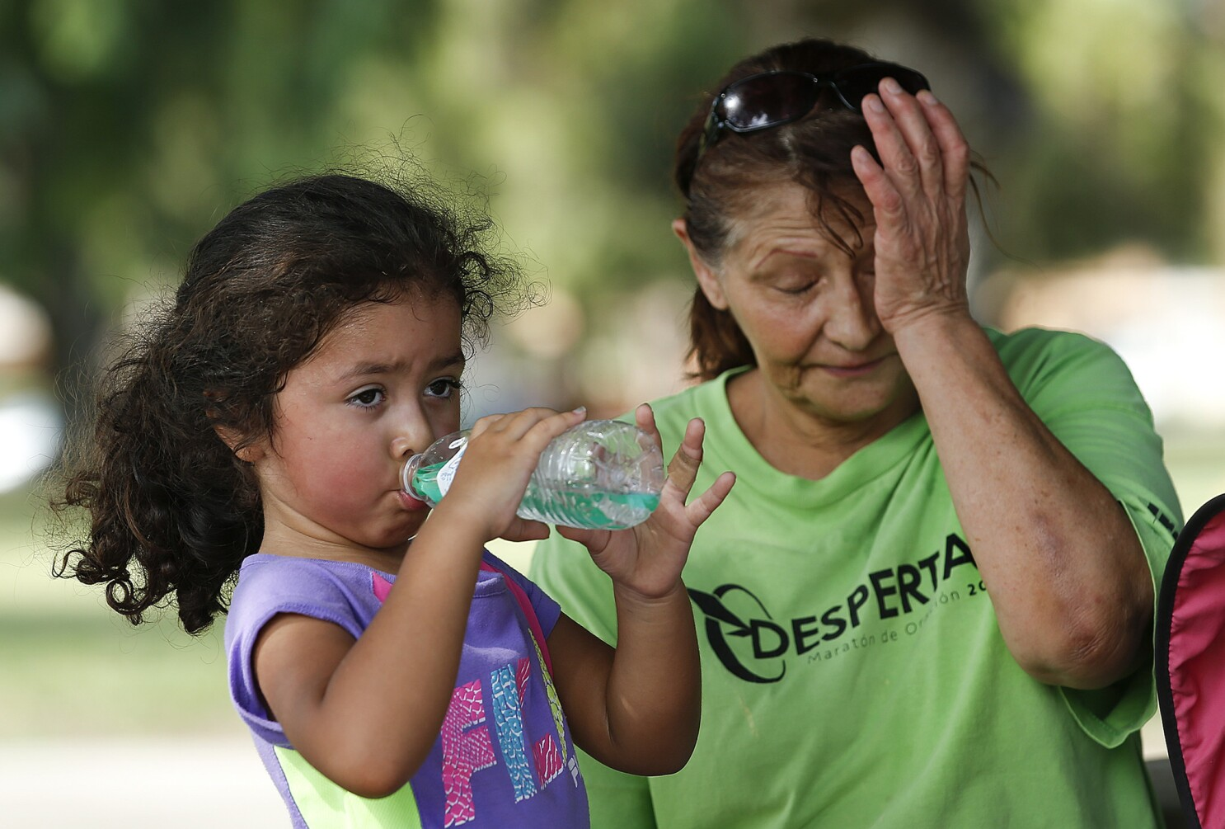
HAQR Approach
Start with the strategy
Respite sites
Weatherization
Communication
Etc.
Identify barriers to implementation
Important…but doesn’t tell you which strategy to prioritize.
Photo Credit: Melcon, Los Angeles Times 9.1.2017

Slide 33
Prioritization with community
And considering a health lens

Slide 34
Session # | Session Title | Detailed High-Level Agenda
Session #1 | Intros, Background & CBO Experience | Introductions Project goals, roles & responsibilities Background on susceptibility & vulnerability CBO experiences with extreme weather
Session #2 | Survey Goals & Survey Development | How information will be used Survey goals & methods Draft survey
Session #3 | Conceptual Framework | Conceptual framework
Session #4 | Refine Survey & Conceptual Framework | Review survey & Conceptual Framework Survey distribution plan
Phase 1 Community Stakeholder Group
NICOS, Self-Help for the Elderly, Golden Gate Senior Center, Rafiki, Leaders4Earth, Coalition on Homelessness, Southwest Community Corporation

Slide 35
Session # | Session Title | Detailed High-Level Agenda
Session #1 | Intros, Background & CBO Experience | Introductions Project goals, roles & responsibilities Background on susceptibility & vulnerability CBO experiences with extreme weather
Session #2 | Survey Goals & Survey Development | How information will be used Survey goals & methods Draft survey
Session #3 | Conceptual Framework | Conceptual framework
Session #4 | Refine Survey & Conceptual Framework | Review survey & Conceptual Framework Survey distribution plan
Phase 2
Survey Distribution
NICOS, Rafiki, Leaders4Earth, Coalition on Homelessness

Slide 36
Community Survey Results

Slide 37
CLIMATE SURVEY RESULTS OVERVIEW
Between January 18 and July 12, 2023, four (4) organizations participated in survey recruitment in San Francisco, CA.
Organization | Target Populations | # of surveys | % surveys fully complete
NICOS | Limited English-speaking adults | 252 | 99.6%
Rafiki | Older adults; persons with disabilities and/or chronic mobility issues | 38 | 88.4%
Leaders4EARTH | Youth and young adults | 142 | 94.7%
COH | Single unhoused or marginally housed adults | 110 | 96.5%
TOTAL |  | 547 | 96.8%

Slide 38
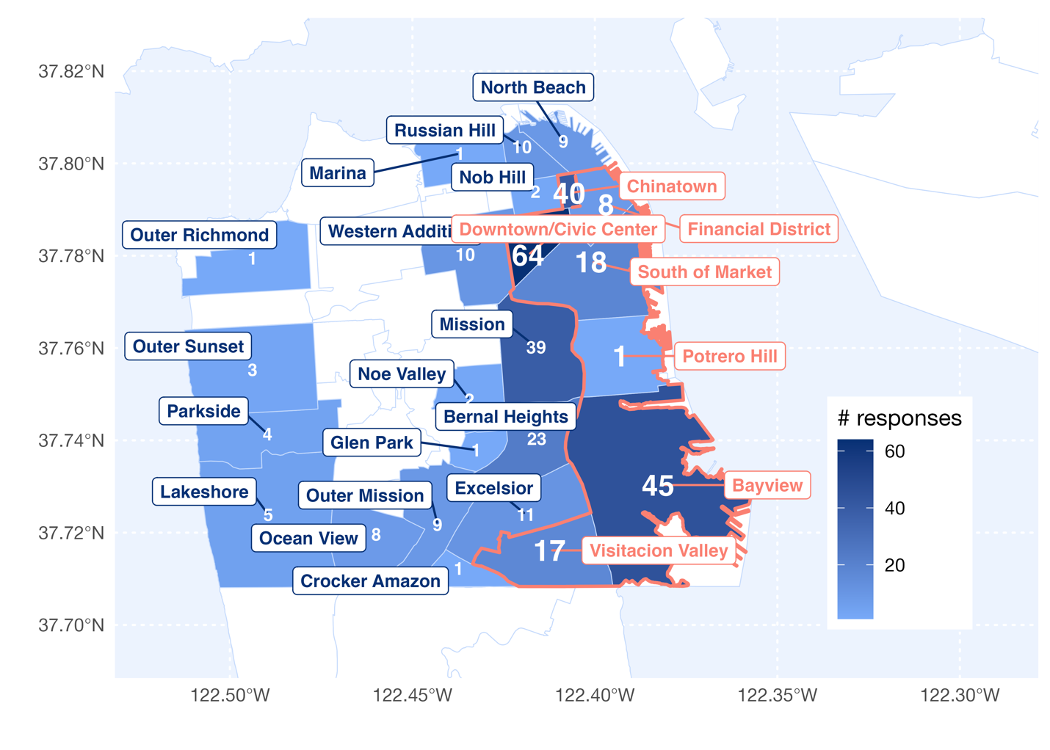
Neighborhoods Represented
Our priority neighborhoods are outlined in pink, and response counts are enlarged.

Slide 39
DEMOGRAPHICS - GENDER & AGE
 |  | Gender |  |  |  |  | Age
 |  | Female | Male | Transgender | Non-binary |  | Median years (IQR)
NICOS (n = 252) |  | 74% | 24% | 0 | 2% |  | 38 (9)
Rafiki (n = 38) |  | 85% | 10% | 2% | 0 |  | 69 (13)
Leaders4EARTH (n = 142) |  | 47% | 52% | 1% | 1% |  | 17 (4)
COH (n = 110) |  | 35% | 59% | 4% | 1% |  | 42 (23)
All participants (n = 519) |  | 60% | 37% | 1% | 1% |  | 36 (22)

Slide 40
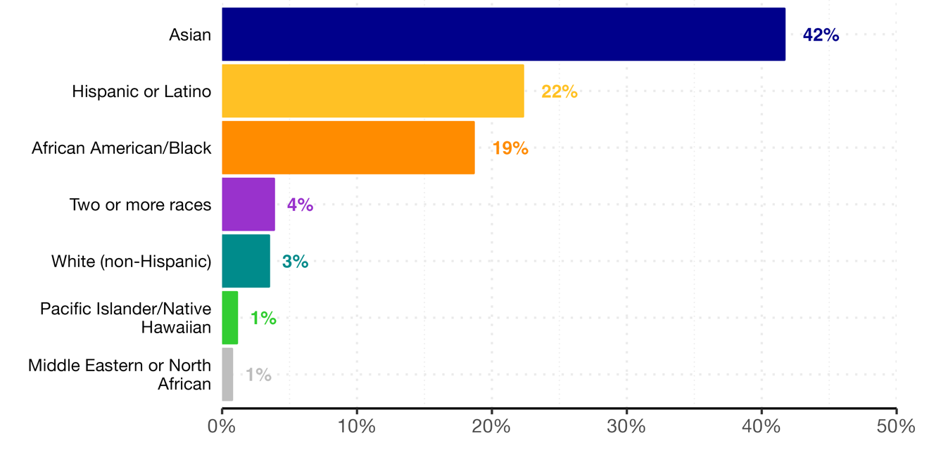
DEMOGRAPHICS - RACE/ETHNICITY

Slide 41
DEMOGRAPHICS - HOUSING TYPE
 |  | Housing Type |  |  |  |  |  |  | Crowding
 |  | Single Family Home | Condo/ Apt | Section 8/ Public Housing | Rent/ Share room | SRO/ Hotel | Experiencing homelessness |  | >1 person per room
NICOS (n = 246) |  | 19% | 24% | 5% | 41% | 11% | 0 |  | 77%
Rafiki (n = 38) |  | 53% | 21% | 24% | 3% | 0 | 0 |  | 14%
Leaders4EARTH (n = 142) |  | 30% | 54% | 6% | 9% | 1% | 1% |  | 61%
COH (n = 91) |  | 11% | 2% | 4% | 9% | 18% | 56% |  | 35%
All participants (n = 522) |  | 24% | 28% | 6% | 23% | 9% | 10% |  | 62%
Priority neighborhoods |  | 15% | * | * | * | * | * |  | *
Notes:
Updated (AN 07.13.23) NOTE: crowding was quite different from May 2023 iteration – just iterating that crowding is >=1 person per room in house

Slide 42
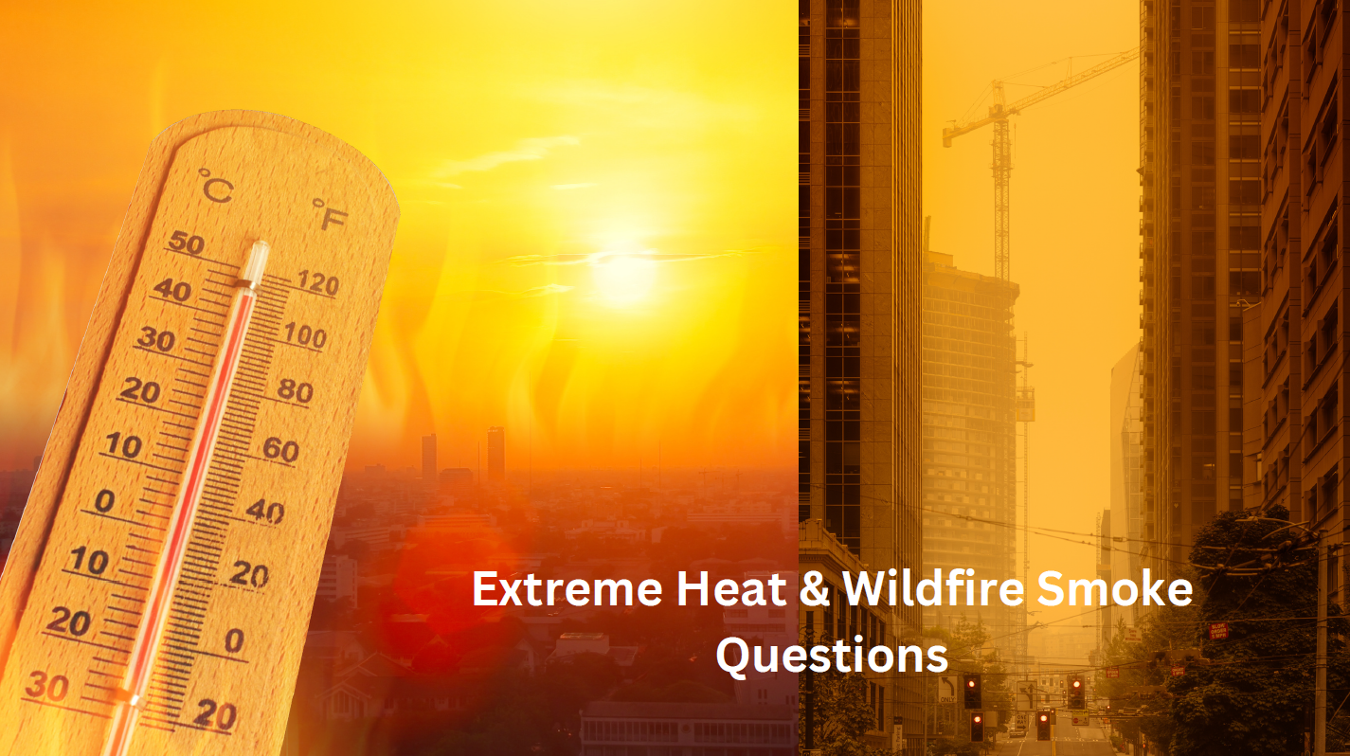

Slide 43
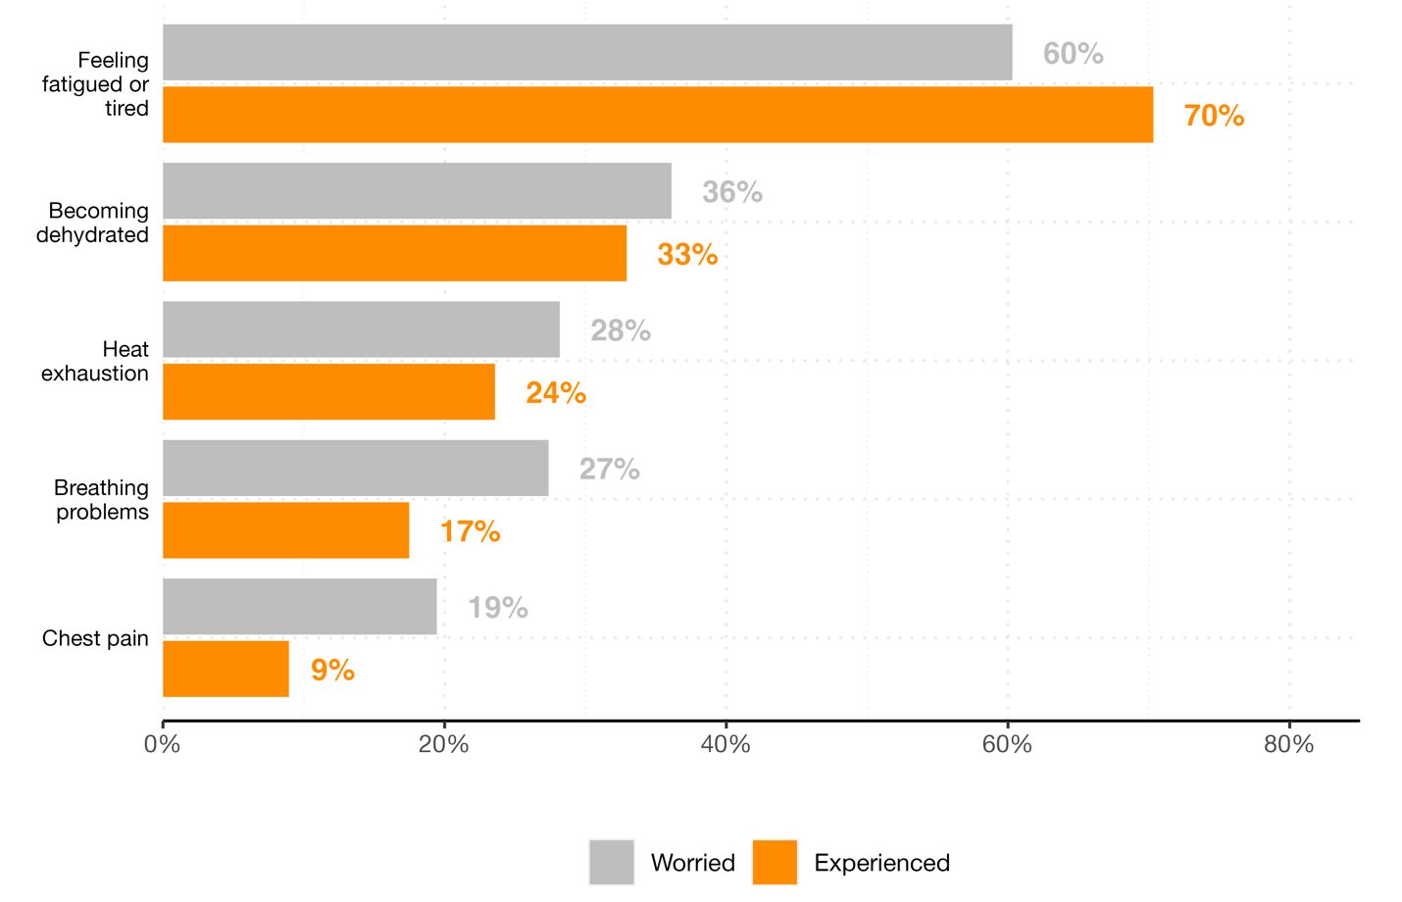
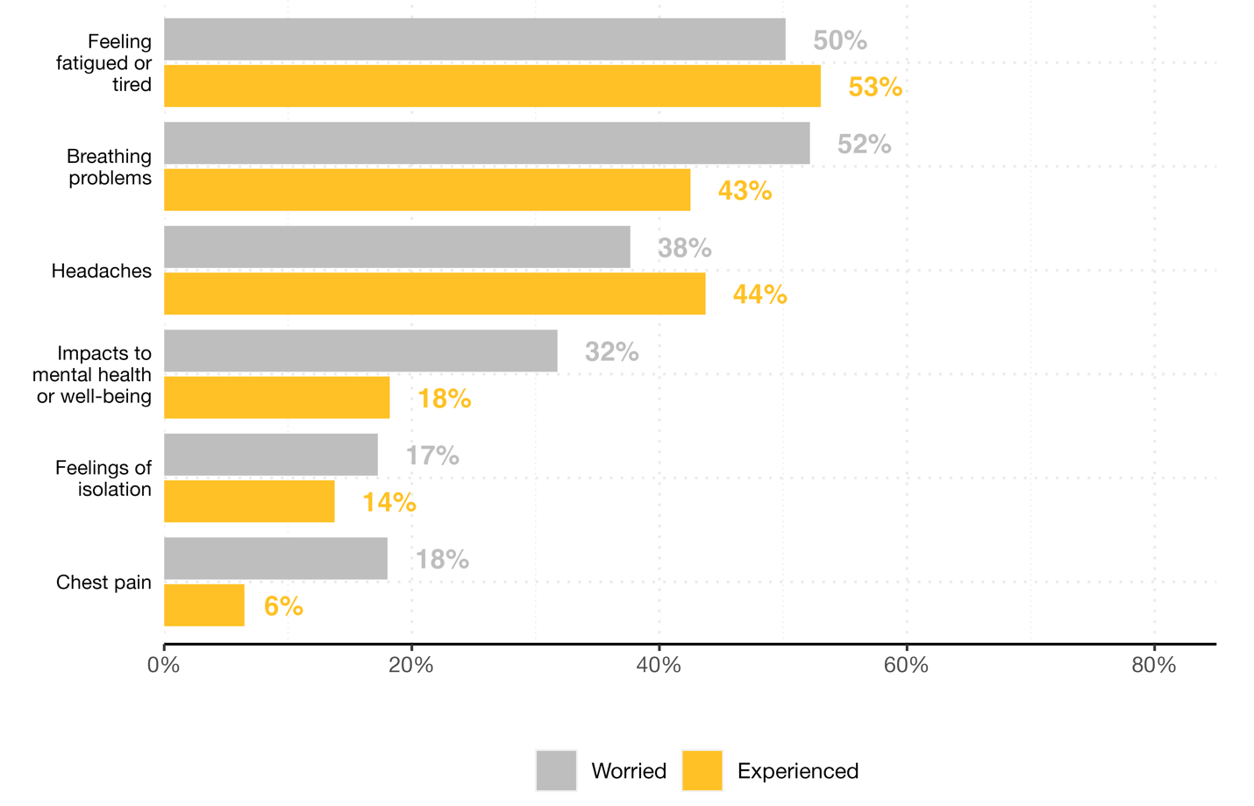
HEALTH CONCERNS
Health Concerns During
Extreme Heat Events (n=242)
Health Concerns During
Wildfire Smoke Events (n=247)
Nearly three-quarters of survey participants felt fatigued during extreme heat waves, and a third experienced dehydration.
Half of survey participants felt fatigued during wildfire smoke events, and nearly half experienced breathing problems or headaches.
Notes:
Update with new numbers, add results by organization
Potential fatigue scales: https://www.ncbi.nlm.nih.gov/pmc/articles/PMC2579971/; https://academic.oup.com/occmed/article/60/2/159/1423839
Breathing scale: Breathlessness, cough, and sputum scale
Need to find a heat exhaustion scale…
Updated (AN 07.13.23)

Slide 44
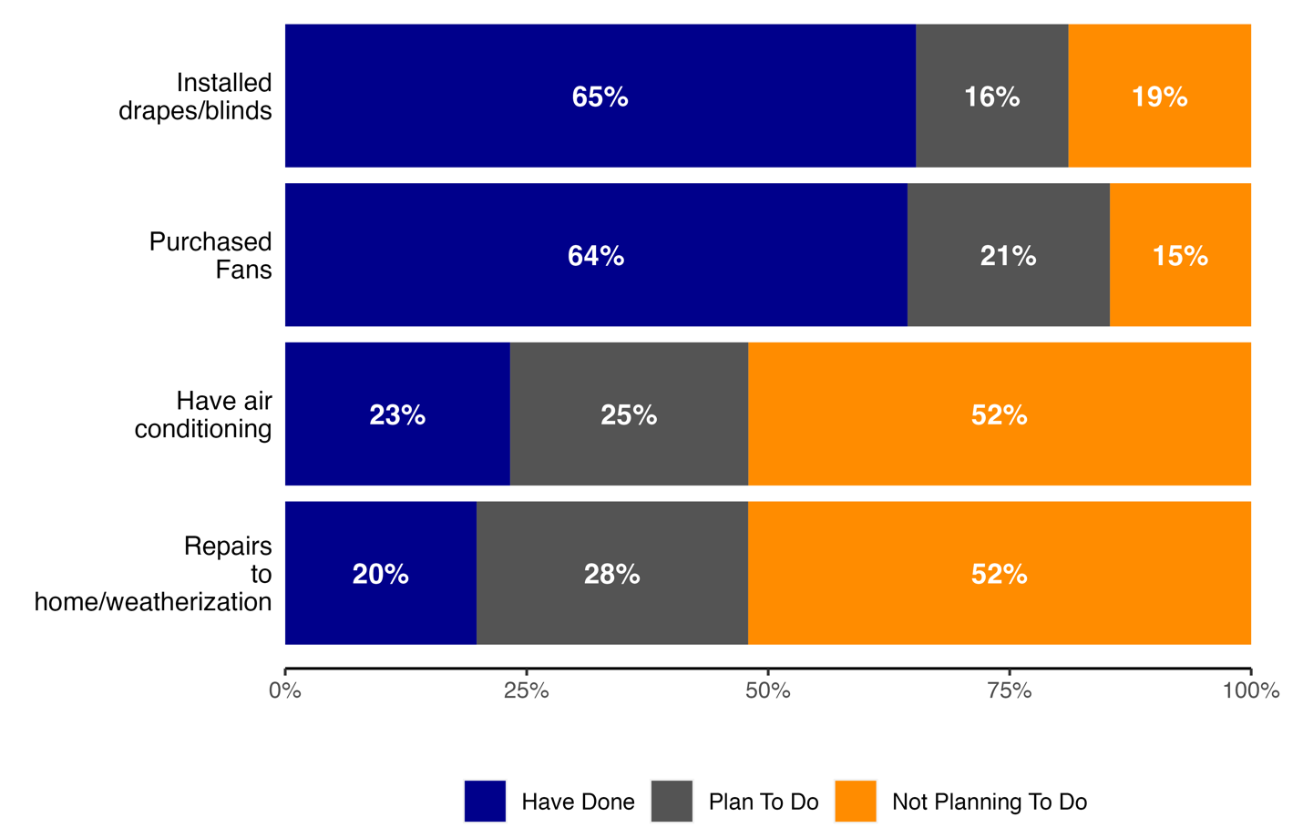
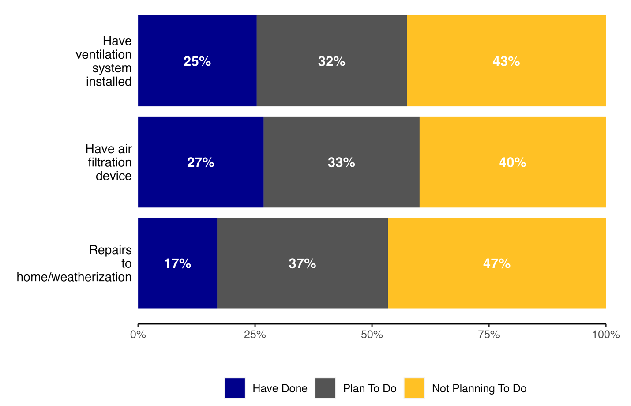
PREPARATION: BUILDING & EQUIPMENT
Building & Equipment Preparation
for Extreme Heat Events (n=254)
Building & Equipment Preparation for Wildfire Smoke Events (n=249)
Nearly two-thirds of survey participants have either installed window drapes/blinds or purchased fans, but only a quarter have air conditioning in their place of residence.
Those experiencing homelessness/living in public housing/SROs were among the least prepared for either extreme weather event in terms of building preparations

Slide 45
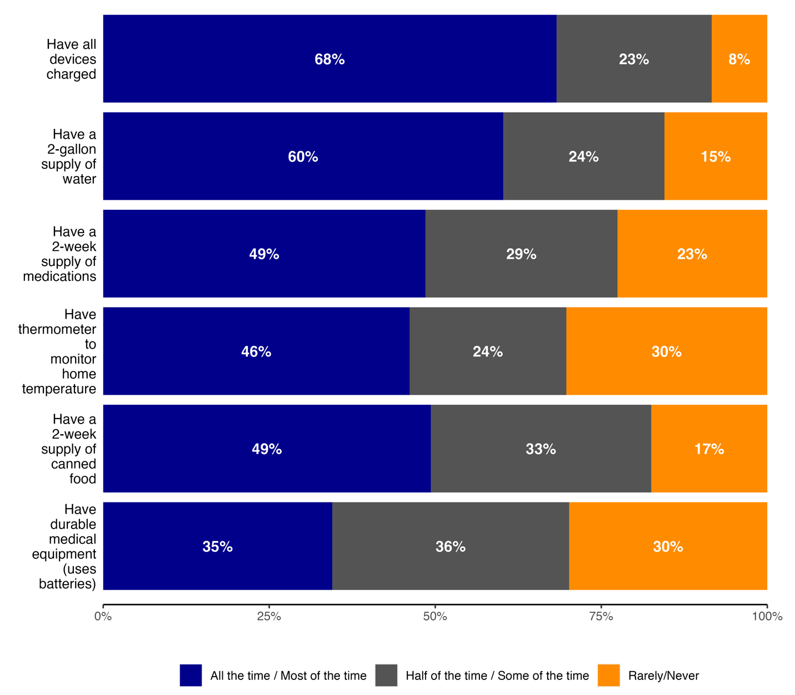
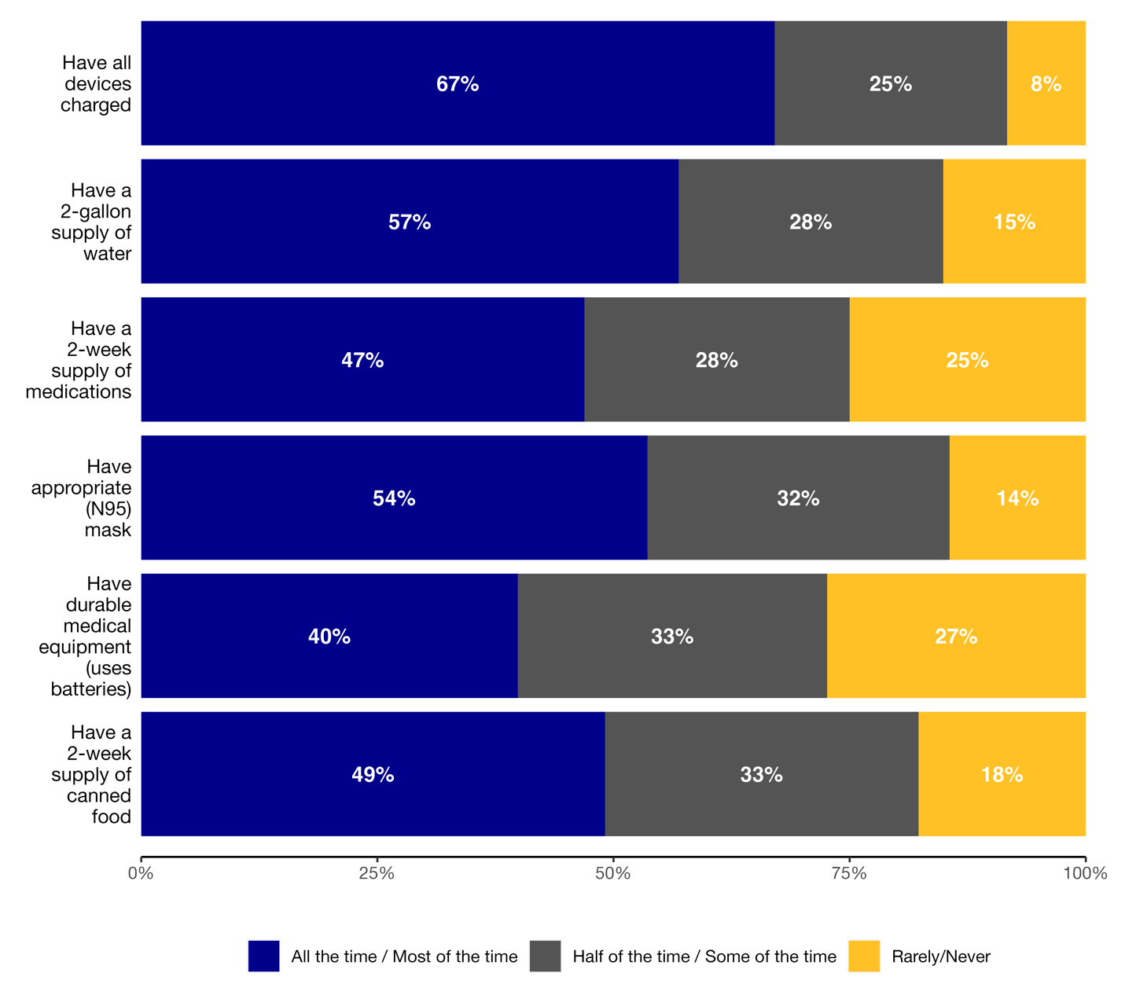
PREPARATION: EMERGENCY SUPPLIES
Those affiliated with COH or reporting that they were experiencing homelessness/living in public housing/SROs were among the least prepared for either extreme weather event in terms of supply preparations, from food and water to masks and thermometers.
Notes:
Update with new numbers, add results by organization
Updated (AN 07.13.23)
Question: how to collapse 2-week supply of food/water/drink → if they have at least one of them? Or all of them?

Slide 46
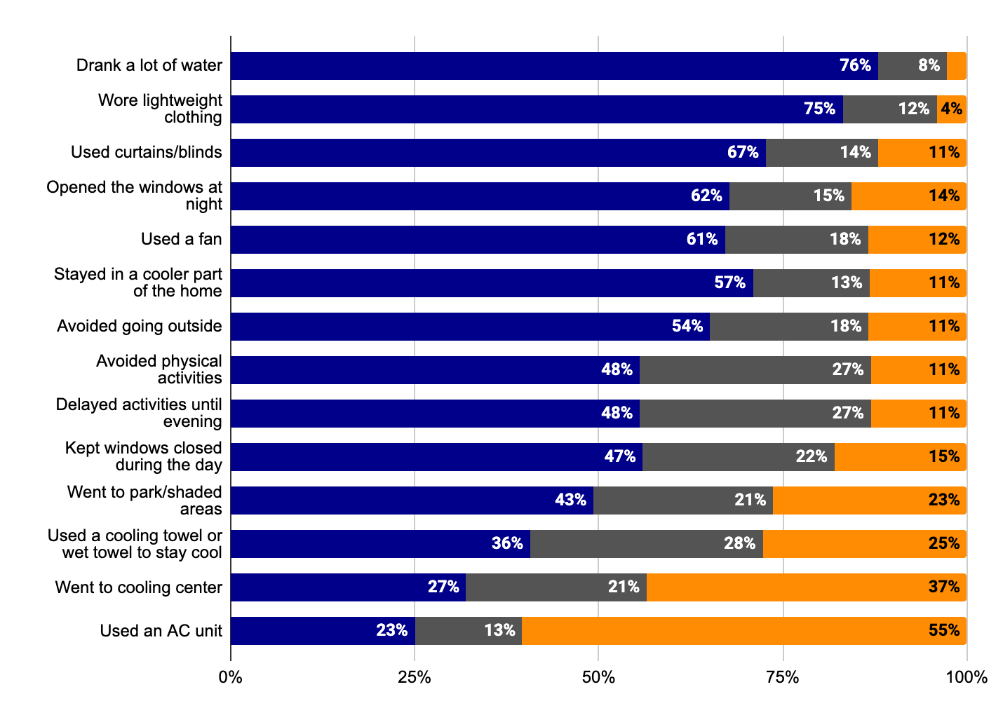
PROTECTIVE ACTIVITIES: EXTREME HEAT
Frequency of Activities to Reduce Exposure to Extreme Heat
(n=261)
When asked about other protective activities not listed above, survey participants reported taking cold showers and going to cooler locations like malls and taking transit to the beach. Participants cited weather alerts via news and a duty of personal protection as influential catalysts in engaging in these protective behaviors. Reported usage of air conditioning was rare.
Notes:
Update with new numbers, add results by organization
Updated (AN 07.13.23) - able to arrange by most frequently done to least? Done!

Slide 47
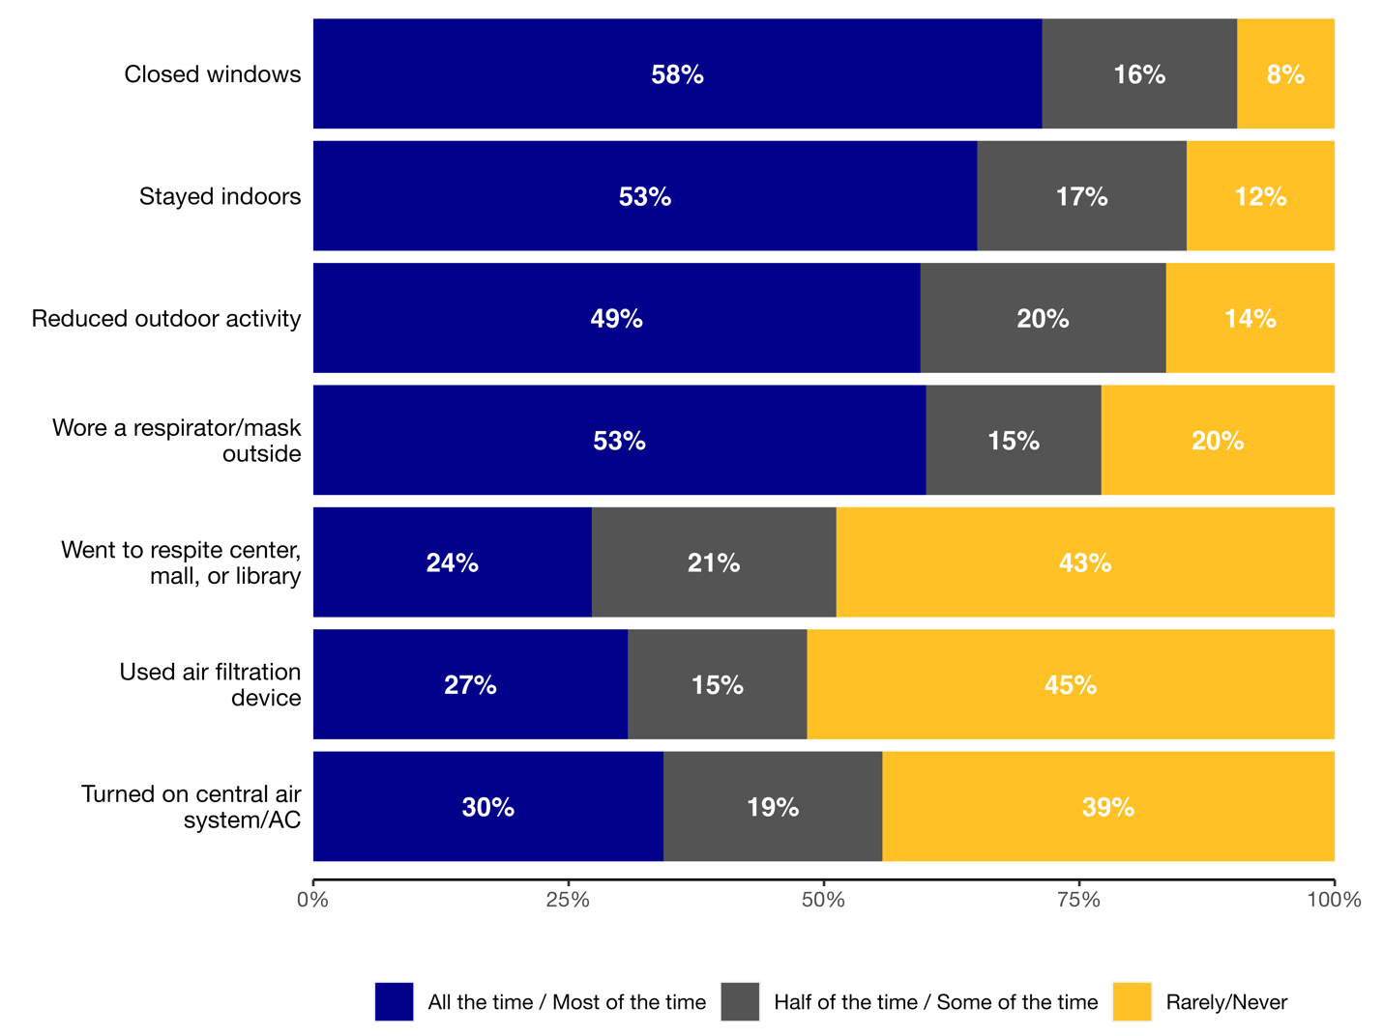
PROTECTIVE ACTIVITIES: WILDFIRE SMOKE
Frequency of Activities to Reduce Exposure to Wildfire Smoke
(n=261)
Of those who already have an air filtration device, 65% used it “All the time” or “Most of the time”
*Type of mask worn (n=163): 44% 43% 17% 13%
Simple N95/KN95 K94 Cloth
Notes:
Update with new numbers, add results by organization
Look at: Of those that have an air purifier, how many use it
(07.13.23 update) Of those who already have an air filtration device, 65% used it “All the time” or “Most of the time” (you rock! This was just a note to myself to look at in the future :) )
Updated (AN 07.13.23)

Slide 48
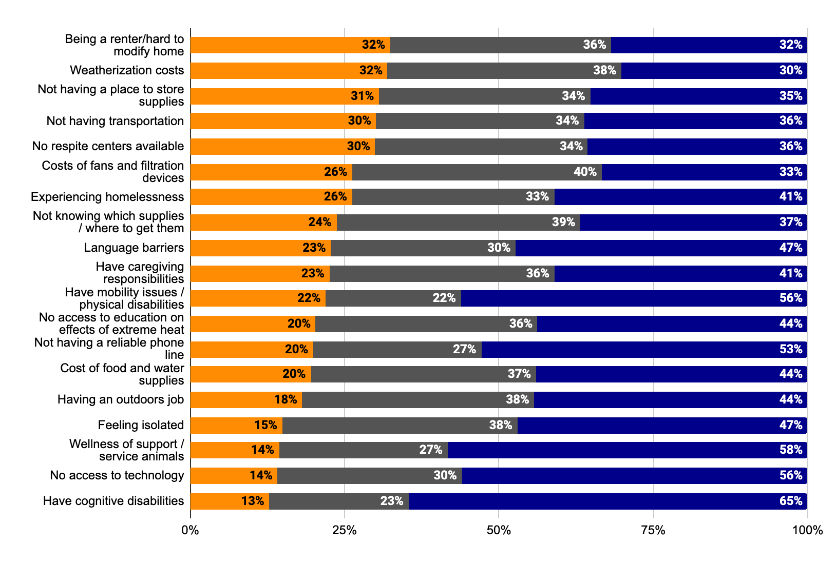
CHALLENGES: EXTREME HEAT
Challenges During Extreme Heat Events (n=234)
The underlying commonality to challenges to preparing was cost-driven – whether it be the price of weatherization or buying appliances to being renters / experiencing housing instability
Notes:
Update with new numbers, add results by organization, reverse order so major challenge is first
Updated (AN 07.13.23)

Slide 49
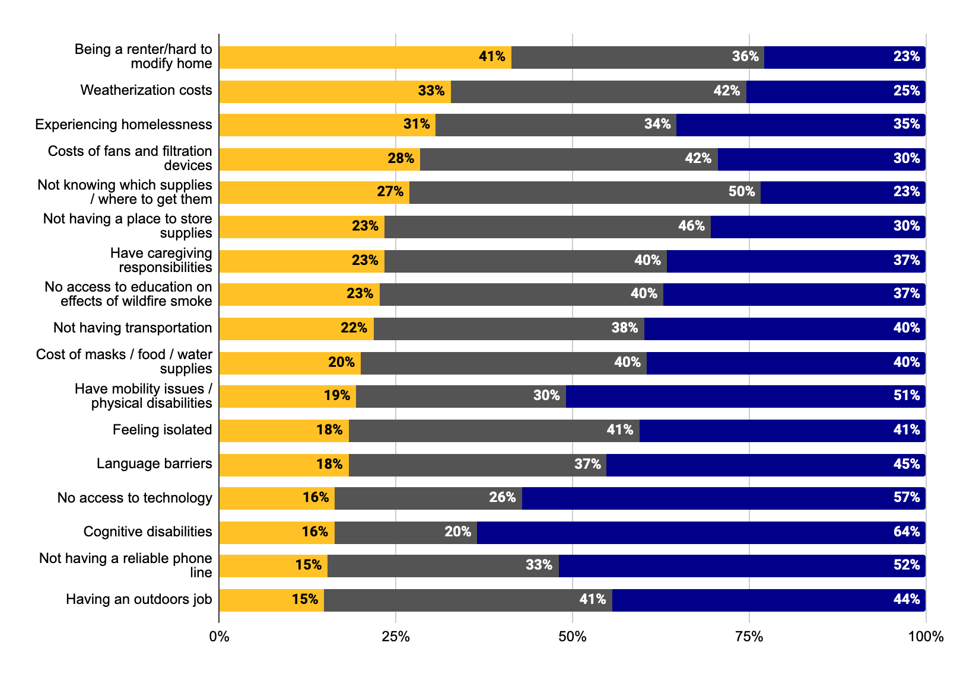
CHALLENGES: WILDFIRE SMOKE
Challenges During Wildfire Smoke Events (n=232)
Participants felt that the same challenges of preparing for extreme heat events applied to wildfire smoke events – costs of home modification/weatherization/appliances ranked as the most common challenges.
Notes:
Update with new numbers, add results by organization, reverse order so major challenge is first
Updated (AN 07.13.23)

Slide 50
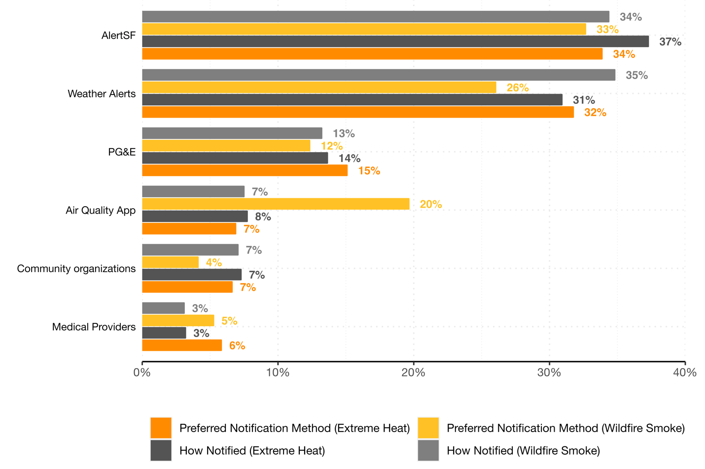
OUTREACH, HEALTH ALERTS & PREFERRED NOTIFICATION
Outreach
8% of survey participants have ever received a wellness check for extreme heat or wildfire smoke events (n = 520).
Early warning systems
54% of survey participants have ever received a health alert for extreme heat or wildfire smoke events (n = 520).
Notes:
Among those who did receive wellness checks (n = 24), phone calls were the most common form of contact (accounting for 58% of contact), followed by text messages (21%) and door-to-door contact (21%).
When asked about which organizations provided wellness checks during extreme heat events, participants reported La Raza, Chinatown Community Development Center, Rafiki, Harm Reduction Coalition, Code Tenderloin, HealthRIGHT 360, SF Aids Foundation, Homeless Coalition, and the City of San Francisco.
When asked about which organizations provided wellness checks during wildfire smoke events, participants reported Rafiki, YMCA, Code Tenderloin, HealthRIGHT 360, and SF Aids Foundation.

Slide 51
Thank you for your interest in reviewing the climate survey preliminary results & for providing feedback!!
QUESTIONS OR COMMENTS?
PLEASE CONTACT:
Neeta.Thakur@ucsf.edu

Slide 52
Thanks!
Notes:
So onto updates

