Slide 1
Coordination Committee Meeting #3 September 22, 2021 | 2:30pm – 3:30pm
Introductions (on the Chat)
Name | Agency | First Concert
Agenda
HAQR Updates
Review Implementation Teams
Existing Buildings | Feedback
Green Infrastructure | Feedback
Next Steps
Matt Wolff | SFDPH | Matt.Wolff@sfdph.org

Slide 2
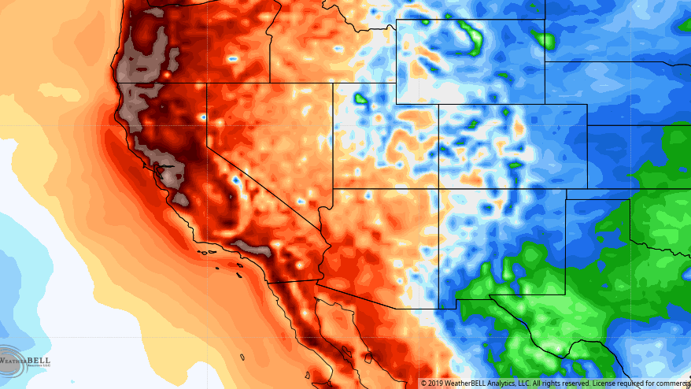
HAQR Updates

Slide 3
Heat and Air Resilience Project: Updates
HAQR Updates
2021 San Francisco Urban Heat Watch: Postponed Until 2022
Health and Human Services Office of Climate Change and Health Equity https://www.hhs.gov/about/news/2021/08/30/hhs-establishes-office-climate-change-and-health-equity.html
Biden Administration Mobilizes to Protect Workers and Communities from Extreme Heat https://www.whitehouse.gov/briefing-room/statements-releases/2021/09/20/fact-sheet-biden-administration-mobilizes-to-protect-workers-and-communities-from-extreme-heat/
Conferences | Webinars
09/24/2021: 2nd Annual NorCAL Symposium for Climate, Health, and Equity https://norcalsymposiumorg.wpcomstaging.com/
09/30/2021: Heat Resilience Through Green Infrastructure https://nihhis.cpo.noaa.gov/Urban-Heat-Island-Mapping/UHI-Campaigns/Webinars
11/16/2021: 2021 Place and Health Conference https://www.placeandhealthconference.com/#lct=entranc

Slide 4
Implementation Teams: Workflow Review

Slide 5
Heat and Air Resilience Project: Implementation Team Workflow
Meeting Summer 2021
Meeting Winter 2021/2022
Existing Buildings
Address barriers for weatherization in public and private facilities, especially those serving vulnerable populations.
Green Infrastructure
Reduce urban heat islands and poor air quality through trees, open space and natural areas, parks, cool pavement, and other green infrastructure.
Community Readiness
Support community-facing resilience programs that build community capacity
Emergency Response
Address barriers for weatherization in public and private facilities, especially those serving vulnerable populations.

Slide 6
Heat and Air Resilience Project: Implementation Team Workflow
Phase 1: Develop a Work Plan
Phase 2: Expand Strategies
Create Team Goals and Objectives
Develop Implementation Plan Based on Work Plan
Landscape Analysis
Scoping
SMART Goals
Identify Stakeholders
Roles and Responsibilities
Research Needs
Community Involvement Strategy
Resources Available | Needs
What Are The Current Barriers?
How Will This Strategy Be Evaluated?
Prioritization
Deliverable: Work Plan
Presentation to Coordination Committee for Review
Presentation to Coordination Committee for Review
Incorporate Feedback to Finalize Implementation Plan
September 2021
Incorporate Feedback to Finalize Work Plan
Phase 3: Implement Strategies

Slide 7
Heat and Air Resilience Project: Implementation Team Workflow
Prioritization Criteria | Analysis
What is the magnitude of impact? | Prioritize actions that help the most people
What is the urgency for this action? | Prioritize actions that respond to the most urgent needs.
How effective is the action? | Prioritize actions with significant evidence base.
What is the political feasibility? | If an action is not currently politically feasible, generating buy-in could itself be an action.
What is the economic feasibility? | If an action is not currently economically feasible, identifying funding could itself be an action.
What is the social feasibility? | If an action is not currently socially feasible, generating buy-in could itself be an action.
What is the technological feasibility? | If an action is not currently technologically feasible, research could itself be an action.
Does it advance racial and social equity? | Prioritize actions that address root causes of inequality.
Does it impact future actions? | Allow for actions that may not have the greatest magnitude but are first steps towards future actions.
Does it address other goals? | Prioritize actions that address other City initiatives.

Slide 8
Heat and Air Resilience Project: Implementation Team Workflow
Prioritization Criteria | Analysis
What is the magnitude of impact? | Prioritize actions that help the most people
What is the urgency for this action? | Prioritize actions that respond to the most urgent needs.
How effective is the action? | Prioritize actions with significant evidence base.
What is the political feasibility? | If an action is not currently politically feasible, generating buy-in could itself be an action.
What is the economic feasibility? | If an action is not currently economically feasible, identifying funding could itself be an action.
What is the social feasibility? | If an action is not currently socially feasible, generating buy-in could itself be an action.
What is the technological feasibility? | If an action is not currently technologically feasible, research could itself be an action.
Does it advance racial and social equity? | Prioritize actions that address root causes of inequality.
Does it impact future actions? | Allow for actions that may not have the greatest magnitude but are first steps towards future actions.
Does it address other goals? | Prioritize actions that address other City initiatives.
This exercise is too academic. There are too many criteria. Please simplify!
Many of the terms are too abstract. How do you measure magnitude, urgency, political feasibility, etc?
Capacity is a particularly important indicator– i.e. Is there a staff-person to work on this action?

Slide 9
Heat and Air Resilience Project: Implementation Team Workflow
Revised Prioritization Exercise
Section | Question | Scale
Impact | This action directly advances the goals and objectives of this implementation team. | Yes, Somewhat, No, Not Sure
 | This action directly or indirectly addresses root causes of health disparities. | Yes, Somewhat, No, Not Sure
 | This action aligns with and/or supports other City climate goals. | Yes, Somewhat, No, Not Sure
 | This action is a necessary first step to future HAQR resilience actions. | Yes, Somewhat, No, Not Sure
Capacity | My (department / organization) is likely willing to allocate STAFF TIME for implementation of this action within the next calendar year | Yes, Probably, Probably Not, No
 | If necessary, my (department / agency) is willing to allocate MONEY for implementation of this action within the next calendar year | Yes, Probably, Probably Not, No
Notes:
Reworked the purpose of the exercise:
- All actions are important. Prioritized actions will be the ones the Team will focus on in 2022. All other actions will be kept in an ‘action bank’ for future.
- We didn’t want to give points to different actions, so the purpose of this exercise is to compile data that the Implementation Team can use to select actions.
- Reduced questions, simplified scale, recognized that a lot of the work (goals and objectives) were already done by the implementation team.

Slide 10
Heat and Air Resilience Project: Implementation Team Workflow
Phase 1: Develop a Work Plan
Phase 2: Expand Strategies
Create Team Goals and Objectives
Develop Implementation Plan Based on Work Plan
Landscape Analysis
Scoping
SMART Goals
Identify Stakeholders
Roles and Responsibilities
Research Needs
Community Involvement Strategy
Resources Available | Needs
What Are The Current Barriers?
How Will This Strategy Be Evaluated?
Prioritization
Deliverable: Work Plan
Presentation to Coordination Committee for Review
Presentation to Coordination Committee for Review
Incorporate Feedback to Finalize Implementation Plan
September 2021
Incorporate Feedback to Finalize Work Plan
Phase 3: Implement Strategies

Slide 11
Implementation Teams: Workplans

Slide 12
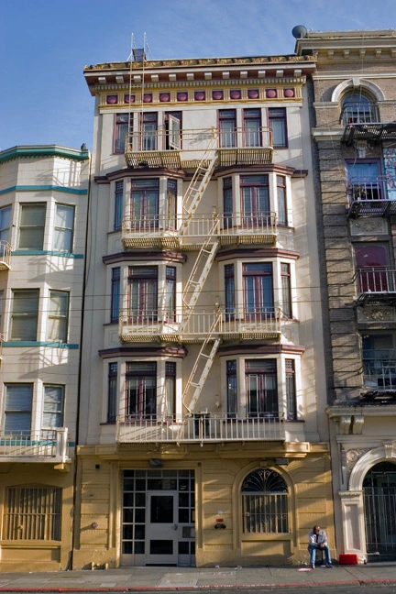
Existing Buildings
Heat and Air Resilience Project: Existing Buildings
Name | Department | Organization
Melissa Higbee (chair) | ORCP
Erin Carson | MOHCD
Teri Dowling | SFDPH
Lowell Chu | SFE
Ryan Ramos | SFE
Sachiko Tanikawa | RED
Elizabeth Hewson | HSH
Nicole Reams | HSH
Julia Laue | DPW
Vito Vanoni | DPW
Mark Puchalski | TNDC
Heather Heppner | CCDC

Slide 13
Heat and Air Resilience Project: Existing Buildings
Problem Statement | 2026 Goals and Objectives | Barriers | Opportunities and Existing Actions| Workplan Actions and Action Bank
Most buildings in San Francisco have no air-conditioning or other adaptations for increased extreme heat events. Historically, it has reached 85°F about 4 days per year in San Francisco. By the end of the century, climatologists predict this number to grow by about 300%.
California wildfires, which are now an annual certainty, represent an additional climate stressor, and exacerbate these heat events with air quality impacts, increasing the need for vulnerable residents to be able to safely shelter-in-place.
San Franciscans who carry the heaviest health burden often have little to no access to indoor spaces with cooling and ventilation capacity. In San Francisco, most health impacts of extreme heat happen indoors.
San Francisco’s affordable/permanent supportive housing residents are particularly vulnerable. They are more likely to be older adults or people with pre-existing health conditions, and more likely to be without the resources to prepare for and respond to the hazard.
Affordable/permanent supportive housing buildings often exacerbate the extreme heat and smoke events. These buildings are largely concentrated in parts of San Francisco that are known to be urban heat islands. These buildings are often older, with small living spaces, limited ventilation, no mechanical cooling, and without weatherization upgrades; making them more susceptible to overheating and smoke infiltration.

Slide 14
Heat and Air Resilience Project: Existing Buildings
Problem Statement | 2026 Goals and Objectives | Barriers | Opportunities and Existing Actions| Workplan Actions and Action Bank
 | 2026 Goals and Objectives
1 | In affordable/permanent supportive housing with no HVAC systems, tenants have access to air purifiers.
2 | All affordable/permanent supportive housing has, at a minimum, a cool room within the building.
3 | Cooling/clear air weatherization best practices have been identified across a range of building types, including resolution of code conflicts.
4 | 75% of all City buildings that have been identified as potential respite centers have been weatherized. Facility managers are able to balance cooling needs with energy demand to minimize grid impacts consistent with GHG mitigation goals.
5 | Vulnerable residents receive information in real-time and reliable ways to understand conditions (air quality, heat, forecasts) in order to plan for these impacts and access resources (face masks, purifiers, cooling centers, water)

Slide 15
Heat and Air Resilience Project: Existing Buildings
Problem Statement | 2026 Goals and Objectives | Barriers | Opportunities and Existing Actions| Workplan Actions and Action Bank
Barriers
AH/PSH buildings operate with severely constrained budgets, limiting the ability to take on debt for upfront costs of weatherization increased O&M costs for equipment. | To date, there has been limited use of public respite facilities. For a variety of reasons, people tend to prefer to shelter-in-place when possible.
Each building has a unique set of constraints and potential cooling/clear air options. There is no one size fits all, making it more challenging to scale weatherization efforts. | The Wholesale Distribution Tariff conflict with PG&E is hampering progress on City projects that involve upgraded electrical service or located on the Downtown grid.
Weatherization programs are not reaching enough buildings in SF to achieve the levels of weatherization needed given our changing climate. BayRen energy efficiency program’s reach is limited by a program budget cap and rebate set at $750 per unit by CPUC. | CA's electric grid is severely constrained during extreme heat and wildfires, increasing the likelihood of Flex Alerts, rolling blackouts, or Public Safety Power Shutoffs (PSPS), and decreasing the effectiveness of mechanical cooling and ventilation during such events.
Building owners making weatherization improvements face conflicting regulatory requirements from different agencies (e.g., historic preservation, ADA, green building) that make projects more costly, time consuming, or infeasible. | AH/PSH building decision makers don’t always know what solutions residents want. There may be a diversity of preferences within the same building. The solutions residents prefer may not be feasible or available.

Slide 16
Heat and Air Resilience Project: Existing Buildings
Problem Statement | 2026 Goals and Objectives | Barriers | Opportunities and Existing Actions| Workplan Actions and Action Bank
Opportunities and Existing Actions
BayREN Multi-family EE program - Rebates and technical assistance for achieving 10% energy efficiency. | New CPUC ruling that equity programs are not subject to a cost effectiveness test.
COVID-19 ventilation improvements: Building owners have made ventilation improvements to keep building occupants safe during COVID; PW guidance on ventilation during COVID. | Renovations to support public respite facilities, e.g., Laguna Honda, Kezar Stadium, libraries
988 Howard Work Group: Developed solution to address overheating building | Article 38 of the San Francisco Health Code requires new construction in areas of poor air quality to install enhanced ventilation systems to protect residents from health effects associated with breathing polluted air.
Draft update to Chapter 7 Municipal Green Building Code includes energy resilience. Critical Community Facilities new construction or HVAC replacement: solar + storage ready. | Chapter 9 Environment Code sets goal of all buildings zero emission by 2040. Natural gas boiler replacement provides opportunity for heat pumps that also provide energy efficient cooling.
Better Roofs Ordinance: between 15% and 30% of roof space on most new construction projects incorporate solar, living roofs, or a combination of both.

Slide 17
Heat and Air Resilience Project: Existing Buildings
Problem Statement | 2026 Goals and Objectives | Barriers | Opportunities and Existing Actions| Workplan Actions and Action Bank
 | 2022 Workplan Actions
1 | Promote and develop financing models to facilitate weatherization and equipment installation (heat pumps, envelope improvements, ventilation upgrades). Leverage the CPUC decision allowing for equity programs to not be subject to cost effectiveness test to develop new programs, especially for smaller buildings that are underserved by existing programs.
2 | Raise awareness among decision-makers of the weatherization challenges posed by conflicting codes. Gain sufficient traction to create a Task Force with SME representation from Historic Preservation, Green Building, ADA, Electrification, PGE, PUC to create guidelines/policies to handle conflicting goals within City agencies/codes, such as a prioritization matrix.
3 | Prepare a list of pilot projects to study the common issues that arise when weatherizing specific building types. Choose about 5 building types across a range of structures. Study buildings for their constraints and options. Identify programs that could pay for the improvements.
4 | Develop heat and air quality design guidelines for new buildings, including rehab projects, to help designers and PMs consider array of strategies, not just AC. Consider the application of the Article 38 Health Code enhanced ventilation standard to more buildings in the guidelines.
5 | Prioritize buildings to weatherize based on criteria such as age, function, and equity. Pick a target percentage to achieve each year.
 | Action Bank
6 | (EMERGENCY RESPONSE?) Fund three community organizations to pilot a cooling/clean air respite center that would be open to the public, would attract vulnerable populations, would publicize, and is cost efficient regarding staffing and resources. Provide funds for operational costs.
7 | (COMMUNITY READINESS?) Coordinate with 311, DEM (SF72.org), SFAlterts text alerts to provide vulnerable residents with information.
8 | Conduct a study to support affordable housing tenant access to air purifiers in buildings without HVAC. The study should identify: cost, including maintenance and replacement costs; funding source(s) for equipment; protocols for managing filter replacement; evaluation of available technologies.
9 | Fund a common room cooling pilot program. Involve residents as well as management in program design and implementation.
10 | Identify programs for quick deployment of new technologies to test and learn.
11 | Identify City-owned buildings requiring weatherization to serve as public respite centers. Develop a weatherization standard. Identify funding. Identify indirect impacts.

Slide 18
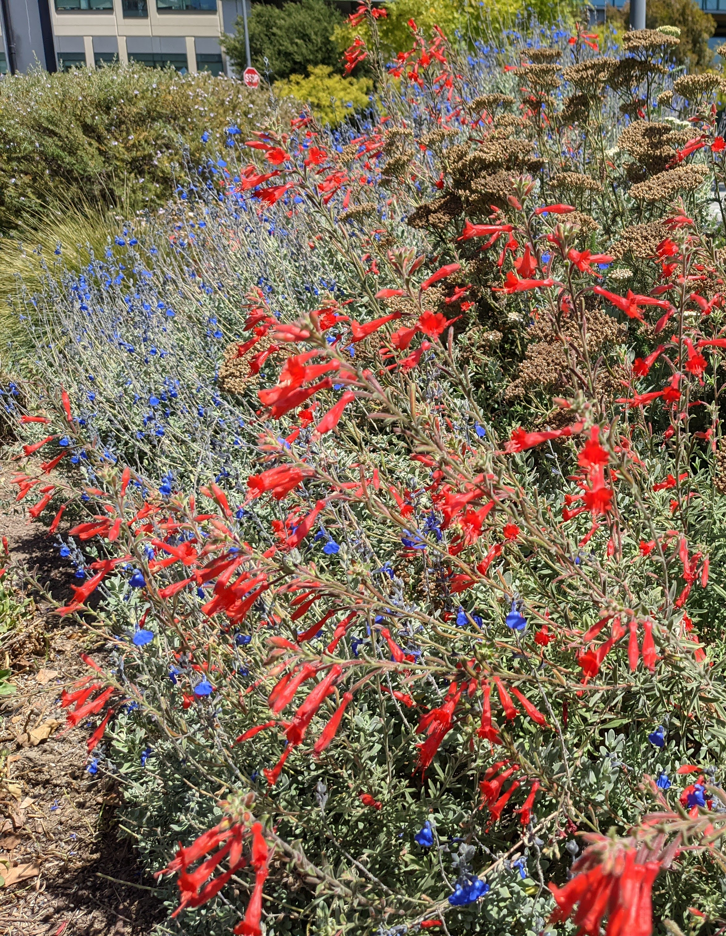
Green Infrastructure
Heat and Air Resilience Project: Green Infrastructure
Name | Department | Organization
Jennifer Cooper (chair) | DPW – Landscape Architecture
Dennis Kern | RPD - Operations
Jon Swae | DPW – Urban Forestry
Peter Brastow | SFE - Biodiversity
Nicholas Crawford | DPW– Urban Forestry

Slide 19
Heat and Air Resilience Project: Green Infrastructure
Problem Statement | 2026 Goals and Objectives | Barriers | Opportunities and Existing Actions| Workplan Actions and Action Bank
Access to tree coverage and green infrastructure is not distributed evenly through San Francisco and many of the neighborhoods with the greatest health burden of extreme heat and air quality are underserved.
The ability to identify exactly where heat islands and air quality issues are concentrated in the city and identify interventions that can reduce people’s exposure to extreme heat and particulate matter is critical. This information can be used to prioritize interventions to create maximum health benefits to the public. Clearly communicating these benefits and listening to other overlapping community concerns can create a plan that is extracting as much benefit as possible from any effort undertaken.
Measures of success can include surface temperature readings over time, increase in tree canopy coverage, and an improvement in health outcomes.
There is currently not a clear method to identify these priorities and coordinate funding between agencies and non-profits for installation and long-term maintenance.

Slide 20
Heat and Air Resilience Project: Green Infrastructure
Problem Statement | 2026 Goals and Objectives | Barriers | Opportunities and Existing Actions| Workplan Actions and Action Bank
2026 Goals and Objectives
Tree Planting Plant trees wherever conditions allow. Plant all empty street tree basins in communities experiencing heat and air quality impacts. Heat islands are measurably lower than originally projected (reduction by degrees). Canopy coverage increase corresponds to transportation and potential cool routes to make sure mobility is tied to heat resilience (Green Connections Plan). Public understands how interventions are connected to benefits through clear communication. Create tree nursery and climate justice education center. Protect existing trees from removal through regulation.
Cool Pavement Large areas of asphalt have been identified and partnerships formed with large institutional property owners (such as SFUSD) to install cool/green replacements. Encourage pavement removal through non-profit partnerships that support cool pavement and green infrastructure goals. City streetscape plans have been reviewed and opportunities identified for planted medians or sidewalk expansions to allow for additional tree and sidewalk planting. Other types of shading devices have been identified where tree plantings are not practical.
Data Access Health data is collected at regular intervals to evaluate connection between green space and health measures. Tree canopy is being measured by LIDAR every five years. RPD has completed a tree inventory.

Slide 21
Heat and Air Resilience Project: Green Infrastructure
Problem Statement | 2026 Goals and Objectives | Barriers | Opportunities and Existing Actions| Workplan Actions and Action Bank
Barriers
Political Barriers Difficult to coordinate across agencies (funding and communication) Change to decision making based on data instead of district/agency. | Technological Barriers Data Gaps Health Data LIDAR data is outdated RPD full inventory assessment Data Use How to use data to prioritize interventions
Social Barriers Public perceptions on tree plantings and relation to green infrastructure (loss of parking, introduced cleaning nuisance, not capturing perceived benefit) Shading perceptions are often focused on tree plantings rather than potential artificial interventions. | Economic Barriers Funding for new plantings is limited Resources for tree and landscape maintenance is limited Including green infrastructure in areas with limited space requires moving curbs and utilities that are expensive and, by necessity, long-term project. Maintenance does not consider lifetime costs

Slide 22
Heat and Air Resilience Project: Green Infrastructure
Problem Statement | 2026 Goals and Objectives | Barriers | Opportunities and Existing Actions| Workplan Actions and Action Bank
Opportunities and Existing Actions
Green infrastructure grant program | Urban Forest Master Plan
Green schoolyards | StreetTreeSF
Bureau of Urban Forestry Planting Strategy | Tree and plant nursery
Entire non-profit ecosystem of tree planting groups | Other green infrastructure programs (green roofs, etc.)
San Francisco Department of Environment grant program (carbon grants have been used to support tree plantings in the past)

Slide 23
Heat and Air Resilience Project: Green Infrastructure
Problem Statement | 2026 Goals and Objectives | Barriers | Opportunities and Existing Actions| Workplan Actions and Action Bank
 | 2022 Workplan Actions
1 | Review urban heat island and air quality exposure data, and spatial heat and air quality-related health data to identify priority action areas in each district. Identify barriers and opportunities in each of these priority areas to develop a menu of HAQR actions that includes tree planting, non-tree shade options, and cool pavement pilot programs.
2 | Define a process for routine LIDAR data collection on a 5-year basis. Identify and secure dedicated funding sources and develop a data management plan.
3 | Explore potential funding options such as bond, green infrastructure grants, and other financial vehicles.
 | Action Bank
4 | Continue to explore partnerships with non-profits, health organizations, and other City departments
5 | Collect literature on the relationship between green infrastructure and public health.
6 | Support implementation of the newly funded Bureau of Urban Forestry nursery at 5th Street between Harrison and Bryant.
7 | Compare costs of irrigation versus hand watering for maintenance.
8 | Pursue public information campaign in partnership with non-profit planting groups to better understand the public concerns around green infrastructure and to better understand barriers and opportunities.
9 | Based on the mapping exercise, develop district-level plans that includes planting trees in priority areas, studying non-tree shade options, and exploring cool pavement pilot program strategies.

Slide 24
Next Steps

Slide 25
Heat and Air Quality Resilience Project (HAQR)
Next Steps
Finalize Work Plan | Begin Phase 2
Meeting Winter 2021/2022
Existing Buildings
Address barriers for weatherization in public and private facilities, especially those serving vulnerable populations.
Green Infrastructure
Reduce urban heat islands and poor air quality through trees, open space and natural areas, parks, cool pavement, and other green infrastructure.
Community Readiness
Support community-facing resilience programs that build community capacity
Emergency Response
Address barriers for weatherization in public and private facilities, especially those serving vulnerable populations.

Slide 26
Heat and Air Quality Resilience Project (HAQR)
Next Steps
Next Meeting: Early December
Evaluation (How can we Improve)
Community Readiness | Emergency Response Teams
If you want to be involved, Matt.Wolff@sfdph.org or Alex.Morrison@sfgov.org
Any other thoughts or suggestions? Activities or events you want highlighted? Let us know.

