Slide 1
Coordination Committee Meeting #2 July 30, 2021 | 3:00pm – 4:00pm
Introductions (on the Chat)
Name | Agency | Last ”Binge” TV Show
Agenda
Review
PNW Heat Wave
HAQR Updates
Implementation Team Prioritization Process
Matt Wolff | SFDPH | Matt.Wolff@sfdph.org
Alex Morrison | SF ORCP | Alex.Morrison@sfgov.org
Notes:
[Alex]

Slide 2
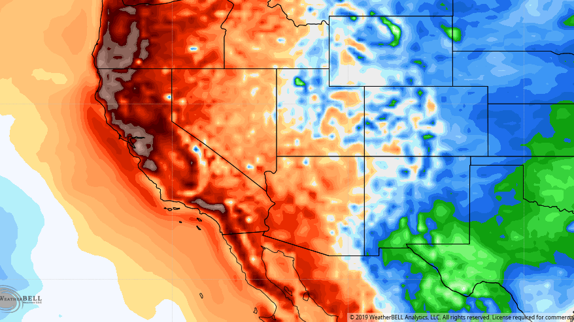
Review
Notes:
Name, agency or organization, Last TV show you binged?
Alex: The Expanse
Matt: Hacks

Slide 3
Background on Extreme Heat and Air Quality
Heat and Air Quality Resilience Project (HAQR)
Climate change makes San Francisco's extreme heat events and wildfire smoke events more frequent and more intense.​
These events have significant, cascading, and compounding impacts on public health and these health impacts are not evenly distributed. The communities who carry the heaviest health burden are the ones most exposed, most sensitive, and least likely to have the economic, social, or political resources necessary to prepare or adapt. ​
San Francisco is particularly vulnerable to the health impacts of extreme heat and wildfire smoke because our built and natural environment are not adapted for them.​
The actions necessary to reduce health impacts from extreme heat or wildfire smoke exist across departments and organizations and requires collaboration from agencies and community organizations that 1) plan or executive emergency preparedness and response activities, 2) build regulate or maintain housing or other facilities, 3) plan or manage open space, infrastructure and other public works, 4) provide health care and other community services, or 5) who represent, engage, or work closely with the communities most vulnerable to the health impacts of these events. ​’
While the City has carried out interdepartmental planning to identify medium-to-long term resilience strategies, there has not been sustained and coordinated effort to implement these strategies or a centralized space to discuss emergent issues and share resources.
Notes:
Can provide one-pager

Slide 4
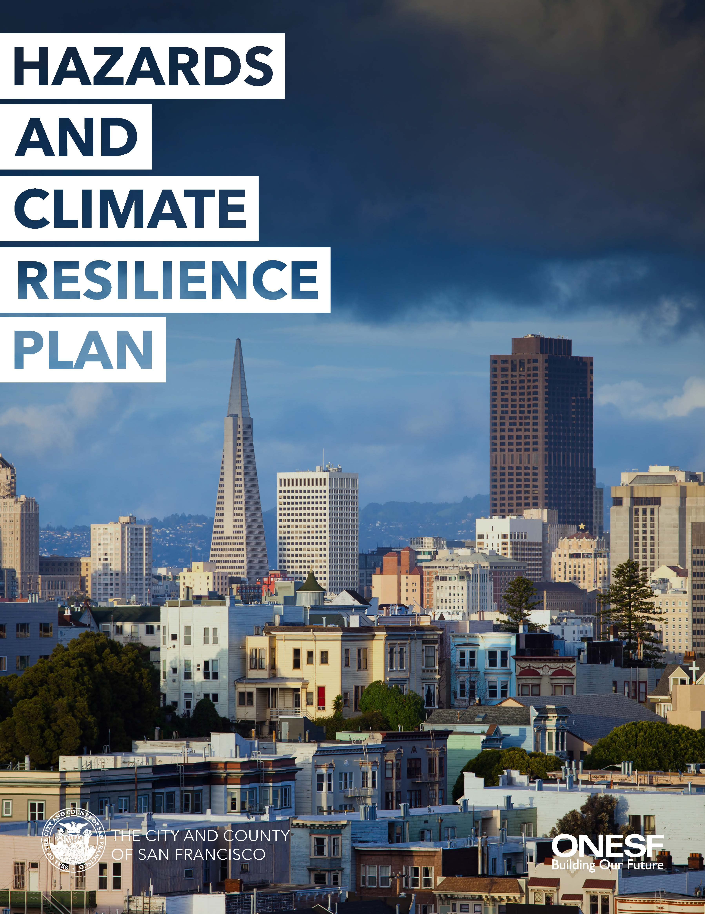
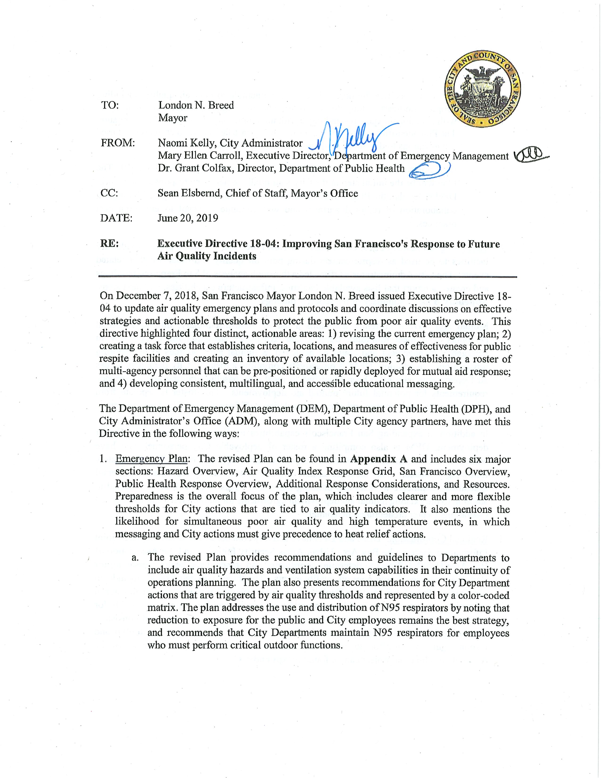
Heat and Air Quality Resilience Project
Increasing the resilience of San Francisco’s frontline communities to the health impacts of extreme heat and wildfire smoke by: ​
Coordinating the implementation of medium to long-term resilience strategies
Making sure efforts benefit communities with the greatest health burden​
Increasing funding for activities​
Supporting research and evaluation​
Increasing community involvement
Executive Directive 18-04
Notes:
The goal of the Heat and Air Quality Resilience Project is to increase the resilience of San Francisco’s frontline communities to the health impacts of extreme heat and poor air quality. To achieve this, the Heat and Air Quality Resilience Project bolsters the immediate and on-going emergency response actions that you’ve heard about today with targeted implementation planning for the City’s medium to long-term preparedness, response, and resilience strategies.
The project is designed to turn high-level strategies from the City’s existing plans and directives that you see on the right side of the slide (the Hazards and Climate Resilience Plan, Executive Directive 18-04, and Climate Action Plan) into specific initiatives with detailed implementation plans. The Project provides resources to coordinate implementation across departments and community stakeholders, makes sure that initiatives benefit communities with the greatest health burden, and we are identifying funding sources (including the State’s newly adopted $3.7 billion budget for climate resilience), research needs, performance measures, and increasing community involvement opportunities.

Slide 5
Pacific Northwest Heat Wave

Slide 6
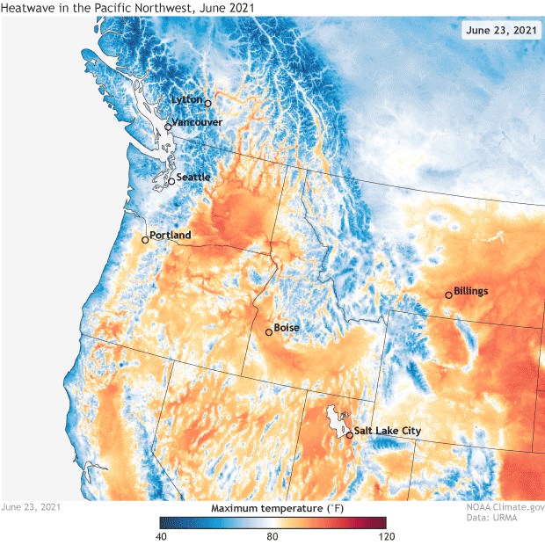
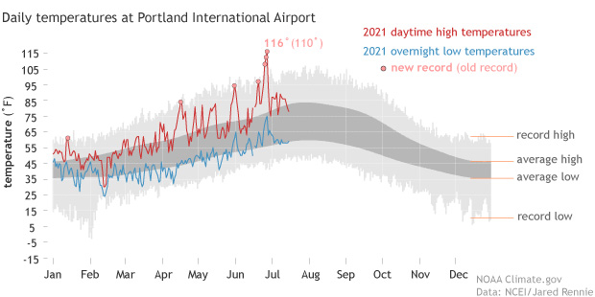
Pacific Northwest Extreme Heat Event
Heat and Air Resilience Project: PNW
Record Breaking Extreme Heat Event:
Seattle: 108 Degrees
Portland: 116 Degrees
Salem: 117 Degrees
Canada: 121 Degrees!
Notes:
Seattle, Portland, Vancouver: Similar Climates
Climate change doesn’t only change averages, it changes the maximum and minimum temperatures. In today’s climate, researchs theorize this was a 1-1000 year event, but without manmade climate change, 1 in 150,000.
NWS used 25/75 intervals
A high-pressure system, stronger than ever observed in the region sat over the region for several days.
The cloudless skies and sinking air associated with the high pressure helped record temperatures build.
Seattle highest temperature ever recorded of 108 (previous 105 in 2009)
Seattle had only hit 100 degrees three times ever, and it hit 100 degrees three times this June.
Portland’s Previous High Temperature was 107 degrees (Set in 1965), they broke that on Saturday (108), Sunday (112) and Monday (116).
Average temperature at the Portland Airport for late June is 73 degrees– nearly 40 degrees cooler!
Lytton British Columbia hit (116, 118, 121) which was the highest temperature ever recorded in the country of Canada– the previous high was 113.

Slide 7
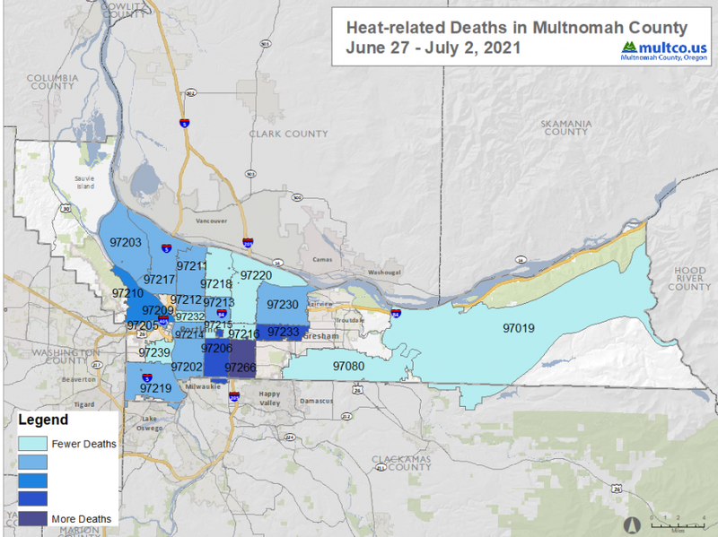
Pacific Northwest Extreme Heat Event
Heat and Air Resilience Project: PNW
Health Impacts
Between June 25 and July 1, 719 Deaths reported to BC Coroners. Three times normal.
HHS Region 10 had 3504 heat-related illness ED visits.
June 28 2021: 1090 Heat-related ED visits
June 28 2019: 9 Heat-related ED visits
Oregon and Washington: At least 200 heat-related deaths
Multnomah County Data (Conversation):
60 HRI Deaths
154 HRI ED Visits
Demographic | Socioeconomic
Preliminary Analysis From Portland (WashPo)
61% of deaths in zip codes with poverty rates higher than the county average
Male, Over 75
Impervious Surfaces (Homeless Encampments)

Slide 8
Pacific Northwest Extreme Heat Event
Heat and Air Resilience Project: PNW
Other Impacts
Infrastructure Impacts
Sprinkler systems
Over a billion marine animals died
Contributes to wildfire conditions
King County (Seattle) Public Health
EMS Impacts
EMS call volume increased as the heat wave went on
EMS call volume peaked after 5pm on the hottest day
Hospital Impacts
Diversion at 2200 on 6/28 created cascading impacts
Renal failure admits/visits of particular concern
Important to outreach to LTCF to prevent evacuations
Emergency Response
Tracked Heat-Related Illnesses, Drownings, Renal Failure
Cooling centers used (as well as in Multnomah)

Slide 9
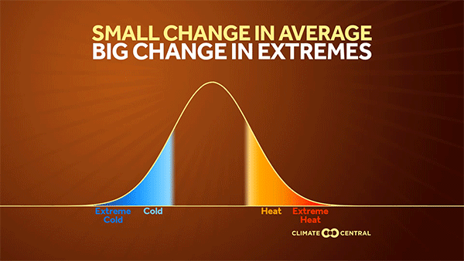
Pacific Northwest Extreme Heat Event
Heat and Air Resilience Project: PNW
Lessons Learned
1000-year events are not only possible but are likely to happen more than once every 1000 years
Important to receive extreme projections!
Significant health impacts, especially in the zip codes with the highest poverty rates
Temperature distribution throughout the City predicated on green infrastructure, impervious surfaces, and based on legacy of redlining and disinvestment
Social determinants of health
People without access to cooling in their home are particularly vulnerable
Long Term Care Facilities
Older Adults
Unsheltered Populations
Social Isolation
Others?

Slide 10
HAQR Updates

Slide 11
Heat and Air Resilience Project: Updates
Implementation Teams
Green Infrastructure
Reduce urban heat islands and poor air quality through trees, open space and natural areas, parks, cool pavement, and other green infrastructure.
Existing Buildings
Address barriers for weatherization in public and private facilities, especially those serving vulnerable populations.
Community Readiness
Support community-facing resilience programs that build community capacity
Emergency Response
Address barriers for weatherization in public and private facilities, especially those serving vulnerable populations.
Notes:
4 implementation, community readiness and emergency response under one and then turn it over to the chairs: call Melissa, Lisa, Jennifer

Slide 12
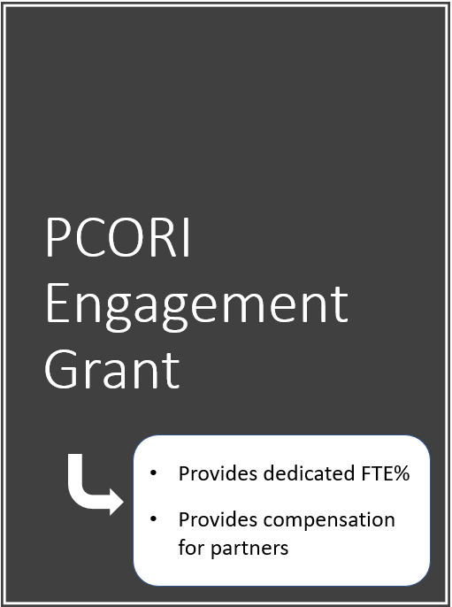
Bring community perspectives to implementation teams
Engage in the process
Co-develop mitigation strategies
Notes:
Turn it over to [Neeta]

Slide 13
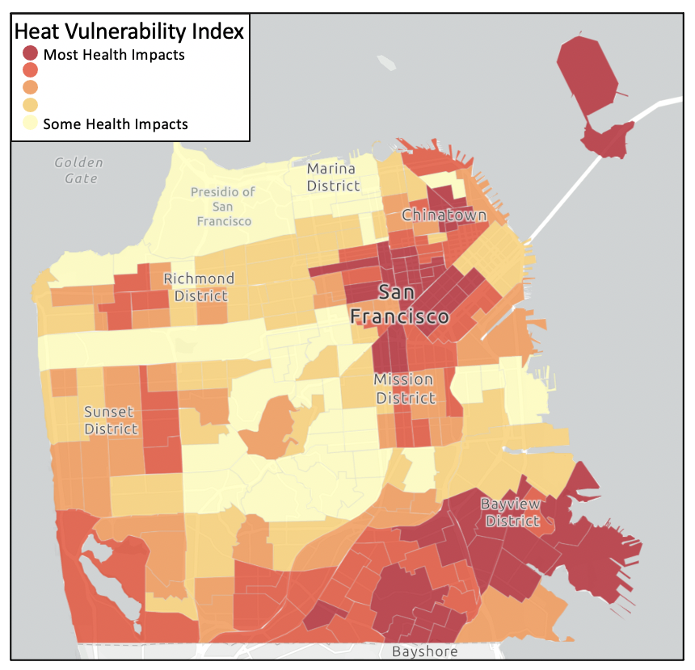
BUILDING CAPACITY FOR RESEARCH TO ADDRESS CLIMATE-IMPACTED HEALTH CONDITIONS
CONCEPTUAL FRAMEWORK AND LOGIC MODEL
Context/Situation Inputs & Group Dynamics Activities Outcomes & Impacts
UCSF CER/PCOR Researchers
Coffee-Break Meetings
HAQR Meetings
Identify & Engage Community Stakeholders
Consult – Conduct Focus Groups & Interviews
Conceptualize
Generate Research Questions
Prioritize Research Questions
Disseminate Research Agenda
System & Capacity Changes
Community empowerment
Shared power relations in research
Sustainable partnerships
Growth in capacity
Co-developed CER Agenda
Improved Health & Reduced Disparities
Municipality Stakeholders
Structural Dynamics
Relational Dynamics
Warming climate disproportionately affecting low-income communities
National & Local Policies, Trends, Governance
Social, Economic, Cultural Factors
Historical Context of Collaboration
Community & University Capacity/ Readiness
Health Issues
Individual Dynamics
Industry Stakeholders
Community Stakeholders & Community Voices
Notes:
[Neeta]

Slide 14
Proposed Workplan and Timeline
AIM 1: Activities | Identify Stakeholders
Months 2-6 | Coffee-break Meetings Training Joining implementation teams as a stakeholder
AIM 2: Activities | Prioritize Health Conditions and Identify Strategies
Months 7-12 | Community-wide survey Prioritize climate-related health condition for target Identify acceptable mitigation strategies Process mapping to identify barriers and levels
Aim 3 Activities | Action Planning
Months 12-18 Months 18-24 | Focus groups Prioritize mitigation strategies Town hall Pilot test Move successful pilots forward for testing in larger setting
Notes:
[Neeta]

Slide 15
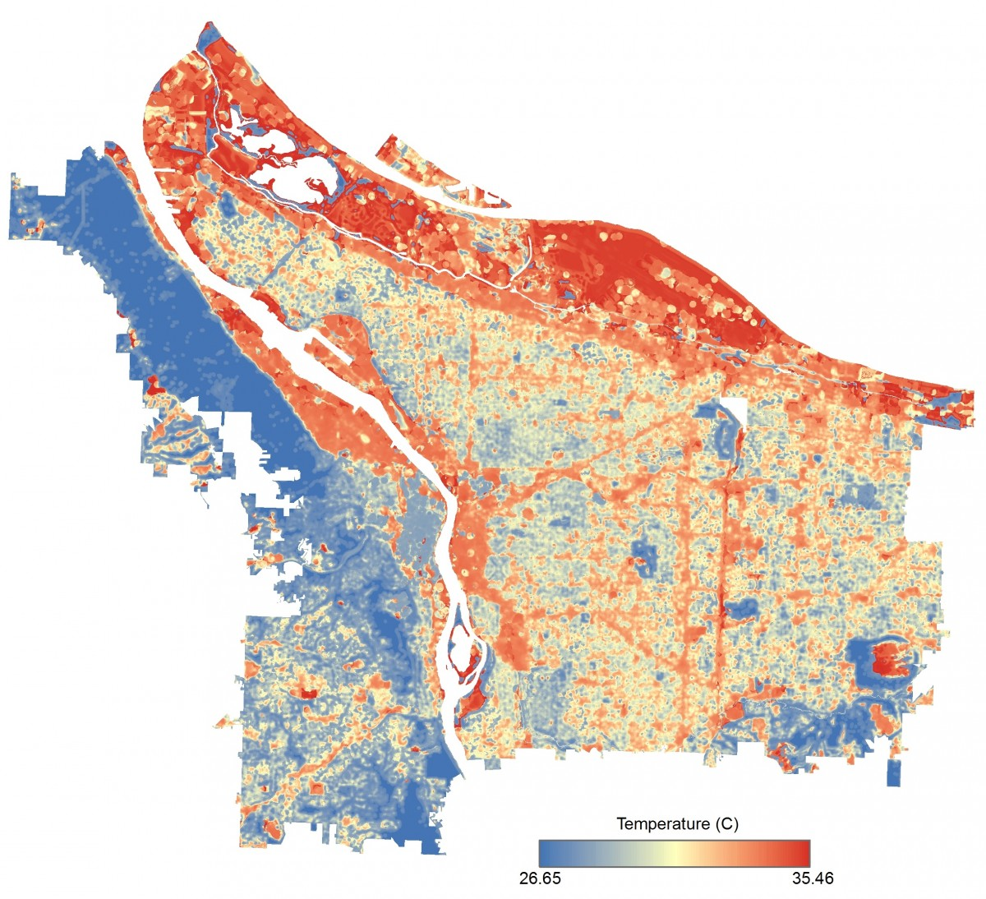
Heat and Air Resilience Project: Updates
NOAA / CAPA Heat Watch Campaign
Campaign Date- Early September
Current Activities
Volunteer Recruitment
Determining Sites of Interest
Next Steps
Communications
Activation!
How Can We Use This Data?
Portland, OR Heat Map
Notes:
[Matt]
Grant from NOAA providing financial support for carrying out a community-led volunteer effort to develop a detailed heat map for San Francisco, identifying specific heat islands within the city.
This effort is being carried out in partnership with Brightline Defense Project, NICOS Chinese Health Coalition, Neighborhood Empowerment Network, and the Department of the Environment.
Information collected through this effort can be used to help target interventions and measure effectiveness of future interventions as well.
Review current activities. Working with Francis from DEM as well as the mayor's office on publicizing the effort over the next month
In the future, we will solicit input from you all for how we can use this data
If you are intrested in elarning more or volunteering, please let us know!

Slide 16
Heat and Air Resilience Project: Updates
Data Tracking
Sources:
Council for State and Local Epidemiologists Heat Syndrome Caste Definition,
Minnesota Department of Public Health
Assessment of Extreme Heat and Hospitalizations to Inform Early Warning Systems” Proceedings of the National Academy of Sciences
Extreme Heat and the Risk to Your Health: An Article for Practitioners” Government of South Africa
Definitions:
Renal Disease (N00 – N399)
Ischemic Heart Disease (I20 – I25)
Health Impacts of Direct Heat (E86, T67, X30)
Drowning (W65 - W74)
Falls (W13, W13.2, W13.4, W13.8, W13.9)
Rhabdomylosis (M62.82)
Asthma (J45)
COPD (J44)
Exclusions
W92

Slide 17
Introduce Prioritization and Feedback Process
Notes:
As you know, we have been working to form the implementation teams to create a detailed implementation plan for strategies that relate to extreme heat and air quality. We have shared what that effort looks like at a high level (which you'll see again in the next slide) but we wanted to share what that process will look like for the different groups going forward as well as when you can expect to be able to provide feedback on not only the process but the deliverables of the process as well.

Slide 18
Heat and Air Resilience Project: Implementation Team Workflow
Phase 1: Develop a Work Plan
Phase 2: Expand Strategies
Create Team Goals and Objectives
Develop Implementation Plan Based on Work Plan
Landscape Analysis
Scoping
SMART Goals
Identify Stakeholders
Roles and Responsibilities
Research Needs
Community Involvement Strategy
Resources Available | Needs
What Are The Current Barriers?
How Will This Strategy Be Evaluated?
Prioritization
Deliverable: Work Plan
Presentation to Coordination Committee for Review
Presentation to Coordination Committee for Review
Incorporate Feedback to Finalize Implementation Plan
September 2021
Incorporate Feedback to Finalize Work Plan
Phase 3: Implement Strategies
Notes:
As you heard earlier, all of the groups are currently in Phase I and still early in the process of developing their expected work plans. Two of the teams will be presenting a draft work plan at the September coordination committee for review: the Existing Buildings Team and the Green Infrastructure Team.
During the meeting in September, we will be getting initial impressions from the coordination committee on the draft work plan during the meeting, but we will also have a period for feedback after the meeting as well.
Now, we're going to be walking through the exercises we will be using to develop this work plan and then asking some questions from you all to get feedback on how we are approaching the prioritization process in particular

Slide 19
Heat and Air Resilience Project: Implementation Team Workflow
Phase 1: Develop a Work Plan
1. The year is 2026. There’s an extreme heat wave. There’s a wildfire smoke event. What does success look like?
Create Team Goals and Objectives
Generate List (If necessary, refer to HAQR objectives and the Implementation Team description)
Organize List by Topic Area
Landscape Analysis
Scoping
This list represents our team Goals and Objectives
Prioritization
2. What are our measures of success? How will know whether we are successful?
Deliverable: Work Plan
Generate List (if necessary, refer to goals and objectives identified above)
Attach Possible Data Sources
Presentation to Coordination Committee for Review
Incorporate Feedback to Finalize Work Plan
This list represents our team Evaluative Metrics
Notes:
To start, we are creating team goals and objectives through the lens of what does success in responding to these hazards look like in 2026 (not too far, but past the short-term period). We'll then look at identifying measures of success related to these goals, which will help create evaluation metrics to identify if we are moving towards those goals in the long-term.

Slide 20
Heat and Air Resilience Project: Implementation Team Workflow
3. Document existing City and Community actions related to the implementation team Goals and Objectives.
Action
Description
Lead Organization(s) and Partner Organization(s)
Status (planned, on-going, on-hold)
Phase 1: Develop a Work Plan
Create Team Goals and Objectives
Landscape Analysis
This list represents our Existing Actions
Scoping
4. What are the opportunities to improve/expand the Existing Actions so they better meet the Goals and Objectives?
Prioritization
This list represents our Opportunities
Deliverable: Work Plan
5. What are the barriers to the improvement of these Existing Actions?
Economic
Social
Political
Technological
Informational
Presentation to Coordination Committee for Review
Incorporate Feedback to Finalize Work Plan
This list represents our Barriers
Notes:
The next general step is to perform a landscape analysis of what is already occurring around the identified goals and objectives. As everyone here knows, there is a lot of work already ongoing in the community and within agencies so ensuring that we are strategically supporting these efforts is important. To do that teams are reviewing and cataloging existing actions. After creating this catalogue, teams will identify opportunities to potentially improve or expand these where they align with the goals and opportunities. Finally, this exercise ends with identification of barriers to improving the existing actions.

Slide 21
Heat and Air Resilience Project: Implementation Team Workflow
6. What actions may pursue the Opportunities to improve Existing Actions?
Generate List
Organize List
Phase 1: Develop a Work Plan
Create Team Goals and Objectives
Landscape Analysis
7. What actions may address Barriers to Existing Actions?
Generate List
Organize List
Scoping
Prioritization
8. What other actions would help the City and Community achieve the team Goals and Objectives?
Generate List
Organize List
Deliverable: Work Plan
Presentation to Coordination Committee for Review
9. Combine these three organized lists.
Attach each action to at least one Goals and Objectives
Develop a specific and measurable desired outcome for each action.
Incorporate Feedback to Finalize Work Plan
This list represents our Possible Actions
Notes:
Following this, we move into the scoping portion of the implementation teams work. This portion focuses on brainstorming new actions that may be pursued in order to take advantage of oppertunities and address the barriers that were identified in the course of the excercises thus far. Additionally, we then generate ideas that have not been considered to this point that would put us on the path towards those goals and objectives. Finally, we combine these three lists together and this represents a list of potential actions composing the work plan for each team.
[Alex Hand to Matt]

Slide 22
Heat and Air Resilience Project: Implementation Team Workflow
10. Evaluate each Possible Action
Impact (How much of an impact will the action have on its attached Goals and Objectives and desired outcomes?)
What is the magnitude of impact? (How many people does it help? How much does it help them?)
What is the urgency for this action? (What is the cost of inaction?)
How effective is this action?
Feasibility (How difficult is it to implement the action?)
Politically (leadership support, committed partners)
Economically (cost, maintenance)
Socially (public support)
Technologically
Advances Social and Racial Equity (Does the intervention target root causes of disparities?)
Spillover (Does the action have co-benefits or negative impacts)
Impacts Future Actions (Is the action a first step for future actions?)
Advances Other Goals (Climate Action, Housing, etc)
Phase 1: Develop a Work Plan
Create Team Goals and Objectives
Landscape Analysis
Scoping
Prioritization
Deliverable: Work Plan
Presentation to Coordination Committee for Review
Incorporate Feedback to Finalize Work Plan
Notes:
This is the section that we would like your feedback on in particular, as many people have thoughts on prioritization and it's usually a pretty subjective process. We intend to use the following criteria: Impact, Feasibility, whether it Advances Social and Racial Equity, has spillover (positive co-benefits and un-reduced impacts).
These are not going to be scored or ranked, we will be discussing them and the context will inform implementation team members providing a draft prioritized list of the proposed actions

Slide 23
Heat and Air Resilience Project: Implementation Team Workflow
Prioritization Criteria | Analysis
What is the magnitude of impact? | Prioritize actions that help the most people
What is the urgency for this action? | Prioritize actions that respond to the most urgent needs.
How effective is the action? | Prioritize actions with significant evidence base.
What is the political feasibility? | If an action is not currently politically feasible, generating buy-in could itself be an action.
What is the economic feasibility? | If an action is not currently economically feasible, identifying funding could itself be an action.
What is the social feasibility? | If an action is not currently socially feasible, generating buy-in could itself be an action.
What is the technological feasibility? | If an action is not currently technologically feasible, research could itself be an action.
Does it advance racial and social equity? | Prioritize actions that address root causes of inequality.
Does it impact future actions? | Allow for actions that may not have the greatest magnitude but are first steps towards future actions.
Does it address other goals? | Prioritize actions that address other City initiatives.
Phase 1: Develop a Work Plan
Create Team Goals and Objectives
Landscape Analysis
Scoping
Prioritization
Deliverable: Work Plan
Presentation to Coordination Committee for Review
Incorporate Feedback to Finalize Work Plan

Slide 24
Heat and Air Resilience Project: Implementation Team Workflow
Phase 1: Develop a Work Plan
11. Develop a Work Plan
Introduction to the Implementation Team
Implementation team goals and objectives
What are the existing actions?
What are the barriers?
What are the opportunities?
Action List
Action name
Action description
Which goals and objectives does the action address?
Prioritization results
Impact
Feasibility
Address Social and Racial Equity
Spillover
Create Team Goals and Objectives
Landscape Analysis
Scoping
Prioritization
Deliverable: Work Plan
Presentation to Coordination Committee for Review
Incorporate Feedback to Finalize Work Plan

Slide 25
Heat and Air Resilience Project: Implementation Team Workflow
Feedback on Prioritization Criteria/Process
Phase 1: Develop a Work Plan
We will send a follow-up after the meeting, along with materials, to get feedback on the following aspects of the process:
Does this process make sense?
Are there other criteria we should be considering when prioritizing?
General feedback or suggested changes?
Create Team Goals and Objectives
Landscape Analysis
Scoping
Prioritization
Deliverable: Work Plan
Presentation to Coordination Committee for Review
Incorporate Feedback to Finalize Work Plan

Slide 26
Next Steps

Slide 27
Heat and Air Quality Resilience Project (HAQR)
Next Steps
Heat Watch Campaign (Early September)
Provide additional feedback on prioritization criteria
Participate in September meeting to provide feedback on draft work plans

