Slide 1

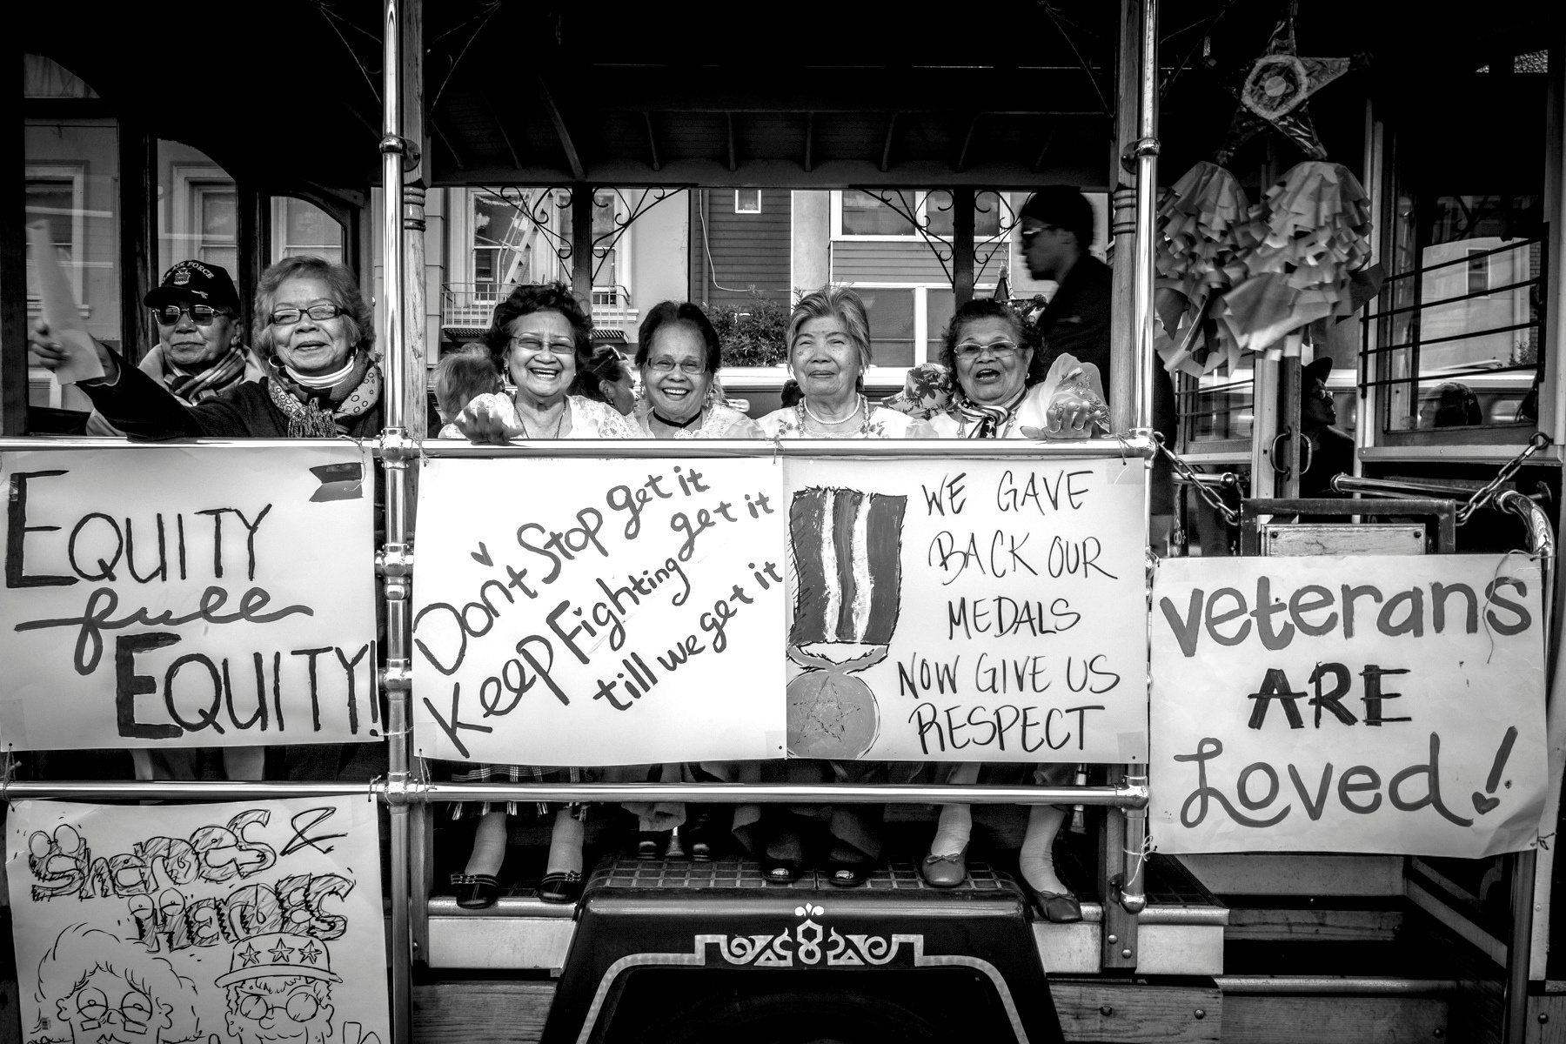


Bayanihan Equity Center
An introduction to the organization, its services and advocacy
Presented by Luisa M. Antonio & Mary Roque

Slide 2
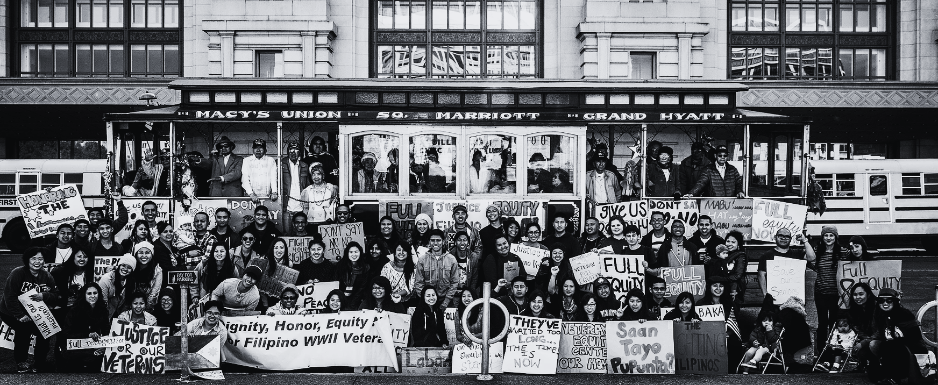
Our Mission
The Bayanihan Equity Center provides culturally responsive services to address the needs and advance the rights of marginalized communities in pursuit of equity and justice.

Slide 3
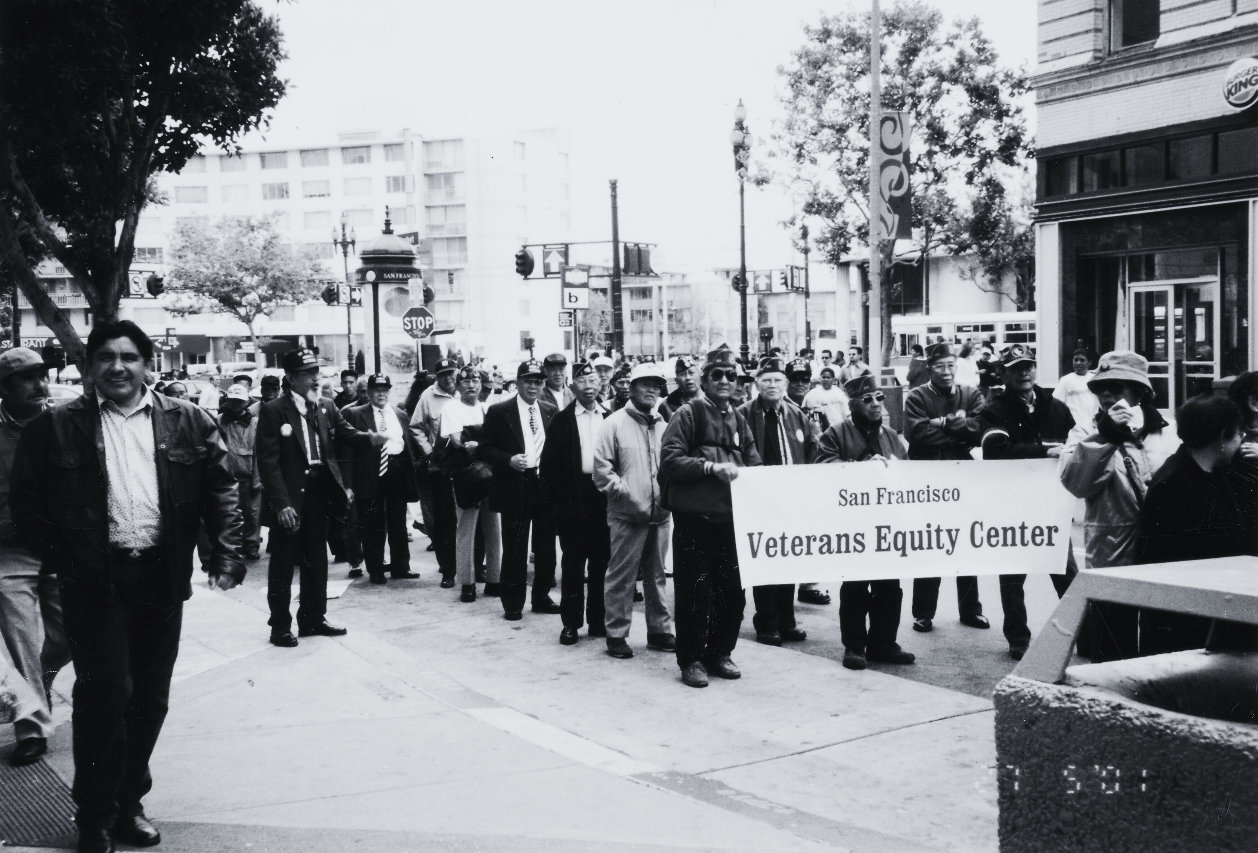
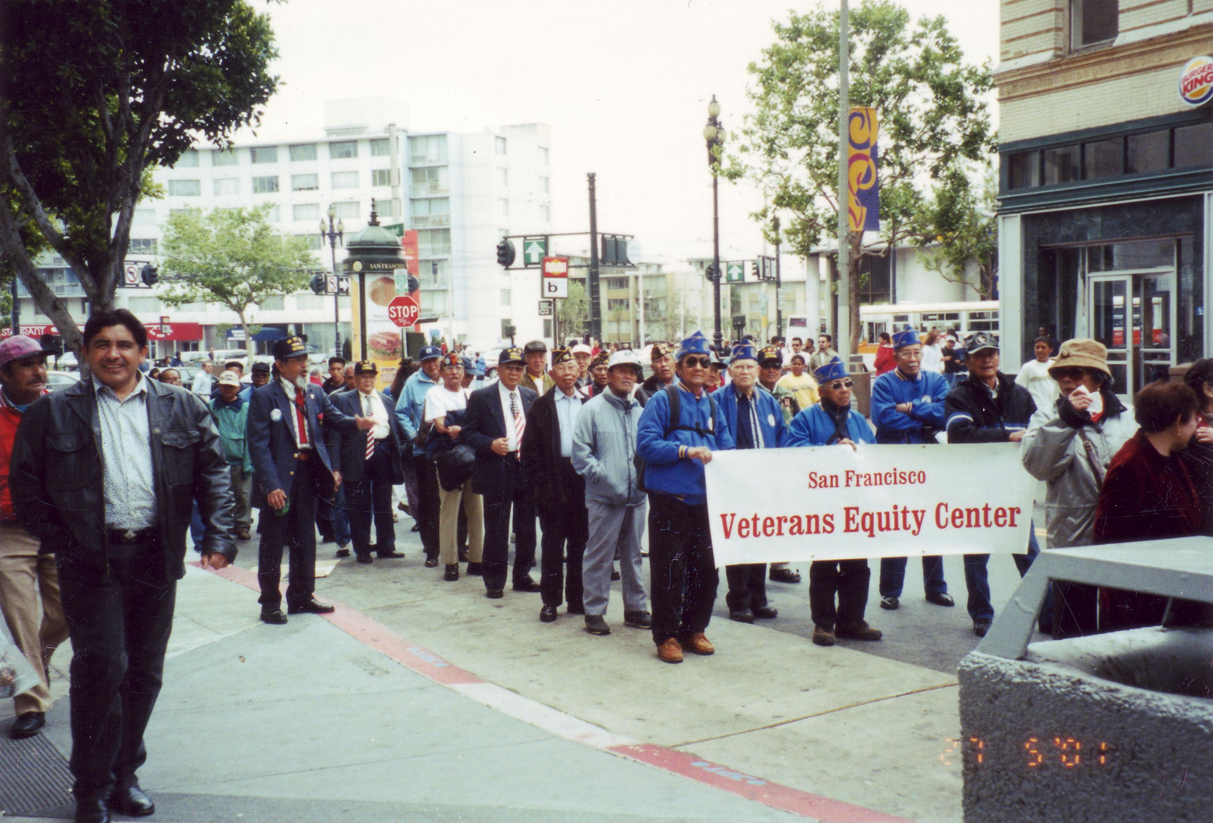
In service of the community since 1999
The Bayanihan Equity Center was originally founded as the Veterans Equity Center in December 1, 1999 to serve Filipino World War II veterans and their families.

Slide 4
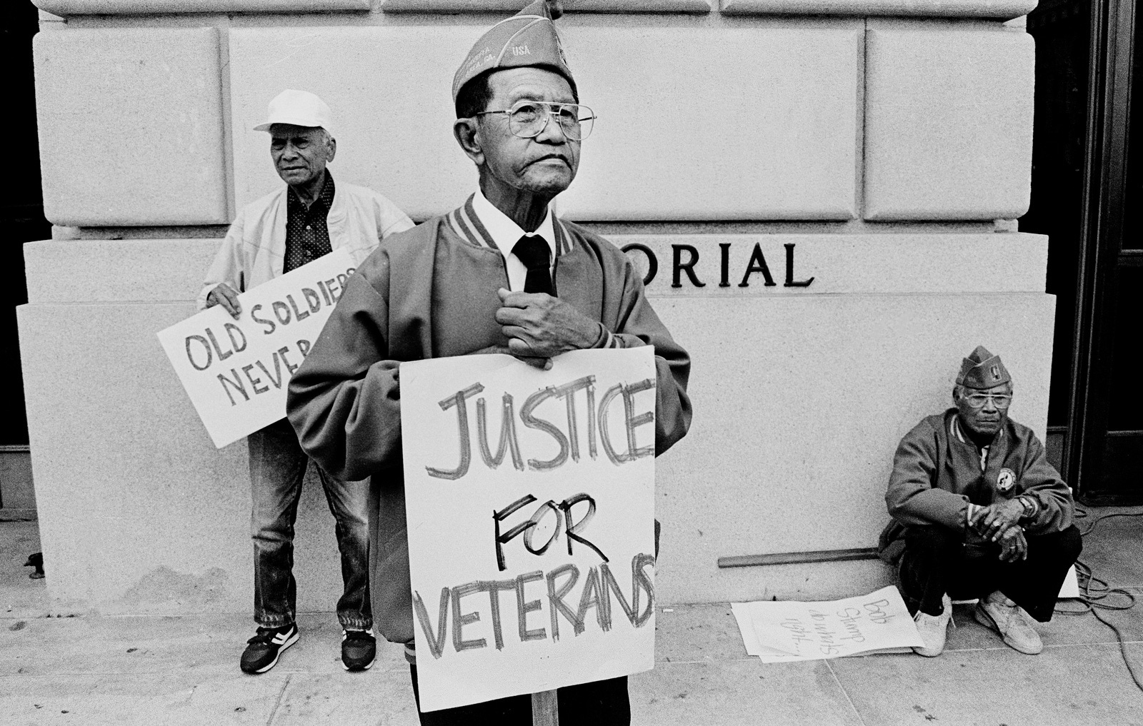
Immigration & Naturalization Reform Act of 1990 (P.L. 101-649)
Enacted on Novemberr 29, 1990.
More than 100,000 Filipino World War II veterans became eligible for naturalization, and of that, 26,000 veterans in the Philippines immigrated to the United States.
These veterans were unqualified for veteran benefits, and became dependent on social programs, such as SSI, soup kitchens, and the support of volunteers.
Photo by Rick Rocamora

Slide 5
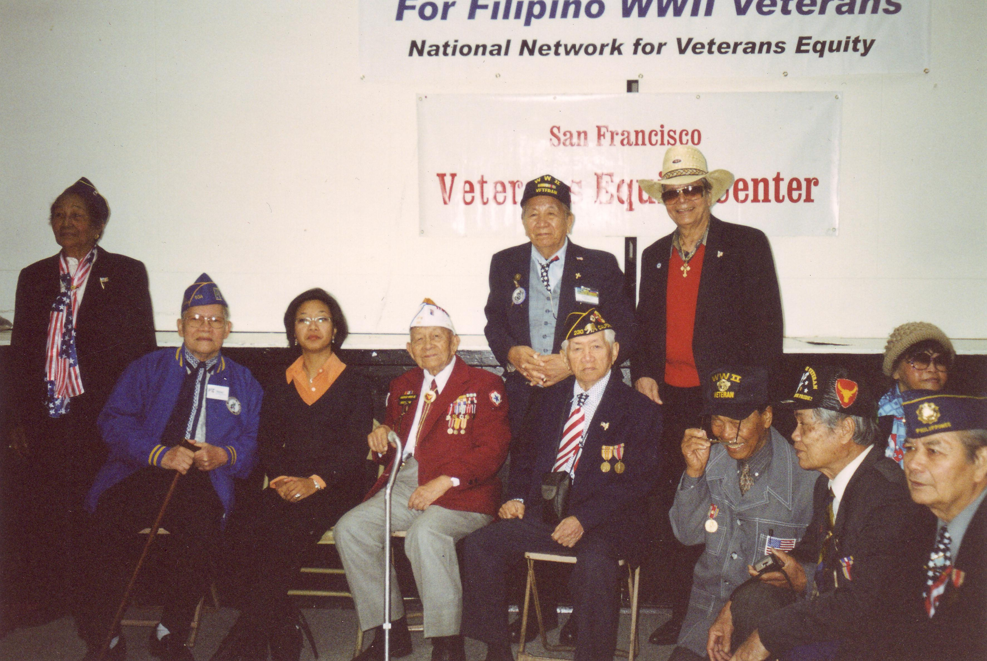
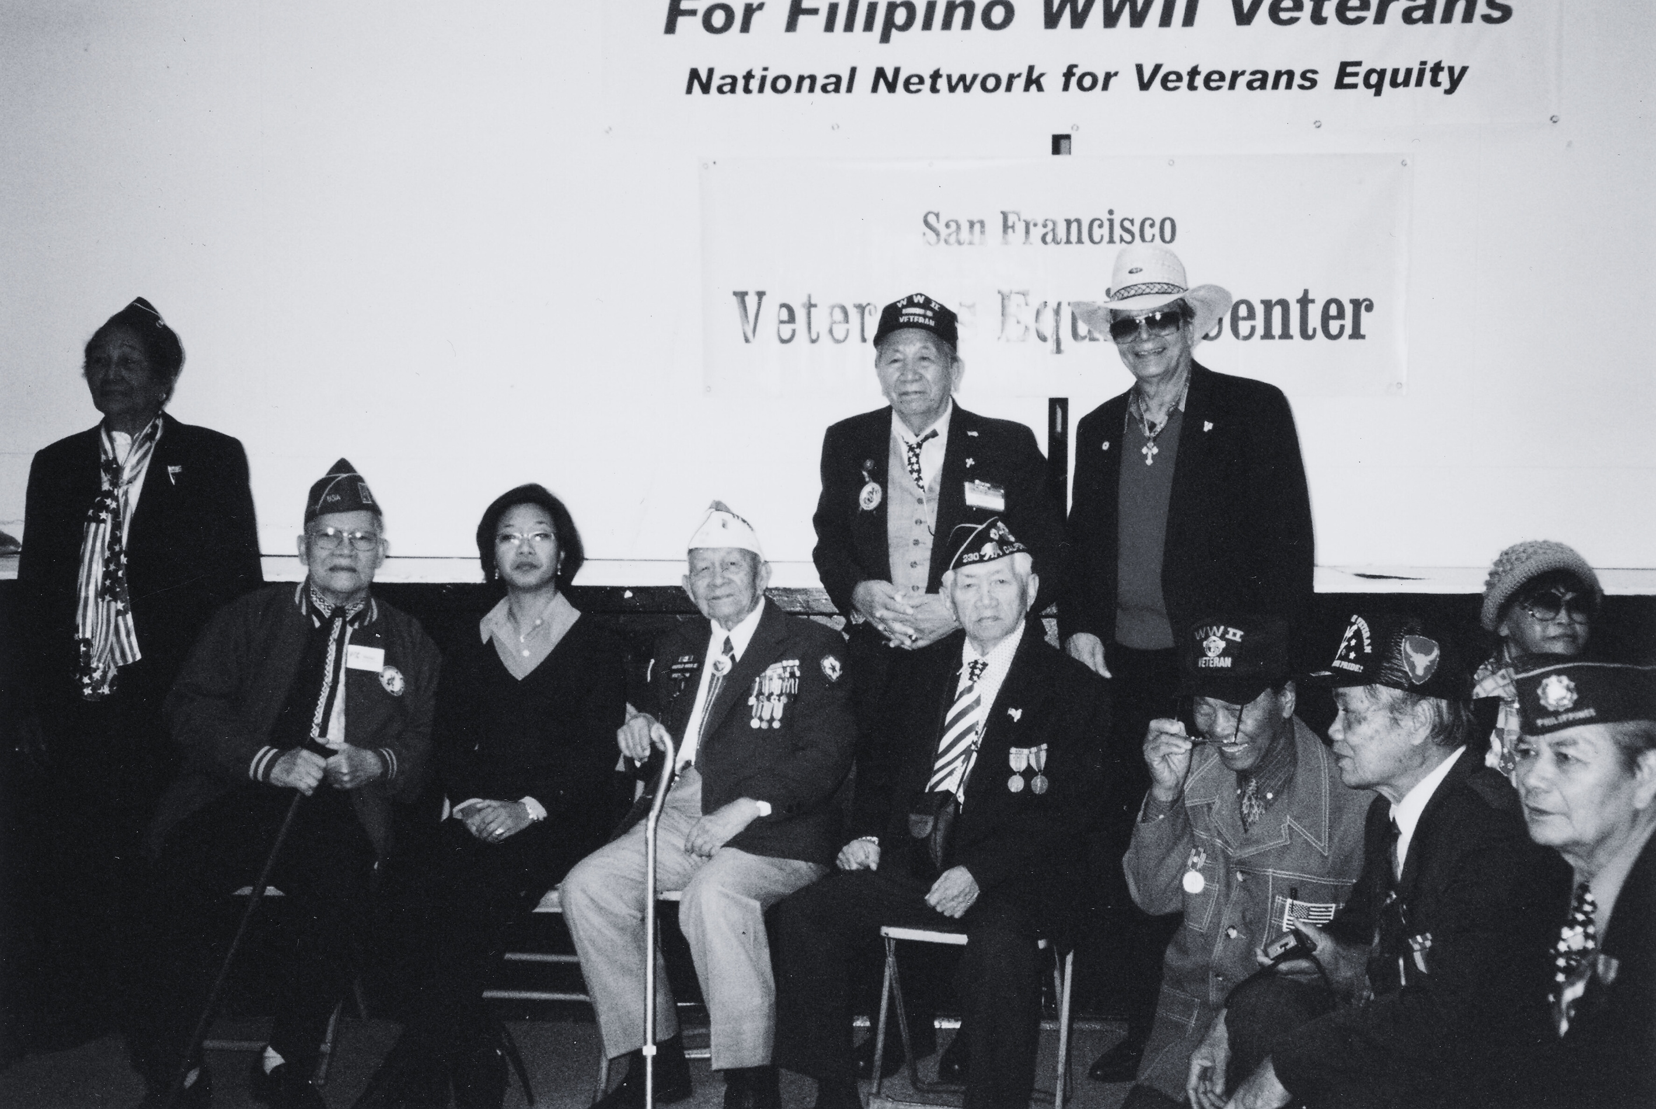
Rooted in community strength
Service providers, individuals in the community and a number of Filipino WWII veterans created the Veterans Equity Center to provide a “one-stop-shop” delivery system of care for the veteran population in need of services.

Slide 6
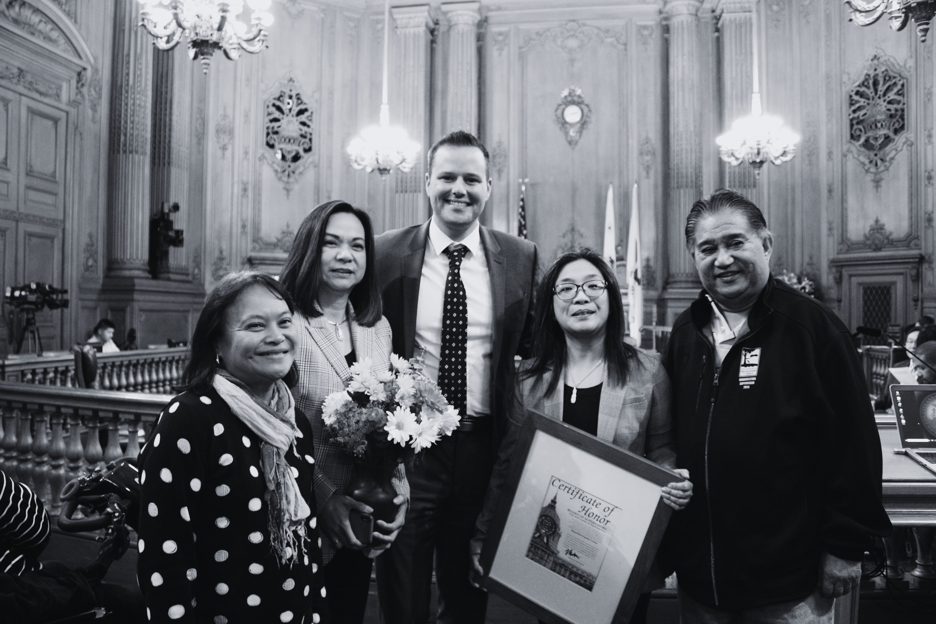
In 2017, we expanded our mission and formally
changed our name to the Bayanihan Equity Center.

Slide 7
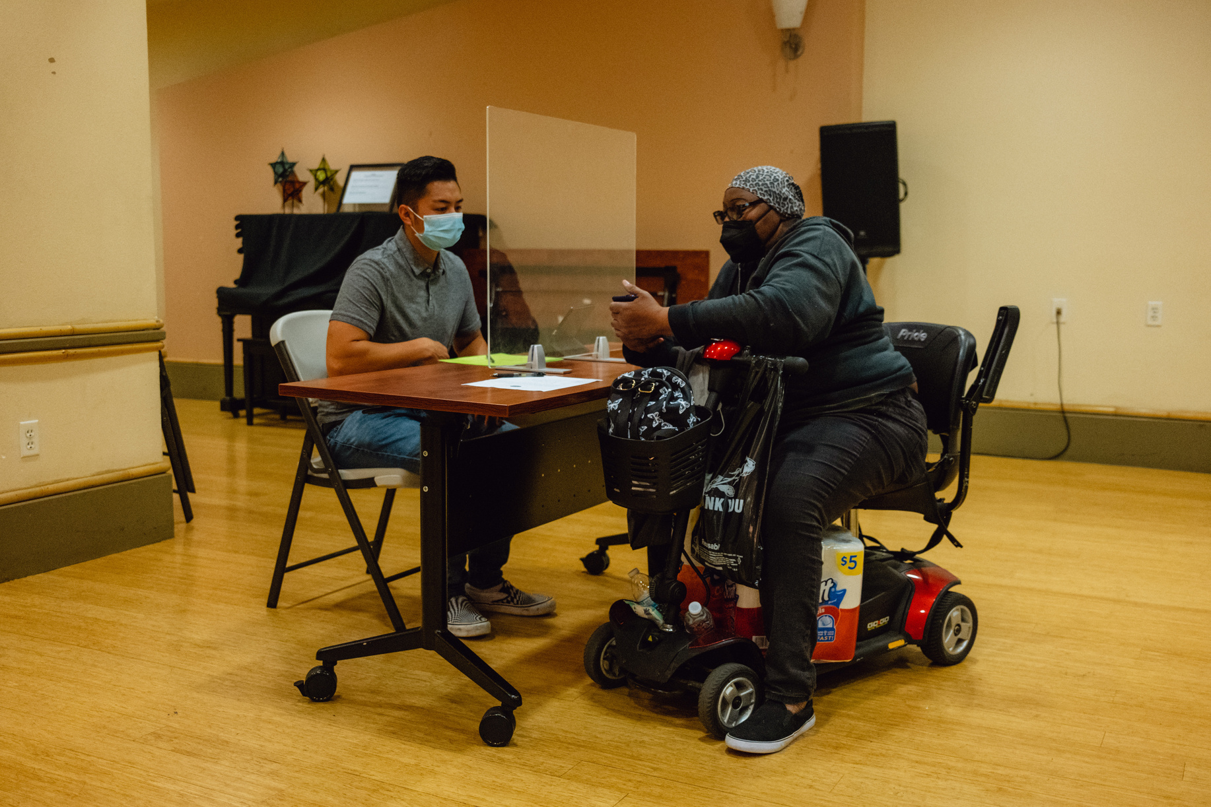


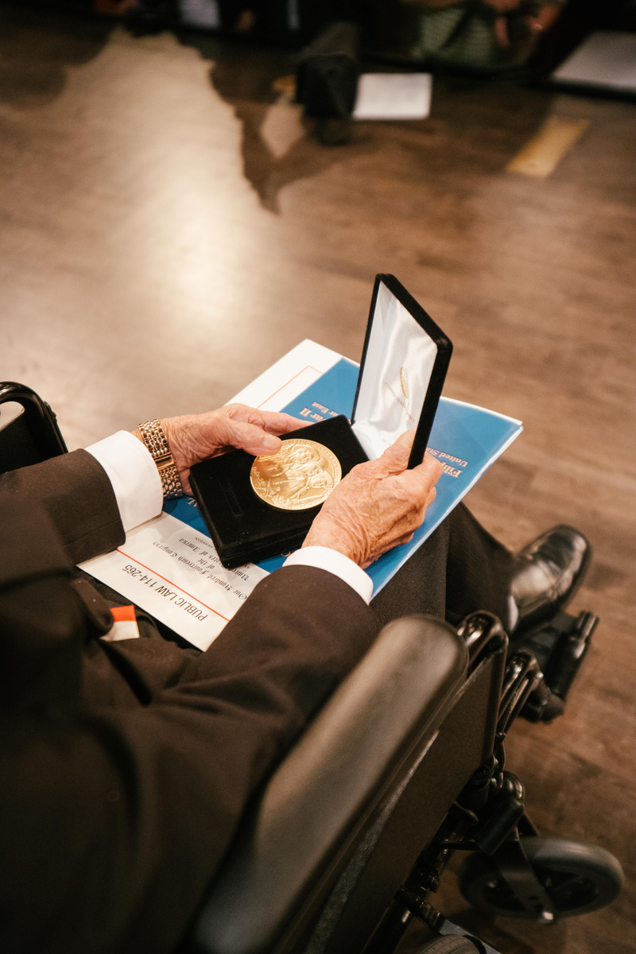
Our Services
Advocacy &
Community Education
Case Management
Food Access
Activities Programming
One-on-one assistance in areas such as housing, immigration, transportation, and many more.
BEC is a part of the SF-Marin Food Bank’s pantry network, and at the onset of the pandemic, created the Supplemental Grocery Program (SGP).
BEC hosts recreational activities designed to combat social isolation.
BEC provides educational workshops, produces in-language materials, and collaborates with CBOs to inform & empower the community.

Slide 8
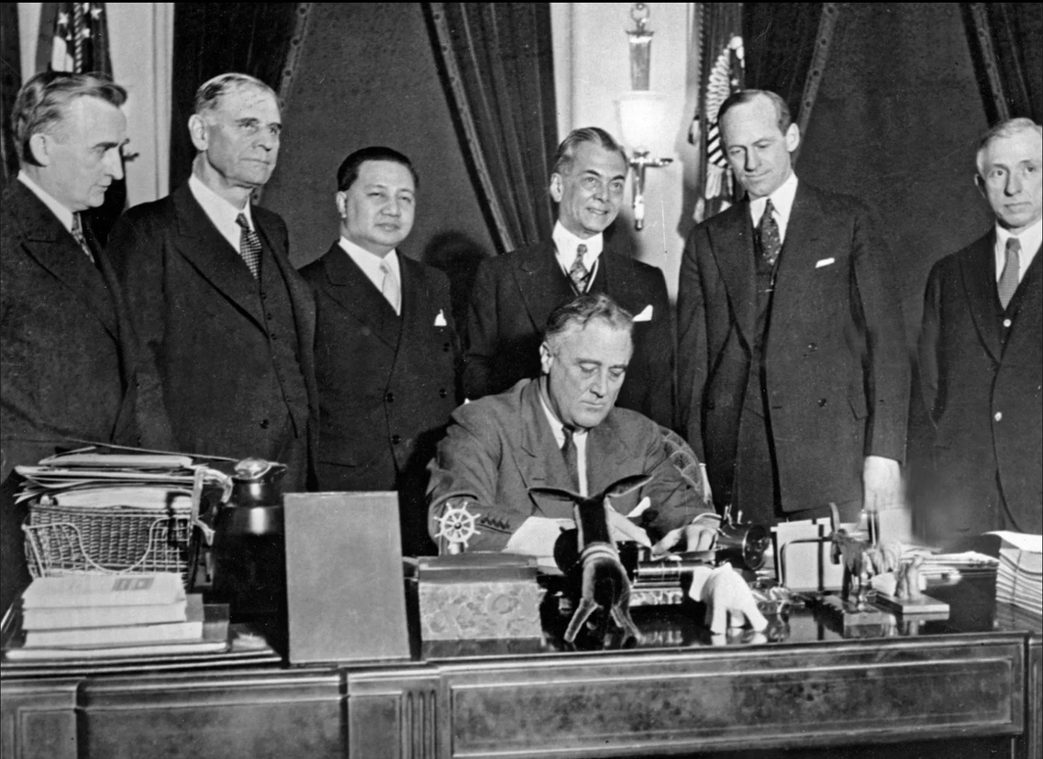
Background
The Philippine Islands became a U.S. posession in 1898, when they were ceded from Spain following the Spanish-American War (1898-1902).
01.
In 1934, U.S. Congress passed the Philippine Independence Act (Tydings-McDuffie Act (P.L. 73-127).
02.
A 10-year timetable for the eventual independence of the Phiilippines was set & the Philippine Commonwealth Government was established.
03.

Slide 9
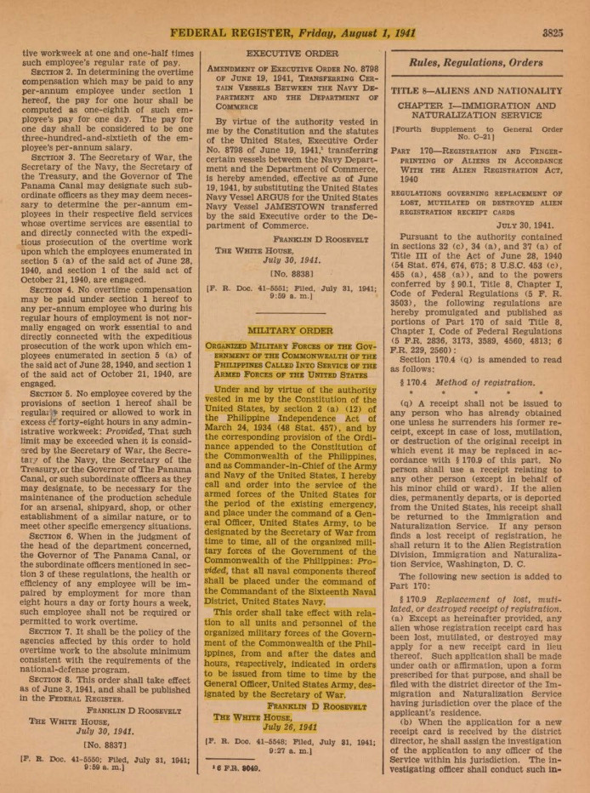
Establishment of USAFFE
On July 26, 1941, President Franklin D. Roosevelt issued an executive order inducting military forces of the Philippine Commonwealth under the newly created United States Armed Forces of the Far East (USAFFE).

Slide 10
Rescission Acts of 1946
Applied only to Filipino veterans who were members of the:
Commonwealth Army of the Philippines
Recognized
Guerilla Forces
New Philippine Scouts
Soldiers enlisted in the military forces of the Philippines under the provisions of the Philippine Indenpendence Act of 1934.
Individuals who served in resistance units that later became a part of the Philippine Commonwealth.
Recruited as a result of the Armed Forces Voluntary Recruitment Act of 1945.

Slide 11
First Supplemental Surplus Appropriation Rescission Act (P.L. 79-301)
Enacted on February 18, 1946.
Authorized a $200 million appropriation to the Philippine Commonwealth Army with a provision limiting veterans benefits to service-connected disability and death compensation.
Payments would be paid at the rate of ₱1 for every $1 paid to a member of the U.S. Armed Forces.
Provision that service under the Philippine Commonwealth Army, “shall not be deemed to have been active military, naval, or air service for the purposes of any law of the United States conferring rights, privileges, or benefits upon any person by reason of the service of such person or the service of any other person in the Armed Forces.”

Slide 12
Second Supplemental Surplus Appropriation Rescission Act (P.L. 79-391)
Enacted on May 27, 1946.
Provision that service of the New Philippine Scouts shall not be deemed to have been active military or air service for the purpose of any laws administered by the Veterans Administration.

Slide 13
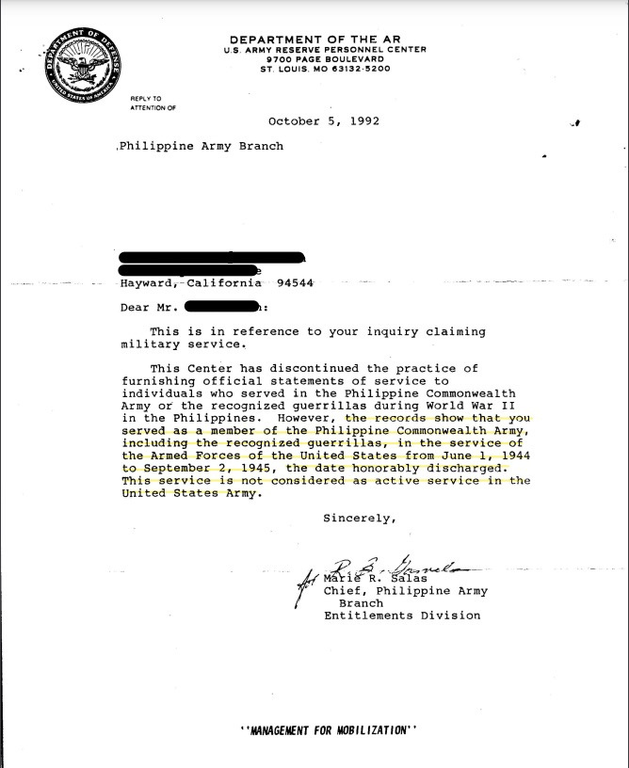

Slide 14
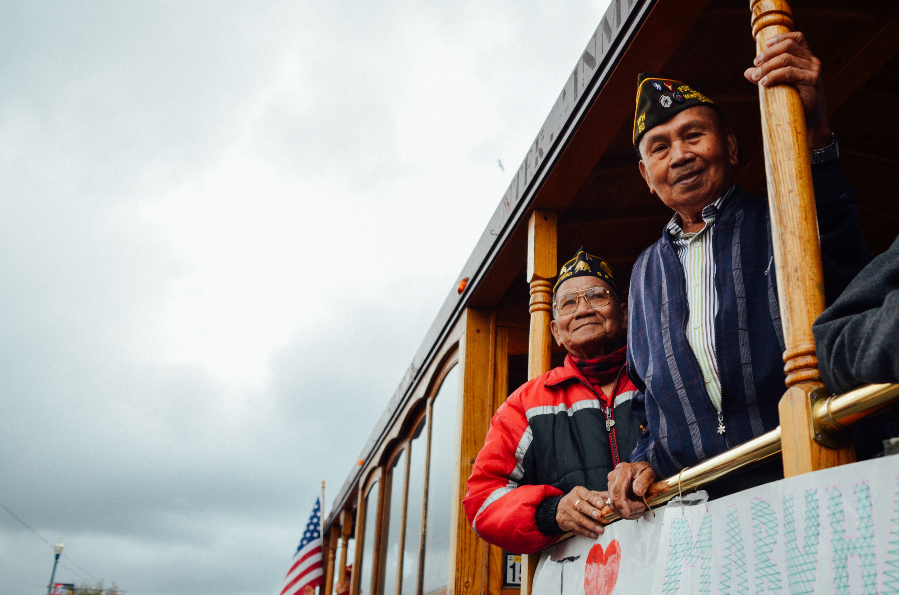
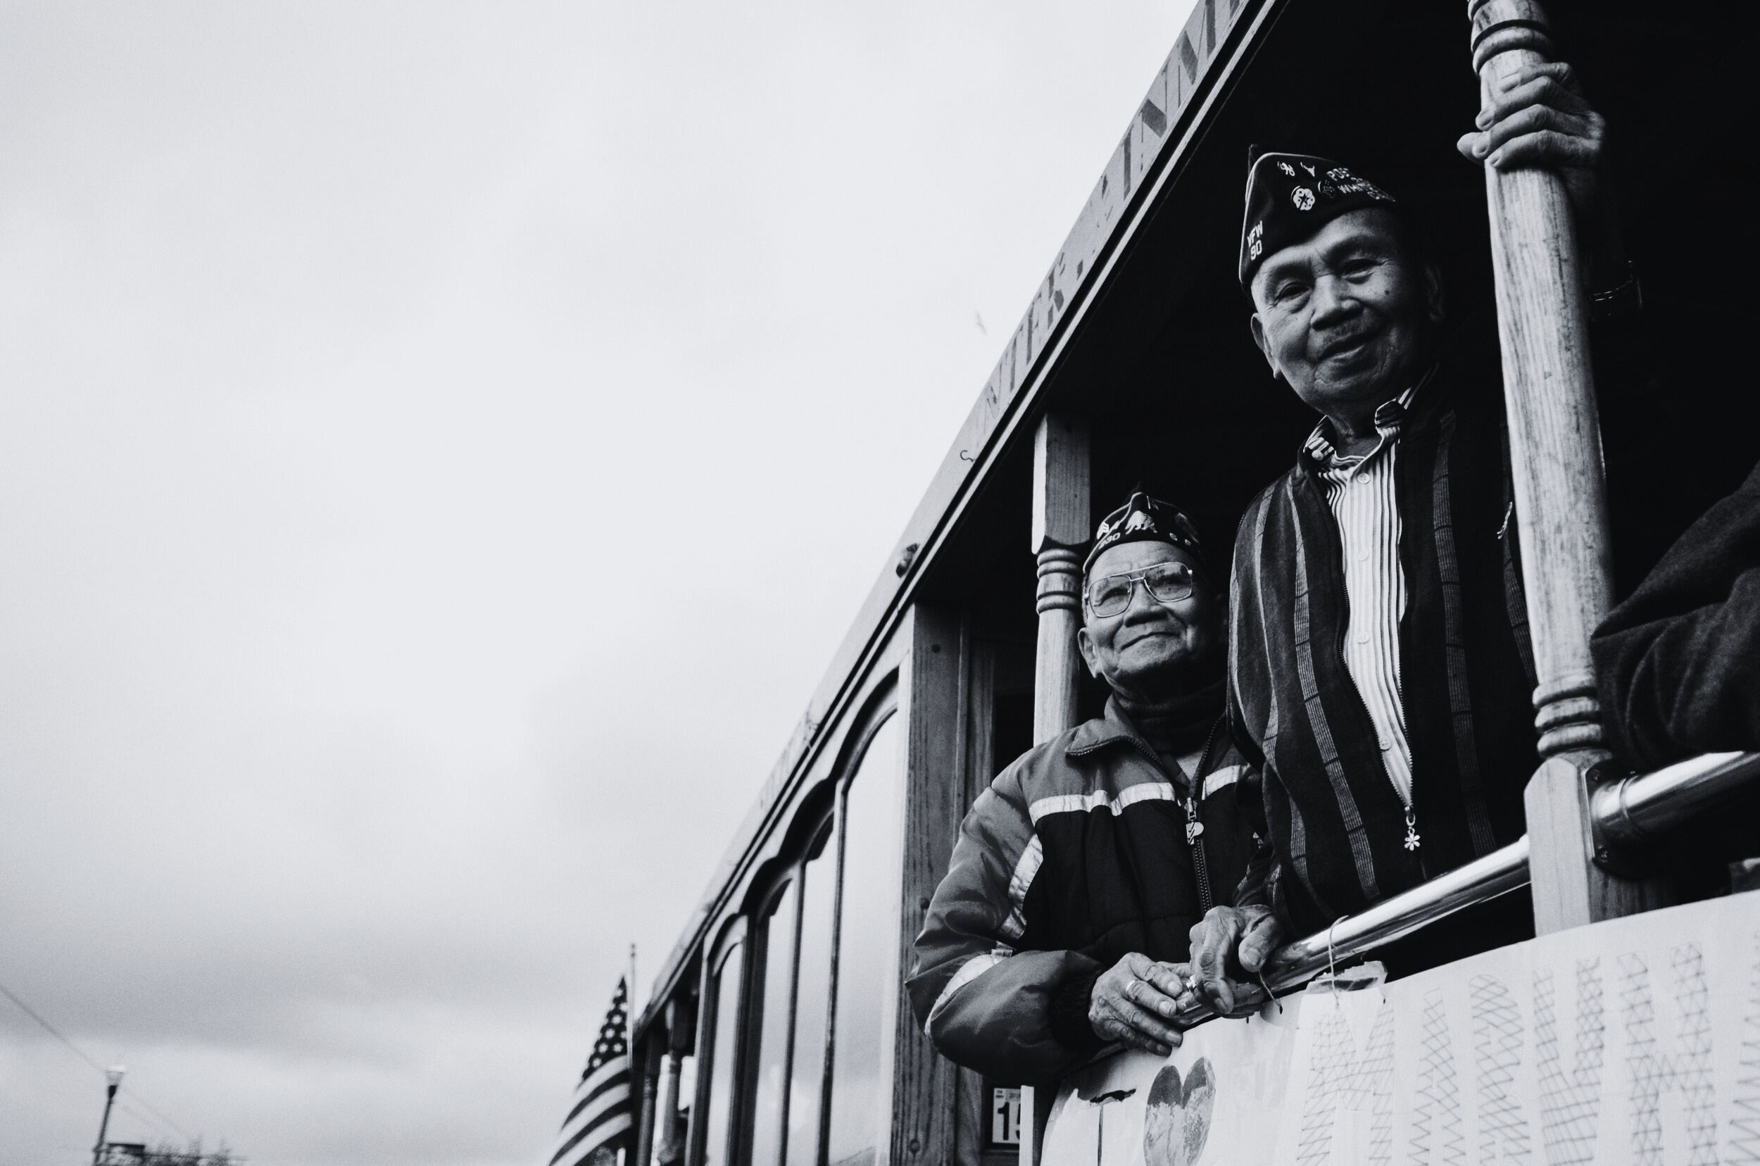
Filipino Veterans Equity Compensation
February 17, 2009 – President Obama signed the 2009 Recovery Act part of which established the Filipino Veterans Equity Compensation (FVEC).
FVEC authorized the release of a one-time lump sum payment to an eligible Filipino veteran, $15,000 to a U.S. Citizen and $9,000 to a non-citizen.
56% of the 42,765 claims were denied.
Deadline to apply was February 16, 2010.

Slide 15
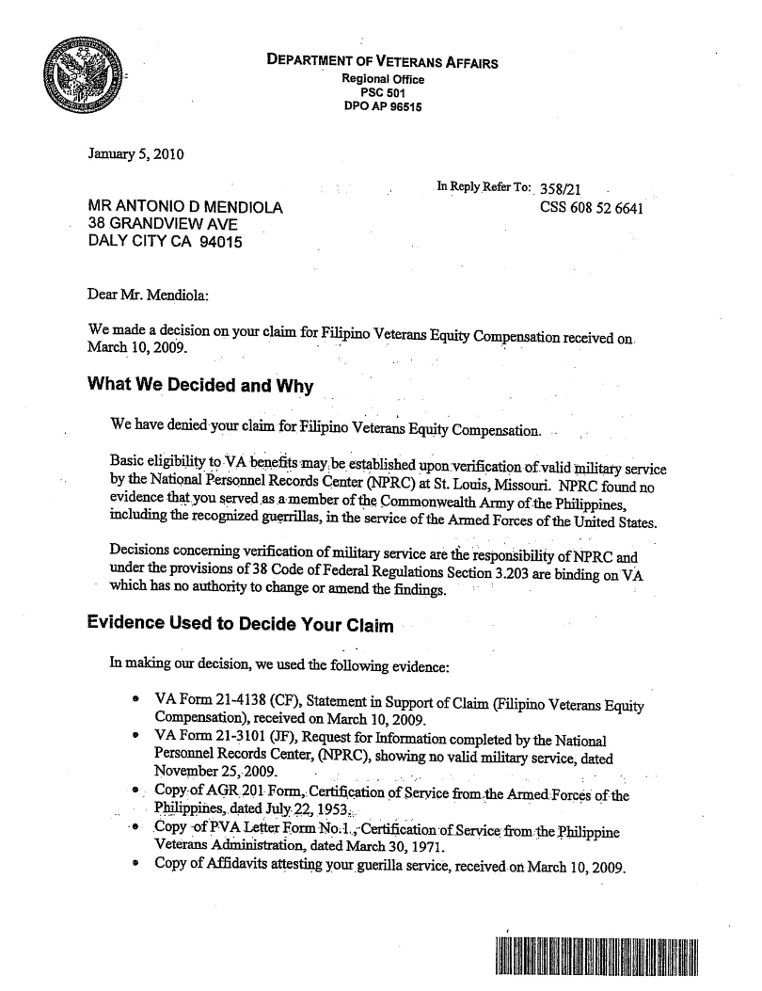

Slide 16
Missouri List
The U.S. Army developed and administered a recognition program between 1942 and 1948.
1.2 million applied for recognition, 260,000 were recognized.
The process involved working with Philippine Authorities and guerilla unit commanders.
The U.S. Army transferred copies of the documentation, finding aids, claim folders to the National Personnel Records Center (NPRC) in St. Louis, Missouri.

Slide 17
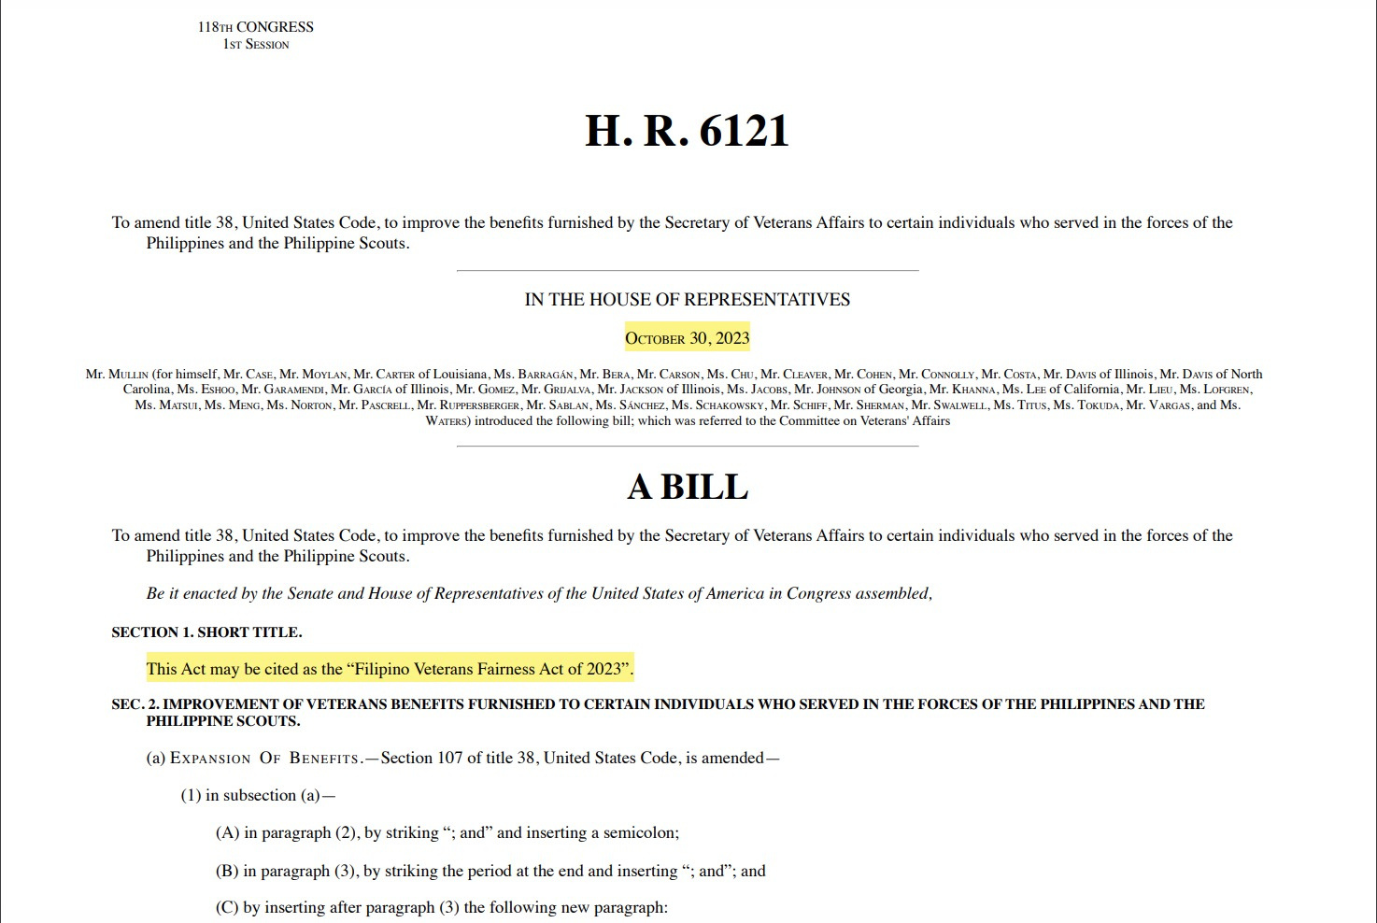

Slide 18
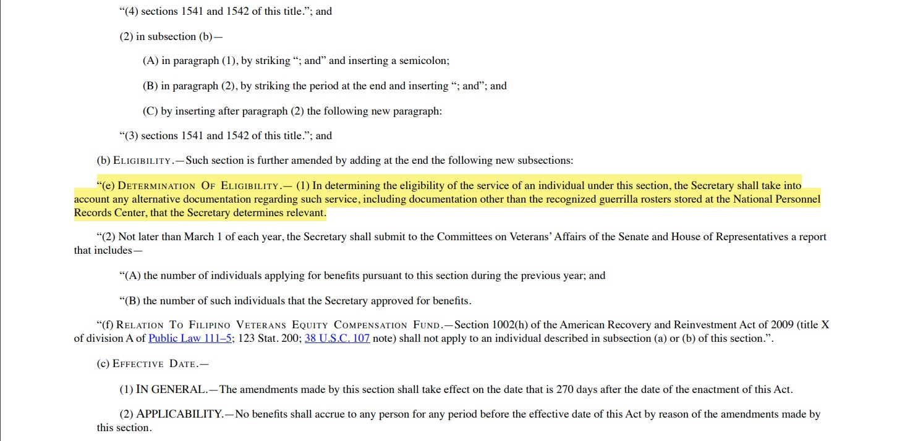

Slide 19
Contact Information
1010 Mission Street, Suite C
San Francisco, CA 94103
TEL: (415) 255-2347
EMAIL: info@sfbec.org

