Slide 1
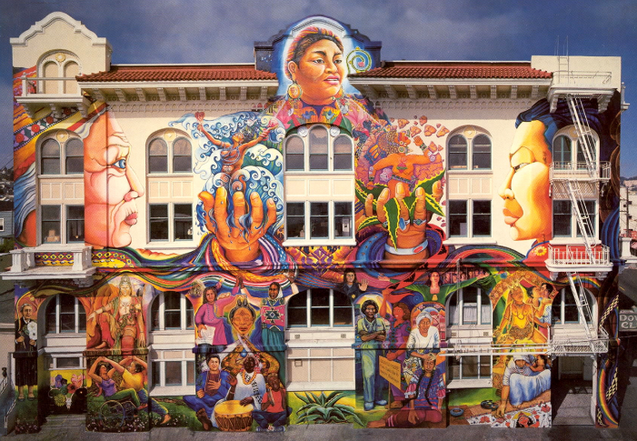
San Francisco – Mental Health Services Act
FY23/24 – FY25/26 Three-Year Integrative Plan
March 2024

Slide 2
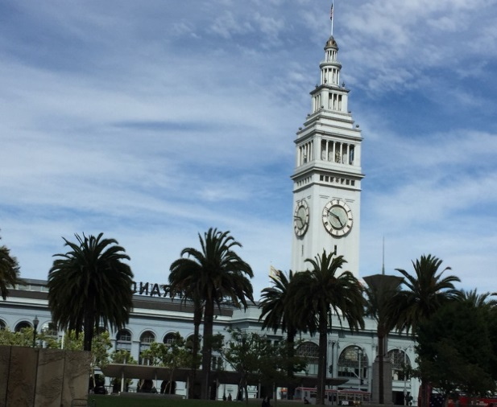
Behavioral Health Services (BHS)
BHS offers a full range of specialty behavioral health services provided by a culturally diverse network of community behavioral health programs and private psychiatrists, psychologists and therapists.
Mental Health and Substance Use Services include outpatient treatment, inpatient treatment, medication management, linkage services and a large array of more specialized treatment services.
Services are available to residents of San Francisco who receive Medi-Cal benefits, San Francisco Health Plan benefits and to residents with limited resources.

Slide 3
Mental Health Services Act Overview
3
MHSA Enacted into law in 2005
1% tax on personal income over $1 million
Designed to support the transformation of the mental health system to address unmet needs
Based on a set of core principles

Slide 4
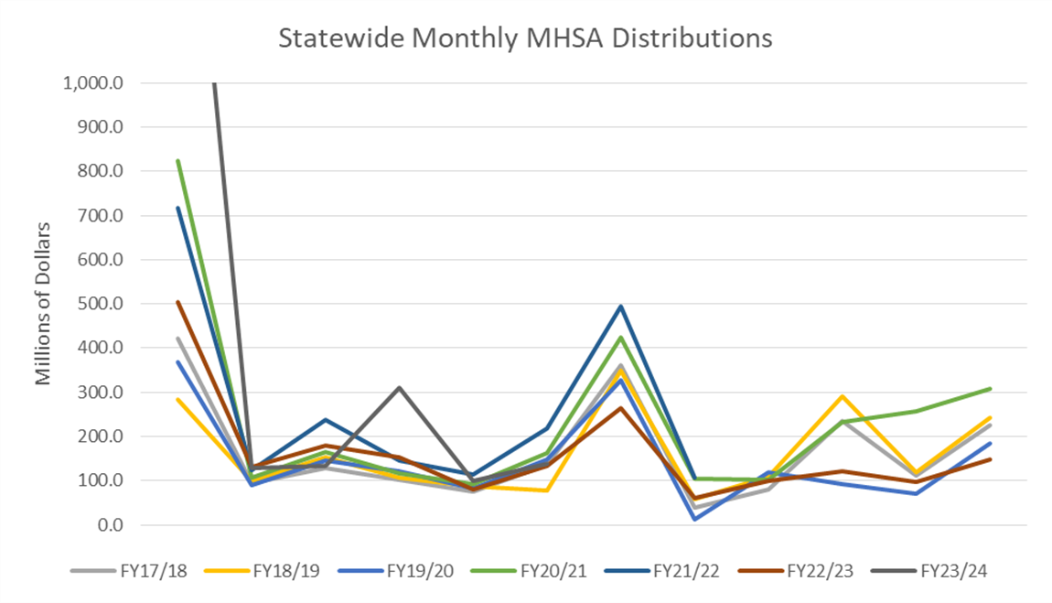
Mental Health Services Act Revenues
Cash Transfers include state withholding tax payments, estimated tax payments and year end tax payments
Cash Transfers are largest in months following quarterly tax payments and year end tax payments
The tax filing and payment deadline for calendar year 2022 taxes as well as first, second and third quarter 2023 estimated taxes was extended until November 16, 2023 for individuals impacted by the winter storms
Original estimate was that approximately $500 million of MHSA revenue that would have been received in FY22/23 was received in FY23/24
Actual non-withholding payments were $300 million less than estimated through November 2023

Slide 5
MHSA County Expenditures
Counties are required to prepare a Three Year Program and Expenditure Plan
Gain approval of Plan through annual stakeholder process
All MHSA
expenditures are required to be in accordance with an approved Plan
Counties required to prepare and submit MHSA Annual Revenue and Expenditure Reports
MHSA funds cannot be used to supplant existing resources
30

Slide 6
MHSA Statewide Estimated Revenues
(Cash Basis-Millions of Dollars)
Fiscal Year
Estimated
 | 22/23 | 23/24 | 24/25 | 25/26
Cash Transfers | $1,813.8 | $2,180.0 | $2,030.0 | $2,131.5
Annual Adjustment | $530.6 | $2,366.9 | $753.2 | $212.0
Interest | $12.4 | $34.2 | $34.2 | $10.0
Total | $2,356.8 | $4,581.1 | $2,817.4 | $2,353.5
31

Slide 7
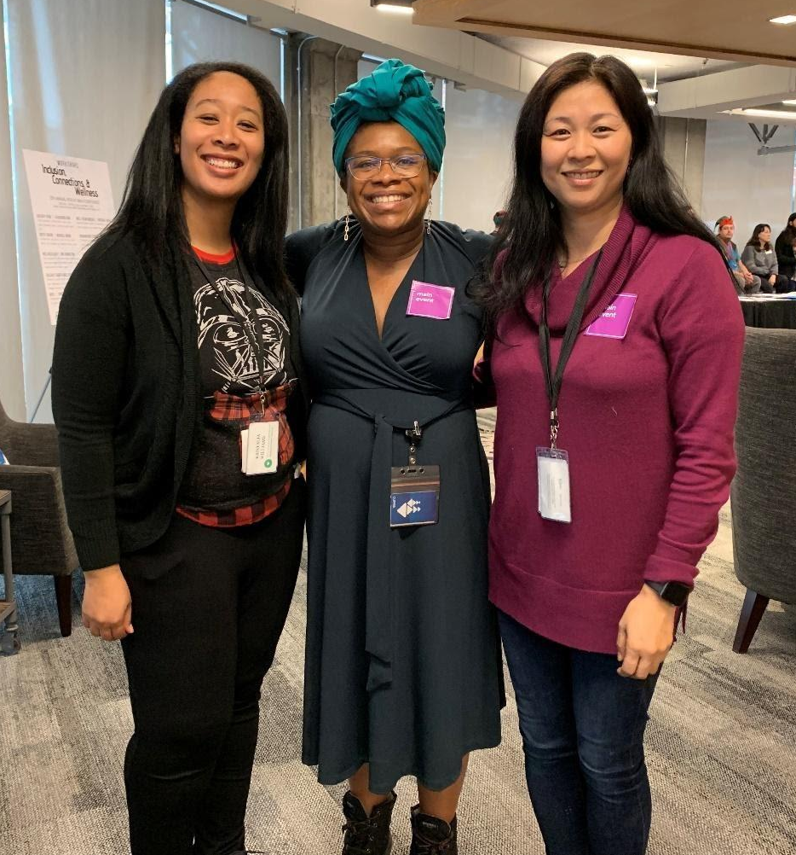
FY23-26 Three-Year Integrative Plan
Each year BHS/MHSA is required to collect community and stakeholder input and integrate this feedback into all areas of MHSA programming. A Three-Year Integrative Plan or Annual Update is required each year.
The FY23-26 Three-Year Integrative Plan is a report that includes community program planning input, program outcomes/highlights from FY21/22 and plans for FY23/24, FY24/25 and FY25/26.

Slide 8
MHSA’s 5 Funding Components: San Francisco’s 7 Service Categories, funding 85 programs
Recovery-Oriented Treatment
Mental Health Promotion
Peer-to-Peer Support Services
Vocational Services
Housing for FSP Clients
Workforce Development
Capital Facilities and Information Technology
Community Services & Supports (CSS)
Innovation (INN)
Prevention and Early Intervention (PEI)
Workforce Education and Training (WET)
Capital Facilities and Technology Needs (CF/TN)
Notes:
Community Services & Supports (CSS)
Supports Full Service Partnership (FSP) Programs and other programs improving the mental health service delivery system for all clients
- Recovery-Oriented Treatment
- Peer-to-Peer Support Services
- Vocational Services
- Housing for FSP Clients
Innovation (INN)
To test novel, creative mental health practices/ approaches that contribute to learning
Prevention and Early Intervention (PEI)
Identify risks early on; prevent worsening of mental illness and promote positive outlook
Funded activities include outreach, identification and linkage
Workforce Education and Training (WET)
Identify gaps in workforce; increase workforce’s cultural and linguistic capacities; educate consumers
Capital Facilities and Technology Needs (CF/TN)
Renovation of admin and service facilities owned by City; modernize information systems and provide access to health records to consumers and family members

Slide 9
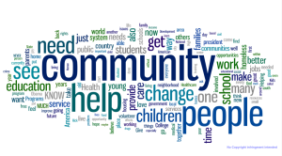
Community Program Planning Process
In 2022, SF-MHSA hosted 16 community engagement meetings across the City.
Over 165 individuals participated in these Community Program Planning meetings.
Community member feedback helped shape existing and future MHSA programming, and the FY23-26 Three-Year Integrative Plan.
We increased our outreach efforts to include more involvement with certain stakeholder groups:
Local veterans
Transition Age Youth
Vocational program participants
Older Adult community
LGBTQ+ community
Primary care and medical staff
Employees of municipal agencies
Law enforcement
Maternal health providers
SFDPH Department of Equity
Black/African American and Latinx Communities

Slide 10
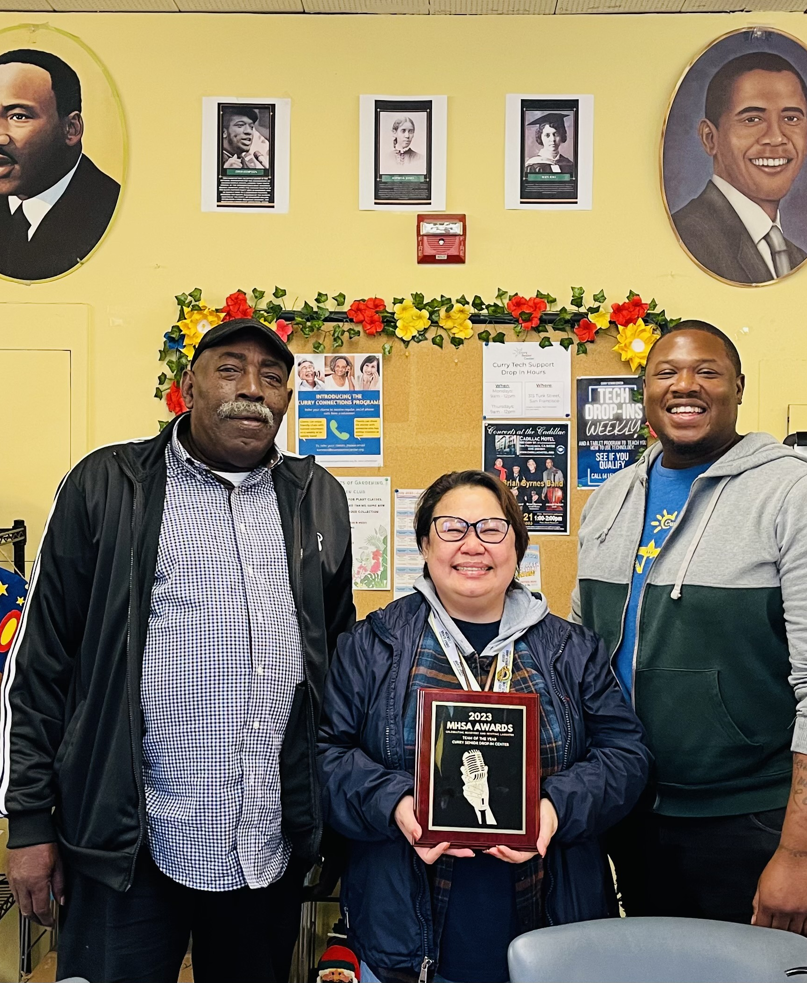
FY21/22 Selected Outcomes
These outcomes are a small sample of the outcomes we achieved. Please see our full
Three-Year Plan for all outcomes reported.
Sustaining funding for current programs and services with demonstrated impact;
Providing additional funding to strengthen population-focused: Mental Health Promotion and Early Intervention Programs;
Expanding the San Francisco Dream Keeper Initiative (www.dreamkeepersf.org), which provides comprehensive support for 300 Black/African American families struggling to meet basic needs due to systemic failure and educational activities for 500 Black/African American youth;
Piloting a project to bring culturally affirming patient navigation support to the City’s Chinatown North Beach Clinic;
Developing a Request for Proposal for Community-Based Organizations to provide mental health services to Black/African American Birthing People
Providing Talk Therapy to Black/African American clients throughout San Francisco;
Providing support to various clients within our population-focused programming:
97% of clients (n=38) within the Asian/Pacific Islander Mental Health Collaborative reported an increase in their quality of life and “feeling better”, as a result of participating in therapeutic activities.

Slide 11
Peer Specialists are Critical to MHSA
MHSA emphasizes the importance of consumer participation in the mental health workforce. Peer Certification programs were created collaborating with Richmond Area Multi-Services, San Francisco State and City College of San Francisco. In addition, all MHSA programs are encouraged to hire peers as members of program staff. SF-MHSA funded 258 peers in FY21/22 throughout our behavioral health system. Consumers can be found working in almost all levels and types of positions, including: peer counselors, health promoters, community advocates, workgroup leaders, teaching assistants, and in management.

Slide 12
FY23-24 through FY25-26 Three-Year Plan
The proposed MHSA Three-Year Plan includes the following:
Sustaining funding for the current 85 MHSA programs and services that have demonstrated to have a significant positive impact on San Francisco communities;
Continuing to implement, support and evaluate the newly funded MHSA programs:
Improving Maternal Mental Health for Black/African American Birthing People
Homeless Children’s Network MA’AT Program
Kummba Peer Fellowship Program
FUERTE
Wellness in the Streets
Technology Assisted Mental Health Solutions
Culturally Responsive Practices for the Black/African American communities;
Continuing to grow Full-Service Partnerships (FSPs) by expanding treatment slots;
Continuing to monitor and engage in stakeholder collaborative meetings regarding
Senate Bill 326 that proposes the modernization of the Mental Health Services Act.

Slide 13
Spotlight on SF’s Changing Needs
San Francisco faces various crises of mental illness, overdose, homelessness, and
housing insecurity—each factor exacerbated by the high cost of living and the
compounding effects of trauma and systematic racism.
MHSA is committed to being a part of San Francisco’s mental health system transformation that provides mental health care to all San Franciscans who lack insurance or who are experiencing homelessness.
MHSA provides 51% of its funding to address serious mental health and co-occurring substance use challenges through our Full-Service Partnership programs.
MHSA provides comprehensive housing programs to better meet the needs of unhoused individuals.
MHSA has population-focused programs that address racism and equity issues.
The Wellness in the Streets program primarily works with individuals directly on the street and provides peer services, support and interventions in the community.

Slide 14
Emphasis on Evaluation
We place a strong emphasis on program evaluation across the MHSA components. Over the past years, we worked hard to enhance our monitoring and evaluation activities in order to effectively meet the objectives of our MHSA-funded programs.
Increased the integration of MHSA principles into the larger BHS System
Improved tracking efforts of ICM to Outpatient referrals and outcomes
Increased evaluation efforts of Innovation Projects
Improved SMART objectives for MHSA contracts
Improved evaluation frameworks for new Request for Qualifications (RFQs)
Increased evaluation efforts with Gender Health SF
Improved the monitoring of PEI evaluation activities

Slide 15
Comments?
MHSA Regulations
The mental health board established pursuant to Section 5604 shall conduct a public hearing on the draft three-year program and expenditure plan and annual updates at the close of the 30–day comment period required by subdivision (a). Each adopted three-year program and expenditure plan and update shall include any substantive written recommendations for revisions. The adopted three-year program and expenditure plan or update shall summarize and analyze the recommended revisions. The mental health board shall review the adopted plan or update and make recommendations to the county mental health department for revisions.
We usually vote on items for approval, however per MHSA Regulations, we will instead collect comments/revisions for the FY23-26 Three-Year Integrative Plan. We will include your comments and revisions in our Final Report that we submit to the SF Board of Supervisors and the State.

Slide 16
Thank you for your time
Jessica N. Brown, MPH
Director, Office of Justice, Equity, Diversity and Inclusion/Mental Health Services Act
Behavioral Health Services
1380 Howard Street
San Francisco, CA 94103
415-255-3963
Jessica.N.Brown@sfdph.org

