Slide 1
Front Porch Provides:
33 Affordable Housing and 19 Market Rate Retirement Communities
6 Community Service Programs:
Well Connected/Well Connected Español, Social Call,
Creative Spark, Ruth’s Table, Market Day, Home Match
4 Spheres of Work: Nutrition, Social Connections, Creative Engagement, Housing

Slide 2
What Do Home Sharing Programs Do?
Foster Sustainable Home Sharing Relationships: Personalized matching based on lifestyle preferences, social compatibility, and communication style
Make the Process Easy and Comfortable:
Ensuring rooms are habitable
Listing rooms and fielding inquiries
Vetting participants
Facilitating development of lease agreements
Ongoing match support
Create Housing Stock: Providing support to older adults, families, and other vulnerable populations who have fears associated with having a stranger live in their home makes home sharing a viable option

Slide 3
Home Match Process
Home Visit/Intake
Application, Home Visit/Intake, Vetting
Compatible Matching
Lifestyle Preferences & Communication Style
Introducing Candidates
Phone Call, In-Person Meetings
Living Together Agreement, Two Parts: Shared Use of Space, Lease Agreement
Match Agreement
Ongoing Support
Support Throughout the Match

Slide 4
Timeline
Home Visit/Intake
1 Day—1 Week, Based on Participant and Staff Availability
1 Week—? Months, Based on Available Rooms and Participant Needs
Compatible Matching
Introducing Candidates
1 Week—? Months Based on Available Rooms and Participant Needs
Match Agreement
1 Day—1 Week Based on Participant and Staff Availability
Ongoing Support
Support Throughout the Match

Slide 5
Profile of Successful Participants
Home Providers:
Healthy communication
Task exchange, not medical care
Adaptability
Home Seekers:
Healthy communication
Affordability
Supportive/Stable housemate

Slide 6
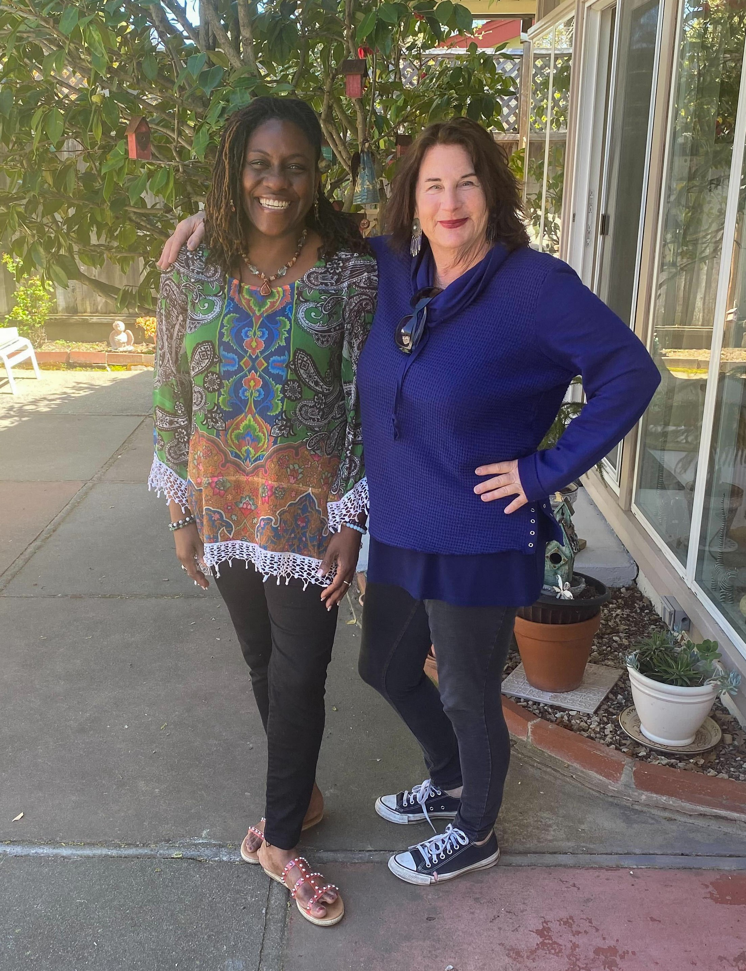
Match Story
From the Marin IJ: After Linda O’Brien’s husband died in December the Marin fashion consultant found herself in need of both companionship and help with expenses. “To hold onto my house, I had to have a roommate,” said O’Brien, 71, who has lived in Marinwood for 32 years … (when) O’Brien met Da’Shonda Parks, a 49-year-old academic counselor at San Francisco State University, they quickly felt a bond. “We are like best friends,” Obrien said. Parks agrees. “There’s such synergy,” Parks said. Read more here!
92% of participants report feeling more financially stable and more socially connected in 2023

Slide 7
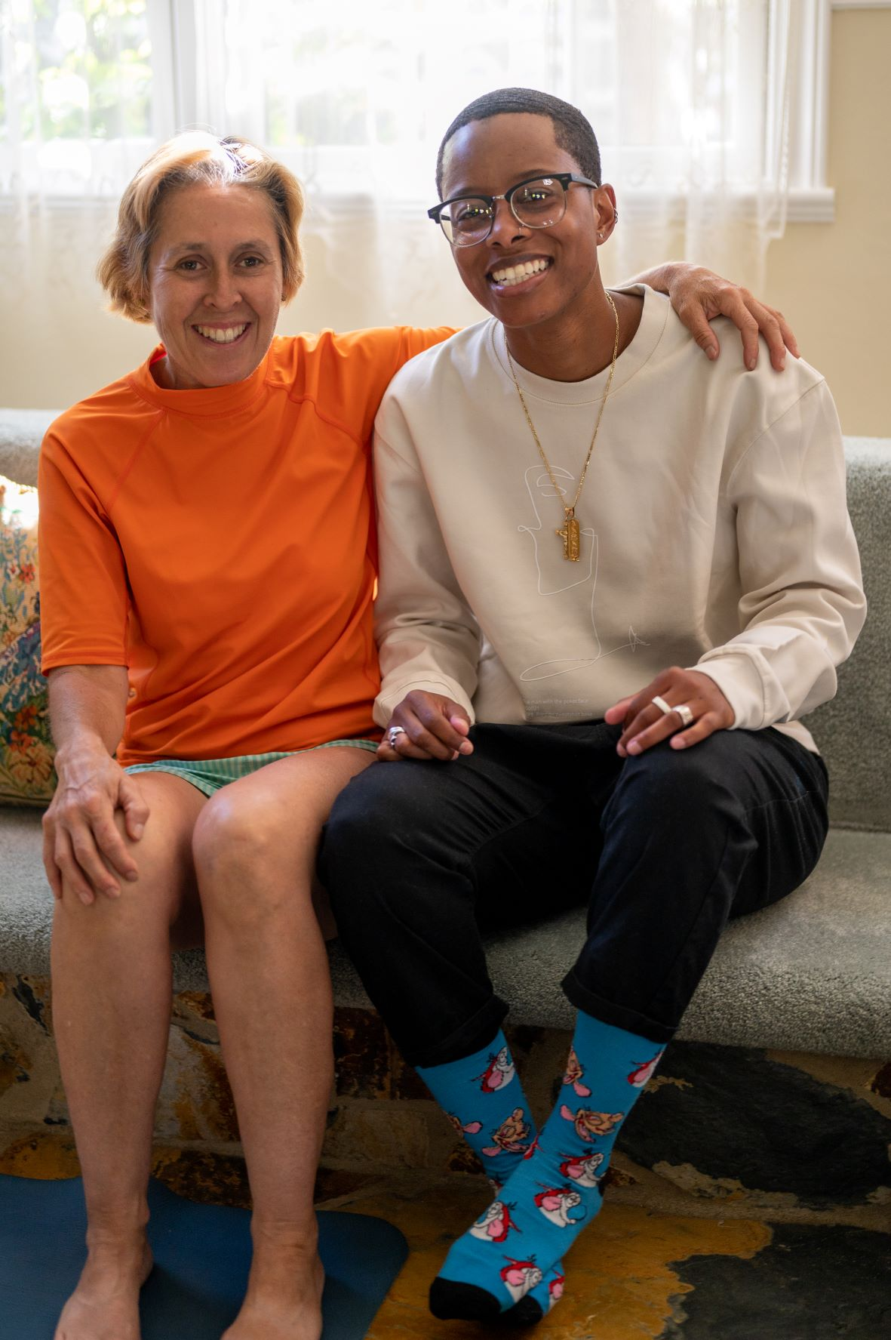
Match Story
"Home Match has been a life saver. After weeks of navigating different housing platforms and finding nothing but over priced apartments, I came across Home Match. I was matched with a housemate who lives in a beautiful home and is within a 15 minute commute to my school. Without Home Match, relocating to California for school would have been stressful!"

Slide 8
Contact Us
Contra Costa County
HomeMatchContraCosta@frontporch.net
(925) 956-7385
Marin County
HomeMatchMarin@frontporch.net
(415) 456-9068
Alameda County
HomeMatchAlameda@frontporch.net
(510) 350-4367
SF County
HomematchSF@frontporch.net
(415) 351-1000

