Slide 1

WHAT’S NEW IN CONTRACTS FOR
CBO’s
Michelle Ruggels
Updated June 6, 2023

Slide 2
Contracting Changes in FY22-23 and FY23-24
New DPH Usage of Grant Agreements
  Why
  What's Different: Contract Templates (Current P-600 vs. New G-100)
  Solicitation Formats (RFP/RFQ vs RFGA)
Appendix Terminology Changes

Slide 3
What is the G-100 Grant Agreement?
Administrative change to improve contract processing time, beginning FY22-23
What is this new Grant Agreement format? Why Now?
The G-100 Grant Agreement is a new contract template and format that has different approval requirements. Most City Departments outside of DPH already use this template/process for community-based contracts.
Effective January 2022, updates to the City's Admin Code, Chapter 21G-Grants were approved by the Board of Supervisors. Implementation began in FY22-23 with a small handful in FY21-22.
As DPH strives to decrease Contract processing timelines, the update has created incentive to begin the transition from Professional Service Agreements (P-600) to Grant Agreements (G-100) to support Community Based Services. (SEE RIGHT ►)
This transition represents a DPH contractual processing change and contract agreement template change (SEE NEXT SLIDE▼)
It is expected to decrease some administrative requirements/barriers that don't align as well with community-based service delivery contracts.
Every potential new Community-Based contracted service, starting with the solicitation development, will be evaluated to determine if it meets the G-100 criteria.
P-600: Professional Services Agreement
Vendor is Contractor
At this time, the most commonly used DPH contract template for the acquisition of professional services. It is designed to fit most situations.
P-600 Agreements are used for services that are “contracted out”
This template is used to grant funding, or in furtherance of a public purpose, “a benefit in the interest of one or more communities in the City or for the general good of the people of the City...”
Funding can be any funding source, including General Fund, Grants, etc.; Funds are “granted”
Updated in January 2022
Established by SF Admin Code, Chapter 21: Acquisition of Commodities and Services
Established by SF Admin Code, Chapter 21G: Grants
Vendor is Grantee
G-100: Grant Agreement (City is Grantor)
P-600 vs G-100

Slide 4
The Change to the New G-100 Templates Starts With a Solicitation
How Do Solicitations Change to Use a G-100 Grant Agreement?
What is a Request for Grant Agreement (RFGA)?
The new G-100 Grant Agreement template follows a solicitation that is labelled: Request for Grant Application (RFGA) rather than a Request for Proposal (RFP) or a Request for Qualification (RFQ).
An RFGA includes specific language and attachments for the resulting G-100 Grant Agreement.
Prior to Solicitation, the DPH Business Office determines if the contracted services will be performed using the G-100 Grant Agreement Template, and if yes, the services will be issued using an RFGA.
What are the key differences between an RFP/RFQ and an RFGA?
RFP/Q Submission is called a “Proposal”
RFGA Submission is called an “Application”
Related Terminology Change:
Solicitation ↔ Sourcing Event
DPH now posts all solicitations through the City System called SF City Partner. In this system, solicitations are not referred to as RFP, RFQ, or RFGA, they are called Sourcing Events.
RFGA Requires Submission of a MANDATORY Statement of Tax Status:
This document is mandatory in order to submit e-questions and the actual Application, meaning it is due before the Application. Failure to submit this form by the due date indicated in the RFGA will disqualify you from submitting an Application. This form determines the applicability of SF Admin Code 14B: Local Business Enterprise (LBE) to the solicitation and resulting agreement.

Slide 5
What else is different about the RFGA?
Terminology Differences
Other Key Differences
RFP/Q Term | Equivalent RFGA Term
RFP/Q | RFGA
Contract | Grant
Contract Award | Grant Award
Proposal Term | Grant Term
Proposer | Applicant
Contractor | Grantee
Scope of Work/ Project Tasks & Deliverables | Grant Plan
Proposal Response Components | Grant Application Response Components
Mandatory Contract Requirements | Mandatory Grant Requirements
Submission of Proposals | Submission of Grant Applications
Revision to Proposal | Revision to Grant Application
1. RFGA includes the following sections, which are not included in the RFP/Q:
Public Purpose* Eligible Expenses Mandatory Statement of Tax Status
2. Attachments
An RFP/Q includes a P-600 Template An RFGA includes a G-100 Template
* Note: A Grant Agreement is used to “grant” funding for, or in furtherance of a public purpose.

Slide 6

"Contract" Agreement Appendix Label Terminology Changes P-600 Professional Services Agreement vs. G-100 Grant Agreement
P-600 vs G-100: Labeling for Vendor Submitted Documents
What is actually different for me?
Content Stays Mostly the Same: Vendor Document Content (aka the Scope and Budget) stays mostly the same
See Next Slide▼
Appendix Labeling is Different: The Final Certified Agreement will have different Appendix Labeling, depending on the Agreement Type, P-600 vs. G-100
See Right ►
New FY 23-24 – UOS/UDC Tables Move from Scope/Grant Plan to the Budget Appendix: These will be removed from the Scope/Grant Plan and will be an Attachment to the Budget Documents (Non-BHS Contracts)
Why? See Slide13▼
P-600 Appendix | G-100 Appendix
None | Appendix A: Definition of Eligible Expenses
Appendix A: Scope of Services Appendix A-1, A-2, A-3: Description of Services | Appendix B: Definition of Grant Plan Appendix B, Attachment 1.1, 1.2, 1.3: Grant Plan
Appendix B: Calculation of Charges Appendix B-1, B-2, B-3: Budget(s) | Appendix B, Attachment 2: Grant Budget Attachment 2.1, 2.2, 2.3: Budget(s)
Attachment 1, 2, 3 to Appendix B: UOS/UDC Tables | Attachment 2a, 2b, 2c: UOS/UDC Tables
Appendix F: Invoice Templates | Appendix C: Form of Funding Request
Non-BHS Contracts Only
New Location FY23-24
Non-BHS Contracts Only

Slide 7

FY23-24 Contract/Grant Plan Appendices Changes
Scope of Services, (aka Appendix A) vs. Grant Plan Terminology
Existing Scope of Services/Grant Plan Content Improvements
Contract Changes for Non-BHS: Move UOS/UDC Tables
Proposed Appendix Durations Changes
One Contract = One Authorizing Solicitation

Slide 8
Terminology Changes in the Scope Document
P-600
G-100
Appendix A: Description of Services (Scope) | Appendix B, Attachment
1. Identifiers | 1. Identifiers
2. Nature of Document | 2. Nature of Document [optional] Special Conditions - If the funding source has any special requirements, they will be pasted here
3. Goal Statement | 3. Goal Statement may be called Grant Plan
4. Target Population Modality(s)/Intervention(s), aka UOS/UDC, moved to the Budget Attachment | 4. Priority Population may be called Target Population [optional] Scope of Services – If the funding source has a specific scope, it will be pasted here Modality(s)/Intervention(s), aka UOS/UDC, moved to a Budget Attachment
5. Methodology | 5.Methodology may be called Plan
6. Objectives and Measurements | 6. Objectives and Measurements
7. Continuous Quality Improvement | Continuous Quality Improvement
8. Required Language | Required Language
9. Subcontractors & Consultants* | . Subcontractors & Consultants*
What is different about the scope document?
Slight Terminology Changes:
Terminology changes in red to the right ►
The main change is that the “Scope” is called the “Grant Plan” in a G-100 Grant Agreement.
Content Stays [Mostly] the Same:
Content changes in purple to the right ►
Depending upon the funding source, there may be additional information added to ensure compliance with the funder’s requirements.
The Modality/Intervention section contains the UOS/UDC information and will be moved to the Budget Attachment (see Slide 10)
*Note: If the Agreement is for a Fiscal Intermediary/ Program Management, a list of subcontracts & consultants may be included.
Non-BHS Contracts Only
Non-BHS Contracts Only

Slide 9
Existing Appendix A (Scope of Services) Content Refinements Effective in FY23-24
Current Label | What's Missing | Proposed Label | Content
Goal Statement | Program Description that succinctly describes the purpose of the program, i.e. what type of service is being provided, in addition to the goal of the program in providing these services. | Goal Statement/Program Description
Methodology | Increasingly the Board of Supervisors requires us to report the following program information which is not consistently available from the contract: Referral source(s), i.e. how do people get into your program? What is considered a successful referral out of your program? How do you track these referrals? Where do people exiting your program generally go next, e.g. do you have a step-down pathway? | Update Instructions under the subsection of Methodology to ensure the inclusion of this information
Future: Level/Category of Service | DPH does a significant amount of reporting of data and currently knowledge about how a program fits within the larger system or service category is largely based on the knowledge of the DPH Business owner, aka SOC Program. The Department intends to develop standard categories that are comprehensive to all types of programs that will be inserted into a section of the Scope of Services/Grant Plan appendices. | TBD | No Change Keep Full Term

Slide 10
Scope of Services/Grant Plan Formatting Change:
UOS/UDC Tables, aka the Modalities and Interventions section, will be moved to the Budget Appendix, beginning FY23-24
Non-BHS Contracts Only
What is the change?
This change is for Non-BHS Contracts Only.
Beginning FY23-24, the Unit of Service (UOS) / Unduplicated Client (UDC) tables, currently in the Appendix A: Scope (P-600) or Appendix B, Attachment 1: Grant Plan (G-100) will move to the first tab of the Budget Workbook named “UOS/UDC Allocation Page”. The tab named “[Vendor Name] Summary Page” in the Budget Workbook will be removed as it will be repetitive of the first tab.
Why?
A Revision to Program Budget, aka RPB may be used for changes to the Budget Appendix but not the Scope of Services/Grant Plan (aka Appendix A). The latter requires an amendment and thus additional approval requirements. By relocating this table to the Budget Appendix, minor changes to the contract/grant agreement may be incorporated without triggering additional approval requirements.
What do I do?
When submitting your Contract Documents, make sure you have (1) Removed “Section 5: Modalities and Interventions” from your Scope/Grant Plan, and (2) Populate this information into the Budget Workbook tab labeled “UOS/UDC Allocation Page”.
This revised Budget template will be available at:
www.sfdph.org/cdta → click on “Contract Development Instructions and Templates”
If you have questions, reach out to your CDTA Program Manager

Slide 11
On the Table for Consideration: Proposed for NEW FY23-24 Agreements
Changes to Appendices Duration
Scope of Services/Grant Plan, Budget Summary, Budget Details Durations
Appendix Name | New BHS Contracts/ Grant Agreements | Existing BHS Contracts | New Non-BHS Contracts | Existing Non-BHS Contracts
Appendix Scope of Services/ Grant Plan | Create One Scope of Services Covering the Full Contract Term (instead of annual updates) Your scope will not need to be resubmitted each year under the assumption it won't change. If it does, a change will be incorporated through an Amendment. Note: If your project includes a start-up period, the scope document must carve out a start-up scope section within the full scope. | No Change Scope of Services Appendix submitted annually | No Change Scope already covers full term
Appendix: Budget Summary | Create the DPH Budget Summary to cover each year of the FULL TERM (instead of one year) Create the DPH Budget Summary tab to identify projected funding for each year of the term of the contract/grant agreement equal to total contract/grant agreement funding. | No Change Appendix B: Budget Summary to continue to cover only one year | No Change Budget summary already covers full term
 | This will make it easier to build in Cost of Doing Business (CODB) Growth annually.
Appendix Budget Details | Provide Budget Detail Tabs to cover TWO YEARS (instead of one year) Your Budget Details will only need to be resubmitted every two years, unless there is a budget change prior to the two years. This will eliminate most "MYE" invoices. | No Change Budget details submitted annually | No Change Budget details cover each year of the full term | No Change Keep Full Term

Slide 12
Other Contract Changes for FY23-24
One Agency Contract Will Only Contain One Authorizing Solicitation
Will this change impact me?
Most existing contracts are set up this way, except for BHS contracts.
In BHS, there are many contracts containing many different programs, each authorized under different solicitations.
How will this be implemented?
As a new solicitation is completed, this will authorize the creation of a new contract. If the agency's old contract has ongoing programs, then the old contract will continue, and the agency will have a second contract for the newly solicited service.
What will happen as DPH transitions to One Contract = One Authorizing Solicitation?
More Contracts. This will generate a lot more contracts as BHS contracts are unbundled.
Anticipate Faster Processing Timelines. With one DPH Program Owner, one primary program Appendix, one term applicable to all programs, and fewer funding sources subject to review, contracts will be simpler, and we can anticipate faster movement through the contract development and review process within DPH.

Slide 13
Need Your Help and FYI for FY23-24
Review your scope of work and ensure continuity with your budget, i.e., it is crystal clear which scope belongs with which budget.
State and Federal Agency Verification Checks
CalAIM Reminders
CODB Legislation

Slide 14
Review Your Scope of Work and Budget
Quality Control is Important for the Scope/Grant Plan
What? It is critical that you (a) review your Scope/Grant Plan, (b) update it to remove old information or clarify current information, AND (c) correlate it effectively to your Budget appendix.
Why? If, and when your contract must be (a) approved by the Board of Supervisors, (b) reviewed by the City Attorney, (c) selected for audit by the Controller’s Office or Budget and Legislative Analyst’s Office, (d) requested by a journalist, or (e) used as the source for BOCC monitoring, it is critical that the Scope/Grant Plan be specific, clearly defined, and clearly linked to the Budget.
Quality Control Tips listed here ►
General Clarity
Scope Specificity
Must be written clearly to describe each program (Goal Statement = Program Description)
If programs are combined within one Scope/Grant Plan, then include clearly defined sections to describe each program.
Ensure the Scope/Grant Plan translates easily to a clearly labeled and easily located corresponding Budget Appendix.
Can someone unfamiliar with your Agency, Contract, Program(s), and Budget pick up the Scope/Grant Plan and Budget Document and understand what the City is funding?
Organization
Be specific and clear in describing the programs funded by the contract itself. The subject program may be part of your Agency’s larger portfolio of services, but ensure you are clear about what pieces are being funded by the contract and what is not funded by the contract.
Final Quality Control Check

Slide 15
You Must Stay in Compliance / Good Standing with State and Federal Agencies
Vendors must remain in good standing with the State and Federal Agencies listed here.
The DPH Business Office will verify the Vendor is in Good Standing with each.
NEW FY22-23 City Nonprofit Supplier Compliance with California Attorney General Registry of Charitable Trusts.
Effective February 7, 2023, the City may not enter into any new contracts or grants, or amend existing contracts or grants, with nonprofit suppliers that are not in current or probationary status with the State Attorney General, including those in suspended or revoked status. Existing contractors must be in compliance by July 1, 2023.
For a full listing of the City Policy visit: Policy on Nonprofit Compliance with CA AG Charity Registry - issued 2.7.23.pdf
California Secretary of State: https://bizfileonline.sos.ca.gov/search
California Franchise Tax Board: https://webapp.ftb.ca.gov/eletter
Internal Revenue Service: https://apps.irs.gov/app/eos/
NEW FY22-23: California Attorney General’s Registry of Charitable Trusts: https://rct.doj.ca.gov/Verification/
Department of Treasury, Office of Foreign Assets Control:
https://sanctionssearch.ofac.treas.gov/
Notes:
Once the steps are determined, add the ongoing verification process by BOCC to this slide.

Slide 16
Legislation Related to CBO Inflationary Costs
The Controller's Office has been working with City staff and non-profit agency representatives on the topic of Cost of Doing Business increases and how to address the uncertainty that occurs each year to our non-profit-Community Based Organization (CBO) partners.
Supervisor Ronen introduced an Ordinance on April 25, 2023 amending the Administrative Code to (1) require the Controller to prepare an initial base budget to guide each City agency in preparation of its proposed two-year budget; to provide that these base budgets must include anticipated cost increases in agreements with nonprofit organizations to reflect inflation; and (2) to adopt a City policy that departments will enter into multi-year grants when the need for a grant program will extend beyond a single year.
It has not been calendared yet for consideration, but here is the link:
https://sfgov.legistar.com/View.ashx?M=F&ID=11932579&GUID=0927AB5B-D754-46EE-AF81-61BA1A3C845A
The goal of the legislation would be to build funding into the City's two-year budget that includes funding for CBO, CODB funding automatically, similar to other inflationary cost increases that City departments must cover. In a good budget year, the City Departments should have sufficient revenue to address all inflationary costs. In a bad budget year, City Departments would have to identify budget reductions to balance revenues and expenses.
  Side Note: If this passes, the idea to have the DPH Budget Summary page capture all years of the contract term (new for BHS) would allow us to identify the proposed CODB increases in the contract.

Slide 17
CalAIM
California Advancing and Innovating MediCal Payment Reform
Beginning July 1, 2023 (BHS ONLY)
Outpatient MH and ODS contracts
  Please see an email from SOC Director, Max Rocha, sent on 5/25/23, with attached memo 'Important Changes to FY 23/24 BHS Contracts for MH and SUD Outpatients Programs'
  Moving to cost reimbursement
  Merging Modes 15, 45, and 60 (MH); and outpatient (91, 105) with ancillary (SUD)
  Establishing new LOE Targets for direct patient care
    Stand-alone Level of Effort worksheet, based on FY22-23 program budgets is due on July 7, 2023 – submit to CDTA PM
  Appendix B templates for FY 23-24 will include a Level of Effort worksheet. Data submitted with your FY 23-24 contracts will be used to update LOE targets for FY 23/24.
  Please make sure that you review your existing Scope of Work (Appendix A/Grant Plan) very carefully, editing anything that may not make sense under your consolidated Appendix B Outpatient program.
  See CDTA website for updated CalAIM Appendices
NTP Contracts
MH & ODS Residential
Transition to CPT Codes on 7/1/23
  Tip Sheets and Cross Walks available at Provider Billing & Documentation Library | San Francisco (sf.gov)
  CalMHSA training course “CPT Coding for Direct Service Providers”. Registration is required. https://moodle.calmhsalearns.org/login/index.php
Mode 55 Pilot - Further Guidance Coming
Reminder – Contractor Appendices available on CDTA Website
Appendix format for G-100
CalAIM Questions? Please email: bhscalaim@sfdph.org​

Slide 18





SFDPH TRAINING!
Shirley Giang
Budget Director
DPH Business Office

Slide 19
Cost of Doing Business (CODB) for Non-Profit Agencies
In FY23-24, the Mayor’s Office is allocating a 4% Cost of Doing Business (CODB) allocation. These funds are budgeted to be ongoing.
3% CODB increase
1% added for contracts that provide services to health and homelessness
Mayor’s Office is also allocating Minimum Compensation Ordinance (MCO) in FY 2023-24 to bring wages to $18.93 per hour. The implementation is still under development.

Slide 20
Cost of Doing Business (CODB) for Non-Profit Agencies
  Please Note:
  For Fee-for-Service reimbursed contracts, the resulting increase should be reflected as a rate increase; there is no requirement to increase units of service to earn the additional CODB/MCO funding.

Slide 21
Cost of Doing Business (CODB) Calculations
  The calculation of individual agency CODB allocations is guided by the same criteria as last year. The baseline amount upon which the actual CODB allocation is determined, includes the following:
  General Fund monies, (which for this calculation includes Medi-Cal and Realignment), as well as continuing work-orders (money given to DPH by other City Departments) which are funded by General Fund monies.
  Grant funds are not eligible for CODB increase.

Slide 22
Increase in MHSA Funding in FY23-24
There is no CODB increase in MHSA funding; however, there is additional MHSA revenue funding available this fiscal year to support the increases, so MHSA funded contractors will receive 4% increase in FY23-24.

Slide 23
Funding Notification Letters Revision to Add CODB
For the following sections, HIV Health Services, HIV Prevention Section and Health Education (under CHEP) a single Funding Notification (FN) letter is issued covering each year of the full contract term. Subsequent FN letters are only issued if there is an annual change in funding.
Due to the FY23-24 CODB adjustment, modification letters will be prepared to reflect CODB increases, along with any other changes to the funding allocation since it was last issued.

Slide 24
Funding Notification Letters
Behavioral Health Services (BHS) is in the process of issuing Funding Notification letters. BHS issues its letters annually, so that the contractors can provide annual budget updates to their multi-year contracts.
BHS Funding Notification letters will be going out in the following order:
  “New” services (e.g. post RFP) effective July 1
  Contracts with No Funding Changes
  Contracts to add the FY23-24 Cost of Doing Business (CODB) funding
  Contracts with funding changes, but no contract negotiation
  Contracts with contract negotiations
It is strongly requested that all agencies adhere to the timeline and submit contract documents per the deadline indicated on the FN letter.
Funding change requests following the initial contract document submission by the contractor will be added once the original contract has been updated to reflect the FY23-24 budget appendices.

Slide 25
California Advancing and Innovating MediCal Payment Reform​ (CalAIM)
Beginning July 1, 2023 (BHS ONLY)​ Contract Changes for Outpatient Services
Changes for MH and SUD Outpatient programs in Appendix B
Payment method will be converted to Cost Reimbursement invoices
Includes Level of Effort (LOE) calculation to track under or over performance
Collapses Mode 15 and Mode 45/60 services and budget into Mode 15 services where applicable
Any Outpatient-91, Outpatient-105, or ancillary services will be consolidated into only Outpatient Services
The new Appendix B format and instructions for Outpatient programs are posted in the CDTA website.
https://www.sfdph.org/dph/comupg/aboutdph/insideDept/CDTA/default.asp

Slide 26
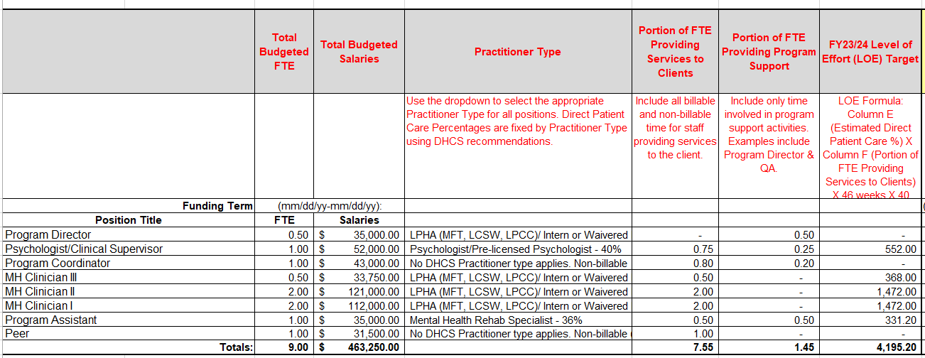
CALAIM Contract Changes
Salaries & Benefits Detail Page of Appendix B

Slide 27
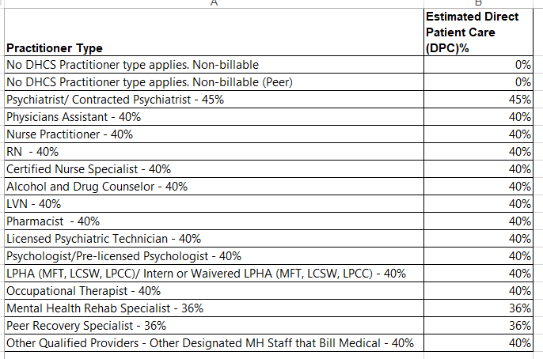
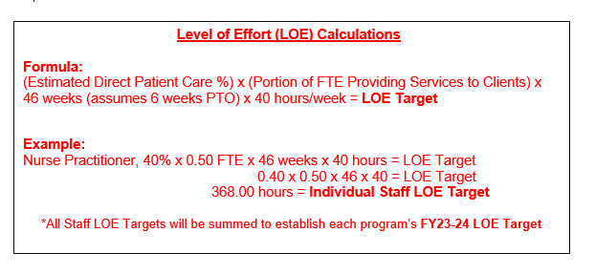
CALAIM Contract Changes
Practitioners and Level of Effort

Slide 28
Reminder on Subcontractor Policy
Contracts that contain subcontractor/consultant expenses are expected to submit a copy of all subcontractor/consultant contracts (signed and dated) to CDTA (cdtaunit@sfdph.org) WITH Appendices A and B.
For contractors that are unable to submit their Subcontractor/Consultant Agreements with Appendices A and B, contractors must: 1) Provide a written explanation on why this requirement cannot be met via email to their CDTA Program Managers and; 2) Submit their Subcontractor/Consultant Agreements no later than 30 days of the submission of Appendix A and B.
Invoice payments for subcontractors will be withheld until a copy of the subcontractor/ consultant contract is on file with the CDTA Program Manager.

Slide 29
Reminder on Subcontractor Policy
In the boilerplate, it is required that the contractor names and identifies the subcontractor/consultant. If the name of the subcontractor or other detailed information is unknown, will then be required to modify the contract to incorporate the name and rate information once that information is available.
Invoice payments cannot be processed if the name is different from the Appendix B, or the reimbursement rate is different from the rate indicated in Appendix B.

Slide 30
Important Items to Remember
It is strongly requested that all agencies adhere to the timeline and submit contract documents per the deadline indicated on the FN letter.
Changes for MH and SUD Outpatient programs in Appendix B
  Payment method will be converted to Cost Reimbursement invoices
  Collapses Mode 15 and Mode 45/60 services and budget into Mode 15 services where applicable
  Any Outpatient-91, Outpatient-105, or ancillary services will be consolidated into only Outpatient Services
Invoice payments cannot be processed if the subcontractor or consultant name is different from the Appendix B, or the reimbursement rate is different from the rate indicated in Appendix B.

Slide 31


Budget Staff Contact Information
NAME | EMAIL ADDRESS
Shirley Giang, Director | Shirley.Giang@sfdph.org
Christina Xiong | Caiqing.Xiong@sfdph.org
Daniel Leong | Daniel.Leong@sfdph.org
Deanna Chan | Deanna.Chan@sfdph.org
JinQuan Li | Jinquan.Li@sfdph.org
Judy Perillo | Judy.Perillo@sfdph.org
Mimi Fung | Mimi.Fung@sfdph.org
Michelle Kern | Michelle.Kern@sfdph.org
Sajid Shaikh | Sajid.Shaikh@sfdph.org
Valerie Lai | Valerie.Lai@sfdph.org
Winnie Chen | Winnie.Chen@sfdph.org
Ya Cong (Grace) Liang | Yliang@sfdph.org

Slide 32
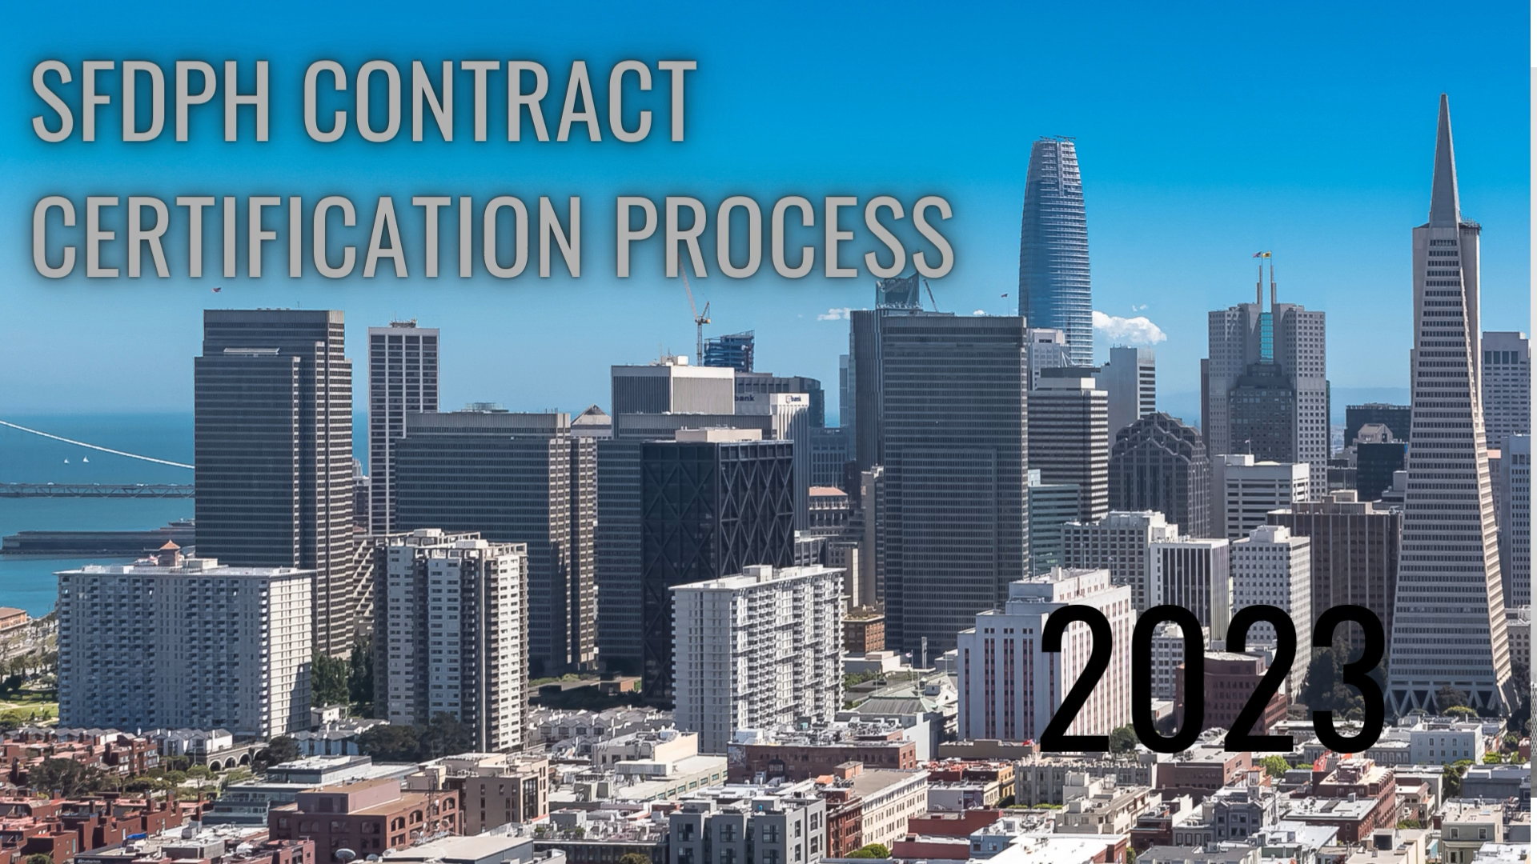

Slide 33
SFDPH Business Office Org Chart
Director of Health
Dr. Grant Colfax
San Francisco Department of Public Health
Deputy Director, Chief Operating Officer
Greg Wagner
Director, Business Office
Michelle Ruggels
BUSINESS OFFICE OF CONTRACT COMPLIANCE (BOCC)
Director, Vacant
BUDGET DIVISION
Shirley Giang, Director
CONTRACT DEVELOPMENT & TECHNICAL ASSISTANCE
(CDTA)
Michelle Long, Director
OFFICE OF CONTRACT MANAGEMENT AND COMPLIANCE (CONTRACTS)
Rob Longhitano, Director
www.sfdph.org/cdta

Slide 34
Principal Point of Contact for Providers
Coordinator for the contracting process
Contract Pre-negotiation & Negotiation
Contract Interpretation
Resolution of Agency-wide Issues
(ATAP/CAP)
Referral & Linkage to DPH staff
Principal Point of Contact for Providers
BHS – Provider Set up for SUD and MH
Organizational Development
Training
Program Transitions
Policies & Procedures
www.sfdph.org/cdta

Slide 35

Contract Change Request Form
Purpose of the Form
To document contractor requests for:
    Programmatic and/or budget changes to contracts
    Negotiation meetings to discuss changes to contracts or service procedures
www.sfdph.org/cdta

Slide 36
Contract Change Request Form
What We’re Trying to Achieve
Reduction in number of contract changes
Response to contractors in a timely manner
Minimal delays to contract completion and payment
www.sfdph.org/cdta

Slide 37

FY 22-23 Contract Change Requests (CCRS)
TOTAL RECEIVED
60
Single and Multiple Types of Changes Requested per Form
www.sfdph.org/cdta

Slide 38
Contract Change Request – What Happened in FY 22-23
TYPE OF CONTRACT CHANGE REQUESTS
58%
BUDGET CHANGES HANGES
34%
DELIVERABLES CHANGES
8%
PROGRAM CHANGES
www.sfdph.org/cdta

Slide 39
Contract Change Request – What Happened in FY 22-23
CONTRACT CHANGE REQUEST BY SECTION - BHS
38%
Children, Youth, and Families (CYF)
23%
Substance Abuse Disorder (SUD)
17%
Adult and Older Adult (AOA)
15%
Mental Health Services Act (MHSA)
6%
Transitional Age Youth (TAY)
www.sfdph.org/cdta

Slide 40
Contract Change Request – What Happened in FY 22-23
CONTRACT CHANGE REQUEST BY SECTION – NON BHS
Community Health Equity and Promotion
(CHEP)
77%
13%
HIV Health Services (HHS)
15%
8%
Maternal, Child and Adolescent Health
(MCAH)
www.sfdph.org/cdta

Slide 41

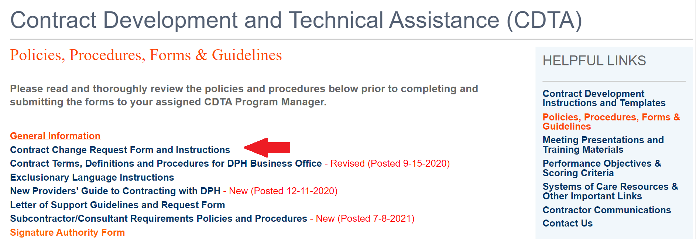
Contract Change Request Form
1. Where can I find the form?
On the CDTA website under the category of Policies, Procedures, Forms & Guidelines.
2. Who receives the form?
The form and supporting materials must be sent to your CDTA Program Manager.
www.sfdph.org/cdta

Slide 42

“The Unforgettables”
1. Turn in your contract documents on time! Date listed in Funding Notification;
2. Submit any subcontracts to your CDTA Program Manager along with your Appendix A & B;
3. Use the contract checklist, found on the CDTA website, under Contract Development Instructions and Templates, to check your work (Appendix A & B) to ensure that you’ve included all required information;
4. If you have any questions, about developing your Appendix A or B, please contact your CDTA Program Manager for assistance.
5. Please sign and return your finalized contract to DPH promptly.
6. If you want to modify your current contract, the Contract Change Request form (CCR) must be used.
7. Expired insurance certificates hold up invoice payments
www.sfdph.org/cdta

