Slide 1
Westside Community Services
Crisis Clinic
Tab
Presented by Brook Chick

Slide 2
Table of Contents
Tab
What programs does the Crisis Clinic offer?
What populations are being served?
What is a Clubhouse?
What outcomes have been documented for Clubhouse Membership?
How is Westside developing a Clubhouse?
How is our funding structured?

Slide 3
What programs does the Crisis Clinic offer?
Tab
Crisis Clinic | On-site Pharmacy | Outpatient | Intensive Case Management
Hours of Operation: Monday through Friday 7:30 am - 4:30 pm Target: San Francisco adult residents who require psychiatric crisis and urgent care services Staffing: 2 designated NPs 2 designated LVNs Referral Pathway: Walk-in | Target: Individuals that need psychiatric medication day of Referral Pathway: Crisis Clinic | Target: Provides outpatient mental health services to chronically mentally ill clients from diverse ethnic backgrounds with a focus on the African American community Staffing: 2 designated NPs 3 Clinical Case Managers Referral Pathway: Multiple - Crisis Clinic, Within Westside, outside Agency, expect a 10 day turnaround | Target: San Francisco adults who have long-standing, chronic psychiatric illnesses Staffing: 3 Clinical Case Managers Referral Pathway: City of San Francisco

Slide 4
What populations are being served?
Tab
Crisis Clinic | On-site Pharmacy | Outpatient | Intensive Case Management
Race: 22.7% Black or African Descent 24.3% White/Caucasian 5% Latina/o/x 48% Other Age: 84% fall between 26 to 64 years of age Gender: 37.8% Female 62.2% Male Veteran Status: .2% reported 82% declined to answer Total Served: 952 | Race: 22.7% Black or African Descent 24.3% 5% Latina/o/x 48% Other Age: 84% fall between 26 to 64 years of age Gender: 37.8% Female 62.2% Male Veteran Status: .2% reported 82% declined to answer Total Served: 952 | Race: 36% Black or African Descent 29.4% White/Caucasian 34.6% Other Age: 85% Majority fall between 26 to 64 years of age Gender: 40.1% Female 59.9% Male 1% non-binary Veteran Status: 1.1% reported 70.6% decline to answer Total Served: 279 | Race: 41% Black or African Descent 23% White/Caucasian Other 36% Other Age: 83% Majority fall between 26 to 64 years of age Gender: 57.5% Female 42.5% Male Veteran Status: 0% reported 52% declined to answer Total Served: 73

Slide 5
What is a Clubhouse?
Tab
The Clubhouse model of social rehabilitation is a well-established augmentation to clinical care. The first Clubhouse was started in NYC in the 1940s. There are now over 300 Clubhouses worldwide.
The Work Order Day:
Clubhouse Members and Staff work together to support daily operations, prepare meals, train for jobs and volunteer positions.
All activities are designed to help members build relationships, assume responsibilities, reduce social isolation, and strengthen their recovery.
(See Fountain House website https://www.fountainhouse.org
and clubhouse-internl.org)

Slide 6
What outcomes have been documented for Clubhouse Membership?
Quality of Life and Functioning Status*
Improved Quality of Life
Increased self-esteem
Increased employment rates
Reduced social isolation
* McKay, C, et.a., A systemic Review of Evidence for the Clubhouse Model of Psychosocial Rehabilitation, Adm Policy Mental Health, 2018, 45:28-47
Healthcare Utilization*
Decreased re-hospitalization rates
Reduced Hospital stays
Reduced emergency mental health care usage
“Research consistently shows that outcomes for people with SMI are tied to the recovery of dignity, hope, self direct, a coherent sense of identity, and the achievement of quality of life.”
Fountain House. An Introduction to Social Practice. Fountain House. https://www.fountainhouse.org/about/social-practice.

Slide 7
How is Westside developing a Clubhouse?
Tab
Present Operations:
Peer Planning Group: Current Crisis Clinic patients
Capacity: Weekly Meetings (Wednesday at 12pm)
Goal: Transition to more frequent programming that aligns with Work Ordered Days
Program Vision:
Operations: Daily Capacity: Up to 30 (year 1)
Unit Development: Culinary, Hospitality, Music, Arts, and Exercise
Partnership with the Veterans Affairs

Slide 8
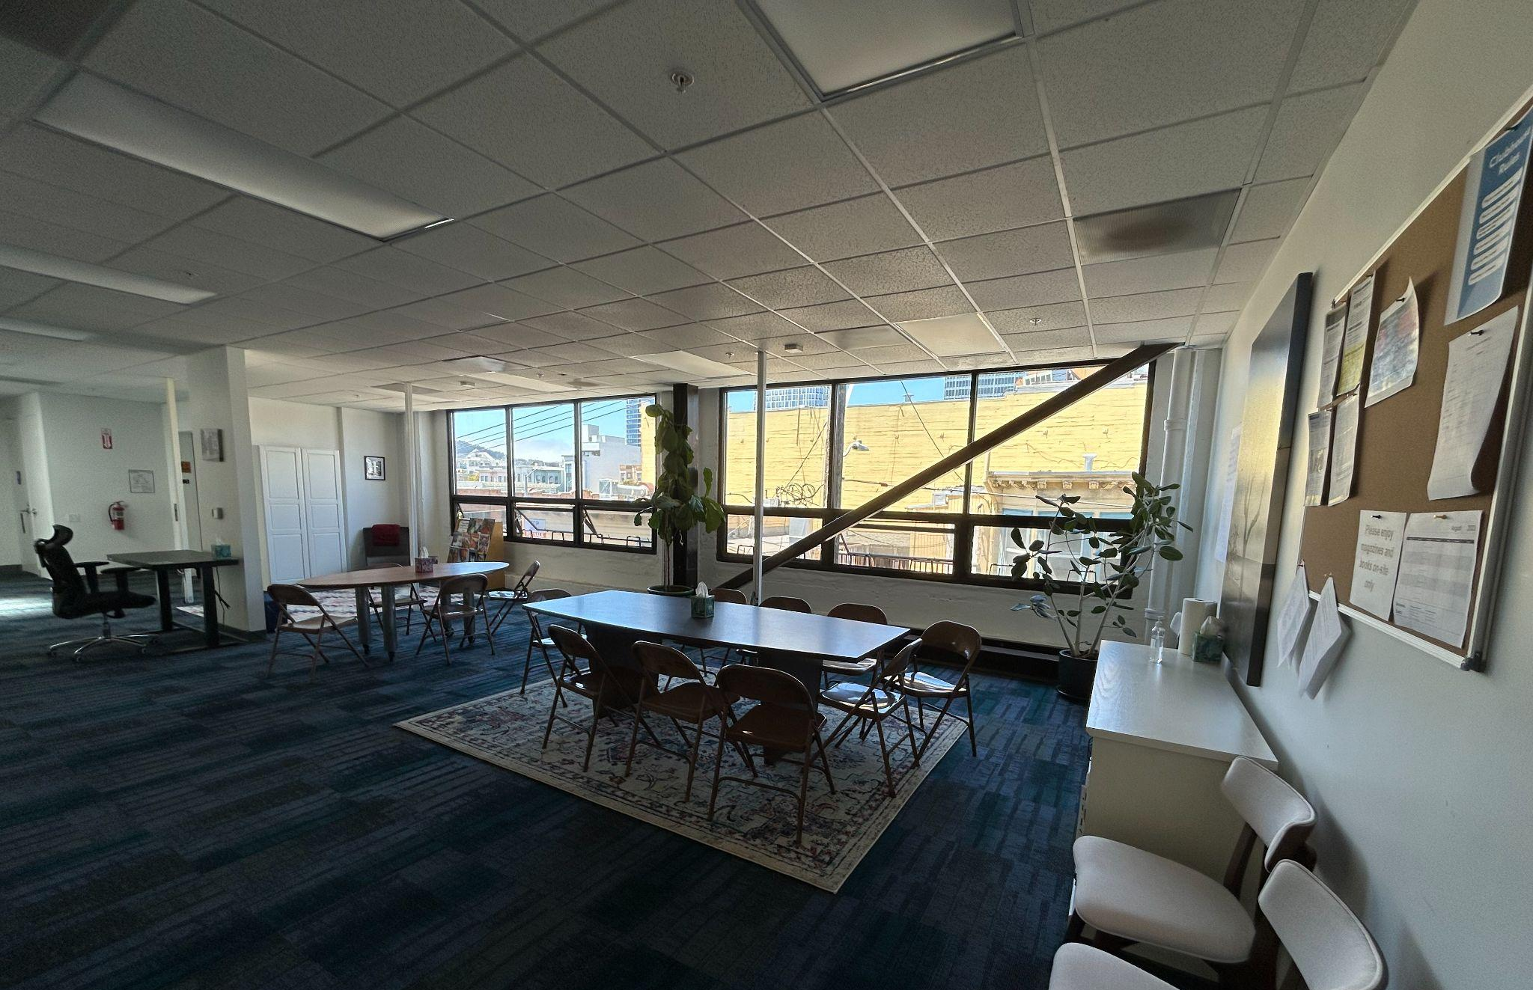
Tab

Slide 9
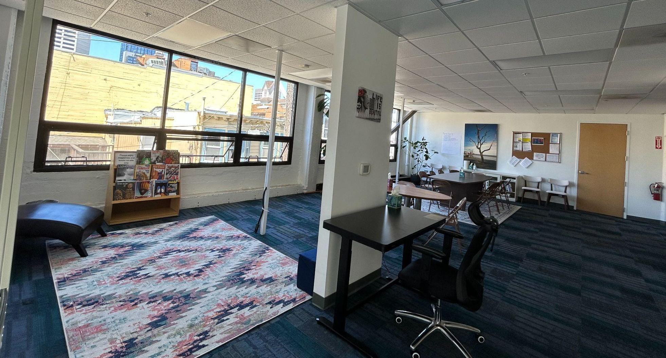

Slide 10
How is our funding structured?
Tab
Crisis Clinic Programs
San Francisco Department of Public Health
Clubhouse Peer Planning Group
California Health Care Foundation
Actively Fundraising

Slide 11
Tab
Thank you for your time!
For questions please contact Brook Chick at 415-930-1177 or
bchick@westside-health.org.

