Slide 1
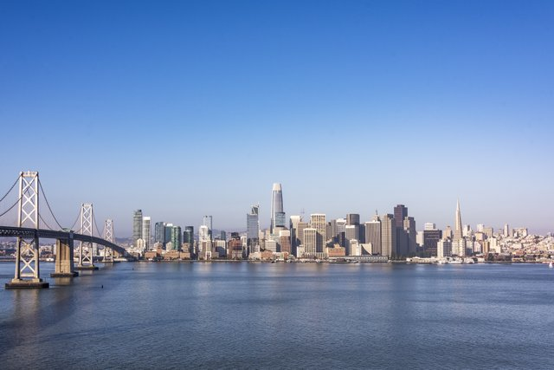
Economic Recovery in San Francisco’s Economic Core
July 25, 2022
Notes:
Thank you!
Here to give this group an update on OEWD’s Economic Recovery and Regeneration team’s work and in particular the Economic Core Recovery Fund initiatives that are planned for this Fiscal year.
- Economic Recovery Framing–
- In addition to the public health threat, COVID created significant disruptions to economic activity
- While we have seen robust recovery in many parts of our economy, even where things are going well, we are still very much in a rebuilding phase and some areas continue to lag and others have changed permanently
Intro ERR
- All of OEWD is focused on economic recovery as are many City Departments
- OSB supporting small businesses to regain lost ground
- Invest in Neighborhoods supporting commercial corridors and economic recovery in our neighborhoods with a particular focus on BIPOC communities and opportunity neighborhoods,
- Workforce is focused on supporting our labor force and people who were impacted by layoffs and the industry shifts that the pandemic brought about.
- Economic Recovery and Regeneration is focused on
- understanding the trajectory of recovery within our city and the parts of our economy that face new challenges to their ongoing economic stability
- For those parts of our economy that are not in the purveiw of other parts of OEWD and the other City departments, starting to think through impact and how San Francisco can support the recovery of those areas
- Biggest example of this is the economic core
- Today I’ll cover
-what that is
- how we are thinking about recovery in the economic core and
- the programming that we have planned for supporting its recovery in the next fiscal year
– want to qualify that this is a huge change to how economies have operated and things still haven’t settled down
- we are very actively watching and learning and developing solutions in real time.
- WELCOME the perspective, ideas, and input by this group.
- The key to comprehensive, equitable and meaningful recovery will be the input and partnership by all of those that make up our economy.
Supplemental:
- Biggest economic impact to SF that emerged from COVID can be characterized as the loss of people in San Francisco
- changes to in person reporting throughout much of our office based sectors
- disruption and ongoing changes within our tourism sector
- city wide phenomenon with city wide impacts but the epicenter for this key disruptions brought about by COVID is our Economic core and the implications in terms of impacts on jobs, small businesses, transportation, tax revenue etc. are most acutely visible throughout that physical area of the city

Slide 2
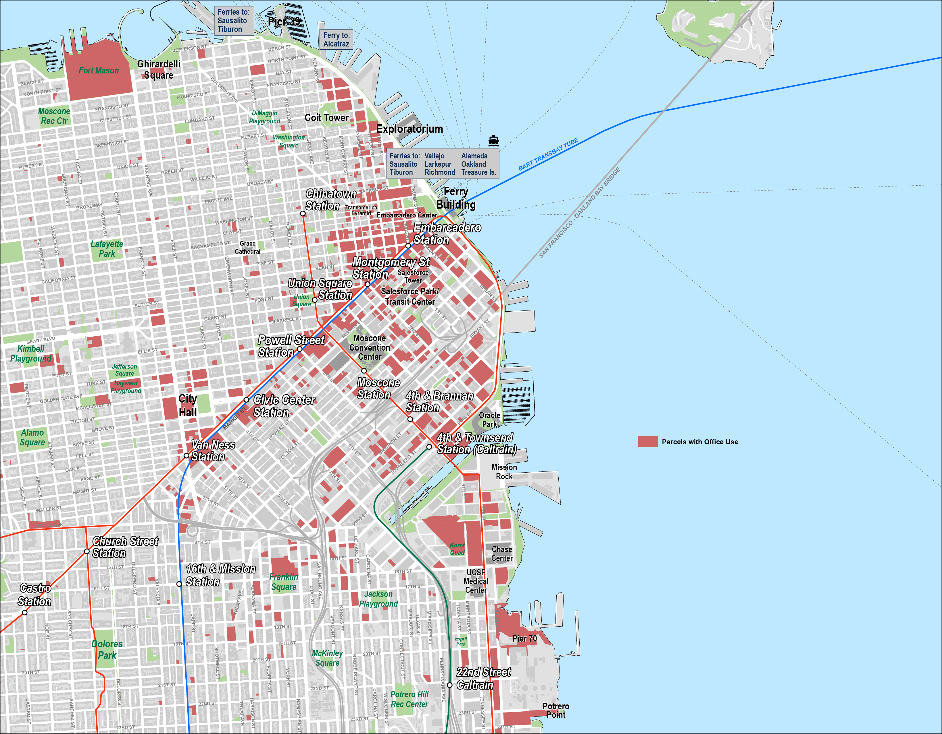
Parcels with >25,000sf office use
Notes:
Economic Core doesn’t have a set geographic boundary – it’s the interlocking set of activities that drive the city’s economy – offices, office and office worker serving businesses, hotels, retail, etc.
Red indicates parcels with more than 25K sf of office use –
Shows where office is most concentrated within the city – not a contained district with clear boundaries but clear areas of concentrations
It is the economic engine of our City’s economy, before the pandemic this area:
Almost 75% of San Francisco’s gross domestic product.
Supplied about 69% of San Francisco’s jobs and employed 39% of SF’s working residents
6 downtown zip codes generated 47% of our Sales Tax not to mention the vast majority of our gross receipts and our transfer tax
42% of our Small businesses (under 50 employees)
Drove the growth of our City and the region
Supplemental:
Concentrated within our downtown and into Union Square, up along the waterfront, down into East Cut, Yerba Buena, South Beach and Mission Bay - that’s exisiting, be mindful that there are other projects like Mission Rock that have gone through entitlement and will add more to the portfolio.

Slide 3
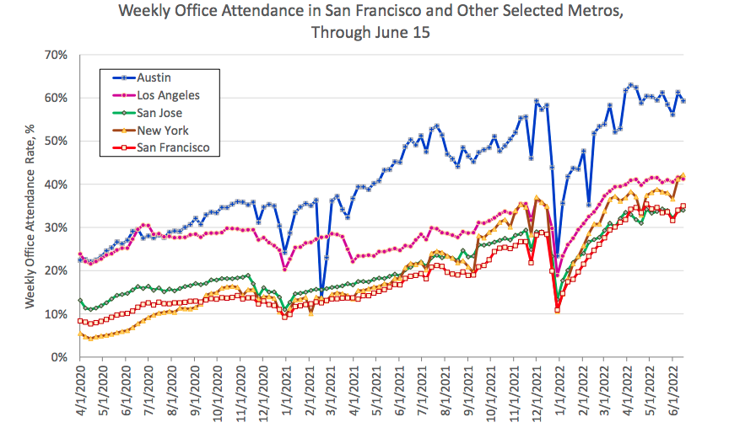
Return to work has slowed since April
Notes:
As we are pretty well aware, there continues to be a significant loss of people in our economic core and this is driven largely by remote work that the pandemic ushered in.
While SF is clearly at the bottom of this (along with San Jose) even the most successful metro areas like Austin are seeing pervasive reductions in in person reporting.
Prior to the pandemic – 470K people worked in SF but lived outside of the City. Remote work has meant that a very large number of those people do not need to come into SF, which has serious implications for the office worker serving business in the economic core

Slide 4
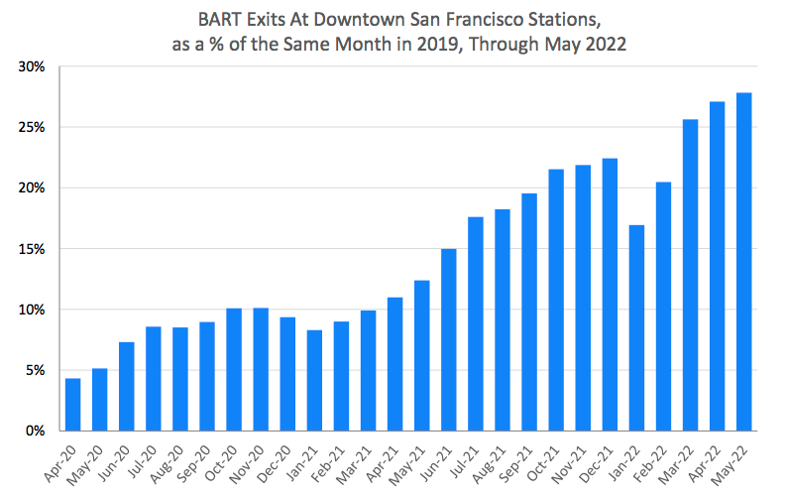
Downtown BART Ridership Below 30% of Normal
Notes:
Reinforced by what we see in terms of overall traffic into the core.
Supplemental: Additionally, traffic on bridges is 90% what it was though it might be moving less people as people are reluctant to carpool or share rides.

Slide 5
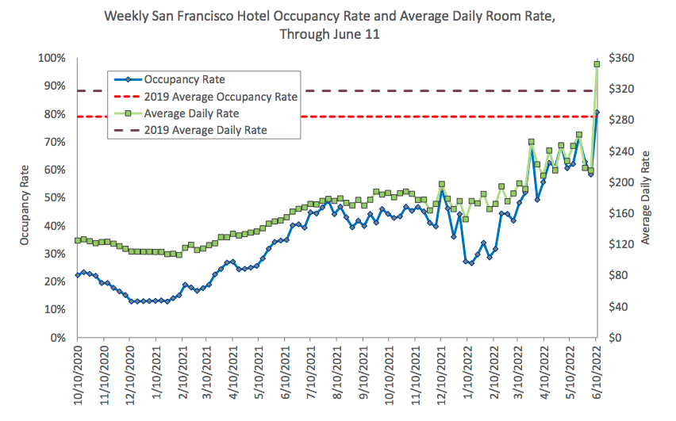
Visitor Volume Recovering but Still Down from 2019
Notes:
Tourism is another big contributor to the foot traffic in the core and while it is recovering to a much greater extent that office attendance, weekly occupancy still fluctuates between 15 - 30% lower volume than 2019.
Supplemenntal: Domestic enplanments reached 80% in April and International reached 60%

Slide 6
Office Sectors Have Led the City’s Job Recovery
5
Industry Employment in February 2022, as a Percentage of February 2020, San Francisco Metro Division
Information Professional, Scientific & Technical Services
Finance & Insurance Health Care & Social Assistance
Government Service Providing Total, All Industries
Construction Transportation, Warehousing & Utilities
Manufacturing Educational Services Wholesale Trade Retail Trade
Other Services Real Estate & Rental & Leasing Administrative & Support & Waste Services Management of Companies & Enterprises Food Services & Drinking Places
Arts, Entertainment & Recreation
Accommodation
50%
60%
70%
80%
90%
100%
110%
120%
Source: Employment Development Department
Notes:
So while our office based industries are doing very well economically and have exceeded the jobs that they held prior to the pandemic, many of our other industries that rely in one way or another on their workers and/or our visitors being in San Francisco still experience job growth on par with a recession.

Slide 7
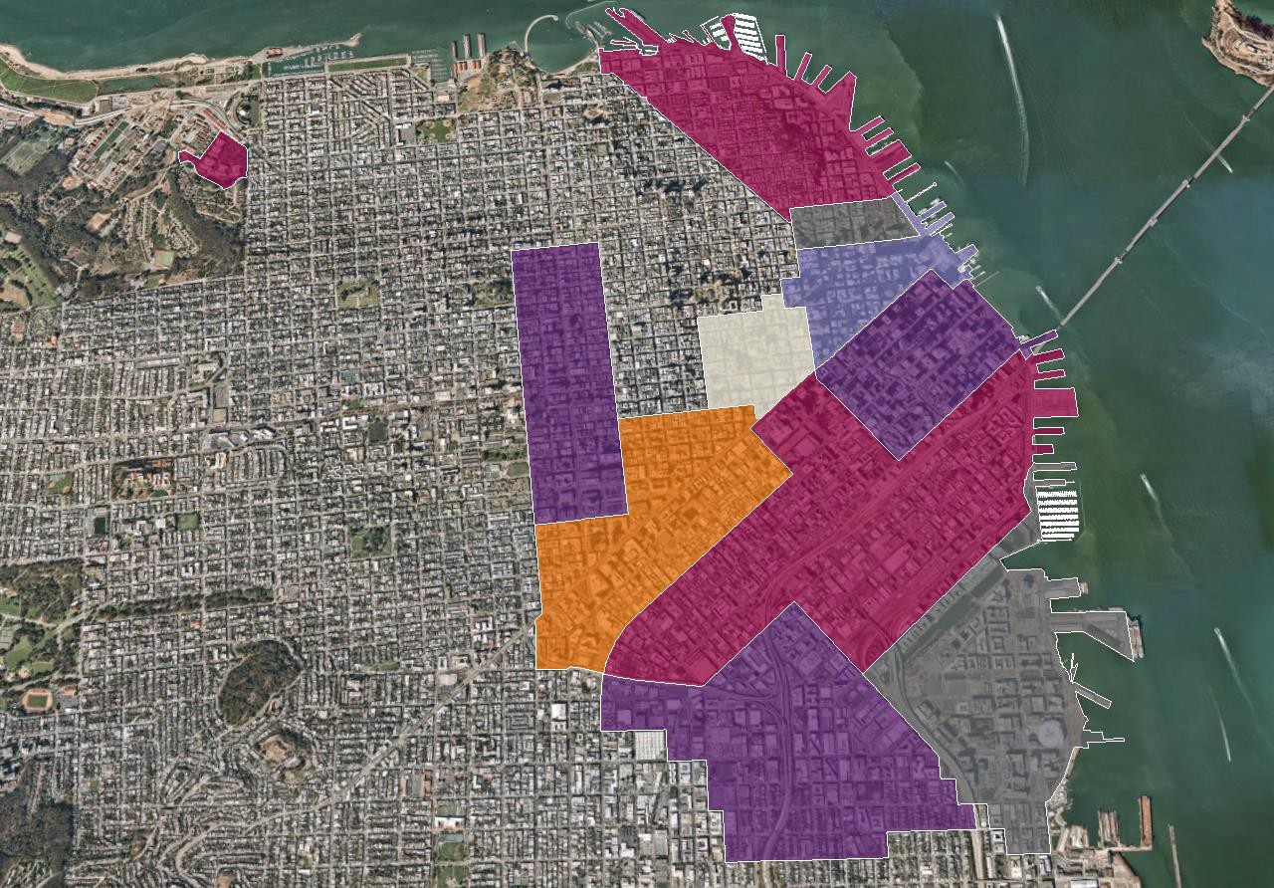
San Francisco
North Waterfront
$80.83/FSG
Total Vacancy (%) 19.7
Jackson Square
$76.15/FSG
Total Vacancy (%): 31.4
North Financial District
$79.91/FSG
Total Vacancy (%): 21.6
Van Ness Corridor
$45.01/FSG
Total Vacancy (%): 18.7
Union Square
$72.15/FSG
Total Vacancy (%):18.1
South Financial District
$82.99/FSG
Total Vacancy (%) 16.9
Mid-Market
$84.39/FSG
Total Vacancy (%): 33.7
South of Market
$68.42/FSG
Total Vacancy (%): 34.1
Mission Bay
$92.82/FSG
Total Vacancy (%): 19.4
Showplace Square
$64.92/FSG
Total Vacancy (%):31.2
Q1 2022
Office Overview
Slide developed by JLL for April 13, 2022 Forum event
Notes:
As companies respond to the decreased reliance on in-person reporting by contracting their footprints or letting go of their offices, we are seeing large vacancies in our office market
– large implications for our tax base
- starts to give us an outline of ongoing losses in volume that we need to backfill.
Supplemental: 17-34% office vacancy rate
--
NOTE: A healthy vacancy would be anywhere around 12 – 14%.

Slide 8
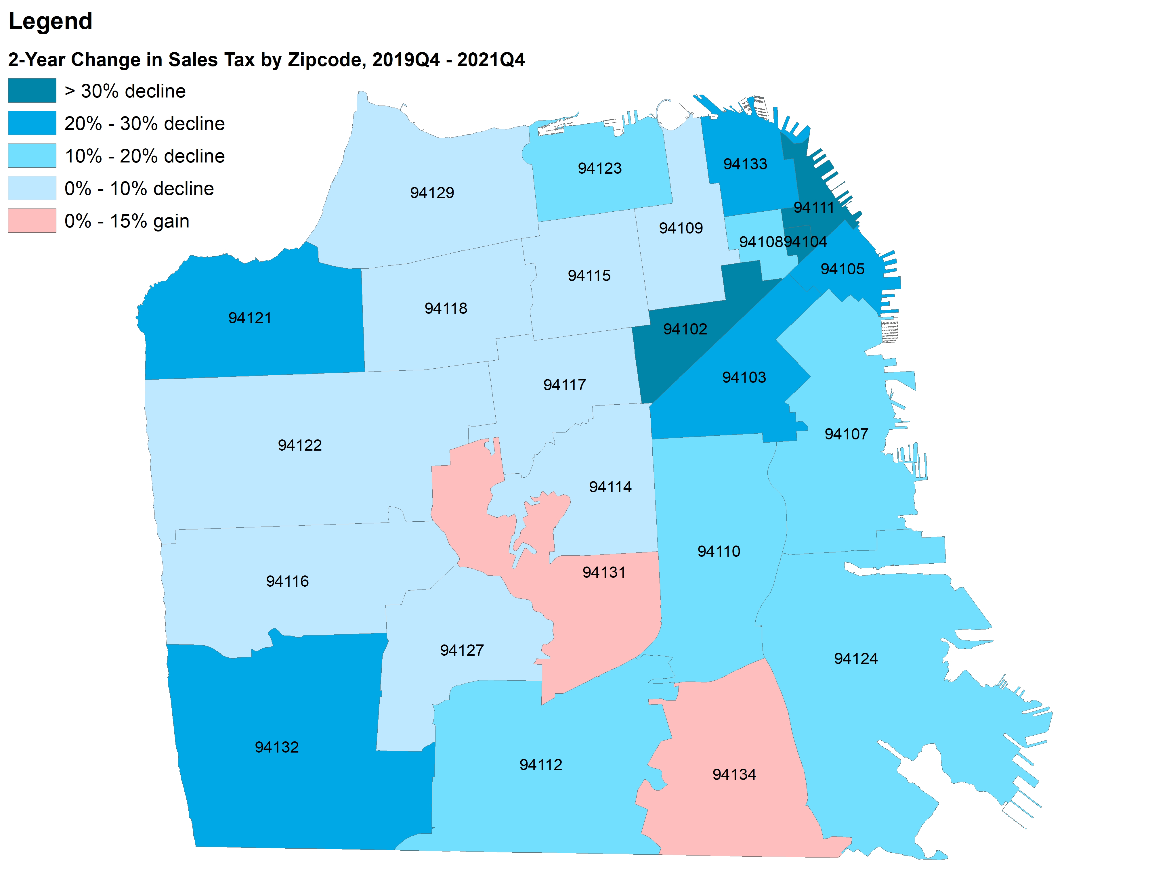
Sales Tax Weaker in the Core Than Elsewhere in the City
10
Slide developed by Dr. Ted Egan - Chief Economist for the City and County of San Francisco
Notes:
One way we can see the implications of so many fewer people coming into San Francisco is the impact on our sales tax
overall SF has still not recovered about 20% of its sales tax overall.
Many of our neighborhoods are doing much better as people aren’t going in to work everyday, they are doing their shopping and eating, and day to day things in their neighborhoods BUT
with so many fewer people circulating throughout the City, things are still mostly down
and in the economic core, we’re seeing really depressed numbers still
this has dire consequences for many of the businesses there and particularly small businesses.
All of this together represents a really big shift with implications for our entire city seen most acutely in our economic core but threaten San Francisco’s function as a job center and economic engine for the city and the entire Bay Area AS WELL the City's tax base and general fund.
Supplemental: all of our neighborhoods are within 25% of where they were pre pandemic, and 2/3 have recovered to within 10%, the downtown districts averaging 60% what they were pre-pandemic – with the zip codes in our economic core ranging from a low of 50% recovery in the FIDI to a high of 77% recovery in SOMA/Yerba Buena.

Slide 9
Economic Recovery and Regeneration Recovery Projects
10
JAN
FEB
MAR
APR
MAY
JUN
JULY
AUG
SEP
OCT
NOV
DEC
2023
Ambassadors Program – SF Welcome Ambassadors and Mid Market/TL Safety Ambassadors
Shine On, SF
Economic Recovery Dashboard Planning
Economic Recovery Dashboard
Forum Events
Ongoing work with economic core stakeholders
Downtown Reopening Events
Downtown COVID Economic Impact Analysis
Street Vibrancy Initiative
Vacant to Vibrant
Tourism Attraction Campaign
Business Attraction, Retention Campaign
Other Recovery Initiatives
Notes:
For all of these reasons, OEWD and my team specifically have been focused on the economic recovery of our economic core - namely, bringing people back to San Francisco. And we’re thinking about this in a couple of ways.
First we are trying to understand where we will settle in terms of employees returning to offices and what we can do to maximize that return. Like we saw, we’re still around 35% and while we don’t expect that is where we will remain, there will undeniably be more flexibility given to employees around reporting going forward. We also know that most employers do not want to get rid of their offices (and a LOT of employees do not want to work 100% from home for the rest of their careers), but there is a lot of rethinking on both sides about why people will be coming into them and how they will be used.
We have a couple of projects underway to really help us understand exactly how this thinking is developing and what it means for our core and our city overall.
Economic Recovery Dashboard will be a central tracker of key recovery data that we hope to make available just as we made the COVID trackers available so that all stakeholders can look at the data and see what’s happening and understand and potentially even come up with solutions around areas that still need support. Thank you Commissioner Cartegna.
Held a Forum in April with a cross sector group of representatives from throughout the economic core to start a discussion around what they are experiencing and begin to create a vision for the recovery of our economic core that supports it in really evolving successfully to the new context that is emerging. Thank you Commissioner Laguana.
Downtown COVID Economic Analysis about to kick off to give us a really robust data analysis about what changes we saw in our core because of COVID, and a survey effort to understand how businesses and employees are expecting to and want to engage with the core going forward and really understanding what the value proposition of our core is going to be in the new normal.
But we’re also really focused on bringing back as many people into the core as possible and driving foot traffic back to the businesses that need it so badly. Much of that work is focused on making the core a place that people want to go.
From the beginning we knew we needed to make people feel comfortable as they reopened store fronts, returned to work, or visited San Francisco and Mayor Breed funded the Ambassador programs and launched the Shine On SF campaign that was really focused on clean, safe, and engaging streets.
Jobs are not going to be requiring people come in the near term and so we need to give employees a reason that they WANT to be at the office – and give others who don’t work downtown, reasons to visit. Some of that is office dynamics, but we’re looking at what we can do to create events and activations in both the public realm and in vacant store fronts so that we are fostering a dynamic compelling place to be.
- Street Vibrancy Initiative
- Vacant to Vibrant
And we need to TELL people about it. Both visitors and employees and businesses. We need to remind people about San Francisco and all of the incredible things it has going for it – its culture and its food and the creativity and its one of a kindness that made it a world class destination - to pull people back into the city and attract the businesses that we need to back fill some of the space that companies let go of in this new context.
Starting with short term solutions to bring people back now but with the intent that they can also seed the changes that are going to be pivotal within the evolution of our core while developing longer term solutions that are really impactful in supporting the long term sustainability of our economic core.

Slide 10
Economic Core Recovery Fund Initiatives
5
Initiative | Programming | Examples
Street Vibrancy | Ongoing Public Space Activations | Bryant Park, NYC Love your Laneways, Melbourne
 | Regional Events | Holiday Markets First Fridays, Oakland
 | National/International Event | SxSW, Austin Jazz Fest, New Orleans & Montreal
Vacant to Vibrant | Pop Ups in Ground Floor Retail | Sip Shop Eat, Oakland ChaShaMa, NYC
Attraction Campaigns | Employee
 | Business | ATLStrong
 | Visitor | Your Comeback Starts Here, LA All Inclusive Boston, Boston
Notes:
These are the three program areas that are planned as part of the Economic Core Recovery Fund that was passed in the latest budget.
Key thing that I would emphasize for these initiatives and one of the big takeaways from the Forum is that our economic core should reflect and celebrate all that makes San Francisco so wonderful. That it is our diversity and all of our cultures as well as our creativity and innovation that make San Francisco so unique. So a priority within each of these areas will be to create programs that directly engage and open access points for local businesses, entrepreneuers, artists, communities, etc. to be part of the economic core and benefit from the opportunity it represents in an intentful way.

Slide 11
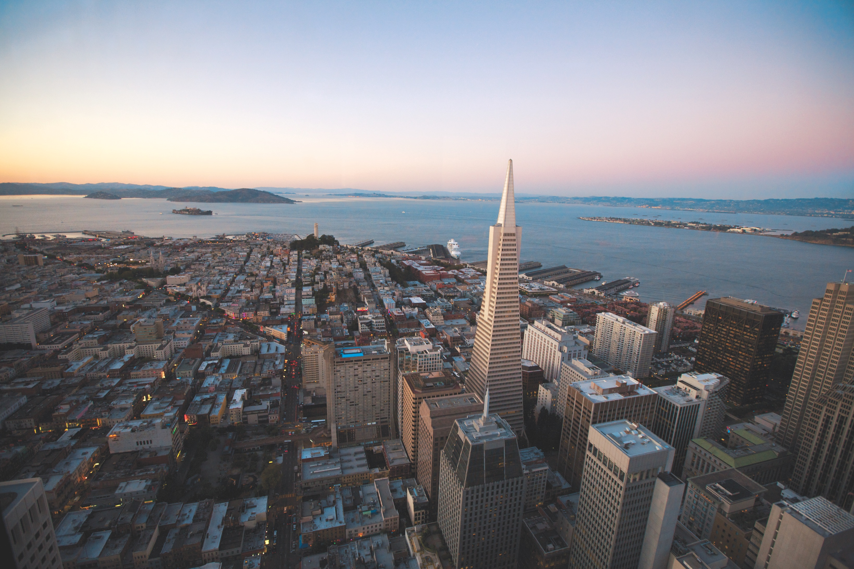
Questions &
Discussion

Slide 12
The Context
People have begun returning to in-person work in San Francisco’s economic core (e.g., the Financial District, East Cut, Union Square, Yerba Buena, Embarcadero, Market Street, and Mission Bay). This return is a significant collective investment in our economic recovery, but it is just a first step.
In this post-pandemic landscape, we need San Francisco's "economic core" to be a place people choose to work, do business, and visit. Citywide and cross-sector partnership is vital to this effort.
Notes:
- SF's economic core represents one of these areas that are both lagging in terms of economic recovery and what we anticipate will be permanent change.
- Tourism fell to almost nothing during the pandemic and is showing very slow recovery
- Likewise the vast majority of office work became almost fully remote during the pandemic and shows little likelihood of returning in its pre-pandemic format
- Significant ramifications for the tourist and office serving businesses and their workforces throughout the economic core
- We have reached a point now where our public health outlook has become stable enough for us to begin to observe and make predictions about the new economic context that we might expect going forward
– One of the strongest emerging realities is that many of the structural elements that tethered people to our economic core – jobs, business meetings, etc. will no longer require that people report in person. Rather people will have the flexibility to choose where they work, socialize, shop, etc. In order to preserve the vibrancy of our economic core we will need to support its recovery in a way that reinforces its unique value proposition with this in mind.

Slide 13
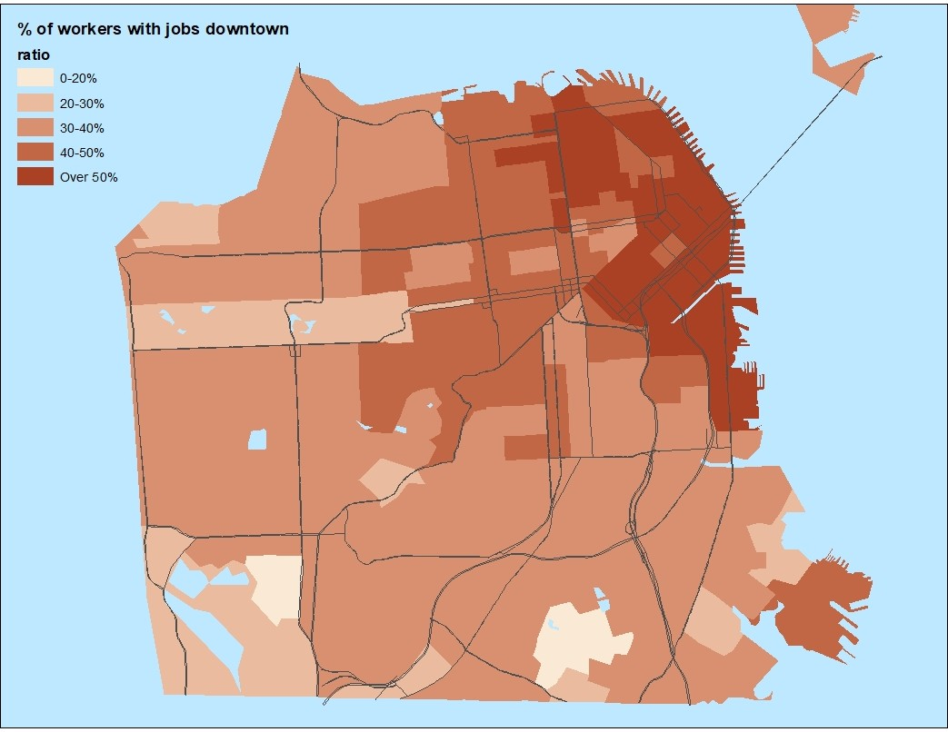
The Core is a Major Job Destination for all San Francisco
2
Source: U.S. Census Bureau, LODES data
Slide developed by Dr. Ted Egan - Chief Economist for the City and County of San Francisco
Notes:
Digging in a bit more to the role it plays and the current status – and thanks to Ted Egan for the following slides
More than 30% of the residents in almost every SF neighborhood work in the economic core

Slide 14
The Core Reflects the Diversity of the City’s Economy
3
Employment by Industry in Downtown San Francisco, 2018
Accommodation / Food
Arts 2%
9%
Other Services 3%
Public Administration
4%
Utilities 2%
Construction 2%
Manufacturing
1%
Wholesale
2%
Health 6%
Education 5%
Admin Services 7%
Retail 5%
Transportation 5%
Information 8%
Prof Services 23%
Finance/Real Estate/HQs 14%
SoSuorucrec:e: U.S. Census Bureau, LODES data
Slide developed by Dr. Ted Egan - Chief Economist for the City and County of San Francisco
Notes:
Every single industry in San Francisco is represented within the economic core. Clearly known as the seat of the City's (and Region's) tech, finance, and other professional service offices but important to note that they make up less than half of the total jobs. They do however drive every other industry represented in SF and create the demand for the jobs by all the industries in the economic core

Slide 15
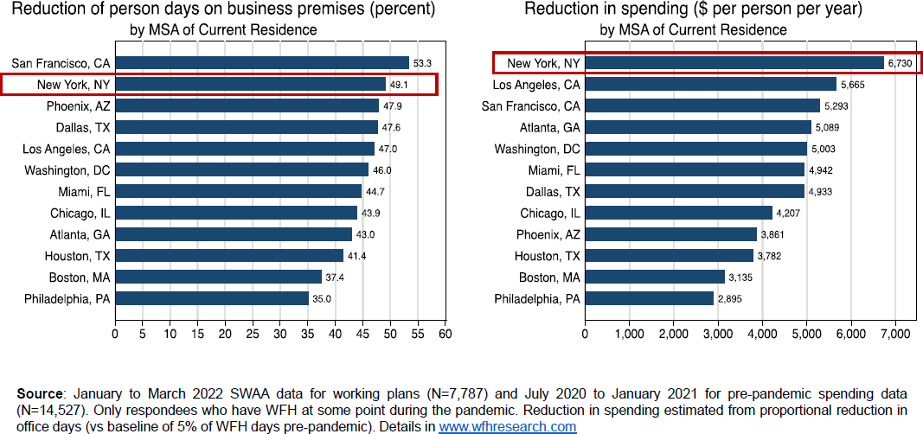
SF Workers Expect to Stay Away > 50% of the Time
8
Source: WFHResearch.com
Slide developed by Dr. Ted Egan - Chief Economist for the City and County of San Francisco
Notes:
… and are likely to continue....especially San Francisco, with significant implications for the businesses based in our office core that cater to these workers.

Slide 16
Renewing the Economic Core: Forum Series
The City is partnering with Advance SF to facilitate discussions among public and private-sector leaders to help build a shared vision for San Francisco’s re-emerging economic core.
Initial Event: April 13th Renewing the Economic Core Forum
Full-day event hosted in partnership with Advance SF that brought private-sector leaders together for a facilitated visioning session to help build a shared vision for San Francisco’s re-emerging economic core.
Additional Events
April 20 – Discussion at today's Directors Working Group
May 11 – Feedback Session on draft narrative for 4/13 event attendees
May 24 – Public dialogue – SPUR panel and dialogue re: renewing the economic core (anticipated 12:30pm timeslot)
Ongoing – Smaller group implementation-focused workshops on key topics of interest (i.e. public realm workshop in early September)
Notes:
Final bullet – touch on expectation that other topic focused groups will emerge
Top themes discussed included:
Urgency, need for near-term actions
Partnerships/programs to support small business (ex: large employers sending employees to nearby local restaurants with events, vouchers)
Leveraging arts and partnering with artists to fuel recovery
Targeting key audiences:
existing workers who could be enticed to stay more
young people
families throughout the region
Creating great "third spaces" that blend home and hospitality
Creating new public realm projects that surprise, delight, draw people
Improving baseline cleanliness and safety
Leveraging communications to change the narrative – a PR campaign, improved coordination among comms teams to promote new efforts, etc.
Near-term opportunities: May Small Business Month; June Pride Month and Juneteenth

Slide 17
Forum Outcomes
The outcome of this series of dialogues will be a new narrative for our economic core that provides a strategic springboard for public-private collaboration on efforts to support recovery, such as:​
policy initiatives
business attraction and retention efforts
beautification/public realm investments​
public space activation​
transportation initiatives
ground floor and office tenanting

Slide 18
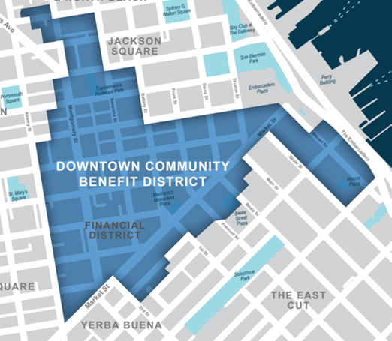
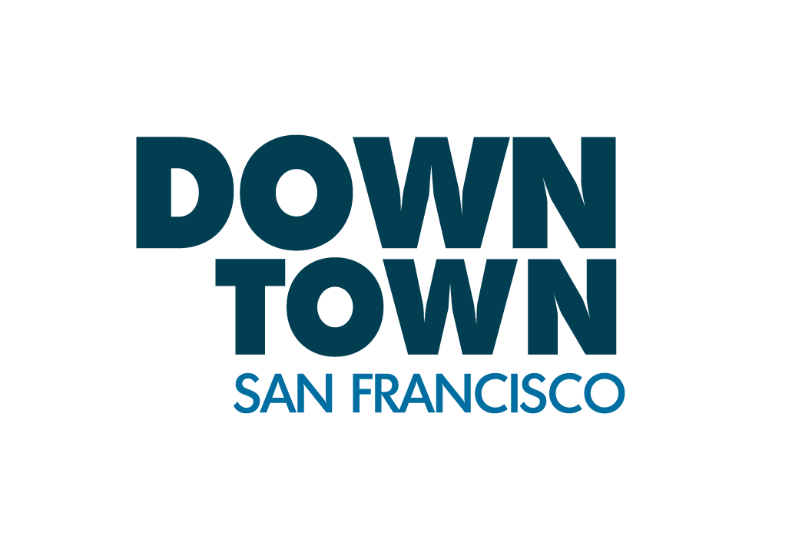
Downtown CBD Public Realm Action Plan
Action Plan for streets and public spaces in DCBD's district
Recommendations will include physical and programmatic public realm projects
Focus areas include:
Branding/wayfinding
Sidewalk landscaping
POPOs activation
Place-based public art
Events
Pedestrian safety, comfort
Led by:
Lead consultant:

