Slide 1
Legislated Vending Program
Bureau of Street-Use and Mapping

Slide 2
Historic Vending Categories
Merchandise Vending
Historically permitted and enforced by SFPD
Does not include items intended for human consumption
Food Vending
For last decade, permitted and enforced by SFPW
Permitting for health and fire elements of operation conducted by DPH and SFFD respectively
Includes both food trucks in parking lane and push carts on sidewalks

Slide 3
Proposed Vending Categories
Vending Program: Merchandise & Pre-Packaged Food Vending
To now be permitted under SFPW Vending Program (PW Code Article 5.9)
Now includes items intended for human consumption, but only if they are prepackaged. Prepackaged items will still require the permittee to obtain a DPH permit.
Mobile Food Program: Other Food Vending
Will continue to be permitted and enforced by SFPW (under PW Code Article 5.8)
Permitting for health and fire elements of operation continue to be conducted by DPH and SFFD respectively
Continues to include both food trucks in parking lane and push carts on sidewalks
Does not include sidewalk vendors selling solely prepackaged food and drink

Slide 4
Proposed Vending Categories (continued)
Vending Program will permit both “Stationary” and “Roaming” vendors:
Stationary Vendors: A Vendor operating from one or more fixed, defined locations.
Roaming Vendors: A Vendor that moves from place to place and stops intermittently to complete a Vending transaction.
Roaming Street Vendors may only utilize non-motorized conveyance on sidewalks.

Slide 5
Vending Program Exclusions
The following activity is not included under the new Vending Program (PW Code Article 5.9)
Vending conducted through motorized conveyance
Food products being sold as part of a fundraiser by a non-profit entity
Operation of, or sales within, Farmer’s Markets
Operation of, or sales within, Swap Meets
Vending within areas already permitted by a ISCOTT permit
Vending of areas in Recreation & Park jurisdiction
Exceptions: UN Plaza and Hallidie Plaza

Slide 6
Obtaining a Vending Permit
BSM Permitting Team working with Digital Services to launch modern application portal.
Application portal to include following requirements:
Business information, type of items to be sold, information on whether vendor will be stationary or roaming
Proposed operating location(s) & hours of operation
Attestation that merchandise was obtained legally
Proof of identity and photo of applicant
Certificate of Liability Insurance
Proof of eligibility for fee waiver or fee discount

Slide 7
Obtaining a Vending Permit - Renewals
Vending permit will be required to be renewed annually
Renewals will require renewal permit fee and up-to-date documentation, such as:
Certificate of Liability Insurance
Up-to-date DPH credentials, if required for food and drink vending
Proof of eligibility for renewal fee discount

Slide 8
Permit Fees
Individual Applicants
Fee waivers to be applied to individuals meeting SFMTA’s annual income limits for MUNI Lifeline Pass (200% of US Dept of Health & Human Services threshold)
50% fee discount to be applied for renewal permits
Groups & Organizations
50% fee discount applies to 501(c)(3) nonprofit organizations meeting one of the following:
Funding ≤ $2.5 million
CBD (Community Benefit District)
Supports a cultural district
Has a mission of supporting economic development or community vitalization
Base Fees
Approximately $400 for initial applications, $100 for renewal applications

Slide 9
Program Requirements - Clearances
Permittees must maintain a minimum six (6) foot path of travel on the sidewalk
Other clearance requirements:
Eight (8) feet from Street Artist License vendors
Seven (7) feet fire fire hydrants
Twelve (12) feet from bus zones or blue zones
Permittees must maintain a minimum two (2) foot path of travel along the curbside while operating adjacent to existing on-street parallel parking

Slide 10
Program Requirements - Zoning & Location
Stationary Vendors may not operate in residentially zoned areas
Vendors may not operate in proximity to
Certified Farmer’s Markets
Swap Meets
United Nations Plaza
Hallidie Plaza
Special Event or other City event permits
Exceptions possible with written consent from the Director of Public Works

Slide 11
Program Outreach
SFPW-BSM Inspection, as well as SFPD, DPH, OEWD, and local community groups, have been performing outreach and educating vendors about the new vendor legislation since April 2022. The outreach has focused on:
Upcoming program requirements
The need to apply for and display a permit (once available)
Siting requirements (e.g., 6’ path-of-travel, 7’ clearance from fire hydrants, etc.)
Providing satisfactory proof of ownership for goods
Timing for Implementation
How to apply for a permit and the resources available to assist them
Outreach is intended to support vendors with limited business experience and limited English language proficiency.
Staff fluent in Spanish and Chinese have been participating in outreach/education.
Community groups (e.g., Calle 24) assisting with messaging and application preparation.

Slide 12
Enforcement - Corrective Actions
Vendors found to be operating without a permit or whom are otherwise not operating in compliance with program requirements will be asked to cease operations and remove belongings from the public right-of-way. A Correction Notice (CN) identifying the violation(s) needing to be remedied and the timelines within which each must be corrected may also be issued.
If deficiencies are not timely addressed, or in the case of willful non-compliance, a Notice of Violation (NOV) with monetary fines attached may be issued under Public Works Code 5.9 as follows:
Operation without a permit
$250 for first violation
$500 for second violation
$1,000 for third or subsequent violations
Other violations of program terms
$100 for first violation
$200 for second violation
$500 for third or subsequent violations
Goods may also be seized when vendors refuse to cease vending and/or are unable to provide satisfactory proof of ownership.

Slide 13
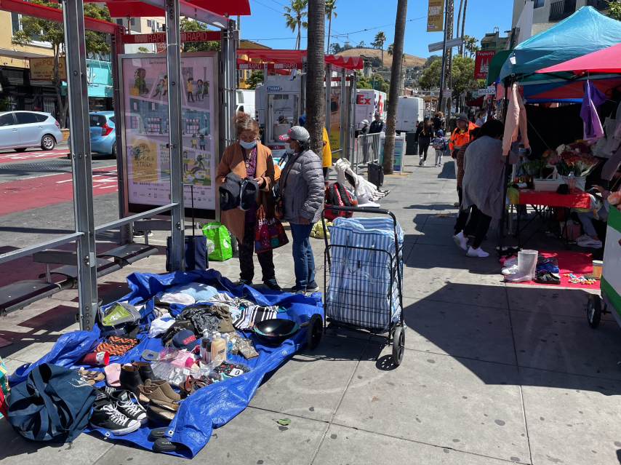
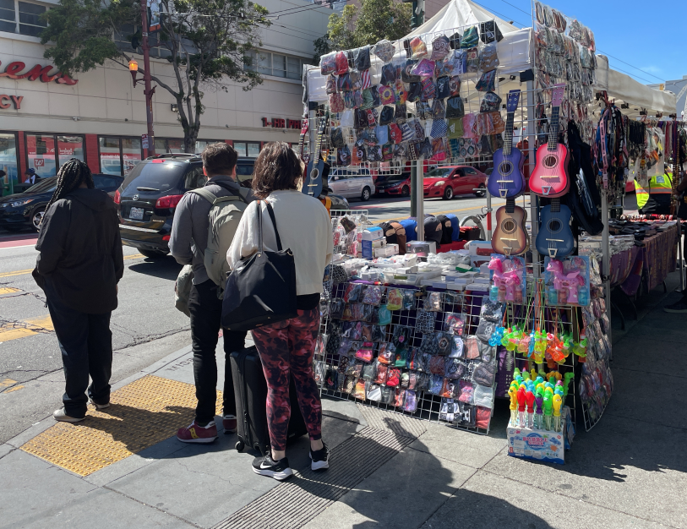
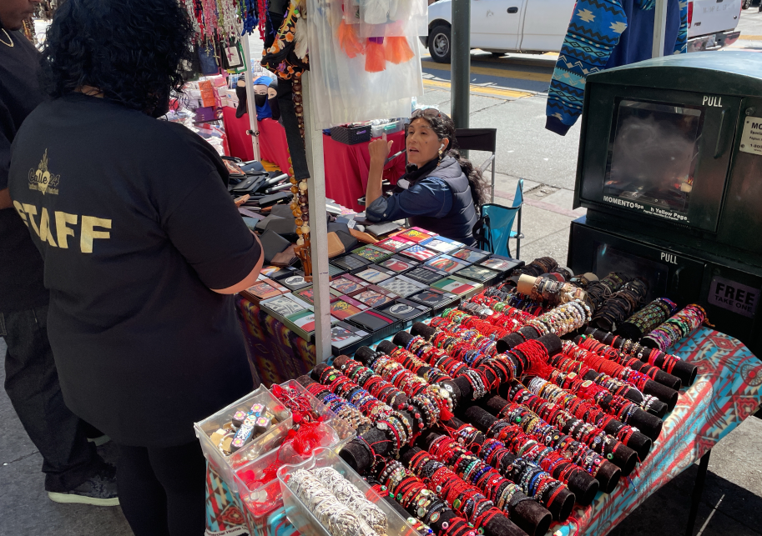
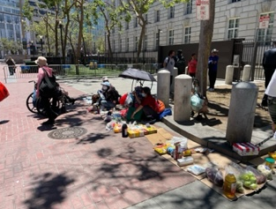
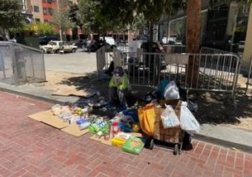
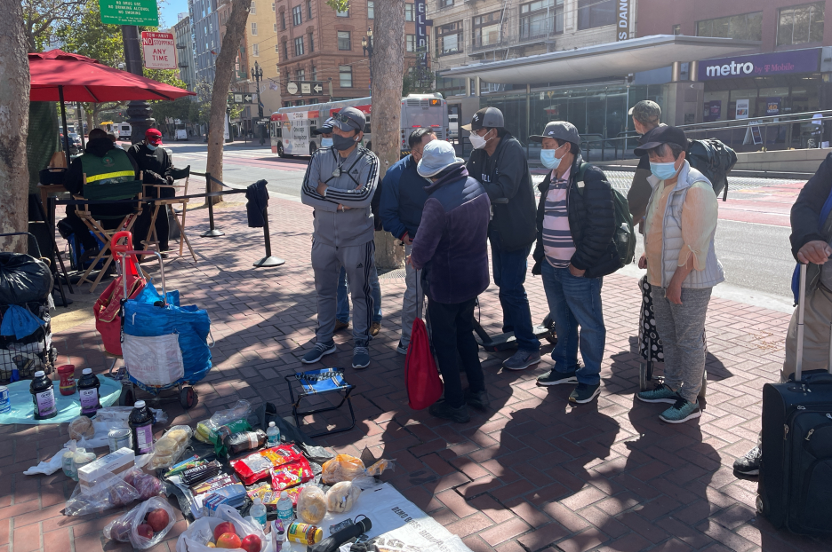
Enforcement - Current Focus
Enforcement focused on two areas - The Mission and UN Plaza - each with unique challenges.
The Mission - Siting Requirements and Accessibility
UN Plaza - “No Vending” Zone

Slide 14
Thank you!

