Slide 1
Contracting 101
June 10, 2019
San Francisco Department of Public Health
Contract Development & Technical Assistance (CDTA)
Utilizing sound business practices, CDTA facilitates the development of city health delivery system contracts, thus ensuring the availability of community services that protect and promote the health of all San Franciscans.

Slide 2
Michelle Long, M.H.A.
Director, Contract Development & Technical Assistance
1380 Howard Street
San Francisco Department of Public Health
Phone: (415) 255-3409
CDTA Website: www.sfdph.org/cdta

Slide 3
Today’s Objectives
By the end of today’s presentation you will know how to make a draft version of contract documents that if done correctly, should proceed through the certification process with minimal delays.
The role and function of each of the Business Office sections
The role of the CDTA website
Contract development documents: when and how to use them
Procedures and Guidelines documents: when and how to use them
Appendix A Narrative Instructions & Template
  Deliverables
  Performance Objectives:
    The relationship between Appendix A and Appendix B
Appendix B Budget Instructions & Template
  BHS
  Non-BHS
The key elements of the Funding Notification
  CID, Funding Source(s), Terms, Amounts, Dates, Contacts
  Its relationship to Appendix B

Slide 4

Department of Public Health Business Office
DPH Chief Financial Officer
Greg Wagner
Director of Business Office
Michelle Ruggels
Business Office Contract Compliance (BOCC)
Michelle Ruggels, Interim Director
Contract Development & Technical Assistance (CDTA)
Michelle Long, Director
Budget Unit
Shirley Giang, Director
Office of Contracts Management & Compliance (OCM)
Mario Moreno, Director
Conduct comp. annual program monitoring of all contractors and Behav. Hlth Svc. Civil Service clinics
Conduct on-site chart audits of all treatment contractors and Civil Service clinics
Conduct situational on-site monitoring, including for Whistle blower complaints
Facilitate contractors’ and Civil Service clinics’ Medi-Cal site certification
Act as lead and team member in Controller’s Joint Fiscal Compliance Monitoring Program
Staff Controller’s Joint Fiscal Steering Committee
Investigate Shelter Monitoring Standard of Care complaints
Review/follow-up on all contractors’ independent audit reports
Implement provisions of Proposition I
Conduct data analysis for contractors’/Civil Service clinics’ deliverables, objectives, clinical compliance
Principal Point of Contact for contracting organizations
Develop standardized contracting policies and procedures
Liaison across covered sections to ensure consistency of contract documents and policies.
Coordination of contract development process, including negotiations, planning and implementation
Liaison with Contracts Office and Budget Unit through certification
Preparation of Appendix A and B for all contracts
Maintain and manage calendar of activities that affect contract development
Plan technical assistance resources and methods of deployment; offer technical assistance as needed
Initiate and/or review contract modification/ revision requests
Lead through Medi-Cal Certification process coordination
Develop, monitor Corrective Action Plans, and update Health Commission
Monitor expenditures and revenues in BHS, both contractual and civil service; prepare revenue projections and track Medi-Cal variance
Oversee the preparation of funding notification letters and invoice templates; approve monthly invoice payments
Develop standardized budget related contracting policies and procedures
Develop and Monitor contract funding mixes by modalities
Oversee and approve budgets for contract and contract mods
Assist BOCC in performing contractor fiscal reviews
Monitor and oversee the preparation of the annual budget narratives, write-ups and analyses for BHS, and others sections as requested
Compile information requests and prepare data analyses pertaining to contractual, and civil service services
Advise and assist planning for contract needs
As needed. prepare and assist in development of Scopes Of Work and contract budgets
Plan, prepare, coordinate, and track Civil Service Comm. (CSC) requests for approval to contract out
Conduct competitive selection processes (RFPs/RFQs); prepare and obtain approval of no-bid and other sole source contracts
Facilitate compliance with City requirements (e.g., insurance, taxes, LBE/MCO/HCAO, etc.)
Plan, prepare, coordinate, and track requests for approval by City Attorney, OCA, the Health Commission and BOS, including responses to Board Budget Analyst and annual Health Commission reporting
As needed, assist program staff in negotiating contract boilerplates and contract terms and conditions

Slide 5
What does it mean to be Principal Point of Contact?
Principal Point of Contact for Providers
Coordinator for the contracting process
Contract Pre-negotiation & Negotiation
Resolution of Issues
(ATAP)
Performance Objectives
Training
Policies & Procedures
Program Transitions
Organizational Development
Referral & Linkage to DPH staff
Contract Interpretation

Slide 6
Contracting is a Collaborative Process
Contracts
System of Care Program Directors
Office of Contract Management & Compliance
Fiscal / Budget Unit
CDTA

Slide 7
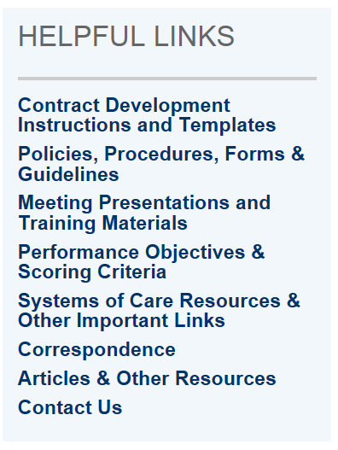
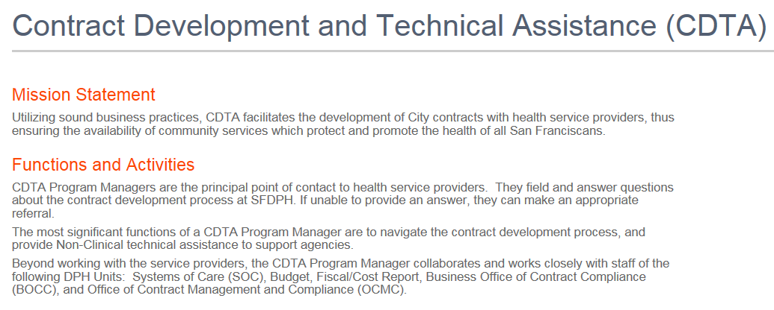
www.sfdph.org/cdta

Slide 8
Reminder: Important DPH Forms
What You Want To DO: | Form to Get it Done:
To make programmatic or budgetary changes to a contract | Contract Change Request Form
Increase the Fringe Benefit Rate above 30% | Fringe Benefit Rate Increase Request Form
Increase the Indirect Rate above 12% | Indirect Cost Rate Increase Request form
Change permissions for signing documents | Signature Authority Form
Spend more in an expense category than the amount currently budgeted (Additional criteria: The increase in the expense category must be beyond $1,000 and the increase exceeds the lesser of $10,000 or the 10% of the expense category budget. This is for Cost Reimbursement invoices only) | Invoice Variance Request Form

Slide 9
Contract Change Request Process
To establish protocols and guidelines for Contractors and
System of Care Program Managers (SOC PM) who wish to make:
  Programmatic Changes
    Change in the Scope of Work or Methodology
    Change to Process & Outcome Objectives
    Addition or deletion of a mode of service as listed in Appendix B
    Increase/decrease in contract deliverables (either UOS or UDC)
    Change to services provided by subcontractor
    and/or budget changes to an existing certified contract or request a contract negotiation.

Slide 10
Contract Change Request Process
Requested Budget Changes
  Additional funds
  A reallocation of existing funds
  A change in the time period for which the funds are allocated
  Creation of a budget line item not included in the certified contract
  Movement of budgeted funds between Salaries/Benefits and Operating Expenses in excess of 10% of the currently certified appendix budget. [See Invoice Manual on CDTA Website for additional Instructions if over 10% or $10k]
  Other

Slide 11
Contract Change Request + Negotiation
Contract Negotiation Request
  A Negotiation Meeting is a meeting with the contractor staff where issues pertaining to development of a contract are discussed, including but not limited to scope of work, distribution of funding, modalities and modes of service, target populations, standard and individualized performance objectives, unit rates, staffing, start-up requirements, Corrective Action Plans (CAPs), past issues and difficulties, and timelines.

Slide 12
Contract Change Request + Negotiation
A Contractor can request a Contract Negotiation at ANY point in the Fiscal Year by:
  Completing a Contract Change Request Form (CCR)
  Responding to a Recommendation Summary
  Sending an email to the CDTA Program Manager
◆ Include topic(s) you would like to discuss during the Negotiation Meeting

Slide 13
Contract Preparation
Common things that can slow down the contract development and certification process
  Expired Insurance Certificates - please check for expired insurance once you send in your contract documents; make sure you have sufficient coverage for the type of service that you are funded to provide and in sufficient amounts
  Use of incorrect document templates - please go to the CDTA website and select the appropriate template
  Late documents – Send in documents by Date listed in Funding Notification; contact your CDTA Program Manager if you cannot make this deadline
  Waiting for Requested Contract Changes - Contractors often delay in meeting the deadline in the Funding Notification because they are waiting for requested changes to the contract such as additional money, funding from a specific funding source, adding a grant funded or state funded program.
Notes:
Looking at procedural ways to cut down the contract development time and get contracts into the 6-8 wk certification process. In talking with staff, we’ve come up with these for areas that slow things down.

Slide 14
If you remember nothing else…
Use the Contract Checklist to assist you as you prepare your documents. If you have questions about your Appendix A or B, please contact your CDTA Program Manager for assistance;
If you want to modify your current contract, the Contract Change Request Form (CCR) must be used;
Expired Insurance Certificates hold up invoice payments;
See the CDTA website for contract templates, objectives, forms, procedures, etc.
www.sfdph.org/cdta
Notes:
Looking at procedural ways to cut down the contract development time and get contracts into the 6-8 wk certification process. In talking with staff, we’ve come up with these for areas that slow things down.

Slide 15
Contract Development & Technical Assistance (CDTA) Staff
Michelle Long, Director 255-3409 michelle.long@sfdph.org
Francine Austin 255-3933 francine.austin@sfdph.org
April J. Crawford 255-3931 april.j.crawford@sfdph.org
Elizabeth Davis 255-3934 elizabeth.davis@sfdph.org
Margaret Elam 255-3410 margaret.elam@sfdph.org
Mario Hernandez 255-3503 mario.hernandez@sfdph.org
Richelle-Lynn Mojica 255-3555 richelle-lynn.mojica@sfdph.org
James Stroh 255-3445 james.stroh@sfdph.org
Valerie Wiggins 255-3514 valerie.wiggins@sfdph.org
Andrew Williams III 255-3928 andrew.williams@sfdph.org

Slide 16
Understanding Your Contract
Michelle Ruggels
Director, Business Office
1380 Howard Street
San Francisco Department of Public Health
Phone: (415) 255-3404

Slide 17
CONTRACTING 101:
New Contracts term approved for up to 5.5 year
Full Not to Exceed (NTE) funding for entire term approved
New Contract | FY19-20 (and Years 3 4, 5) | Boiler Plate Changes
FY18-19 Example (Year 1) | Internal Revision (Request for Program Budget RPB) | Formal Amendment
Funding Notification Issued (BHS for one year; Other sections for all years of the contract term) Contractor submits FY18-19 appendices (or all year’s if not BHS) DPH Internal Approval Contractor signs City Attorney Approval City Office of Contract Administration (OCA) Approval (2x) DPH Fiscal encumbers contractor funding Contract “certified” Invoice templates released. | Initial Payment Released (25% of annual eligible funding for BHS) “MYE” Invoice templates released based on prior year funding and rates (for BHS) Funding Notification Issued for BHS and for others sections if any changes Contractor submits updated appendices for current FY DPH Internal Approval DPH Fiscal encumbers annual funding amount Invoice templates released. Adjustment invoice processed | This will occur if the contract term is extended or the NTE amount is increased. Will require City Attorney and OCA approval. Requires BOS approval if the contract NTE exceeds $10 million and/or 10 years.

Slide 18
Original Agreement and the Boiler Plate
Original Agreement: (aka contract) is the legal agreement which is made by and between the City and County of San Francisco and the Contractor. Original agreements are made only as the result of a competitive solicitation (RFP/RFQ) or an approved Office of Contract Administration (OCA) sole source waiver.
The Original Agreement contains the legal language required by the City, which is also referred to as “the boilerplate” or “City template,” and refers to everything in the Original Agreement up to and including the signature page.
The Original Agreement boilerplate identifies:
  The total contract amount or Compensation amount (funding estimated for all contract years). The Compensation total is also referred to as the Not To Exceed (NTE) amount. Expenditures (spending) made under the contract may not exceed the total Compensation/NTE amount, a requirement that is stated in all City agreements.
  The Term of the agreement. The term of the agreement may include more than one fiscal or funding year (typical contract length is five years). The contract term may not exceed the time period designated in the competitive solicitation or the approved sole source request.

Slide 19
Contract Contingency
DPH Contracts include a 12% Contingency Value as part of the contract Not to Exceed value.
This is a placeholder value which is equal to 12% of the contract allocation. This placeholder is referred to as the “Contingency”. The Contingency allows DPH to accommodate potential funding increases, up to 12% of the contract allocation, without requiring a formal contract modification to add the potential increases, or a second approval by the Board of Supervisors or Health Commission.
The contingency is not money. It is a placeholder value that allows us flexibility to add funding, such as a Cost of Doing Business increase.

Slide 20
Contract Appendices
The Original Agreement also includes appendices specific to each particular contract, including individual appendices for:
  Specific legal, policy, funding, or procedural requirements;
  The Description of Services (also referred to as the narrative or Scope of Work/SOW) (Appendix A-1, A-2, A-3, etc.)
  The Contract Budget Pages (Appendix B-1, B-2, B-3, etc.)
  Invoice Templates
  Proof of Insurance (insurance certificates, additional insured endorsements, and any approved waivers of insurance requirements)

Slide 21
Appendix B
Calculation of Charges Section
Compensation Section
  The full funding over the term of the contract is identified.
  The projected funding for each year of the contract is identified, with the value of the Contingency
  The full term of the contract is identified

Slide 22
Original Agreement/Amendment or
Internal Revision (RPB)?
How do you know, and why might it matter?

Slide 23
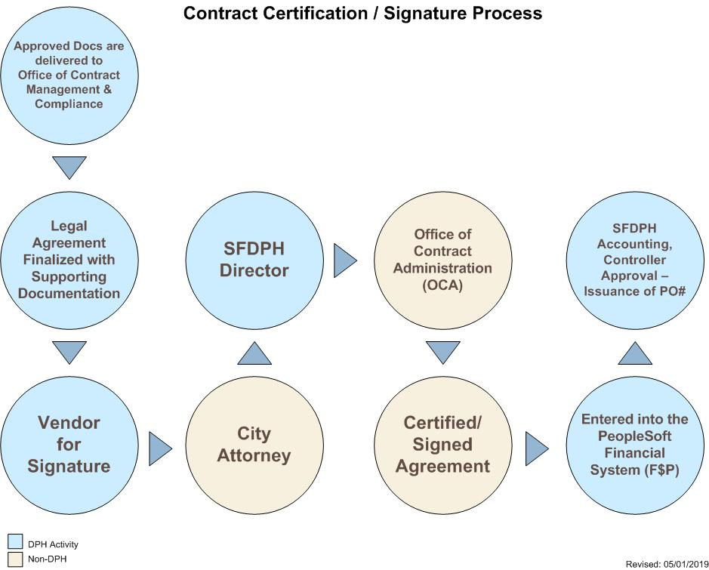

Slide 24
Appendix A
Dean Goodwin
Assistant Director, HIV Health Services
25 Van Ness, 8th Floor
San Francisco Department of Public Health
Phone: (628) 206-7675

Slide 25
Appendix A – Program Narrative
Appendix A – Program Narrative describes your funded program.
Be brief, but thorough when compiling your Appendix A. Refer to the RFP for which you are funded to ensure you are capturing the basic requirements for the services you are providing and the clients you are serving.

Slide 26
Basic Instructions for Appendix A – Contract Narrative
Compare your Appendix A and Appendix B.
Submit Appendix A and Appendix B at the same time.
Use the template provided at the CDTA Website.
Make certain that all of the program details (dollar amounts, funding terms, UOS, UDC, etc.) in the Appendix A Narrative match the details in the budget workbook (Appendix B).
You must submit your Appendix A and Appendix B at the same time.
When writing your Appendix A – Contract Narrative you must use the “Appendix A Narrative Template” document located on the CDTA website: www.sfdph.org/cdta (unless otherwise directed by your CDTA Program Manager).

Slide 27
Basic Instructions for Appendix A – Contract Narrative (continued)
Use the Checklist.
The Checklist is a great time-saver!
Use the “Contract Checklist for Providers” also located on the CDTA website. Review all elements of this checklist to ensure your documents are complete and accurate.
Using the Checklist will help you find and eliminate many common errors. Which will save time of documents going back and forth. This will get your contract documents certified more quickly.

Slide 28
DPH Directive Concerning Appendix A Language for Target Populations
Review Your Narrative For:
Language pertaining to ethnicity when describing target populations.
Consider alternatives to any current language that appear to limit acceptance into a program.
New Language Suggestions:
“While program welcomes and serves all ethnicities and populations, services are designed to meet the cultural and linguistic needs of…”
Replace: “Only serve/ Primarily serve/ Restricted to” with: “Designed to address/ Focus/ Special experience/ Expertise with/ Emphasis on/ etc.”

Slide 29
Refer to Appendix A Narrative Instructions
“SFDPH CDTA Appendix A Narrative Instructions” document can be found at CDTA website: www.sfdph.org/cdta
There are specific instructions for each System of Care (SOC) in separate sections.
Refer to the instructions for the SOC for which you are providing service as there are different requirements from each SOC for different areas of the Appendix A.

Slide 30
Refer to Appendix A Narrative Instructions (continued)
Pay particular attention to the SOC-specific details for:
  Target Population
  Modality(s)/ Intervention(s) – especially the UOS description and table
  Methodology
  Objectives and Measurements
  Continuous Quality Improvement (CQI)
  Required Language

Slide 31
Funding Notification

Slide 32
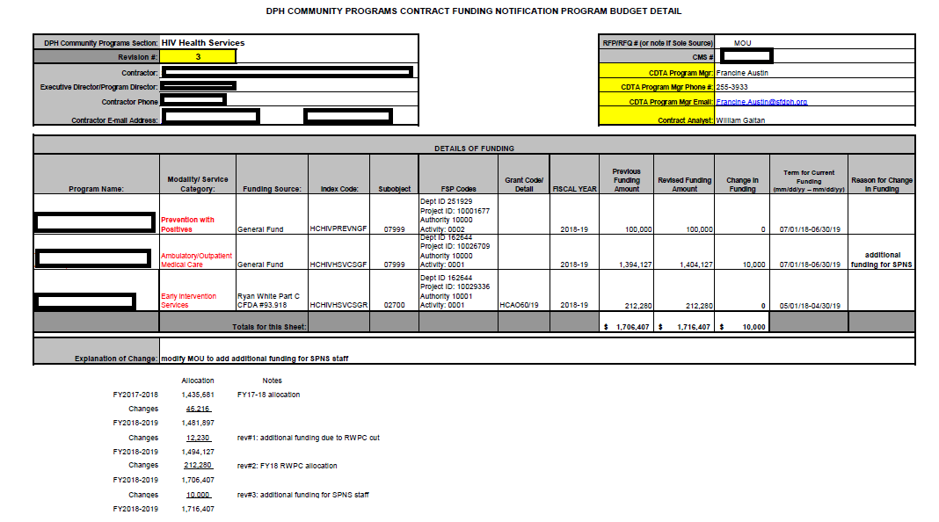
Sample back-up documentation for Funding Notification:

Slide 33
Appendix B – Budget (Non-BHS)

Slide 34
NON-BHS APPENDIX B WORKGROUP
Workgroup Members:
April Crawford – CDTA
Elizabeth Davis – CDTA
Dean Goodwin – SOC/ HHS
Kristine Ly – Contracts Unit
Judy Perillo – Budget Section
Saj Shaikh – Budget Section
Eric Whitney - CDTA
Overview:
Workgroup met over many months from Fall of 2017 through early 2018
Goals of the group:
  To make document more user-friendly for everyone.
  To make available in this document details which workgroup members requested for budget analysis.

Slide 35
APPENDIX B- Non-BHS
Format changes to pages to create more flexibility for edits.
Instructions and examples off to side of budget pages to help guide users.
Capital Expenses removed (Appendix B pages with Capital Expenses is available – tabs are hidden within workbook).
Annualized FTE formulas.
Brief duties related to program instead of Minimum Qualifications in Budget Justification.
Pull down menu for HHS Service Category types to list UOS Cost Caps (can be easily overtyped by non-HHS users).
Changes made to workbook (HIGHLIGHTS)

Slide 36
Things to keep in mind:
THIS BUDGET WORKBOOK IS ONLY TO BE USED FOR NEW CONTRACTS RESULTING FROM RFPs (or new sole source waivers).
Do not use this to modify existing certified contracts (Amendments or RPBs – Revisions to Program Budgets).
This document was presented, reviewed in detail and further edited by DPH staff from CDTA, Contracts Unit, Budget Section at a large meeting in February of 2019.
HHS has floated this out as a Pilot Project with 6 new contracts developed since FY-2018-19
  Providers were able to use without confusion
  No major changes

Slide 37
Review of Actual Workbook: Non-BHS Appendix B

Slide 38
Funding Notification & Appendix B – Budget (BHS)
Judy Perillo
1380 Howard Street
San Francisco Department of Public Health
Phone: (415) 255-3451

Slide 39
Funding Notification
Cover Letter
Funding Detail

Slide 40
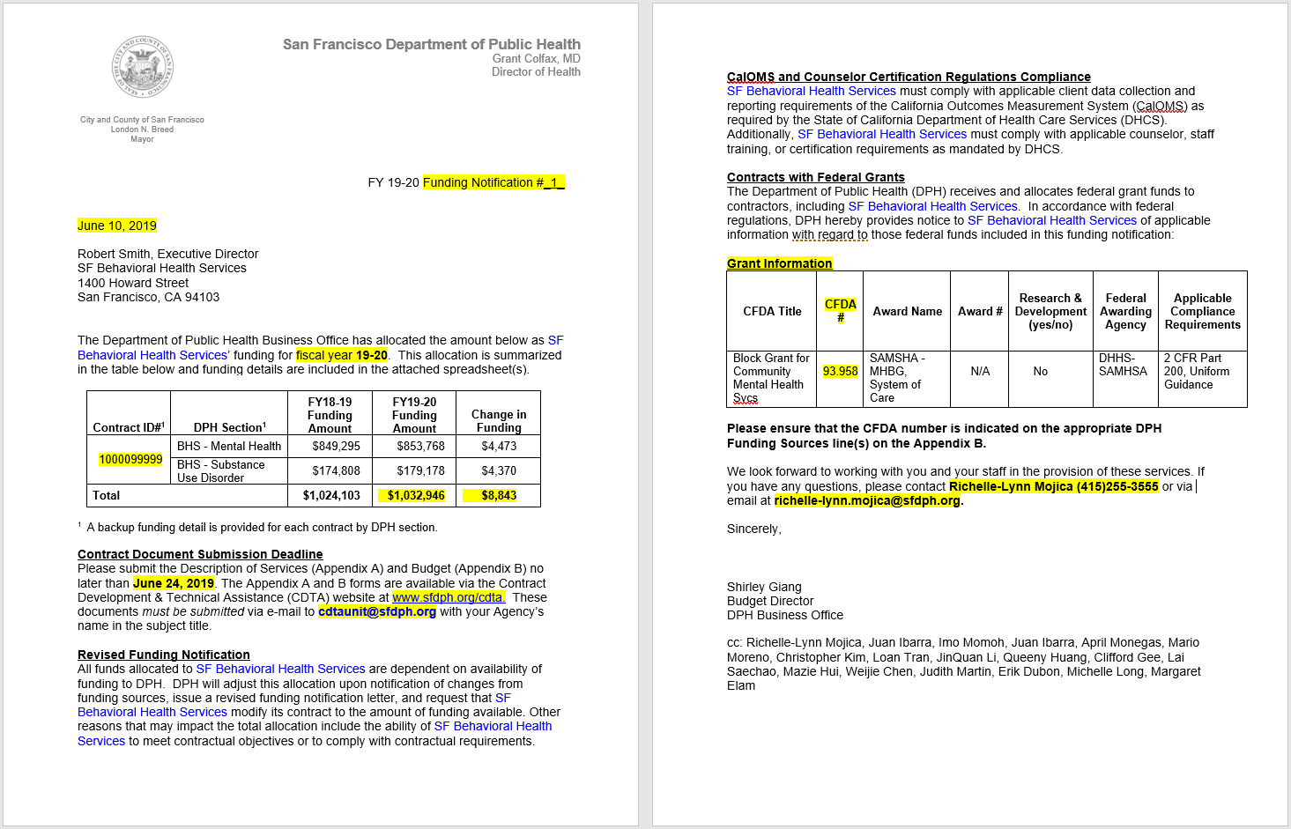
Cover Letter

Slide 41
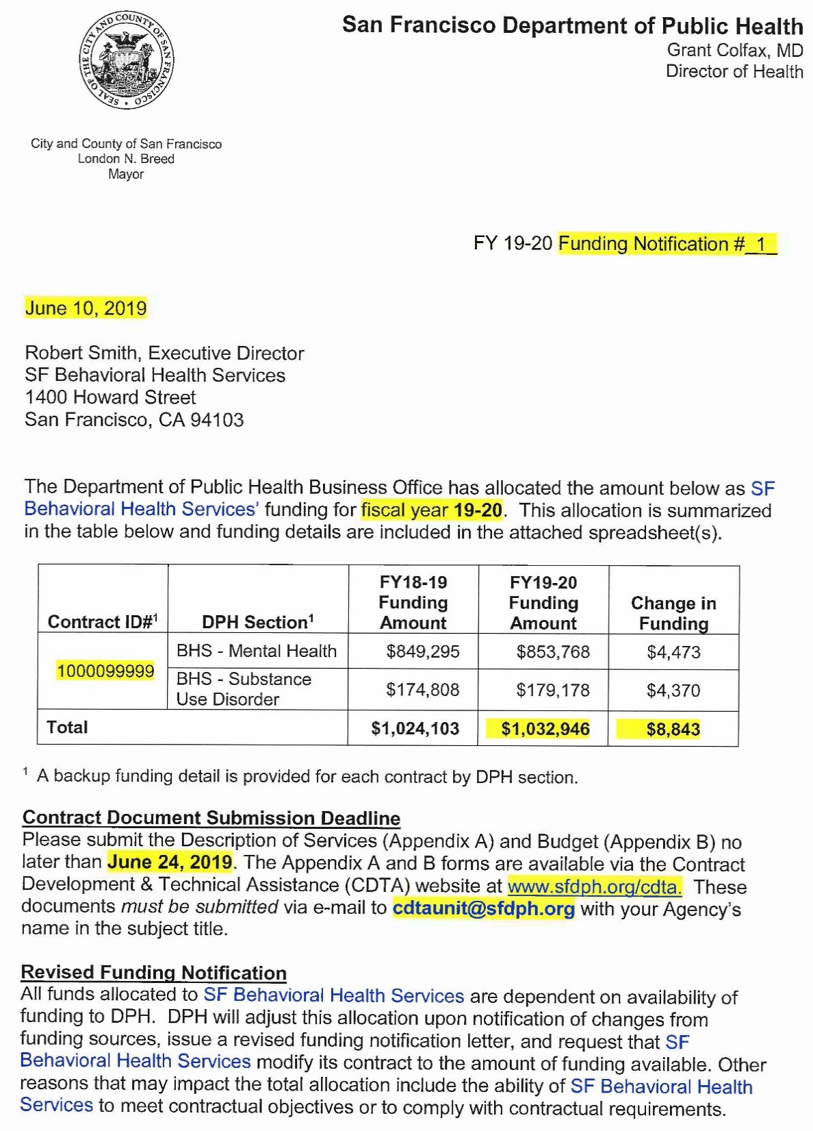
Cover Letter
  Funding Notification #
  Funding Notification Date
  Fiscal Year
  Contract ID#
  Funding Amount
  Contract Document Submission Deadline
  CDTA Website and
  E-mail Address for Contract Document Submission
1.
2.
3.
4.
5.
6.
7.

Slide 42
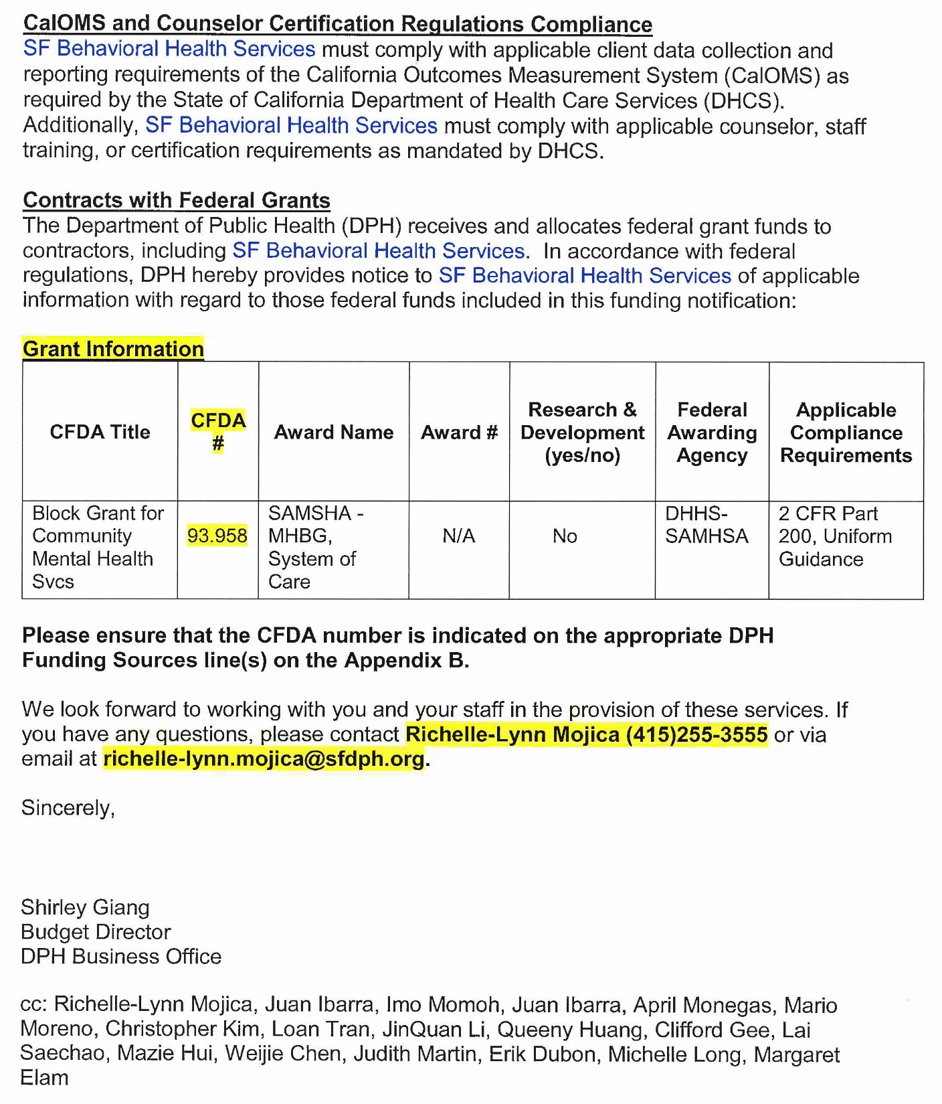
Cover Letter (con’t)
  Grant Information, if there is federal grant funding
  CDTA Manager and Contact Information
8.
9.

Slide 43
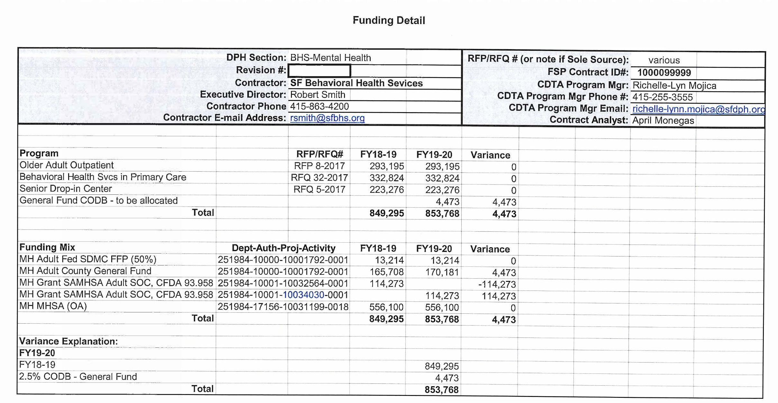
Funding Detail

Slide 44
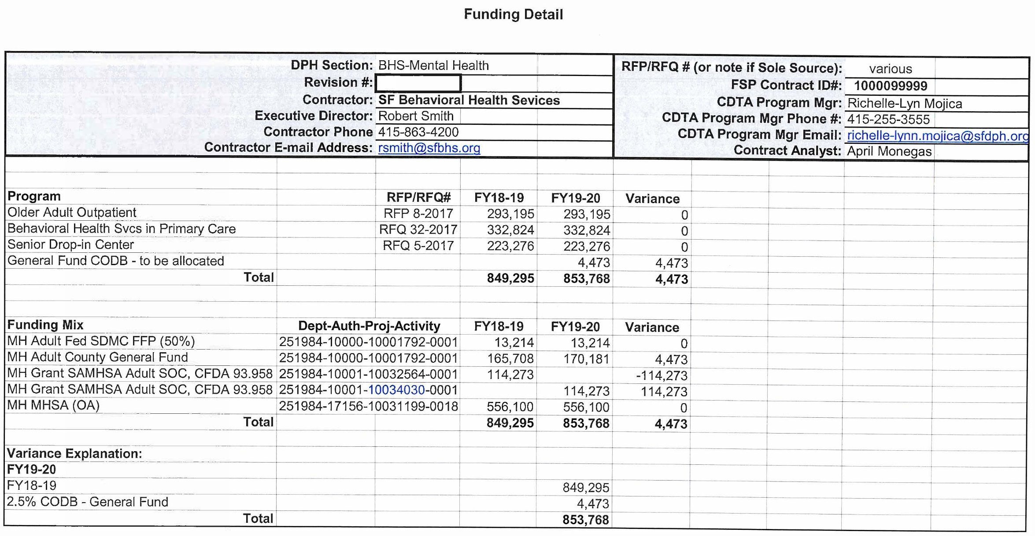
1.
2.
Contractor, Contract, and Contact Information
Program Details
Funding Mix
Variance Explanation
3.
4.

Slide 45
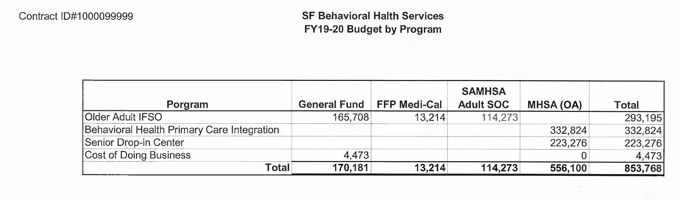
Funding Detail at Program Level
5.

Slide 46
Appendix B – Budget (BHS)

Slide 47
Appendix B – Contract Budget
DPH 1 – Contract Budget Summary
DPH 2 – Cost Reporting Data Collection
DPH 3 – Salaries and Employee Benefits Detail
DPH 4 – Operating Expenses Detail
DPH 5 – Capital Expenses Detail
DPH 6 – Contract-Wide Indirect Detail
DPH 7 – Budget Justification

Slide 48
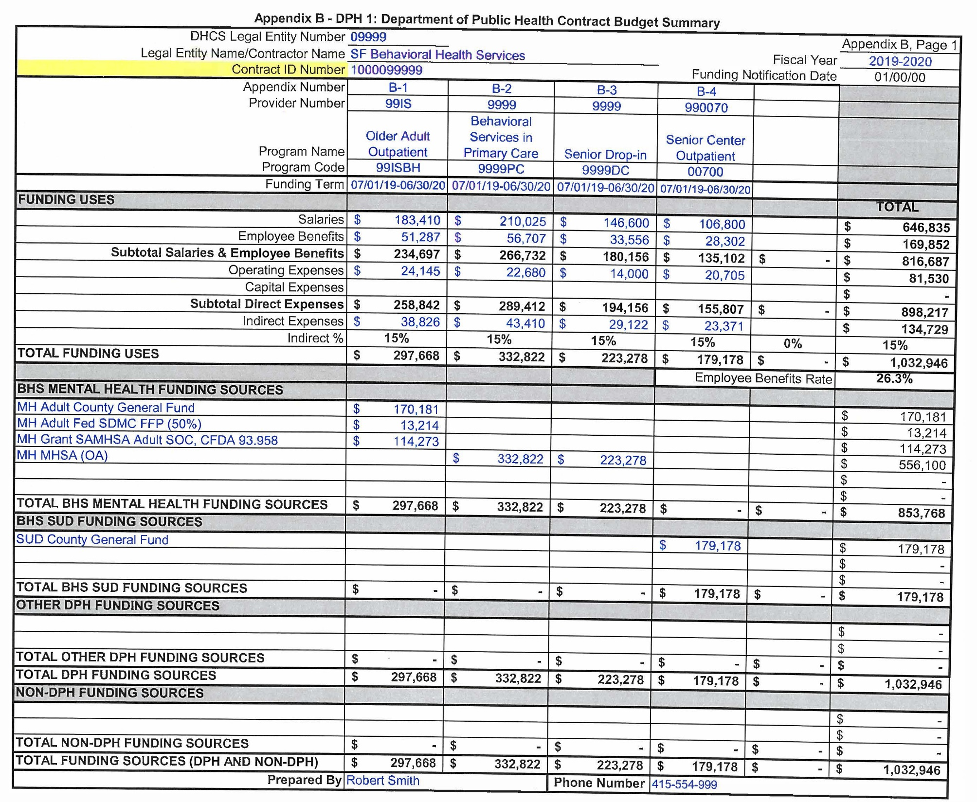
1.
DPH 1 – Contract Budget Summary
  Contractor, Contract, and Program Information
  Funding Term
  Funding Uses and Indirect Rate
  Funding Sources: MH, SUD, Other DPH Section, and Non DPH Funding
  Prepared by and Phone #
2.
3.
4.
5.

Slide 49
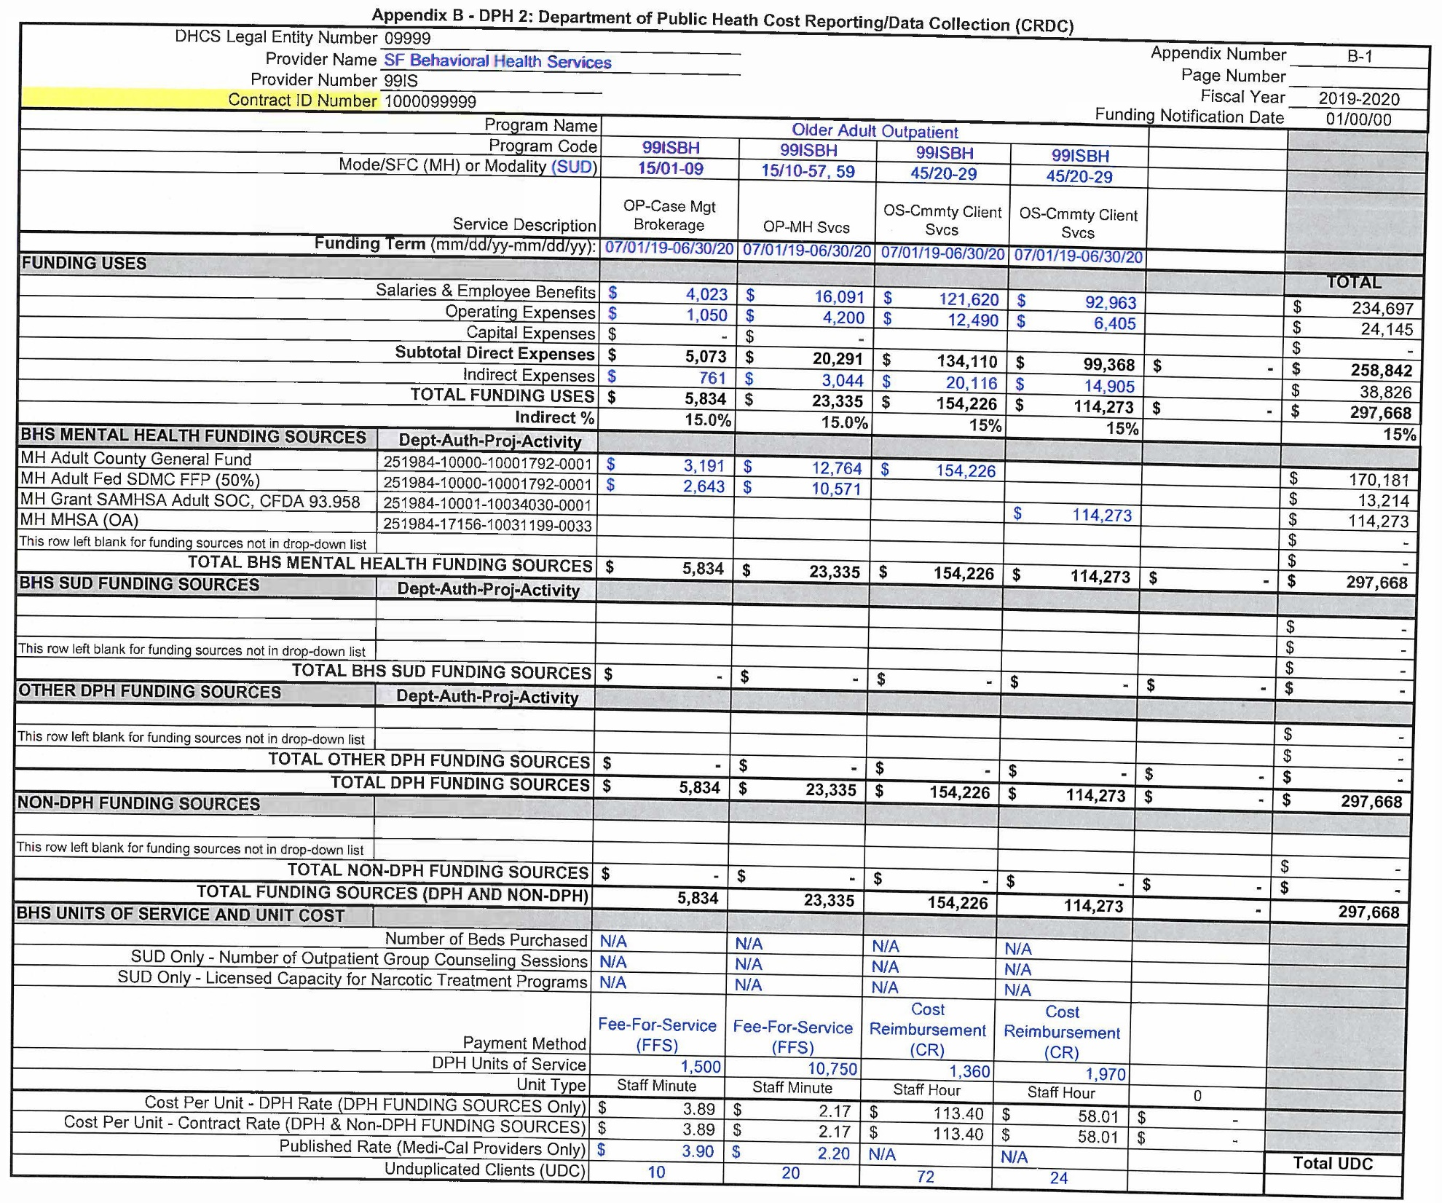
1.
DPH 2 – Cost Reporting Data Collection (CRDC)
  Contract, Program Information, and Service Description
  Funding Term
  Funding Uses and Indirect Rate
  Funding Sources and Accounting Codes
  Payment Method, UOS, Unit Rates, UDC, and Published Rate if there’s MediCal funding
2.
3.
4.
5.

Slide 50
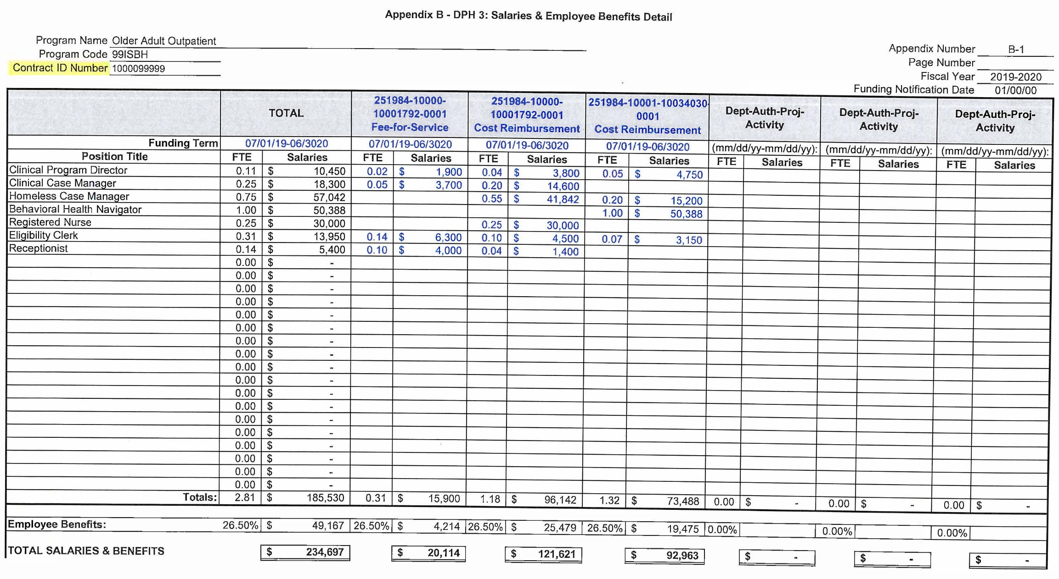
1.
4.
3.
2.
DPH 3 – Salaries and Employee Benefits Detail
  Program and Contract Information
  Positions and FTEs
  Funding Term
  Funding Sources (Dept-Auth-Proj-Activity)
  Employee Benefits Amount and Rate
5.

Slide 51
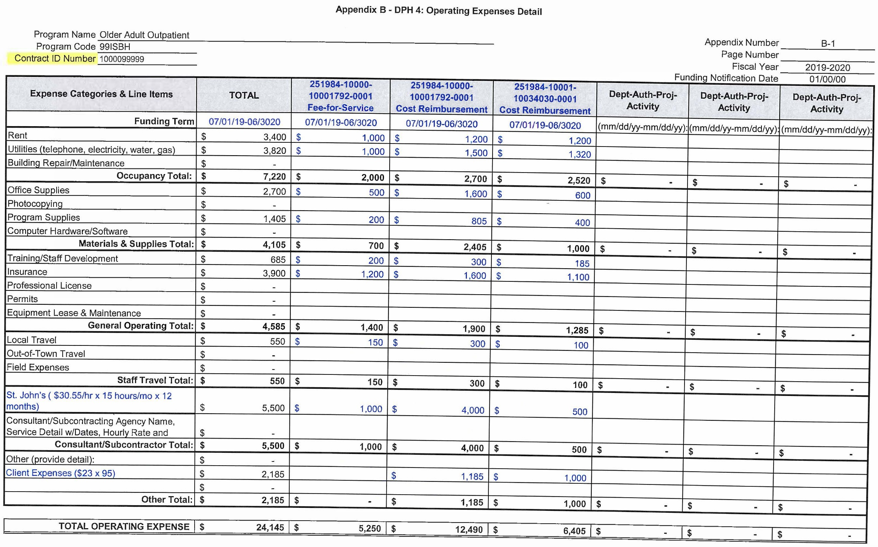
1.
4.
3.
2.
DPH 4 – Operating Expenses Detail
  Program and Contract Information
  Expense Categories and Line Items
  Funding Term
  Funding Sources
  (Dept-Auth-Proj-Activity)
  Consultant/Subcontractor – Agency name/service details with dates, rate, and amount
  Other – brief description
5.
6.
Note: Expense Categories may NOT be changed. However, default Expense Line Items may be edited or deleted as necessary to reflect the contractor's ledger accounts.

Slide 52
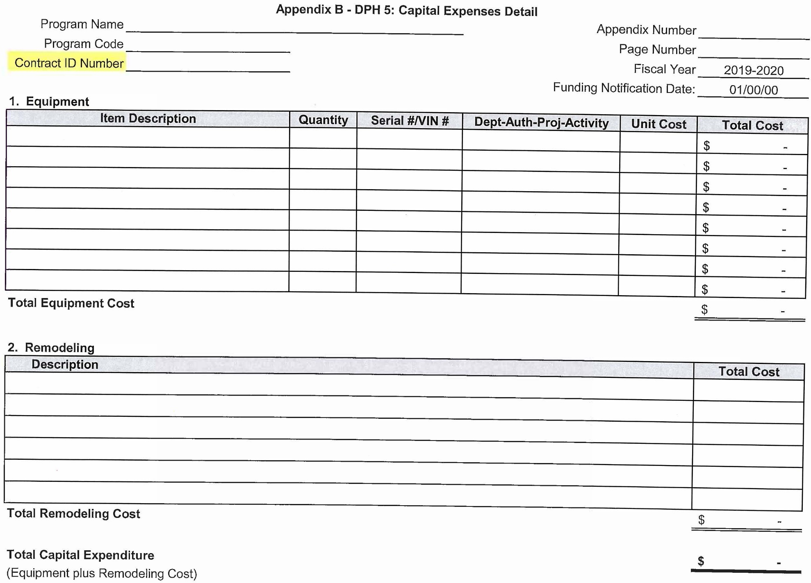
DPH 5 – Capital Expenses Detail
  Purchase of $5,000 or more per unit with a useful life longer than one year.
Note: Capital Expenses should NOT be funded by MediCal or built into the rate that has MediCal funding.

Slide 53
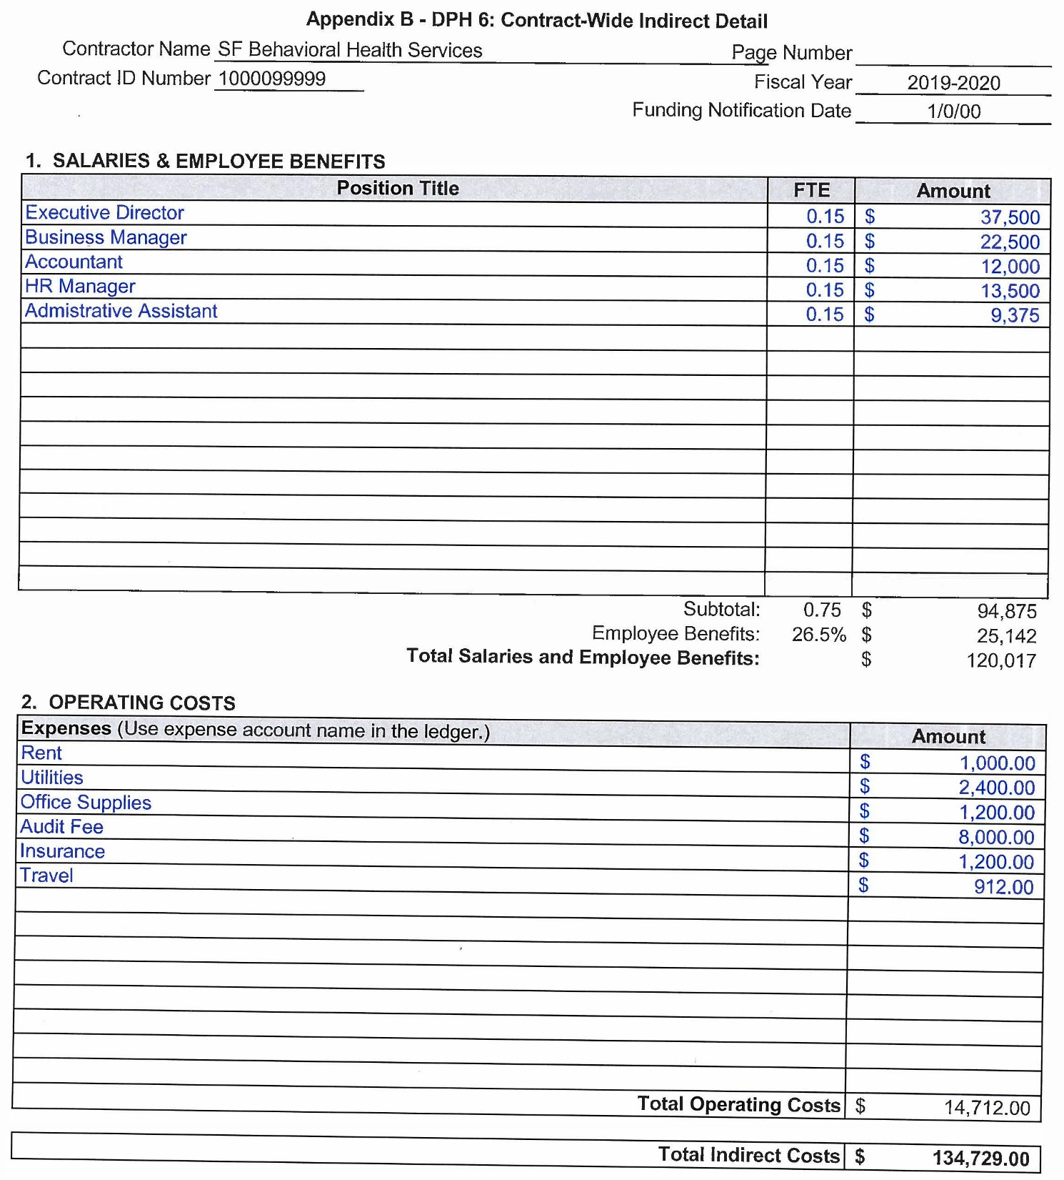
1.
DPH 6 – Contract-Wide Indirect Detail
  Contract Information
  Positions, FTEs, and Amount
  Employee Benefits and Rate
  Operating Expenses (by expense line item)
2.
3.
4.

Slide 54
Appendix B – Contract Budget
DPH 7 – Budget Justification
  BHS Budget Justification is only needed for a program if:
    required by the funder/funding source
    the program/service is new as a result of an RFP/RFQ

Slide 55

Invoice Training
Fall 2019
by
Shirley Giang, Director
Budget Unit

Slide 56
Questions?

