Slide 1
Job Corps Center Exclusive Negotiations Agreement
January 7, 2025
Notes:
The objective of this presentation and discussion is to address the complex context of the Treasure Island Job Corps site (including the seismic and utilities issues and ageing buildings), discuss the current timeliness of advancing solutions, and develop a critical partnership to complete the Island’s structural soundness and urban redevelopment and ensure the sustainability and longevity of the Job Corps site.

Slide 2
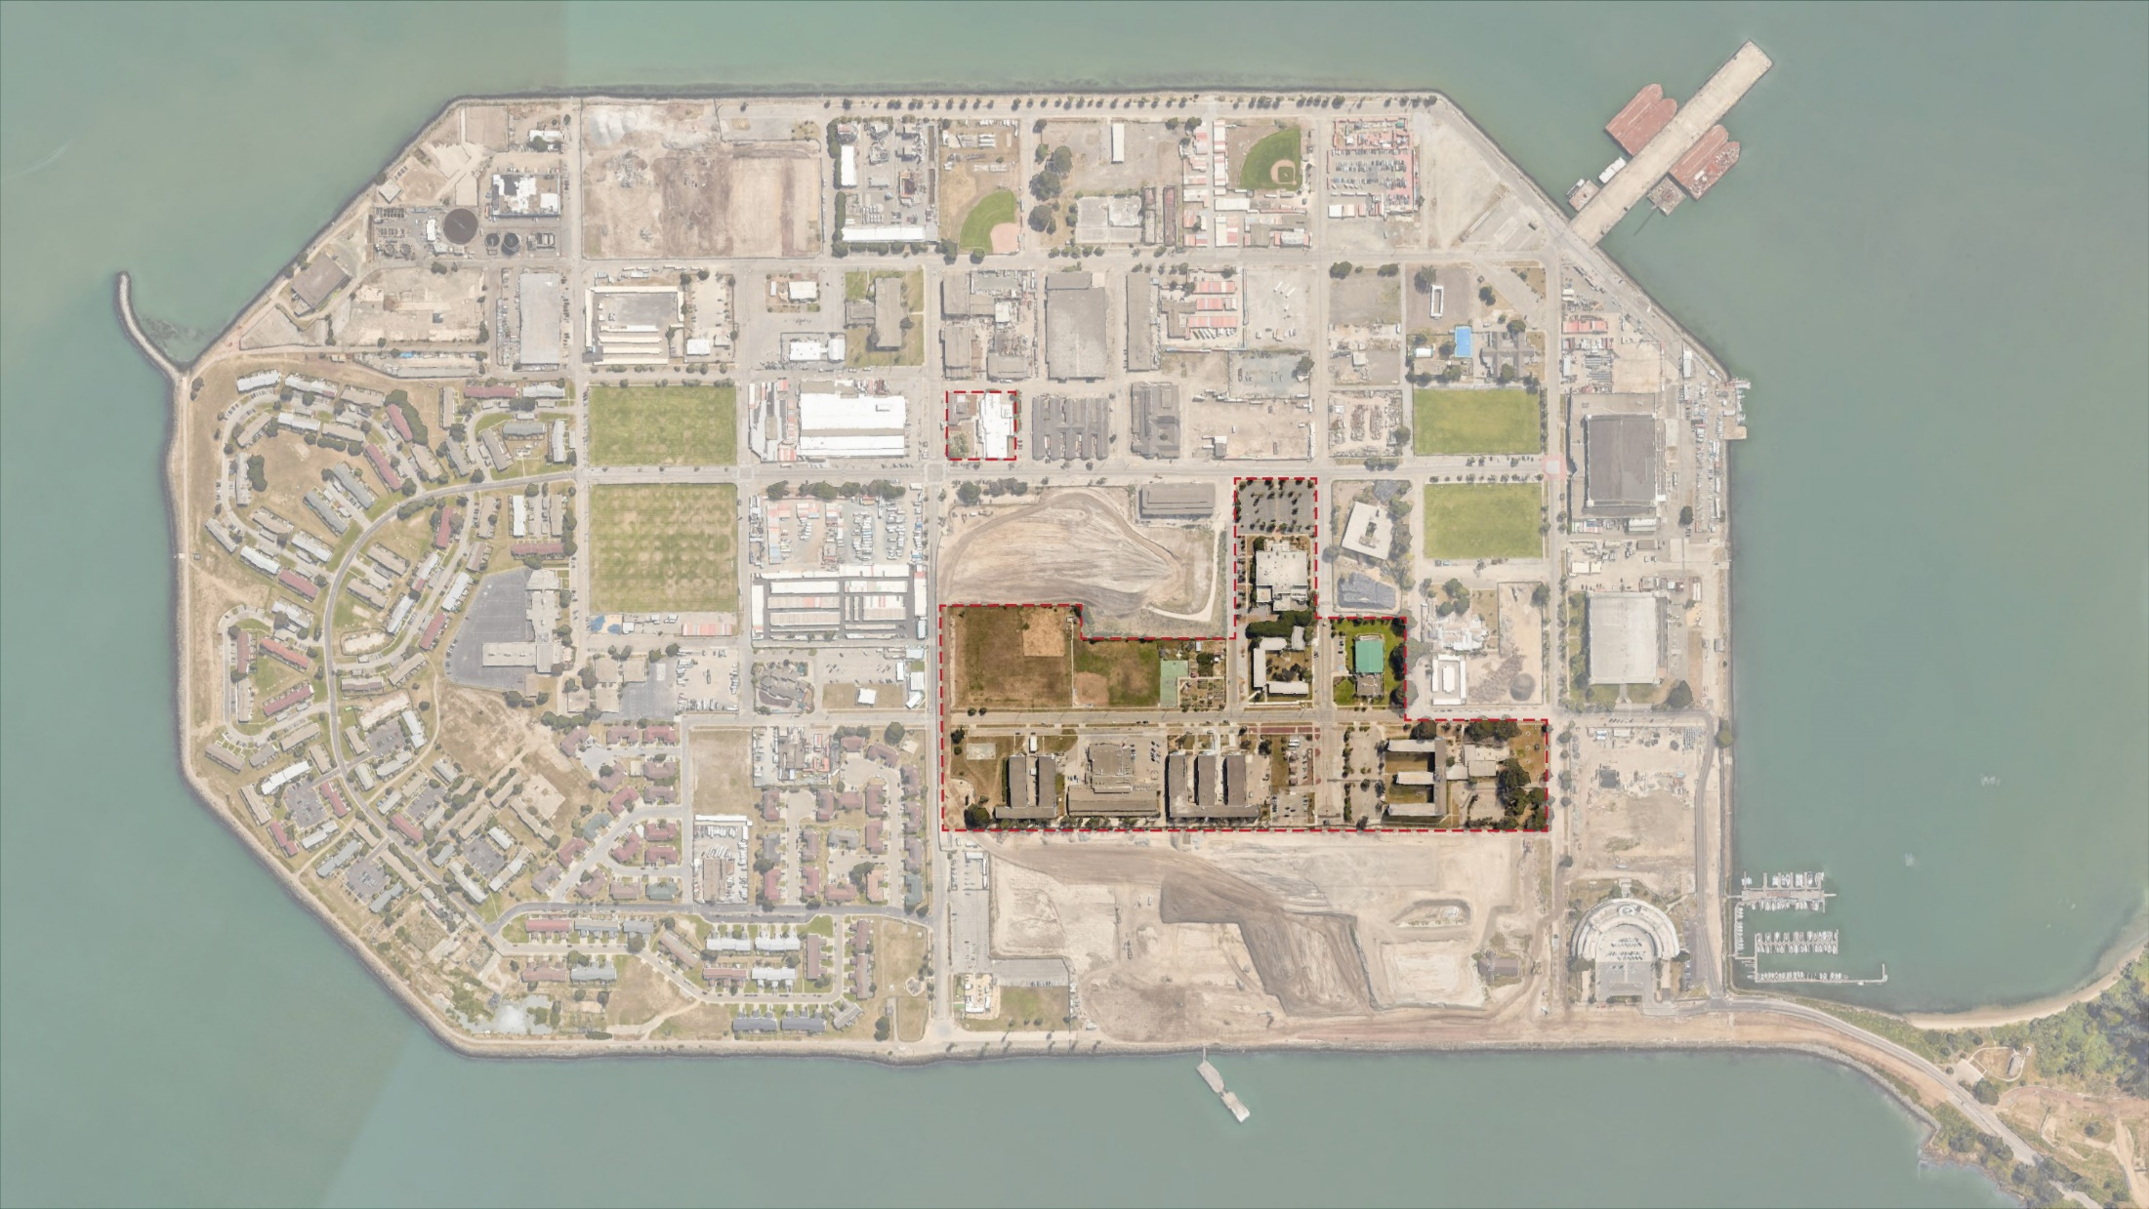
JOB CORPS
Notes:
Existing Job Corp Site is ~36.5 acres
Life Learning Academy is ~1.5 acres

Slide 3
History of DOL/City Engagement
Job Corps Center Campus was created after Naval Station Treasure Island was included on 1993 base closure list
The City briefed the Department of Labor on redevelopment plans for the island beginning in the early 2000s
The campus was not included in the redevelopment plan
Beginning in 2015, TIDA and TICD have provided proposed site and infrastructure improvement plans to DOL for review
In late 2017, TIDA requested temporary and permanent access easements as part of the surrounding redevelopment project
DOL has authorizing legislation allowing the Secretary of Labor to negotiate the disposition or divestment of Treasure Island Job Corps Center, including partnership to construct a new Job Corps campus

Slide 4
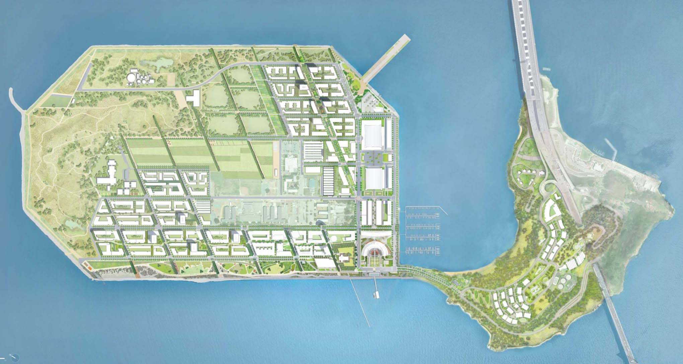
Job Corps Campus in Context of Redevelopment
Job Corps
(Federal Property not included. in Development Project)
Coast Guard
(not incl. in Development Project)
Caltrans Right of Way

Slide 5
Job Corps Campus in Context of Redevelopment
Notes:
Continuity of street grid, utility systems, movement. Additional Housing

Slide 6
Job Corps Facilities
Garden
Administration Building
Gymnasium
Dormitory
Large portions of the Job Corps Campus are underutilized or do not directly support programs
DOL responsible for utilities and roadways within campus
Culinary Arts Program
Classroom Facilities

Slide 7
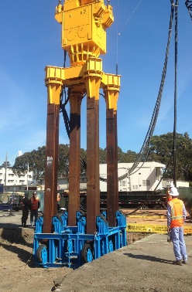
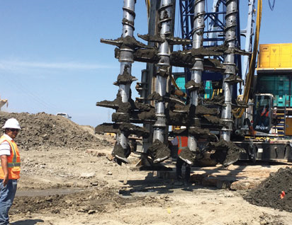
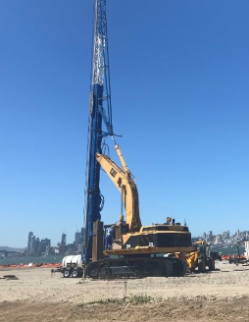
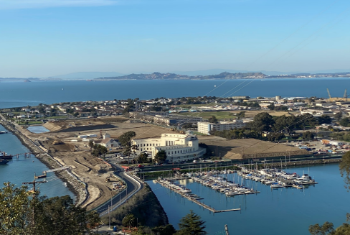
Geotechnical Remediation
`
Job Corps
(Federal Property not incl. in Development Project)
Surcharge
Surcharge
New development areas will be geotechnically mitigated to prevent liquefaction, minimize settlement, and stabilize shoreline.
Notes:
To safely repurpose the island for long-term civilian use, the City and TICD are undertaking an extensive program to address these geotechnical issues and to also raise areas intended for development to prepare for future sea level rise. Geotechnical issues and remediation are described below:
Vibratory compaction to consolidate the upper 50 feet of sandy materials mitigating the potential for liquefaction in future seismic events and providing stable soil conditions
Prevent localized settlement which could compromise utility systems (is this the 30’ pancake? Seems worth describing – can Bob provide a sentence?)
Surcharging of development sites induces consolidation of bay mud to minimize any differential settlement between structures and surrounding roadways.

Slide 8
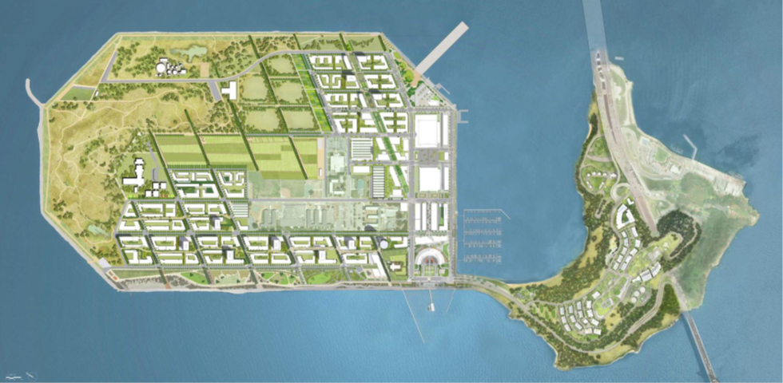
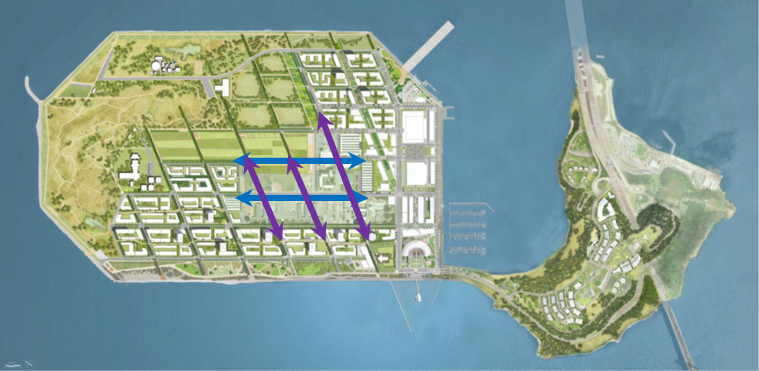
Integrating Community
Notes:
To address this, we intend to step up discussions with the DOL about the potential development of the TIJCC campus. In concept, we could extend the street grid through that property. Conceptually, we could develop this consistent with the rest of the island primarily for residential use and extending the street grid through the property.

Slide 9
Timeliness – Adjacent Development
Current political support
Ability to leverage lessons from implementation of first phases of development
Renewed statewide focus on housing production
Last best opportunity to tie into new infrastructure
Stage 2
Job Corps
(not incl in current project)
Stage 1
Yerba Buena Island (YBI)
Notes:
This situation has gained the interest and engagement of Speaker Pelosi’s office, and this office’s championship of a redeveloped project could be paramount for financial support.

Slide 10
Timeliness – Surrounding Utilities
Job Corps
(Federal Property not incl. in Development Project)
New wet and dry utilities will be laid out in street grid pattern:
sanitary sewer, water supply and storage, reclaimed water, storm drain, power, gas, and communications
Notes:
Alternatively, should DOL/Job Corps engage with the City and TICD in a redevelopment of the campus and new facilities, it is unlikely that any utility mains would remain on the property. Rather, Job Corps facilities could be served from water mains and other utilities in public streets connecting to Job Corps buildings, redeveloped in a pattern similar to that of the surrounding redevelopment.

Slide 11
Opportunities
Modernize Job Corps facilities designed to fulfill its mission
Geotechnically improve Job Corps campus to mitigate seismic risk, including liquefaction
Elevate campus grade and integrate into island-wide climate adaptation strategies
Replace and upgrade existing utilities that are at or near the end of their useful lives
Create synergies with other job training and workforce development programming
Integrate Job Corps into a coherent community with extension of streets and walkways
Deliver additional housing
Challenges – Costs and sequencing
Notes:
A 2010 List of Issues prepared as part of discussions between DOL and the City noted all of the issues above, including geotechnical and stormwater issues, utilities concerns, and the age of Job Corps buildings.
We are now at a point where these concerns have become increasingly apparent and must be addressed.
City/DOL partnership to redevelop the Treasure Island Job Corps campus provides an opportunity to address these risks while ensuring the longevity of the campus and integrating the campus into the larger Treasure Island community.

Slide 12
Assessing Viability
Job Corps Program Requirements
Transportation and Other Impacts
Costs & Revenues
Impacts on Community Facilities, Utilities, etc.
Potential Density
Notes:
Next Steps
Sign ENA
Meet with SLC
Economic Evaluation

Slide 13
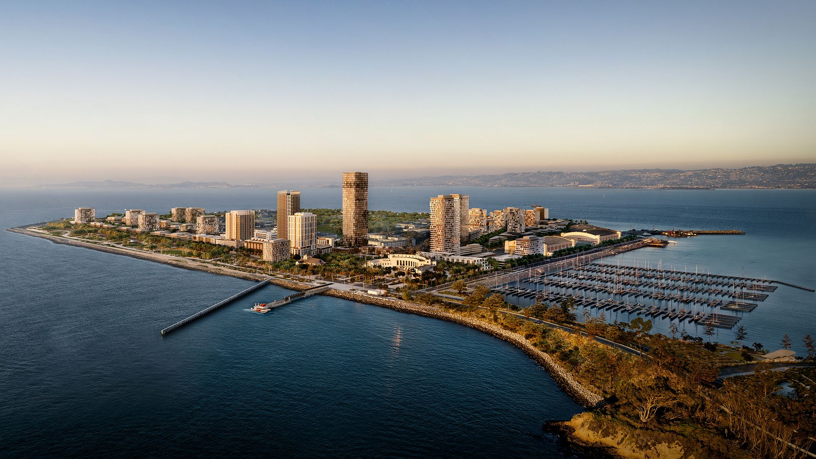
Questions?
Notes:
Entitling the site for mixed use will create significant value. However, extensive land development costs will limit the available of funding generated through the entitlement to subsidize the replacement of the job campus. Additional funding sources and financing strategies will be necessary.
While there will be significant financial costs associated with redevelopment the job corps site, there are also significant financial costs and other liabilities associated with not incorporating the site into the island’s redevelopment, specifically: the seismic safety of both the existing structures as well as the land beneath them due to soil instability; and, the susceptibility of the job corps site to climate risk over time

