Slide 1


Slide 2

Bay Football Club
The Bay Football Club (“Bay FC”) is part of the
National Women’s Soccer League (“NWSL”)
2024 was their inaugural season in the league
Bay FC intends to make Treasure Island the
home of their permanent practice facilities
Ground lease is the culmination of negotiations between Bay FC, TIDA staff, and the Office of Economic and Workforce Development
Bay FC’s training facility and the presence of players, staff, and fans on the island will serve
as a catalyst to economic activity, the surrounding developments, and the long-planned Sports Park
Use conforms with adopted redevelopment plan

Slide 3
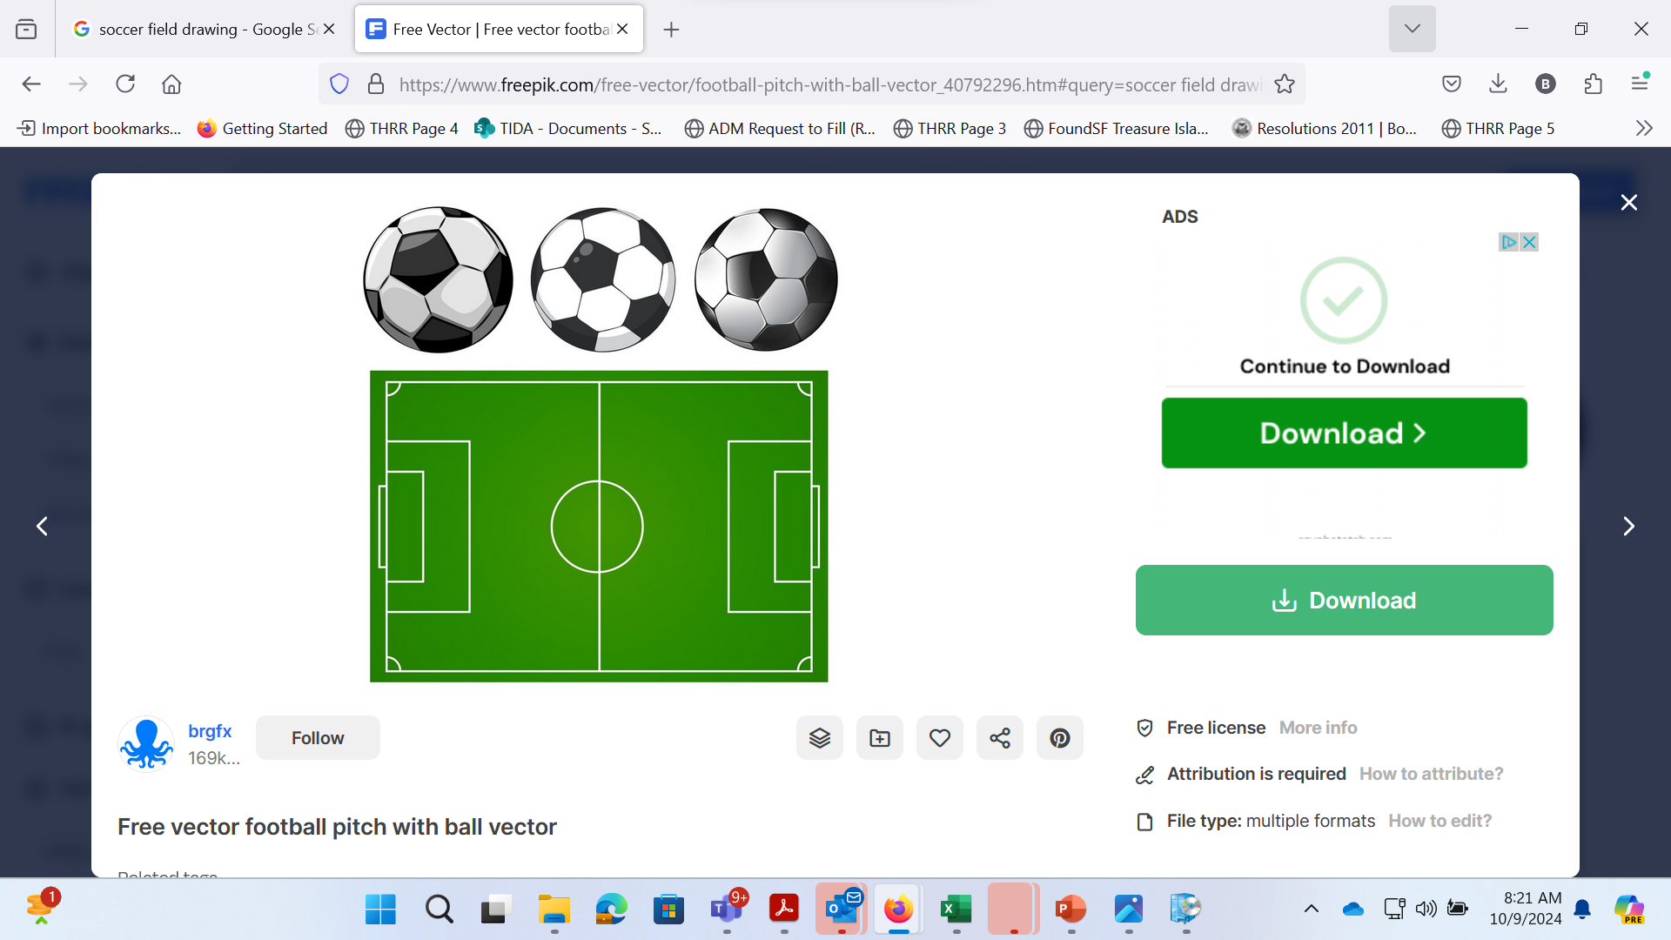
Bay FC’s Facility Needs
Three regulation soccer fields
A training and administration facility of up to 25,000 SF
All fields and facilities would be for Bay FC’s exclusive use

Slide 4
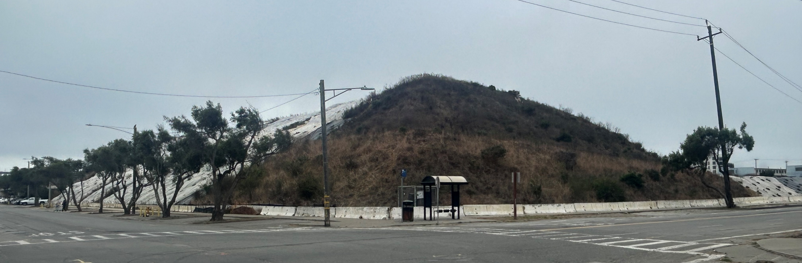
Proposed Site
Location of the existing soil stockpile site
Site is not subject to the Tidelands Trust
Site is zoned as open space
Development of Bay FC facilities
would have minimal impact on
surrounding existing uses and
infrastructure
Accelerate development of the sports usage significantly – it was originally planned as a “late phase” project

Slide 6
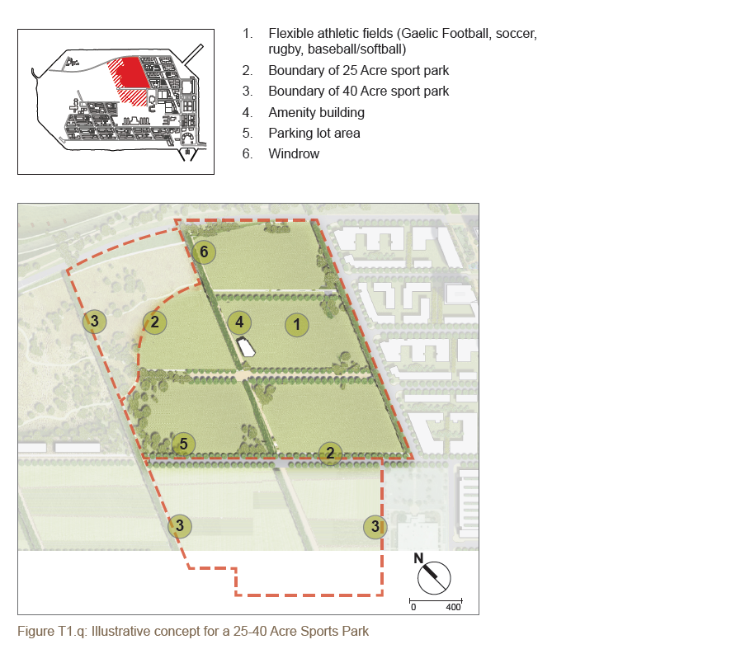
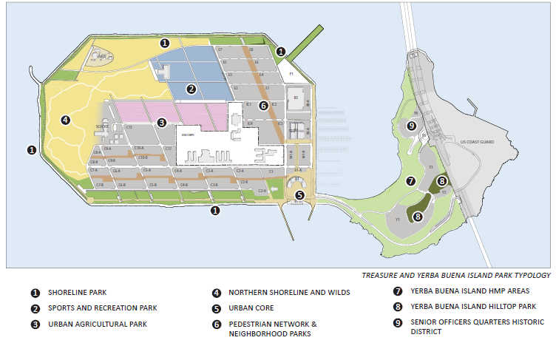
Site

Slide 7
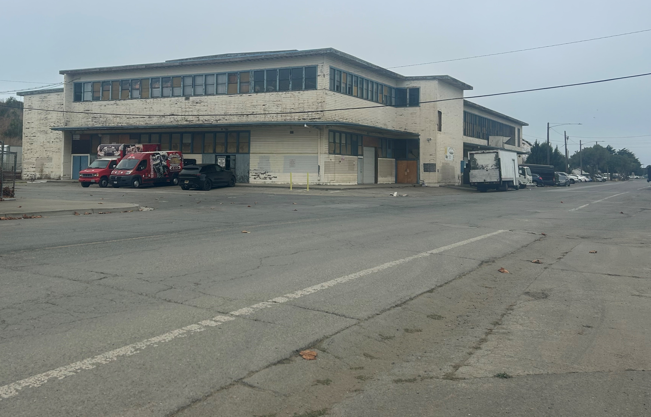
Site Delivery
Bay FC will need site control by July 1, 2025, in order construct facilities for operation in the NWSL 2027 season
Site will be rough-graded to intended future elevation (~+3 feet)
Building 258 on the site will be vacated by February 28, 2025
Bay FC will be responsible for:
  Abatement and demolition of Building 258
  All site improvements including site
  access ramps, fine grading, fencing,
  and construction of fields and facilities

Slide 8
Term & Rent
Term
Initial lease term of 25 years
Four 5-year extension options
Rent
$27,750 per month beginning 24 months after lease commencement or upon completion/occupancy of newly constructed facilities
Rent credit for actual costs incurred to demolish Building 258

Slide 9
Phase Two Option
Bay FC is committed to the community on Treasure Island
and providing access to the sport including public use of
some additional fields
Seek a minimum of one field (approximately 2.5 acres) up to three fields (approximately 7.5 acres) within future sports park area
Exact location, size and programming to be determined
Option could be exercised during a seven-year period
commencing July 1, 2030
Propose a public planning process with Bay FC, other
stakeholder programs, and island residents beginning
no later than July 1, 2027, and concluding no later
than June 30, 2029

Slide 10
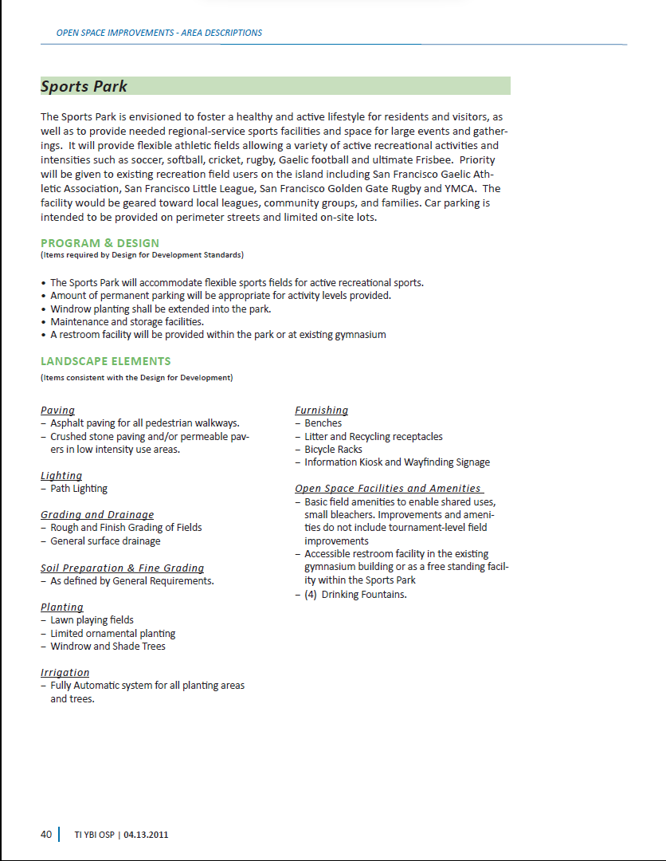
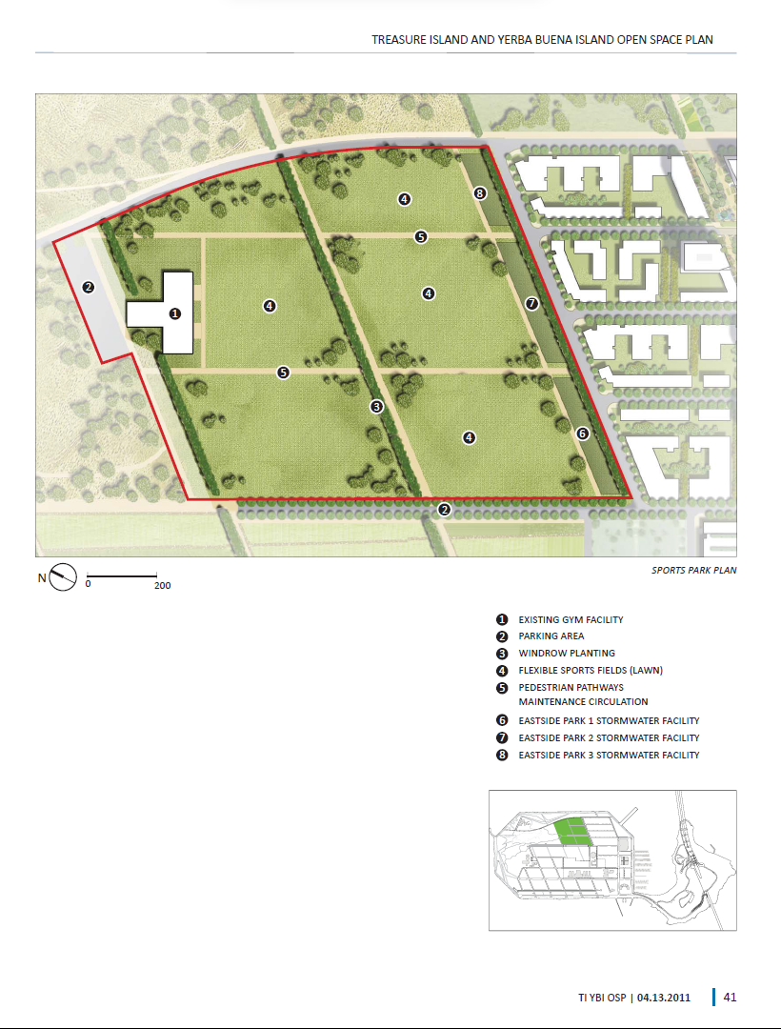
“Priority will be given to existing recreation field users on
the island including San Francisco Gaelic Athletic Association,
San Francisco Little League, San Francisco Golden Gate Rugby
and YMCA.”

Slide 11
Next Steps
Finalize and execute agreement between Bay FC and TIDA
Vacate Building 258 by February 28th
Demolition of Building 258 by Bay FC in March & April
TICD moves soil from stockpile into Stage 2
surcharge areas in May & June
Bay FC assumes site control on June 30th
  Objective is to have permanent practice facilities
  operational for the 2027 NWSL season

