Slide 1
Transition Housing Update
TIDA Housing, Infrastructure, Transportation, & Sustainability Committee
September 6, 2024
Notes:
I will be covering familiar ground today, but hopefully the information is organized and presented in a way that better communicates the opportunities available to residents and the challenges of implementation.

Slide 2
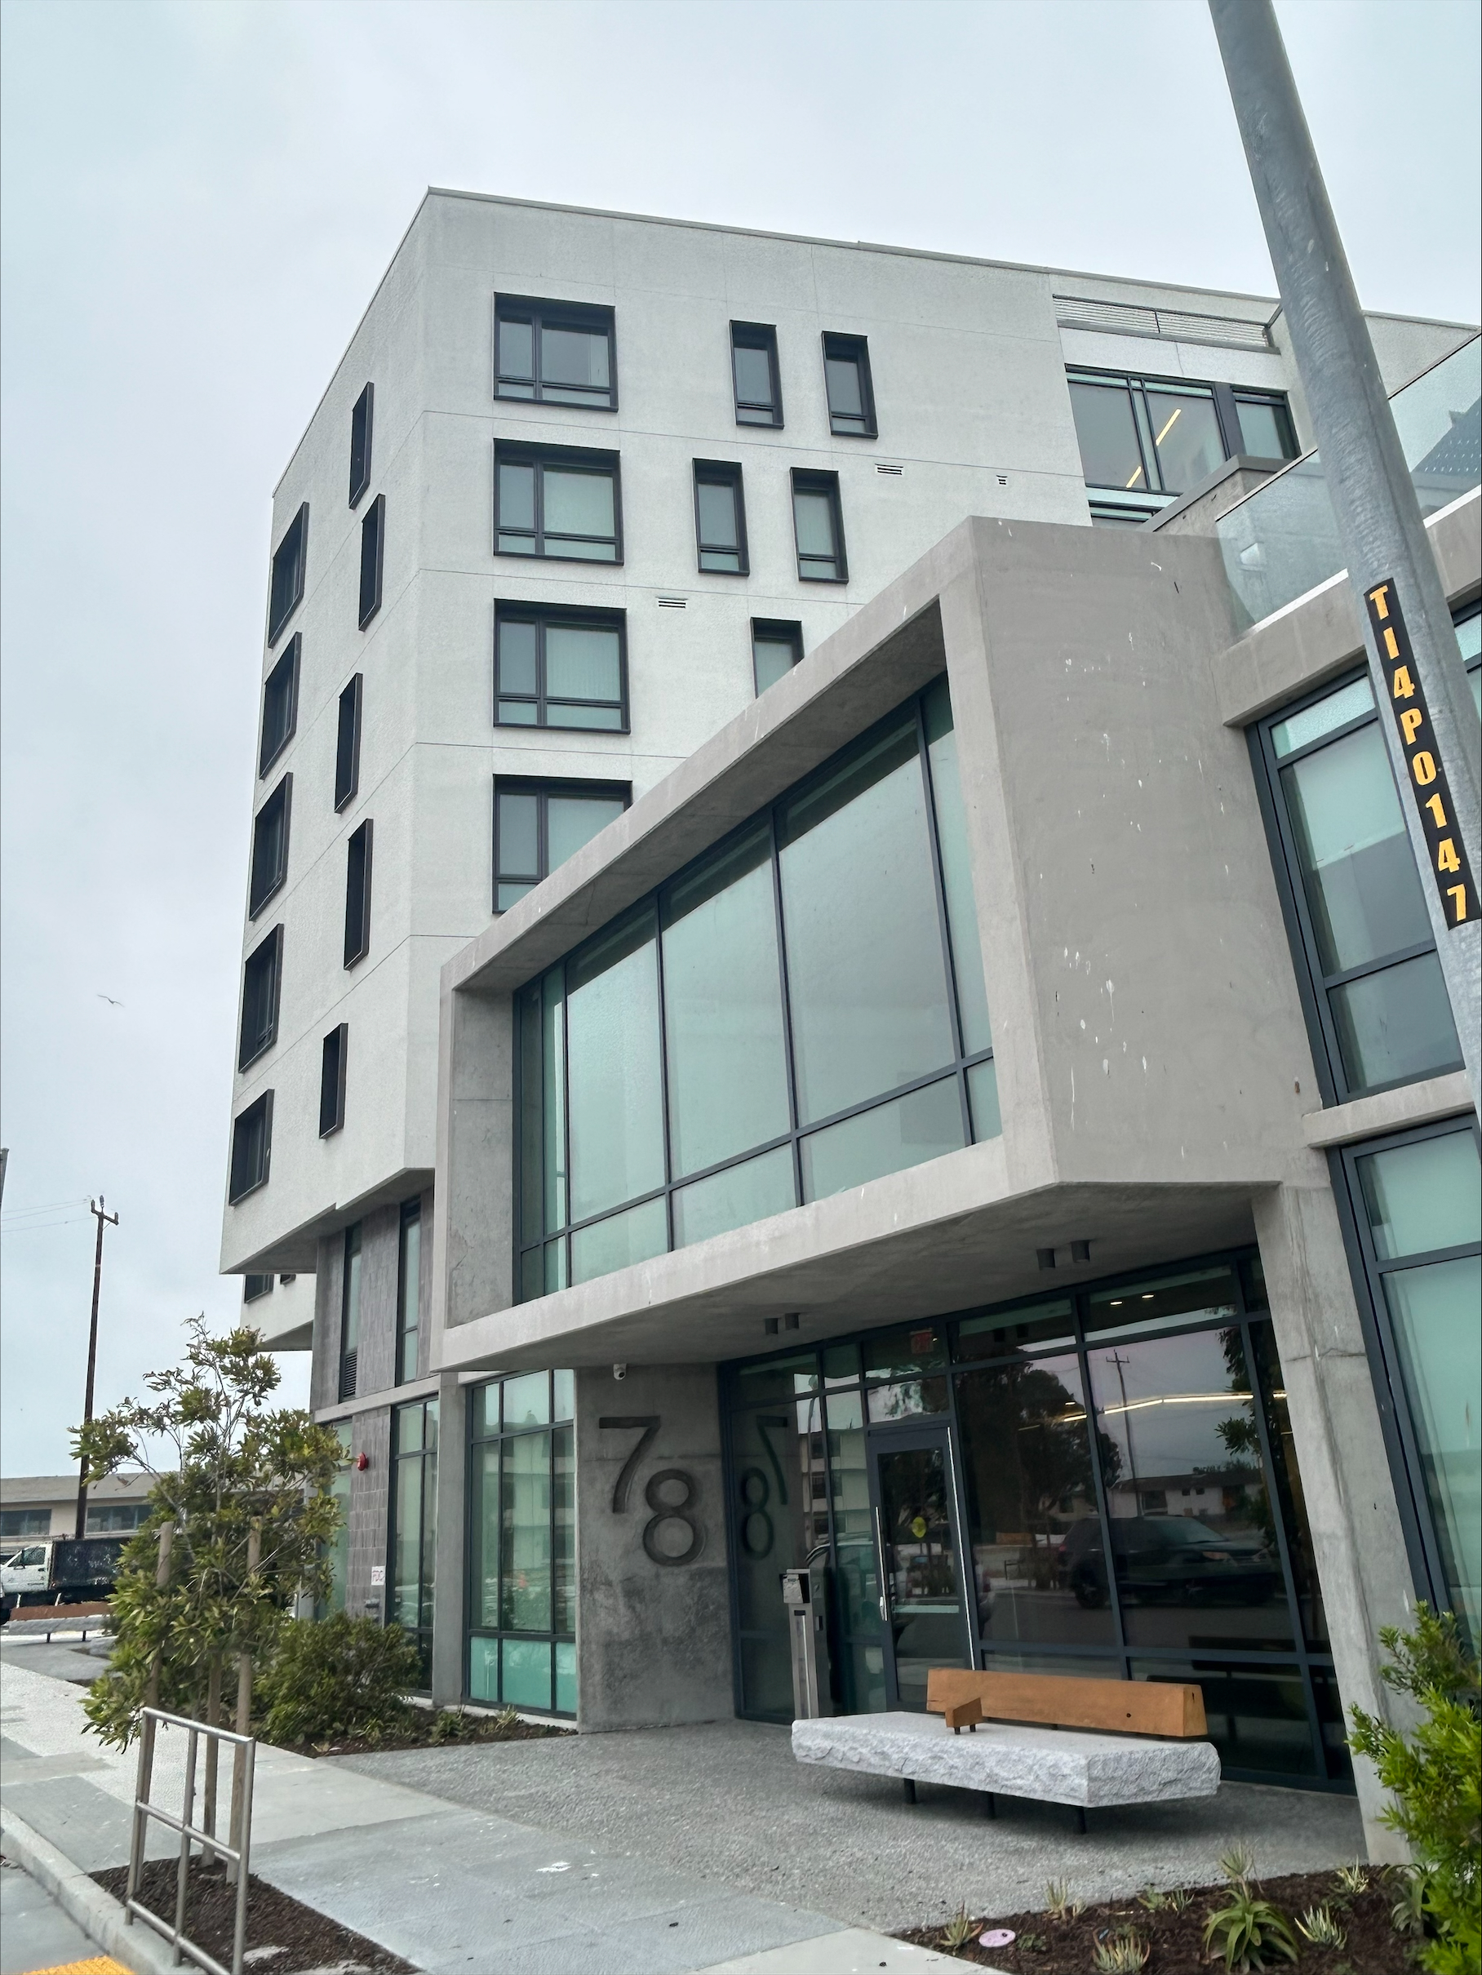
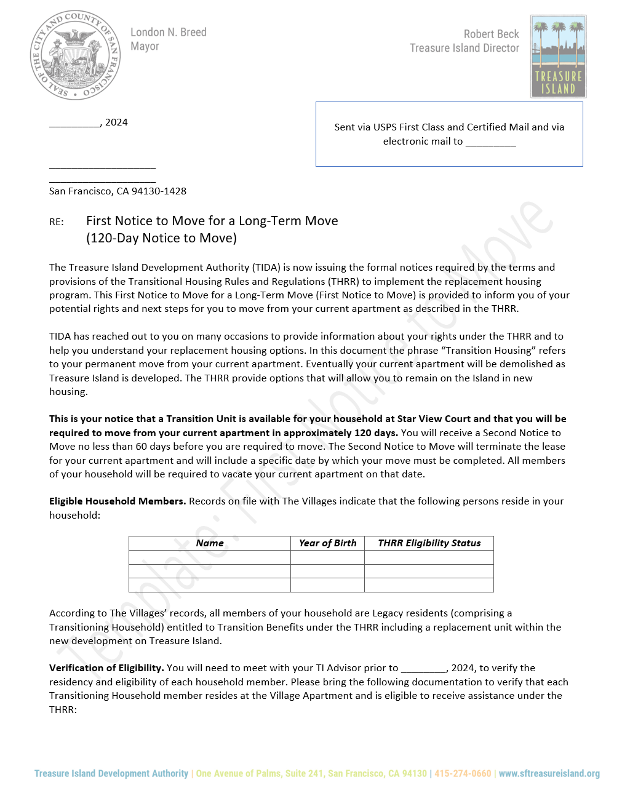
Star View Court:
Transitioning Legacy and Mixed Households
Thirty initial 120-Day First Notices to Move
Notices expire September 16th
Supporting Star View Court Property Managers in lease up
8 households have completed moves
7 have signed leases and scheduled moves
4 households are anticipated to complete move to SVC
6 households have applied for Payment In-Lieu of Transition Unit
3 households are pursuing inclusionary affordable units
2 households have had household changes that alter eligibility (will rescind Move Notices)
Nine additional 120-Day First Notices to Move were issued on August 20th

Slide 3
Star View Court:
Legacy and Vested resident entries in the DAHLIA lottery
DAHLIA Lottery results posted on May 24th
37 residents from The Villages applied
11 Legacy Residents
26 Vested Residents
Nine residents have signed leases at SVC
Two have applications pending

Slide 4
Isle House
24 Inclusionary Affordable Apartments
DAHLIA Lottery for Isle House held in July
36 residents from The Villages applied
20 Legacy Residents
16 Vested Residents
16 residents remain actively engaged in the application process

Slide 5
Treasure Island Housing Providers
Swords to Plowshares
36 Units
Catholic Charities
66 Units
HealthRight 360`
44 Units
HomeRise
114 Units
Swords to Plowshares | 36 Units
Catholic Charities | 66 Units
HealthRight 360 | 44 Units
HomeRise | 114 Units
One TI Total | 260
 | 158
Pre-DDA Households | 81 | 59
Mixed Households | 52 | 46
Post-DDA Households | 146 | 140
Commercial Leases | 34
Villages Total | 313
 | 279

Slide 6
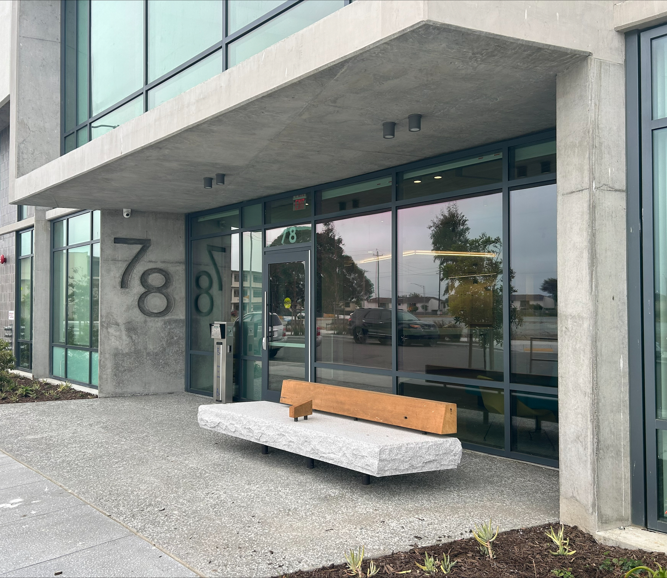
Why do DAHLIA applicants drop pursuits?
Failure to meet income qualification requirements
Earn too much or don’t earn enough
Own income property
Affordable Unit rent versus rent or share of rent in their existing Villages unit
Timing is not convenient
Challenges of providing required documentation
Assume there will always be other opportunities available

Slide 7
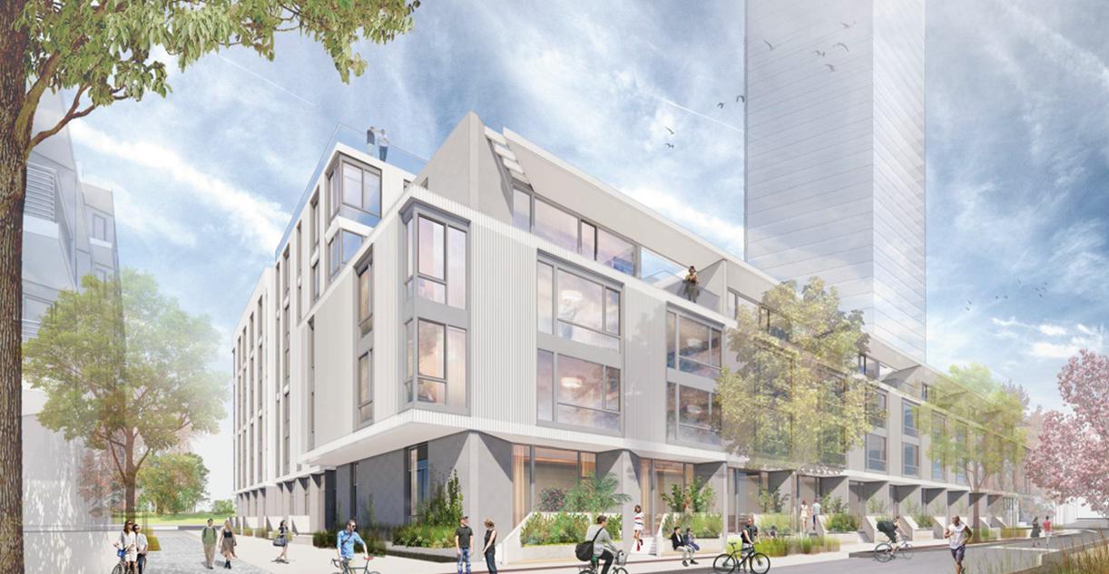
Housing Opportunities for All
Rent a Market Rate or Below Market Rate Apartment in 2024!
Premarketing & DAHLIA Application Period Open in Oct/Nov 2024
MOHCD holds DAHLIA Lottery for Inclusionary Affordable Apartments in December 2024
Lease Up in January 2025
Inclusionary Affordable Apartments are priced for Households earning
60-100% of Area Median Income (AMI)
Legacy and Vested Residents have the highest priority using their Treasure Island Resident (TIR) Preference Number
Hawkins
Apartments for Rent
169 Market Rate Apartments
9 Inclusionary Affordable Apartments
Now is the time to secure your affordable housing opportunity!!

Slide 8
Housing Opportunities for All
How to apply for a Below Market Rate Apartment
Use the DAHLIA website to understand your household income. https://housing.sfgov.org/income-calculator/rental/intro
Register for DAHLIA now for affordable housing at https://housing.sfgov.org/
Apply on DAHLIA when the property is advertised for rent. https://housing.sfgov.org/
If you win the DAHLIA lottery, work with MOHCD and the property manager to complete your application.

Slide 9
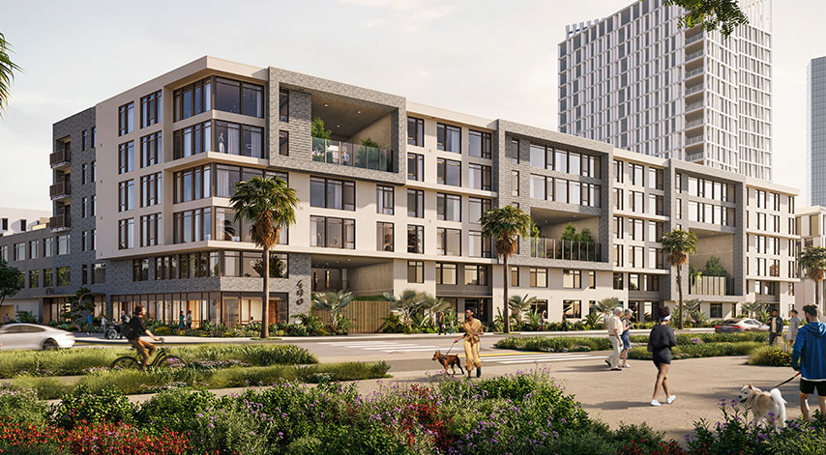
Housing Opportunities for All
Purchase a Market Rate or Below Market Rate Condominium!
Construction Completion delayed to May 2025
Premarketing and DAHLIA Application window expected to open in Feb/Mar 2025
Move-ins beginning in June 2025
Priced for households earning 80-120% of Area Median Income (AMI)
Legacy and Vested Residents have the highest priority using their (TIR) Preference Certificate
Down Payment Assistance for Legacy Residents
First Time Homebuyer Education Required
490 Avenue of the Palms
(formerly “Portico”)
Condominiums for Sale
141 Market Rate Condominiums for Sale
7 Below Market Rate Condominiums for Sale, including Studio, 1-, 2-, and 3-Bedroom units
Residents should contact their TI Advisor
for the latest information and additional details about Premarketing Notices and DAHLIA Lottery Schedules for Inclusionary Affordable Units.
TIAdvisor@arws.com or 415-650-6078
Notes:
Portico
DAHLIA Open Application Period Starts approx. 1 month before lottery, lasts 21 days
DAHLIA Lottery Date January/February 2025
Potential Move In Date March 2025
CTCAC 80% to 120% AMI for CTCAC Inclusionary Units 2023: Below is the link to the AMI chart for CTCAC 2023. This shows the 80% AMI Level. To get the 120% AMI level, you just need to multiply the 100% income level by 1.2.
https://www.treasurer.ca.gov/ctcac/rentincome/23/income/income-limits-051523.pdf
One Person: $104,080 to $156,120
Two Person: $118,860 to $178,440
Three Person: $133,840 to $200,760
Four Person: $148,460 to $222,960
Five Person: $160,560 to $240,840
Six Person: $172,480 to $258,720
Seven Person: $184,320 to $276,480
Eight Person: $196,240 to $294,360

Slide 10
Housing Opportunities for All
How to apply for an Inclusionary Condominium at Below Market Rate
Determine if you can buy a Below Market Rate condominium. https://sf.gov/determine-if-you-can-buy-affordable-housing-program
Complete all First Time Homebuyer Education and Obtain a Certificate. https://www.homeownershipsf.org/homebuyer-education/
Register on DAHLIA. https://housing.sfgov.org/
Apply on DAHLIA when the property is advertised for sale. https://housing.sfgov.org/
If you win the DAHLIA lottery, work with MOHCD and your lender to complete the purchase of your condominium.

Slide 11
Encouraging Villages Residents to Act Now!
TI Advisors First Line of Response and Support
TI Advisors generate all noticing and documentation to support TIDA THRR program.
TI Advisors are the primary contact for residents responding to notices and seeking guidance for future housing opportunities.
TI Advisors are working with Star View Court and Isle House to support all applicants.
TI Advisors are providing resident support for access to affordable housing, DAHLIA registration, and Premarketing Notices.
TI Advisors are coordinating moves with residents and moving companies.
TI Advisors managing all In Lieu Claims and Moving claims with residents and City Finance.

