Slide 1
Sheriff Department of Accountability
Mayor’s Budget Office Presentation to the Sheriff’s Department Oversight Board

Slide 2
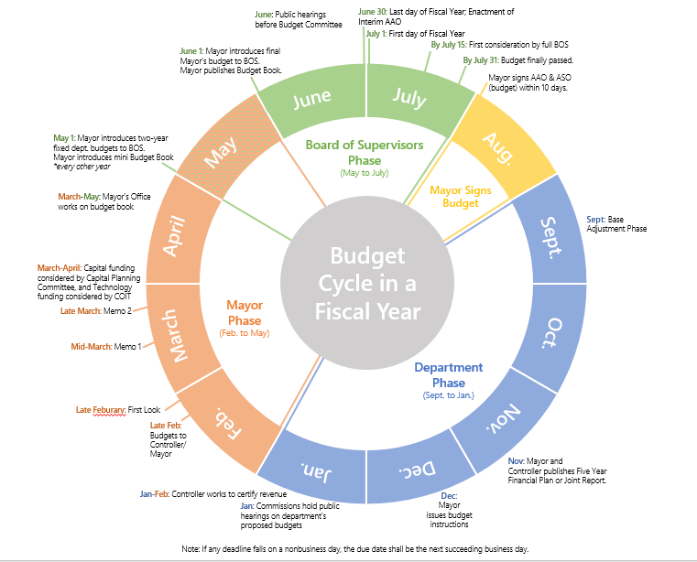
Budget Cycle

Slide 3
SDA Budget
Office of the Inspector General (OIG)
Item | FY23 (M) | FY24 (M)
Salaries and Benefits | 1.6 | 2.1
Professional Services and Contracts | 0.3 | 0.3
Materials and Supplies | 0.005 | 0.005
Work Orders to Other City Departments | 0.2 | 0.1
Oversight Board
Item | FY23 (M) | FY24 (M)
Salaries and Benefits | 0.4 | 0.4
Professional Services and Contracts | 0.06 | 0.06

Slide 4
SDA Staffing
Office of the Inspector General (OIG)
Item | FY23 (qty) | FY24 (qty)
Inspector General (Department Head) | 1 | 1
Investigator | 7 | 7
Senior Investigators | 2 | 2
Attorney | 1 | 1
TOTAL Employees | 11 | 11
Oversight Board
Item | FY23 (M) | FY24 (M)
Board Members (stipends only) | 7 | 7
Management Assistant | 1 | 1
Sr. Administrative Analyst | 1 | 1
TOTAL Employees | 2 | 2

